Slide 1
Beam Delivery and Out of Time Extinction in the Mu2e Experiment at Fermilab
Eric Prebys
Fermilab/UC Davis
3 August 2017

Slide 2
Review: All the Accelerator Physics U Need 2 Know
We can describe (strongly focused) particle motion in terms of initial conditions and a “beta function” β(s), which is only a function of location along the nominal path, and follows the periodicity of the machine.
In other words, particles undergo “pseudo-harmonic” motion about the nominal trajectory, with a variable wavelength and amplitude.
Note: β has units of [length], so the amplitude has units of [length]^{1/2}
x
Lateral deviation in one plane
s
The “betatron function” β(s) is effectively the local wavenumber and also defines the beam envelope.
Phase advance

Slide 3
Experimental Technique and Beam Needs
The general technique is to use protons to make pions, which quickly decay to muons, which are captured on an Aluminum target.
Previous experiments were rate-limited by the need to gate off after individual protons to eliminate prompt backgrounds, which predominantly come from radiative pion capture.
Mu2e will get around this by using a bunched beam of protons, and then waiting for the pions to decay before opening the live window.
This will allow the experiment to achieve a single event sensitivity that is a four order of magnitude improvement of the previous best measurement.

Slide 4
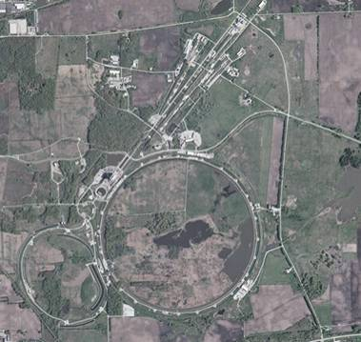
A Brief History of Fermilab
  1968: construction begins
  1972: first beams from Main Ring
    200➔400 GeV proton beams to fixed targets
    Highest energy lab for next 36 years!
  ~1985:
    “Tevatron”: first superconducting synchrotron shares tunnel with Main Ring
    900GeV x 900 GeV p-pBar collisions
    Highest energy collider for 23 years.
  1997: Major upgrade
    Main Injector replaces Main Ring
    -> more intensity
    980 GeV x 980 GeV p-pBar collisions
    Intense neutrino program
  2011: Tevatron permanently turned off after the LHC came full online.
  So what is the lab doing now?
Fixed Target Areas
Main Injector/
Recycler
Main Ring
Tevatron
Trivia: original Main Ring was the first “separated function” synchrotron

Slide 5
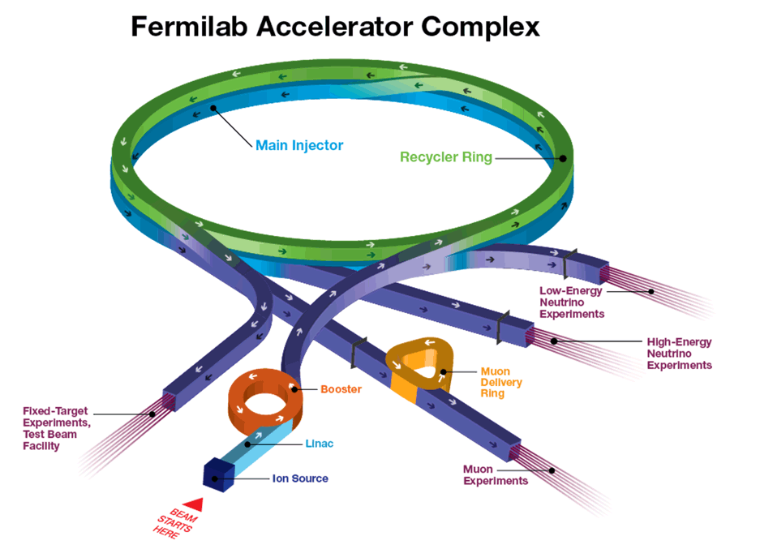
Fermilab Complex Today
60-120 GeV
Fixed 8 GeV ring. Manipulates Booster beam
8 GeV
Formerly for antiprotons
60- 120 GeV
8 GeV
120 GeV + secondary beams
400 MeV
750 keV
3.1 GeV/c muons for g-2
8 GeV protons for Mu2e

Slide 6
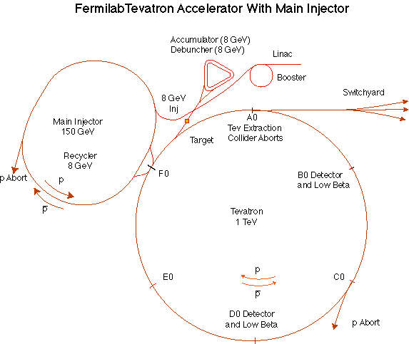
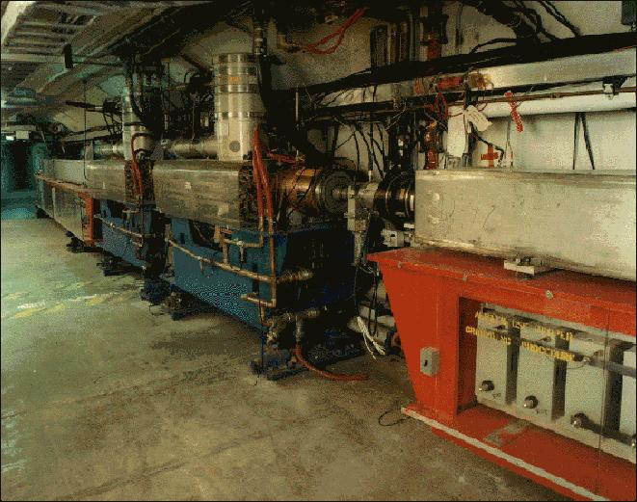
The Challenge of Producing the Mu2e Beam
All protons at Fermilab come from
the Linac/Booster system.
  Only ”original” accelerators at the lab
    First half of linac
    Most of Booster
  The Booster magnets operate in a
  15 Hz offset resonant circuit, which
  Sets a fundamental clock for all
  all accelerator sequencing
    1/15 second = 1 “tick”
  Sets a fundamental “batch” of protons
    1.6 μsec long
    Up to 5x10¹² protons
Because the Booster magnets have no flat top,
it cannot produce the beam structure required by the Mu2e Experiment.
  This is why the experiment (then called MECO) was originally proposed for Brookhaven
Luckily for us, when the Tevatron shut down in 2011, it freed up some equipment, specifically…

Slide 7
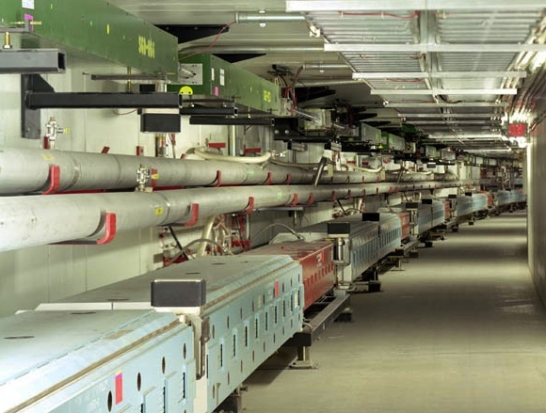
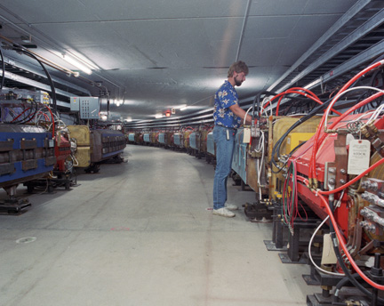
Reduce, Reuse, Recycle...
The Recycler
  8 GeV storage ring made of permanent magnets
  Originally used to store antiprotons for the Tevatron
  Now used for
    pre-stacking protons for NuMI beam
    Bunching each 1.6 μsec booster batches into 4 2.5 MHz bunches with ~1x10¹² protons each for g-2 and Mu2e
The Debuncher Ring
  Together with the Accumulator, it was originally used to collect and store Antiprotons for the Tevatron
  Now:
    Used to temporally separate 3.1 GeV/c muons and protons for the g-2 Experiment
  Future:
    Used to circulate and slow extract beam for Mu2e
Accumulator Gone

Slide 8
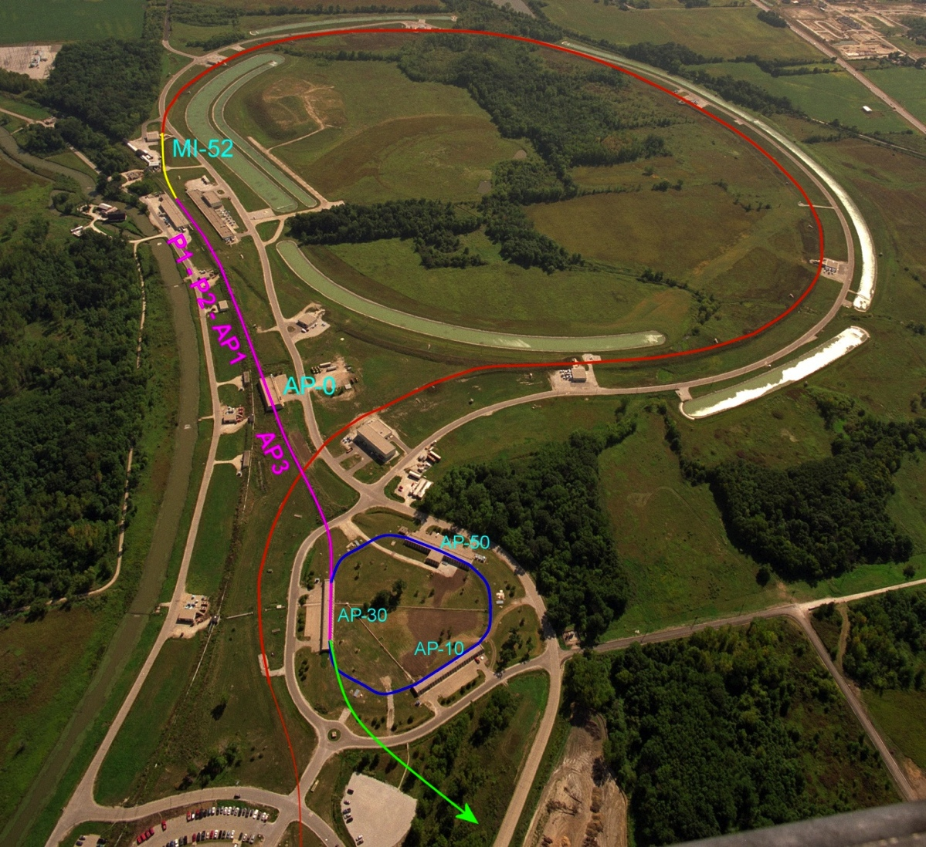
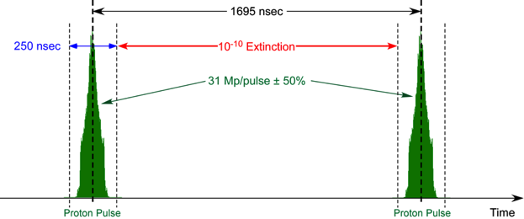
Mu2e Proton Delivery
Two Booster “batches” are injected into the Recycler (8 GeV storage ring). Each is:
  4x10¹² protons
  1.7 μsec long
These are divided into 8 bunches of 10¹² each
The bunches are extracted one at a time to the Delivery Ring
  Period = 1.7 μsec
As the bunch circulates, it is resonantly extracted to produce the desired beam structure.
  Bunches of ~3x10⁷ protons each
  Separated by 1.7 μsec
Main Injector/Recycler
Delivery Ring
(formerly pBar Debuncher)
Mu2e
Booster
Exactly what we need

Slide 9
Rebunching in the Recycler*
1.6 μsec Booster “batch”
2.5 MHz bunches for g-2 and Mu2e
Time [arbitrary units]
53 MHz bunches from Booster
*Data, presented by I. Kourbanis

Slide 10
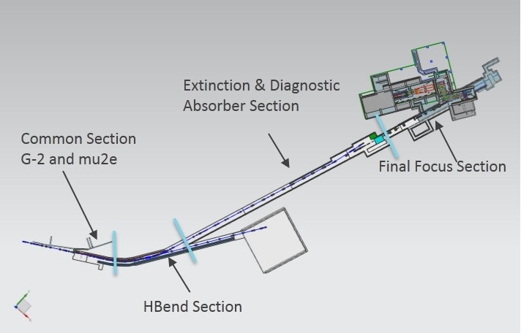
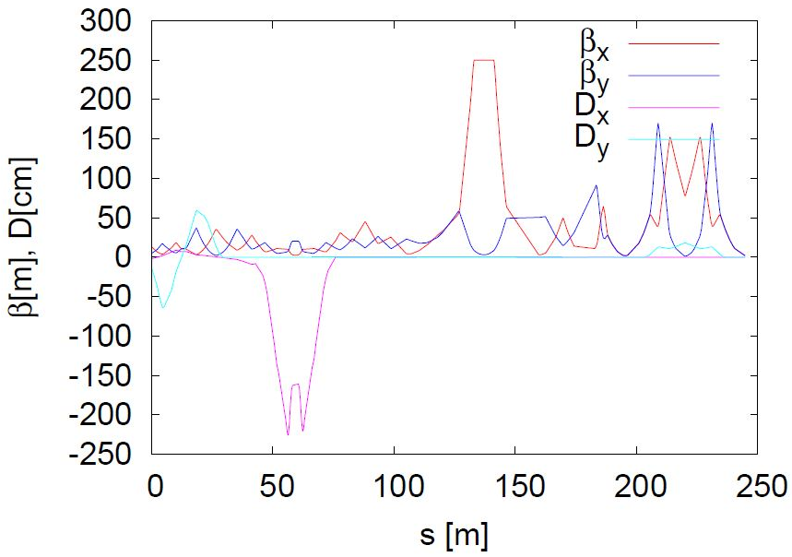
M4 Beamline Design Overview*
Common Section:
g-2 operation
  Transport 3.1 GeV/c muons from DR to g-2 ring
Mu2e operation
  Transport 8 GeV protons to Mu2e
Horizontal Bend Section:
Left bend section uses 4 SDFW and 2 SDF dipoles to bend beam 41° to the mu2e target.
Extinction Section:
Out-of-time to in-time particle ratio < 10⁻¹⁰
At AC dipole location:
  Large β_{x} to maximize the kickers effect .
  Small β_{y} allow small kicker vertical gap.
At collimator: 90° of phase between up & down stream collimator & kicker. Small β_{x} at downstream collimator.
Final Focus Section:
Brings beam to required spot size at target. (2x2 mm²)
2 Vertical dipoles bend the beam down to the target (2x1.375°)
FF magnets are installed on a 1.375° vertical slope.
Mu2e Target
protons
g-2
Bend
more about this shortly
Common
Extinction
Final Focus
Courtesy Eliana Gianfelice-Wendt
*D. Still

Slide 11
Understanding Resonant Extraction
Extracting all the beam at once is easy, but we want to extract it slowly over ~35 ms (~35,000 revolutions)
Use nonlinear (sextupole) magnets to drive a harmonic instability
Extract unstable beam as it propagates outward
  Standard technique in accelerator physics
Unstable beam motion in N(order) turns
Extraction Field
Extracted beam
Lost beam
Septum

Slide 12
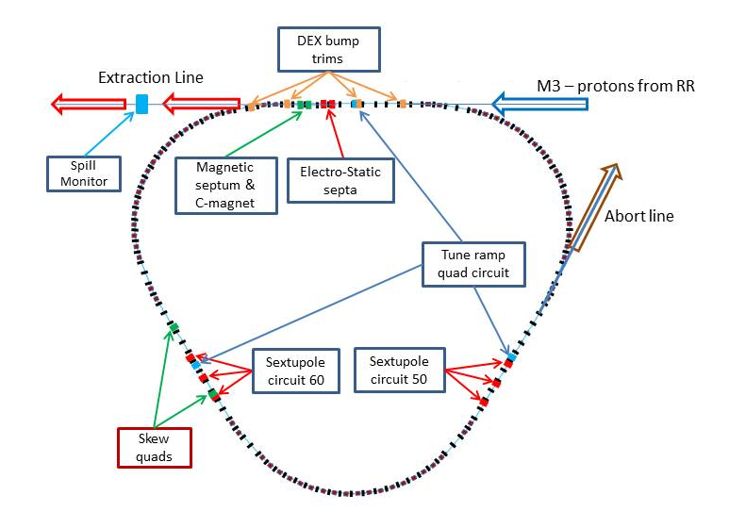
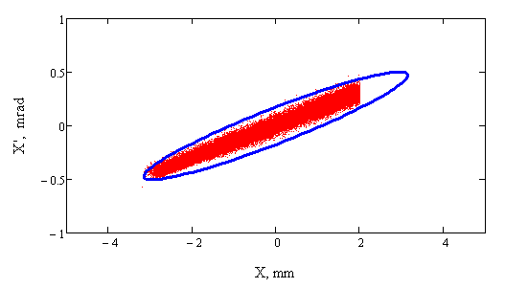
Resonant Extraction in Mu2e*
Two families of sextupoles control the amplitude and phase of the resonance driving terms.
Ramped quads control the distance of the tune from the Q_{x}=29/3 resonance.
Trim dipoles control the position of the beam relative to the electrostatic septum.
SS20-30
RFKO kicker
SS10-60
SS40-50
*V. Nagaslaev

Slide 13
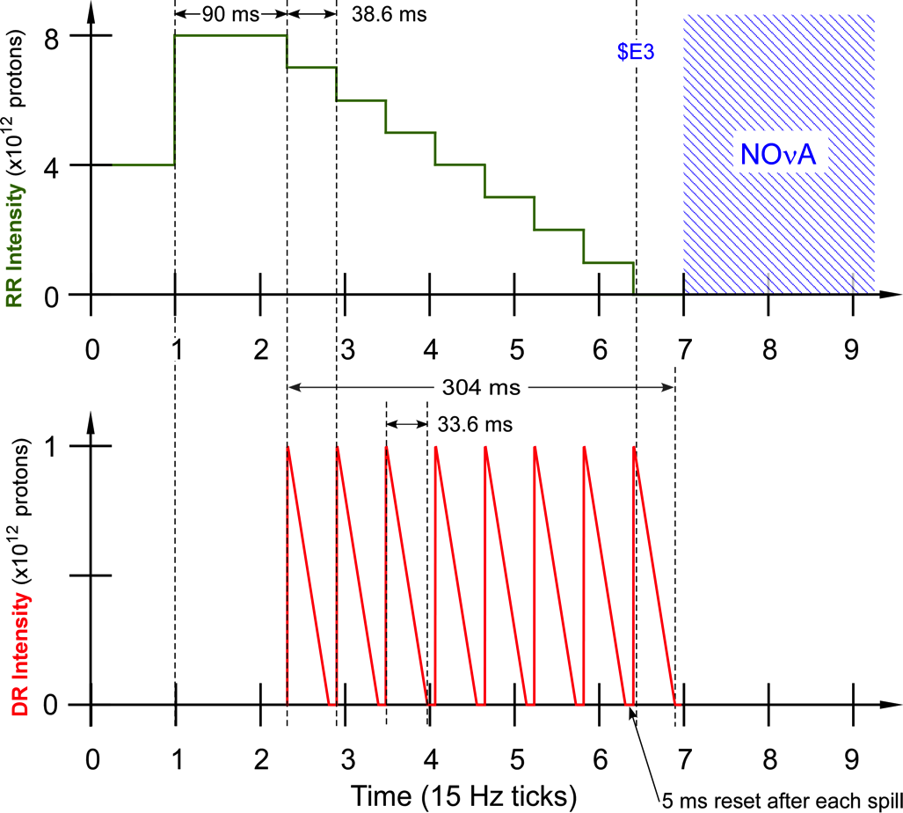
Mu2e Spill Structure
1.33 sec Main Injector cycle
Detail:
  3x10⁷ p/bunch
  1.7 μsec bunch spacing
  ~30% duty factor
  ~1.2x10²⁰ protons year
“ticks”

Slide 14
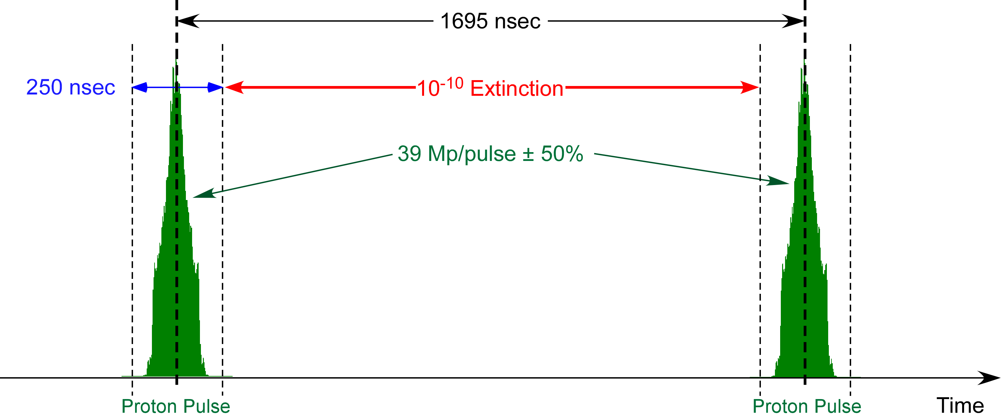
Extinction
Because out-of-time protons could produce prompt backgrounds, it is critical that there be nothing between the proton bunches at the 10⁻¹⁰ fractional level.
This is referred to as “extinction”
In addition to the challenge of achieving this level of extinction will be the challenge of verifying that we have achieved it (“Extinction Monitoring”)
<1 proton every 250 pulses!

Slide 15
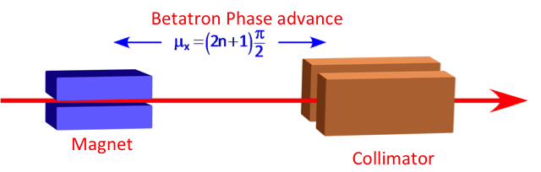
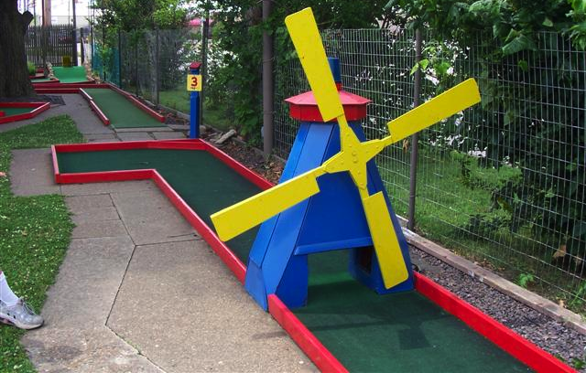
Principle of Beam Line Extinction
A magnet is used to deflect out-of-time beam into a downstream collimator
Ideally, we would use a square pulse to kick out-of-time beam out of (or in-time beam into) the transmission channel, but the 600 kHz bunch rate makes this impossible with present technology.
We will therefore focus on a system of resonant magnets or “AC Dipoles”.
  Even this isn’t trivial
Think miniature golf

Slide 16
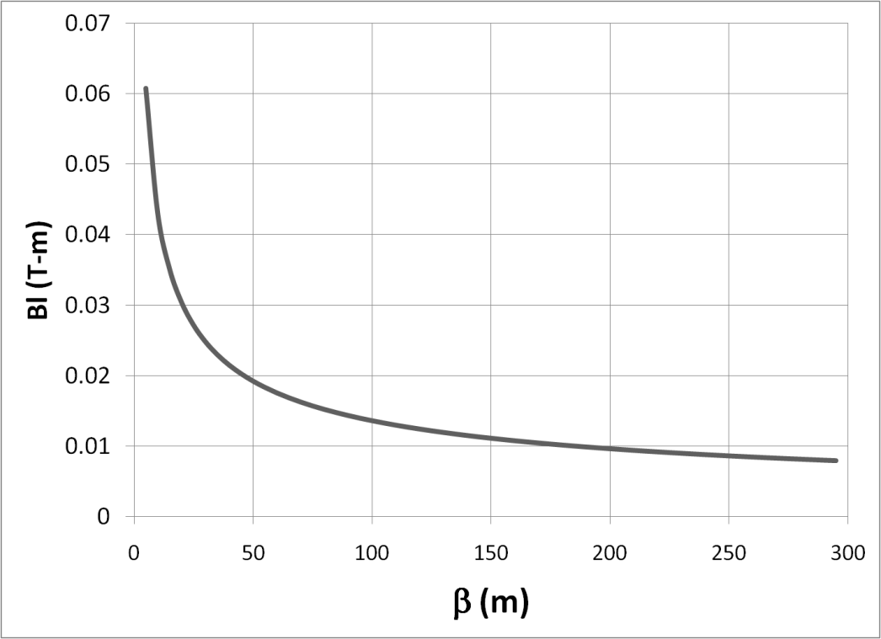
Design Considerations
Magnet length
The cost and complexity of magnets
scale roughly with the stored energy
Clearly, we want to minimize g (waist
in the non-bend plane)
The bend plane is a little less obvious. A detailed analysis shows that to achieve the required bend
Bend plane aperture
Non-bend plane gap
betatron function at dipole
➔Large β_{D}, long weak magnets
- Assume β_{D}=250m, L=6m
- Factor of 4 better than “typical” values of β_{D}=50m, L=2m
Driving consideration in beam line design!

Slide 17
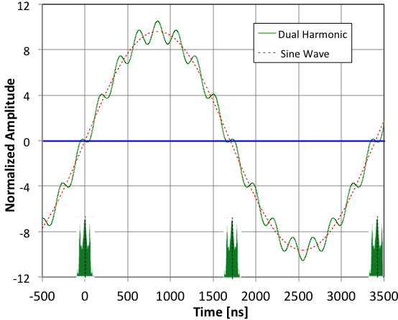
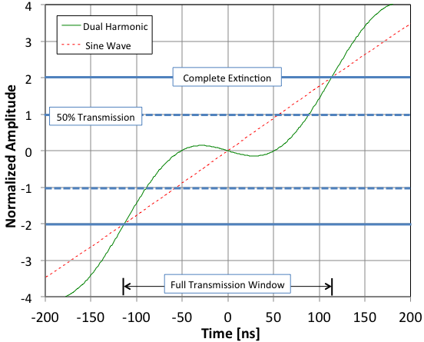
Dual Harmonic Waveform
AC Dipole driven by two harmonics
  300 kHz (half bunch frequency) to sweep out of time beam into collimators
  4.5 MHz (15th harmonic) to maximize transmission of in-time beam
  Beam transmitted at nodes!
Higher harmonic optimized for maximum transmission: 99.5%
Single harmonic would hit collimator too soon
Normalized deflection
δ=1 center of beam at edge of collimator
δ=2 all beam hitting collimator

Slide 18
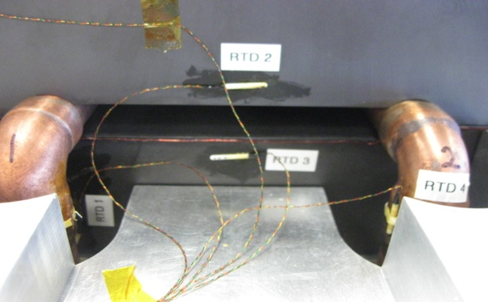
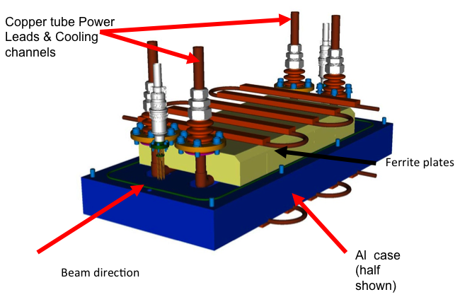
AC Dipole Design and Prototype
AC dipole system consists of 6
identical one meter elements,
arranged in two 3-meter vacuum
vessels.
Extensive tests done with half-meter
prototype
  meets all specifications
Elements individually powered

Slide 19

Extinction Collimation: Two Separate Collimation Issues
Phase space distribution of out of time beam at location of AC dipole
Beam core: out of time beam will be steered into the collimator or collimators
90° downstream of the AC dipole
AC dipole shifts distribution along x’ axis in phase space
Admittance of downstream collimation system
High amplitude beam tails will be steered into the collimation channel, so they must be cleaned up
90° upstream of the AC dipole

Slide 20
Additional Problem: Slow Extraction Tails
Beam that strikes the electrostatic septum during slow extraction results in a large tail in phase space, which can result in beam being scattered into the transmission channel.
Requires an additional collimator
X Phase space at exit from Delivery Ring
Nominal beam envelope
This causes problems

Slide 21
Summary: Collimator Needs and Locations
Halo Collimator (-90°, 1m Steel)
Tail Collimator (1m Steel)
AC Dipole
Extinction Collimator (+90°, 1m Tungsten)

Slide 22
Simulation Procedure
Longitudinal development in Recycler and Delivery Ring simulated by numerical integration model (I. Kourbanis, S. Werkema)
Beam propagation and evolution of third-order resonance in Delivery Ring simulated by Synergia (V. Nagaslaev)
Extraction interaction with electrostatic septum simulated by MARS (V. Nagaslaev)
Beam line propagation and interaction with collimators simulated with G4Beamline as a function of AC dipole deflection angle to produce transmission tables (E. Prebys)
Transmission tables convoluted with longitudinal distributions to optimize harmonic content of AC dipole magnets transmission of in-time beam and extinction of out-of-time beam (E. Prebys)

Slide 23
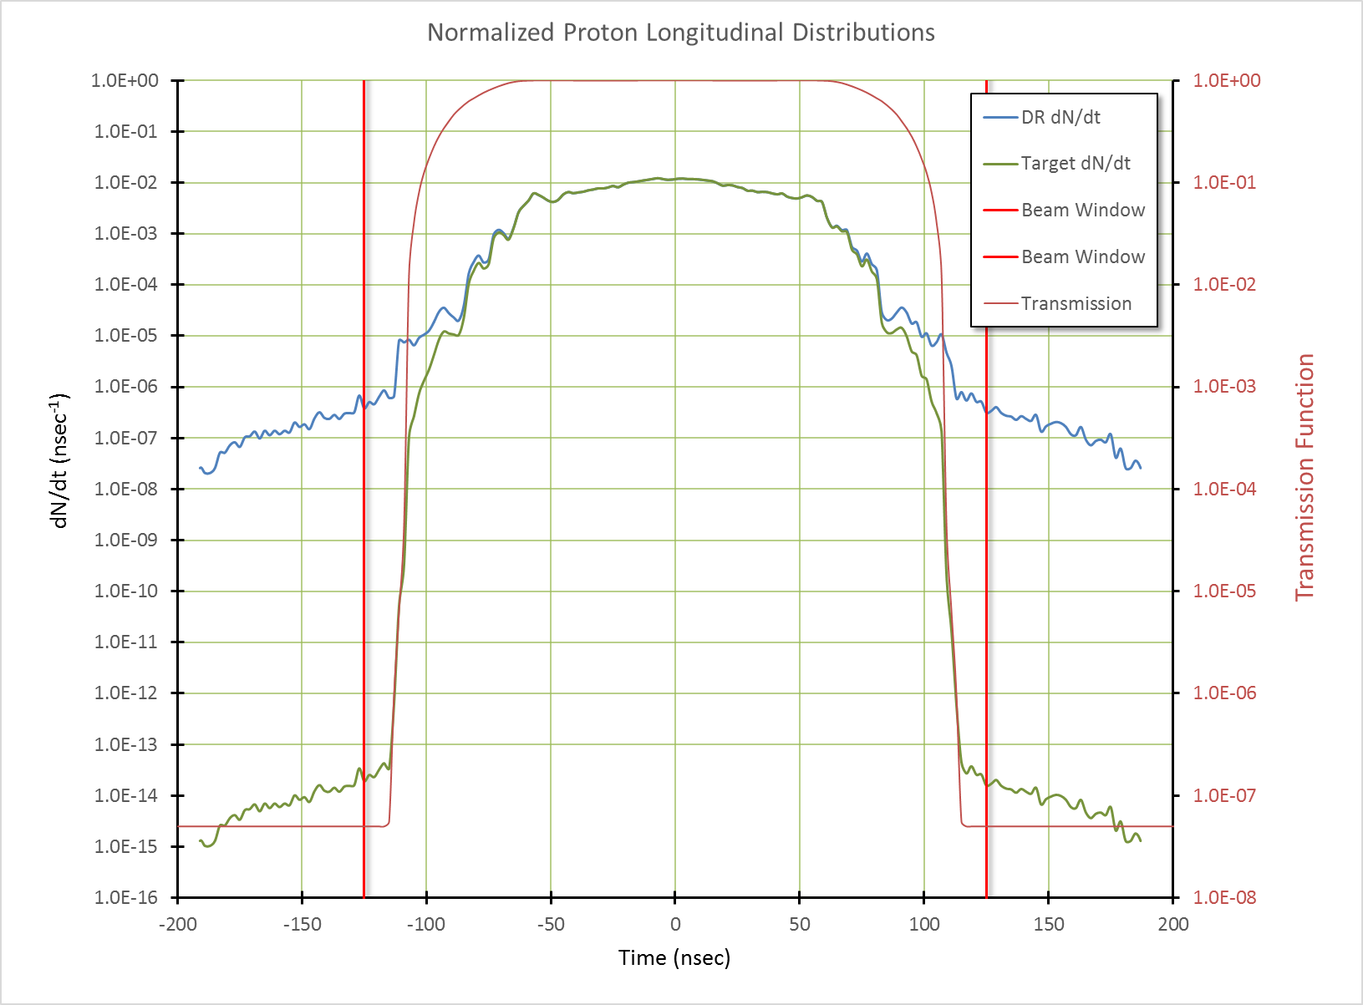
Performance
DR Extraction
Extinction Transmission
Simulation Results
Fraction of DR extracted beam outside of ±125 ns: | 2.1×10⁻⁵
In-time beam transmission: | 99.5%
Beam line extinction: | <5×10⁻⁸
Total extinction: | 1.1×10⁻¹²
Extinction Requirement: | <1.0×10⁻¹⁰
Beam Window
Beam on Target
Almost two order of magnitude margin
Notes:
DR = Delivery Ring

Slide 24
Extinction Monitor*
No confidence in extinction unless we can verify it!
Must measure extinction to 10⁻¹⁰ precision
  Roughly 1 proton every 250 bunches!
Required ~10⁸ dynamic range precludes direct measurement
  Particles in bunches would blind detector to out of time particles
Focus on statistical technique
  Designed a monitor to detect a small fraction of scattered particles from target
    10 - 50 per in-time bunch
  Statistically build up precision profile for in time and out of time beam.
Requirement: 90% C.L. for 10⁻¹⁰ extinction after 6 x 10¹⁶ p.o.t.
  Signal rate per p.o.t. must be > 2.3 / 6 x 10⁶ = 0.4 x 10⁻⁶
  i.e. 16 for a 4 x 10⁷ bunch
*P. Kasper

Slide 25
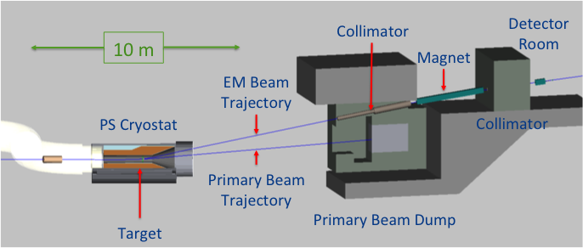
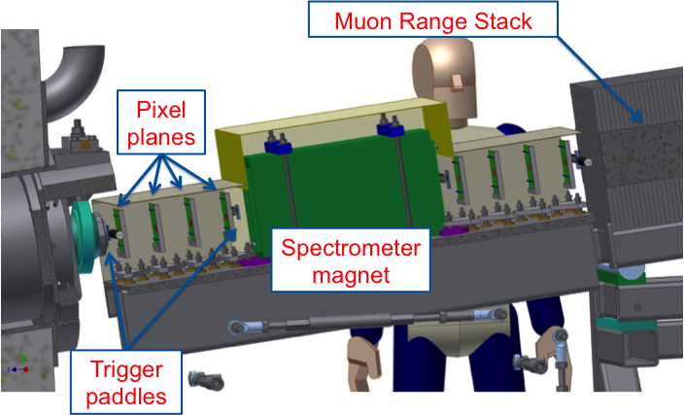
Extinction Monitor Design*
Selection channel built into target dump channel
Spectrometer based on 8 planes of ATLAS pixels
Optimized for few GeV/c particles
~ 1 track per 10⁶ on target
*P. Kasper, L. Bartoszek, M. Jones, A* Gaponenko

Slide 26
Extinction Monitor Performance*
Expect ~30/bunch
Backgrounds considered
Accidental combination
Cosmic rays
Off-target interactions
➔ Negligible at 10⁻¹⁰ level
*A. Gaponenko

Slide 27
Summary
Mu2e had developed innovative techniques to deliver the beam structure required by the experiment, including the stringent limits on out-of-time beam (“extinction”)
We have a robust technique for verifying that we have achieved the required level of extinction.
A projects are well on track to meet the schedule of the experiment as a whole.

