Slide 1
Particle Accelerators
Eric Prebys, FNAL
Summer Intern Talk
Fermilab
Jun 29, 2017

Slide 2
Acknowledgments
People who provided me “show and tell” stuff
  Susan Winchester, Elvin Harms, and Sam Posen
The army that helped to get the fine beam/Helmholtz demo working
  Tube: Marge Bardeen,Mark Adams, and Hans Jostlein, Ed. Dept.
  Helmholtz coil: Todd Johnson, Operations, let me use his winding gear
  Power supply and misc parts: paid for by QuarkNet (Spencer Pasero)
  Camera: Elliott McCrory
Google and Wikipedia, for making us all scholars
Fermilab, for encouraging outreach
You, for coming

Slide 3

A little about me…
Home town: Phoenix, Arizona
1984: BS in Engineering Physics, University of Arizona
  Got a job in an HEP group (after being fired from a gas station).
1984-1990: Grad Student, University of Rochester
  PhD topic: Photon Production in Hadronic Interactions (FNAL)
1990-1992: CERN Fellow, CERN (Geneva, Switzerland)
  Worked on OPAL Experiment at LEP e⁺e⁻ collider
1992-2001: RA and Assistant Professor, Princeton Univ.
  Worked on Superconducting Super Collider (Texas)
  Belle e⁺e⁻ Experiment at KEK, Japan
  Laser-electron scattering experiment at SLAC (Stanford)
2001-Present: Scientist, Fermilab
  Past:
    MiniBooNE short baseline neutrino oscillation experiment
    Proton Source (Linac+Booster) Department Head
    Director of LHC Accelerator Research Program (LARP)
    Director of Joint University-Laboratory PhD Program
  Present:
    Mu2e rare muon conversion experiment
    Integrable Optics Test Accelerator (IOTA) proton injection
    Program director for Lee Teng Undergraduate Internship
    Occasional Instructor at US Particle Accelerator School
Sep. 2017-?: Professor of Physics, UC Davis
    Mu2e
    Director of Crocker Nuclear Laboratory
Experimental HEP
Accelerator Physics (mostly)
Bit of both

Slide 4
Disclaimer
We will talk mostly about the quest to reach the highest energy in accelerators, because that has driven the technology.
In fact, high energy accelerators make up only a tiny fraction of the accelerators in the world.
We’ll summarize some of the many other applications of accelerators near the end.
Like all speakers, my talk represents my experience and expertise:
  Another speaker might emphasize different things.

Slide 5
Units of energy
Energy is (force)x(distance)
For example, when you drop something, gravity “work” through the change in height to convert “potential energy” to “kinetic energy”.
In the same way, when we accelerate something in an electric field, electrical potential (“voltage”) is converted to kinetic energy.
For this reason, a convenient unit of energy is the
“electron-volt (eV)”
which is the energy you get when you accelerate a charge of one electron (or proton) over a 1 Volt potential.

Slide 6
Understanding electron-volts
The eV is a really small unit of energy.
  1.6x10⁻¹⁹ (=.00000000000000000016) Joules - our usual
  unit of energy.
  A 1 kg weight dropped 1m would have 6x10¹⁹
  (60000000000000000000) eV of energy!
On the other hand, it’s a very useful unit when talking about individual particles
  If we accelerate a proton using an electrical potential, we know exactly what the energy is.
  It’s also useful when thinking about mass/energy equivalence
    Which leads us to…

Slide 7
Momentum and energy in special relativity
Classically:
Relativistically:
Always right if you write it this way
This is new!
Visualizing the relationship

Slide 8
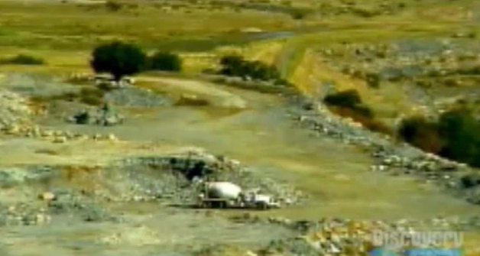
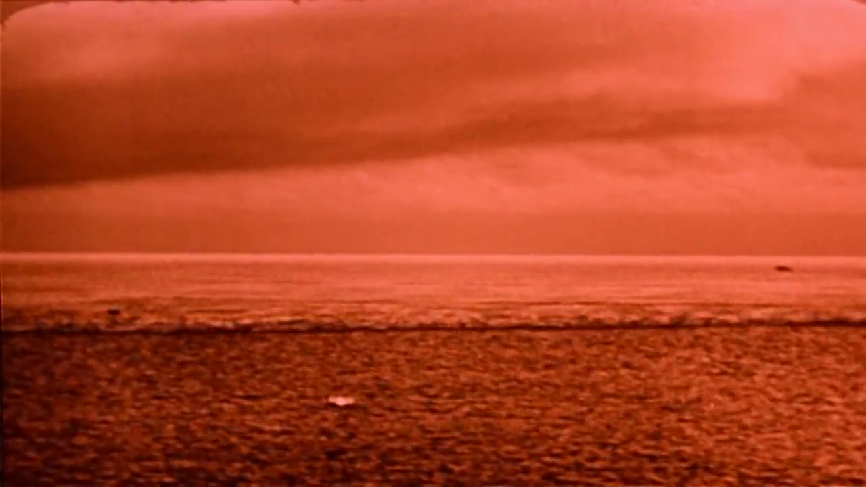
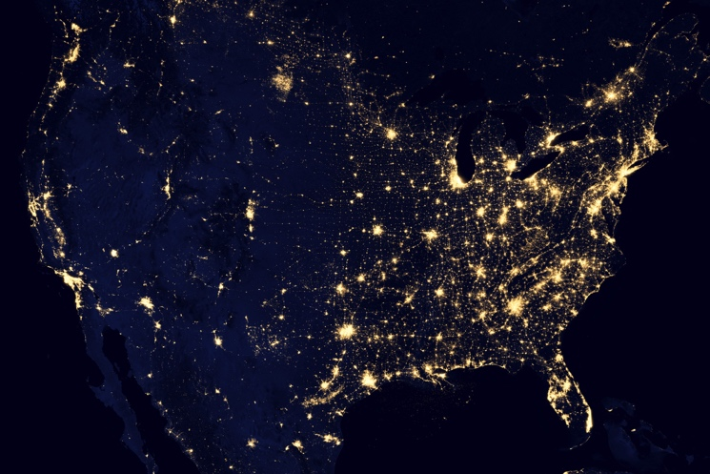
Mass and Energy
High Energy Physics is based on Einstein’s equivalence of Mass and Energy
All reactions involve some mass changing either to or from energy
If we could convert a kilogram of mass
entirely to energy, it would supply all
the electricity in the United States for
almost a day.
Chemical Explosion
Hydrogen Bomb (fusion)
.00000005% of mass converted to energy.
~.1% (of just the Hydrogen!) converted.

Slide 9
Rest energy of fundamental particles
The electron an proton have very tiny masses in our usual units
However, they are more reasonable if we express them in terms of their rest energy in eV:
These energies establish a natural scale to which we can compare beam energy.
Remember these!

Slide 10
Kinetic energy
A body in motion will have a
total energy given by
The difference between this
and mc² is called the “kinetic
energy”
Here are some examples of
kinetic energy
For v<<c (speed of light),
Kinetic energy ~ ½mv²
Kinetic Energy
Rest Energy

Slide 11
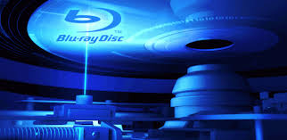
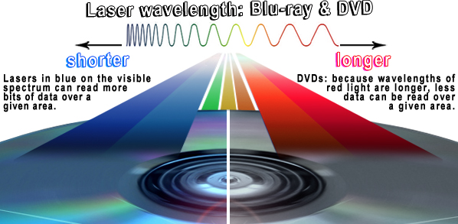
Another way to look at energy…
Question: Why are “blue ray” players blue?
Answer: because light is “quantized”* and blue light is more energetic and has a shorter wavelengths, so the “bits” can be smaller
“Planck Constant”
wavelength
Energy
*See SMP talk by Paddy Fox, Jan. 21, 2017

Slide 12
Wavelengths of other particles
It turns out that all particles have a wavelength
So going to higher energy allows us to probe smaller and smaller scales
If we put the high equivalent mass and the small scales together, we have…
“Planck Constant”
momentum

Slide 13
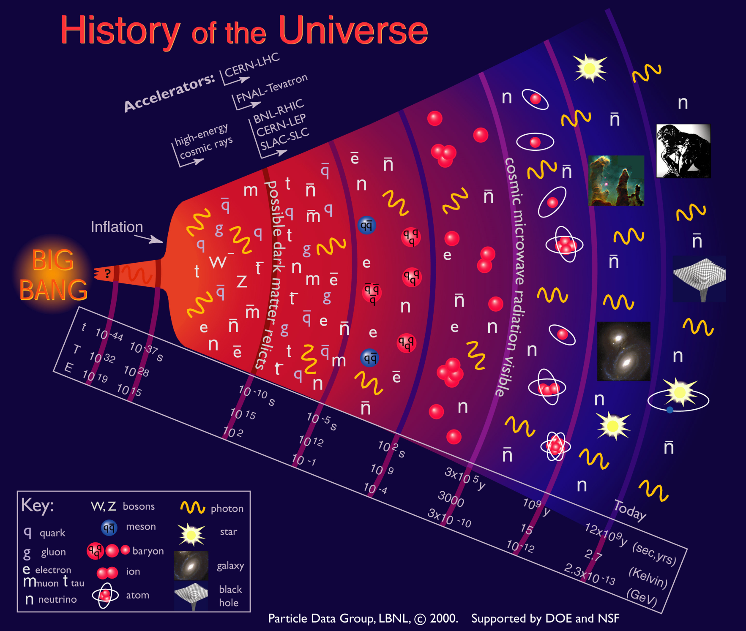
Going to higher energies = going back in time

Slide 14
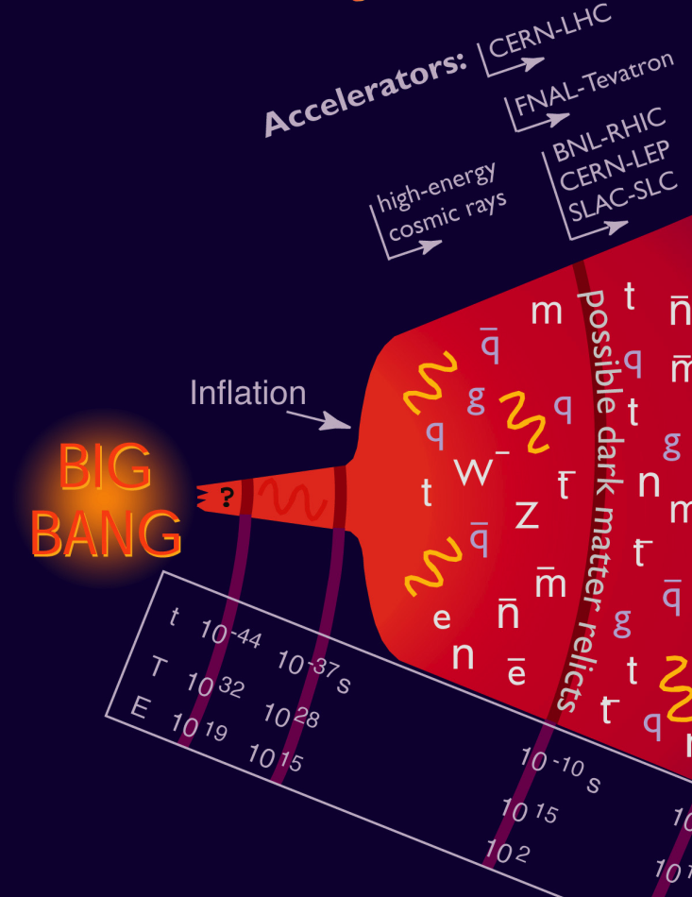
Where we are…
Accelerators allow us to go back 13.8 billion years and recreate conditions that existed a few trillionths of a second after the Big Bang
  the place where our current understanding of physics breaks down.
In addition to high energy, we need high
“luminosity”
that is, lots of particles interacting, to see rare processes.

Slide 15
State of the art: Large Hadron Collider (LHC)
Built at CERN, straddling the French/Swiss border
27 km in circumference
Currently colliding proton beams at 6500 GeV (6.5x10¹² eV) each
That’s where we are. Now let’s see how we got here…

Slide 16
The main parts of an accelerator
A source of particles
  Electrons
    Filament
    Laser->surface
    Radiofrequency (RF) “gun”
  Protons/ions
    Plasma (gas heated until electrons and nuclei separate)
A method of acceleration
  Electric fields
    Static fields
    Radio Waves (RF)
    Lasers
    “Wakefields” in matter
A way to store and focus beams
  Magnetic fields
    Cyclotrons
    Synchrotrons
    Magnetic focusing

Slide 17
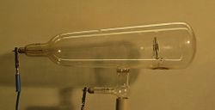
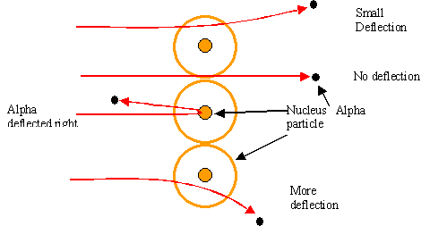
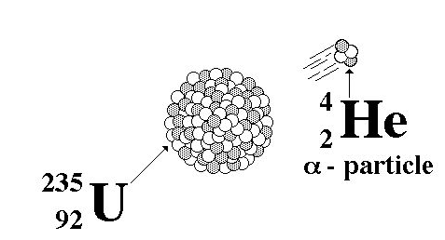
Rewind: some pre-history
The first artificial acceleration of particles
was done using “Crookes tubes”, in the
latter half of the 19th century
  These were used to produce the first X-rays (1875)
  At the time no one understood what was going on
The first “particle physics experiment” told Ernest Rutherford the structure of the atom (1911)
In this case, the “accelerator” was a
naturally decaying ²³⁵U nucleus
Study the way radioactive particles “scatter” off of atoms

Slide 18
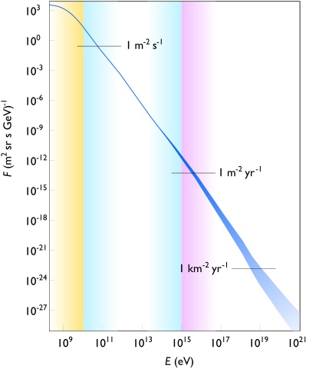
Natural particle acceleration
Max LHC energy
Radioactive sources produce maximum energies of a few million electron volts (MeV)
Cosmic rays reach energies of ~1,000,000,000 x LHC but the rates are too low to be useful as a study tool
  Remember what I said about “luminosity”.

Slide 19
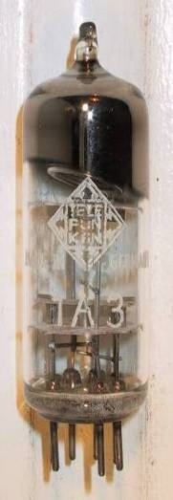
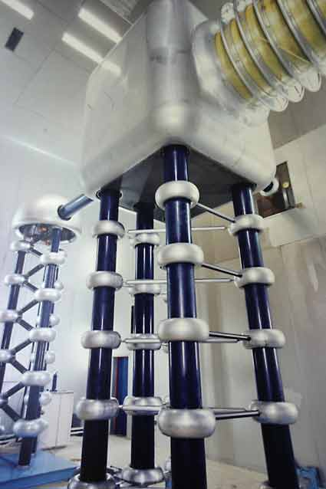
Man-made particle acceleration
The simplest accelerators accelerate charged particles through a static electric field. Example: vacuum tubes (or CRT TV’s)
Cathode
Anode
Limited by magnitude of electric field:
  - TV Picture tube ~keV
  - X-ray tube ~10’s of keV
  - Van de Graaf ~MeV’s
Solutions:
  Alternate fields to keep particles in
  accelerating fields -> Radio Frequency (RF) acceleration
  Use magnetic fields to bend particles so they see the same accelerating field over and over -> cyclotrons, synchrotrons
FNAL Cockroft-Walton = 750 kV

Slide 20
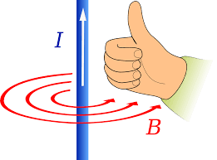
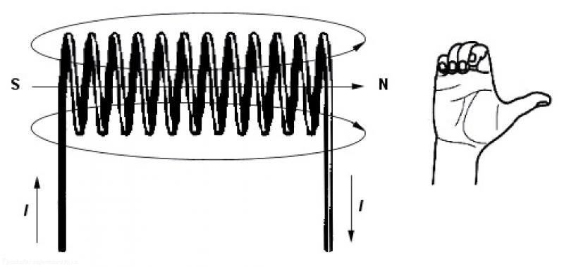
Magnetic fields
Magnetic are produced by electric currents, according to the “right hand rule”
Units are “Tesla” [T]
  1 T pretty big for normal magnets
  LHC superconducting magnets go to ~8 T
Wire:
put thumb along direction of
current
Field circles wire in direction of fingers
Coil (“solenoid”):
Wrap fingers in direction of current.
Field points in direction of thumb.

Slide 21
Forces in a magnetic field
Moving charged particles in a magnetic field experience a force which is
  Proportional to the charge, magnetic field, and velocity
  is perpendicular to both the field and the direction of motion, with a direction given by the “right hand rule”
“cross product”
I do it this way
A lot of books teach it this way
Magnetic field (B)
Note: force reverses for negative charge!

Slide 22
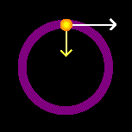
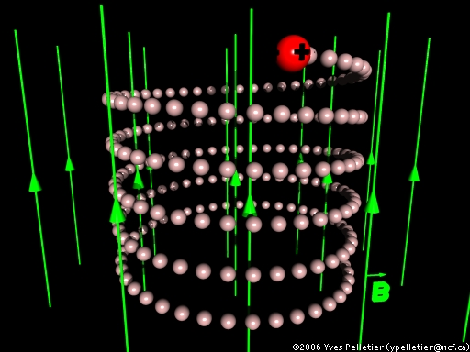
Motion in a magnetic field
Because the force is always perpendicular to the direction of motion, magnetic fields can only change the direction of a particle. The velocity (and therefore the kinetic energy) remain constant!
When the direction of motion changes, the direction of the force changes to remain perpendicular
  ➔ circular motion
momentum (p)
Relativistically correct
Note: in 3D, motion is “helical”
B points out of page

Slide 23

Fine beam tube/Helmholtz coil demonstration
The tube generates an electron beam using a hot filament/cathode, “Wehnelt Cylinder”, and accelerating anode.
Filled with low pressure Hydrogen, which fluoresces when electrons pass through
Heated filament (electron source)
Wehnelt Cylinder focuses electrons

Slide 24
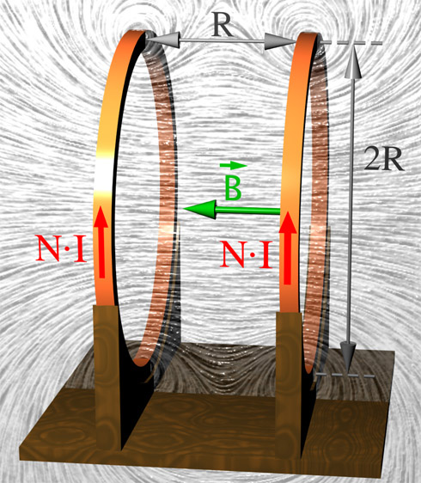
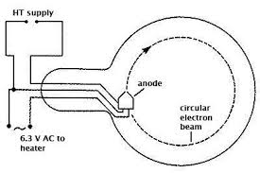
Demo (cont’d)
The Helmholtz Coils produce a ~uniform magnetic field

Slide 25
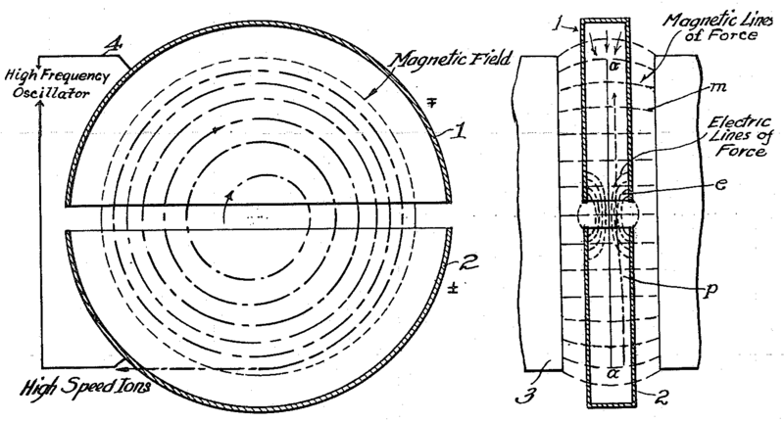
The Cyclotron (1930’s)
would not work for electrons!
side view
top view
A charged particle in a uniform magnetic field will follow a circular path of radius
“Cyclotron Frequency”
Accelerating “DEES”: by applying a voltage which oscillates at f_{c}, we can accelerator the particle a little bit each time around, allowing us to get to high energies with a relatively small voltage.
For a proton:
i.e. “RF” range

Slide 26
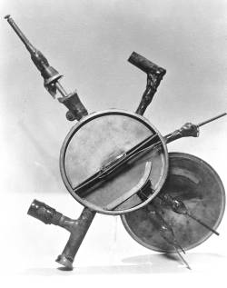
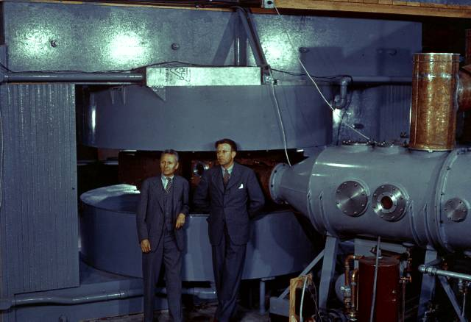
Round we go: the first cyclotrons
~1930 (Berkeley)
  Lawrence and Livingston
  K=80keV
1939 - 60” Cyclotron
  Lawrence, et al. (LBL)
  ~19 MeV (D2)
  Prototype for many
  Parts are still in use!

Slide 27
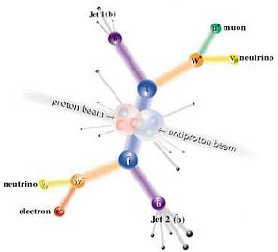
Interlude: electrons vs. protons
Electrons are point-like
  Well-defined initial state
  Full energy available to interaction
Protons are made of quarks and gluons
  Interaction take place between these constituents.
  Only a small fraction of energy available, not well-defined.
  Rest of particle fragments -> big mess!

Slide 28
Synchrotron radiation
As the trajectory of a charged particle is deflected, it emits “synchrotron radiation”
An electron will radiate about 10¹³ times more power than a proton of the same energy!!!!
Radius of curvature
Protons: Synchrotron radiation does not affect kinematics very much
  Energy limited by strength of magnetic fields and size of ring
Electrons: Synchrotron radiation dominates kinematics
  To to go higher energy, we have to lower the magnetic field and go to huge rings
  Eventually, we lose the benefit of a circular accelerator, because we lose all the energy each time around.
Since the beginning, the energy frontier has belonged to proton (and/or antiproton) machines

Slide 29
Onward and upward!
Two major advances allowed accelerators to go beyond the energies possible at cyclotrons
  “Synchrotron” – in which the magnetic field is increased as the energy increases, such that particles continue to follow the same path.
    Edward McMillan, 1945
  “Strong focusing” – a technique in which magnetic gradients (non-uniform fields) are used to focus particles and keep them in a smaller beam pipe than was possible with cyclotrons.
    Courant, Livingston and Snyder, 1952*
*actually invented in 1949 by a Greek-American electrical engineer name Nicholas Christofilos, but it was completely ignored at the time!

Slide 30
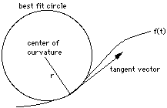
Understanding beam motion
A particle of unit charge in a
magnetic field will move with
a local radius of curvature
No matter how complex the magnetic fields are, if they are all scaled proportionally to the increasing momentum, particles will continue to follow the same trajectory as they accelerate
  Accelerators in which the magnetic fields are scaled this way are called “synchrotrons”
Field changes with location

Slide 31
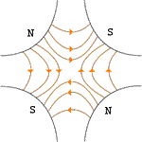
Strong focusing: magnetic gradients as lenses
quadrupole
Fields vary linearly as you move away from center
All fields cancel at the center
A positive particle coming out of the page off center in the horizontal plane will experience a restoring “kick”, proportional to the displacement
Just like a “thin lens” in classical optics

Slide 32
What about the other plane?
Defocusing!
Luckily, if we place equal and opposite pairs of lenses, there will be a net focusing regardless of the order.
➔pairs give net focusing in both planes -> “FODO cell”
The fundamental building block of synchrotrons and beam lines!

Slide 33
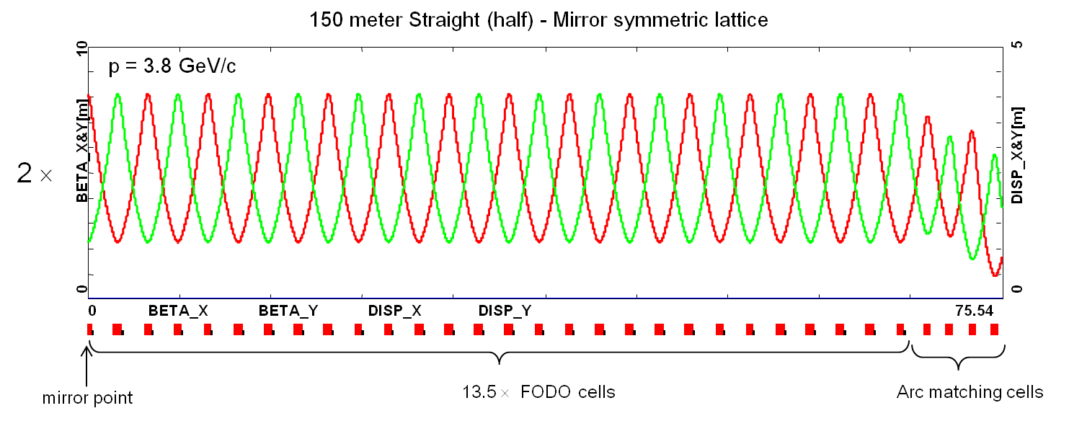
Example of FODO cells
“beta function”: proportional to square of beam size. Size alternates between the two planes
Alternating gradient quadrupoles

Slide 34
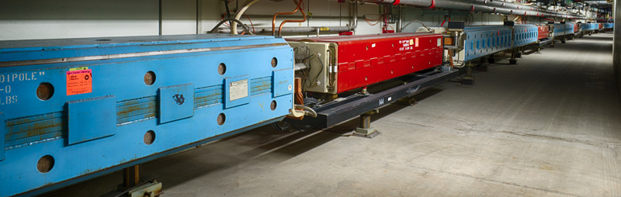
Combined function vs. separated function
Strong focusing was originally implemented by building magnets with non-parallel pole faces to introduce a linear magnetic gradient = “combined function”, which both bent and focused the beam
linear term
=
+
constant
dipole
quadrupole
CERN PS (1959, 29 GeV)
Later synchrotrons were built separate dipole and quadrupole magnets
Dipoles bend
Quadrupoles focus

Slide 35
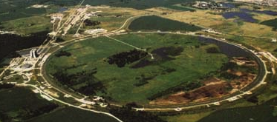
Example: Fermilab Main Ring
First “separated function” lattice
1 km in radius
First accelerated protons from 8 to 400 GeV in 1972
Basic Main Ring “FODO Cell” building block
Quadrupoles with alternating polarity (QF, QD) focus beam
Dipoles (B) bend beam into circle
They thought this idea was so cool that it needed its own logo

Slide 36
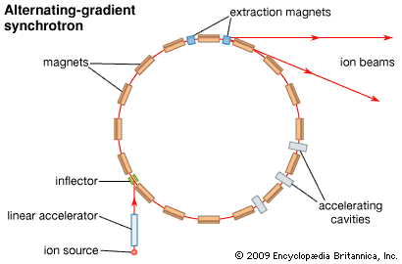
Review: cyclotrons and synchrotrons
Cyclotron: Magnetic field stays fixed. Orbital radius increases as particles accelerate.
  Pros:
    Inexpensive
    Very high current
  Cons:
    Limited energy
    Weak focusing (larger beam sizes)
Synchrotron: All magnetic fields scale with momentum to keep particles in the same orbit
  Pros:
    High energy
    Strong focusing (precise beam control)
  Cons:
    Cost
    Cycle time limits average beam current
But how do we accelerate beam?

Slide 37
Longitudinal motion (acceleration)
We will generally accelerate particles using structures that generate time-varying electric fields (RF cavities), either in a linear arrangement (“linac”)
or located within a circulating ring
In both cases, we want to “phase" the RF so a nominal
arriving particle will see the same accelerating voltage
and therefore get the same boost in energy
cavity 0
cavity 1
cavity N
Nominal Energy

Slide 38
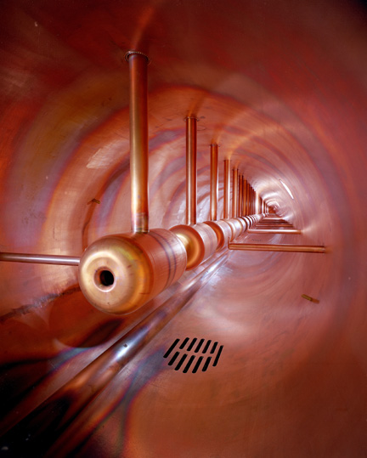
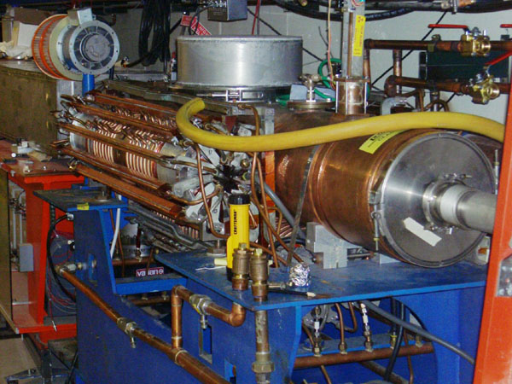
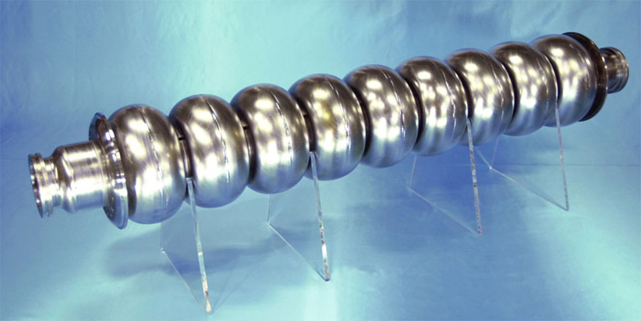
Examples of accelerating RF structures
Use resonant structures to make efficient use of power
37->53MHz Fermilab Booster cavity
Biased ferrite frequency tuner
Fermilab Drift Tube Linac (200MHz): oscillating field uniform along length
ILC prototype elipical cell “π-cavity” (1.3 GHz): field alternates with each cell

Slide 39
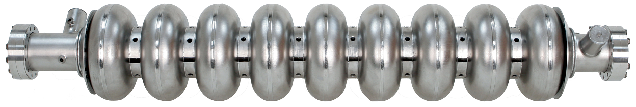
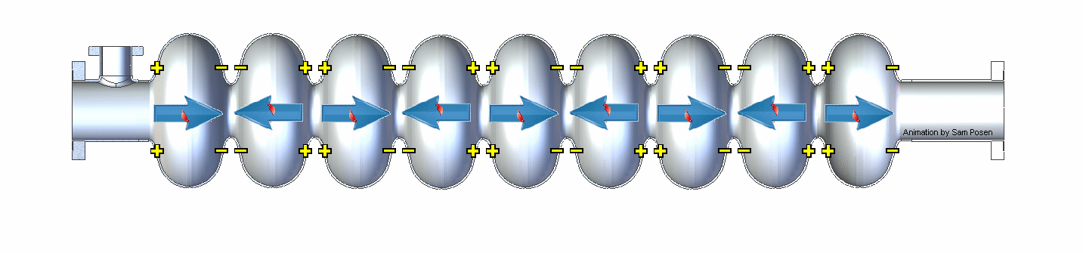
How RF Cavities Accelerate*
Oscillating fields are timed (“phased”) so that the accelerating electric field is always pointing in the right direction whenever a bunch passes through…
Input RF power at 1.3 GHz
Slowed down by factor of approximately 4x10⁹
*Animation from Sam Posen
~1 m

Slide 40
Multi-stage acceleration
Early synchrotrons had low energy injection and provided all the acceleration in a single stage.
The energy range of a single synchrotron is limited by
  Beams get smaller as they accelerate, so an aperture large enough for the injected beam is unreasonably large at high field.
  Hysteresis effects result in excessive nonlinear terms at low energy (very important for colliders)
Typical range 10-20 for colliders, larger for fixed target
  Fermilab Main Ring: 8-400 GeV (50x)
  Fermilab Tevatron: 150-980 GeV (6.5x)
  LHC: 400-7000 GeV (17x)
The highest energy beams require multiple stages of acceleration, with high reliability at each stage

Slide 41
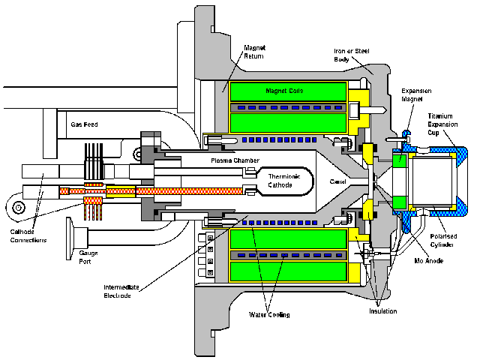
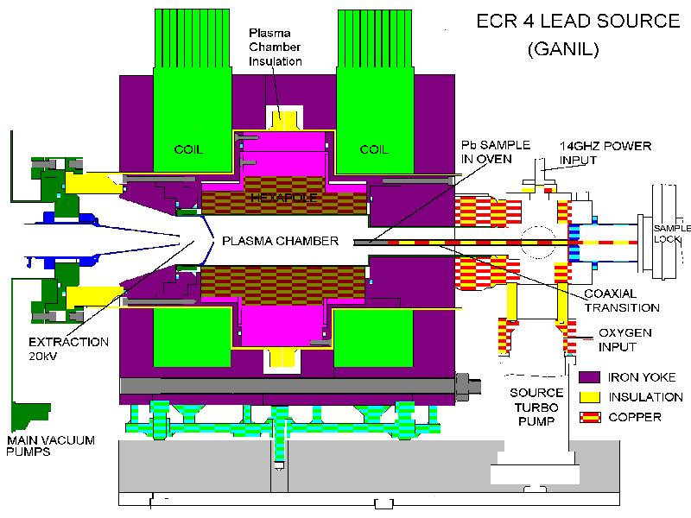
Getting started: ion sources
CERN proton source
CERN Lead source
FNAL H- source. Mix Cesium with Hydrogen to add electron.
Typically 10s of keV and mAs to 10s of mA of current. Want to accelerate as fast as possible before space charge blows up the beam!

Slide 42
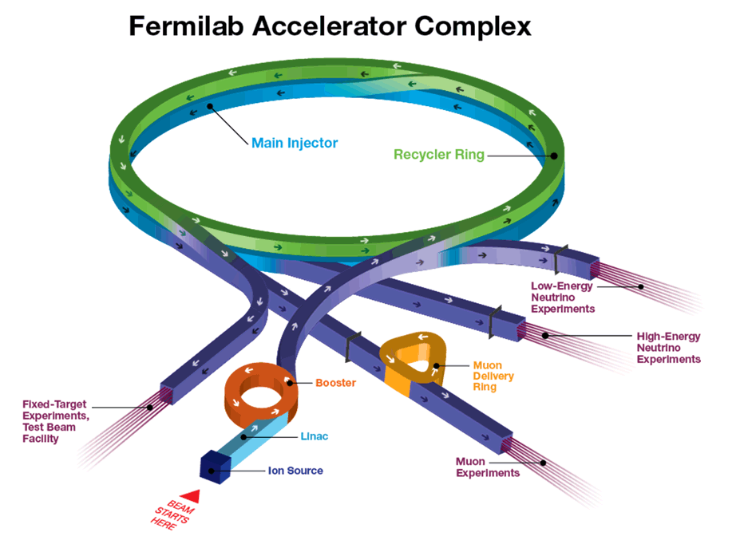
Example: Fermilab complex today
120 GeV
Fixed 8 GeV ring. Manipulates Booster beam
8 GeV
120 GeV
8 GeV
Formerly for antiprotons
120 GeV + secondary beams
400 MeV
750 keV
8 GeV

Slide 43
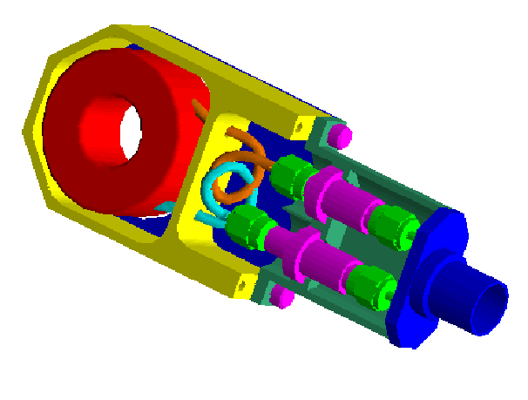
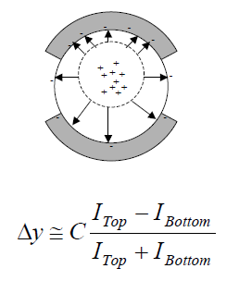
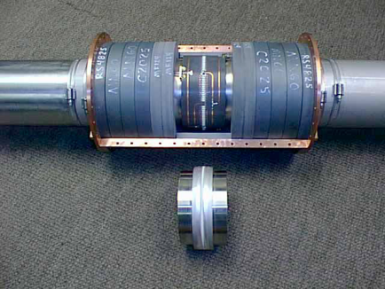
Tricks of the trade: beam instrumentation
Bunch/beam intensity are measured using inductive toriods
Beam position is typically measured with beam position monitors (BPM’s), which measure the induced signal on a opposing pickups
Longitudinal profiles can be measured by introducing a resistor to measure the induced image current on the beam pipe -> Resistive Wall Monitor (RWM)

Slide 44
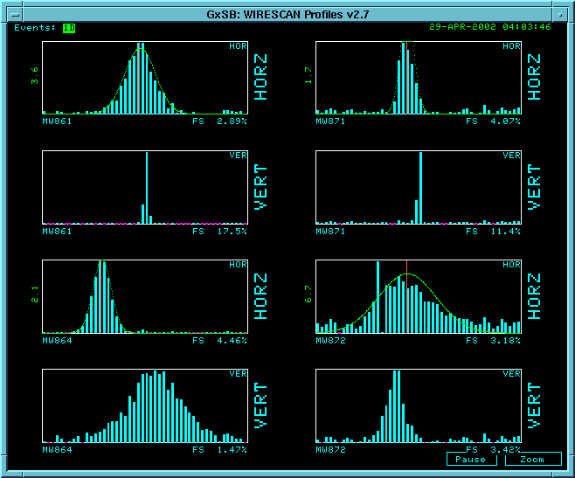
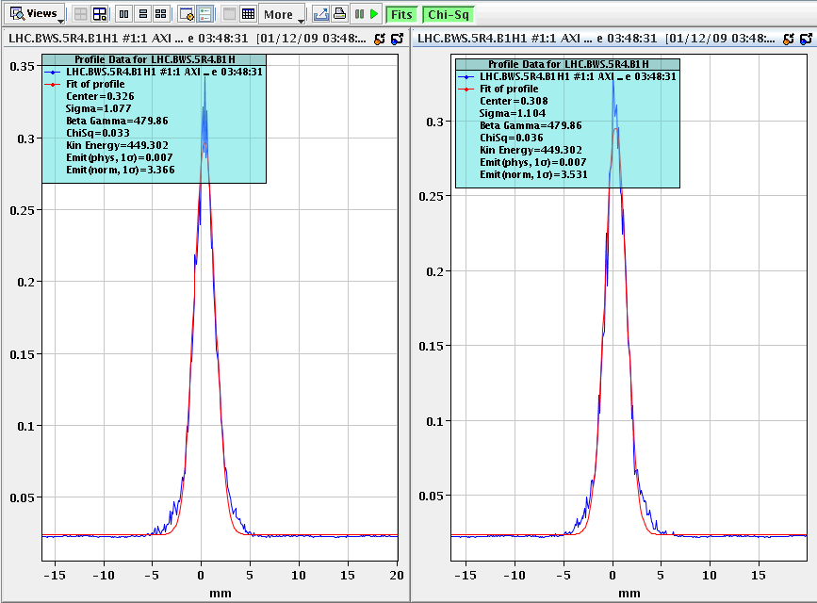
Beam instrumentation (cont’d)
Beam profiles in beam lines can be measured using secondary emission multiwires (MW’s)
Can measure beam profiles in a circulating beam with a “flying wire scanner”, which quickly passes a wire through and measures signal vs time to get profile
Non-destructive measurements include
  Ionization profile monitor (IPM): drift electrons or ions generated by beam passing through residual gas
  Synchrotron light
    Standard in electron machines
    Also works in LHC
Beam profiles in MiniBooNE beam line
Flying wire signal in LHC

Slide 45
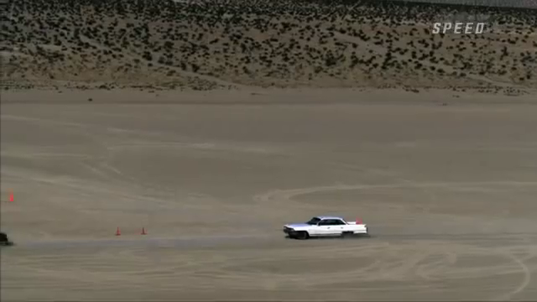

Colliding beams
Two cars hitting each other head-on
at 60 mph…
…is about the same
as one car going 120 mph
hitting a parked car.
But things get very different as we approach the speed of light…

Slide 46
The case for colliding beams
beam
target
For beam hitting a stationary proton, the “center of mass energy” (i.e. energy available to the reaction) is
On the other hand, for colliding beams (of equal mass and energy) it’s
beam
beam
To get the 14 TeV CM design energy of the LHC with a single beam on a fixed target would require that beam to have an energy of 100,000 TeV!
  Would require a ring 10 times the diameter of the Earth!!

Slide 47
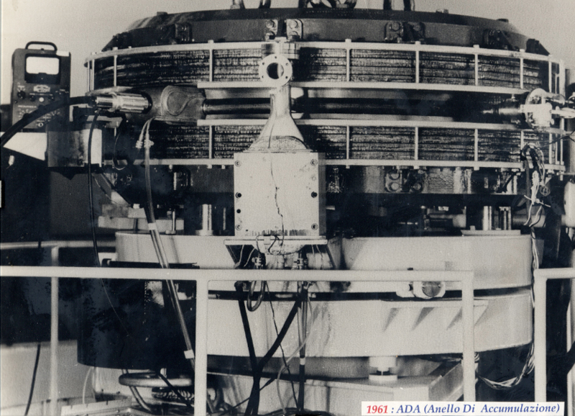
First e⁺e⁻ collider
ADA (Anello Di Accumulazione) at INFN, Frascati, Italy (1961)
  250 MeV e⁺ x 250 MeV e⁻
It’s easier to collide e+e-, because synchrotron radiation naturally “cools” the beam to smaller size.

Slide 48
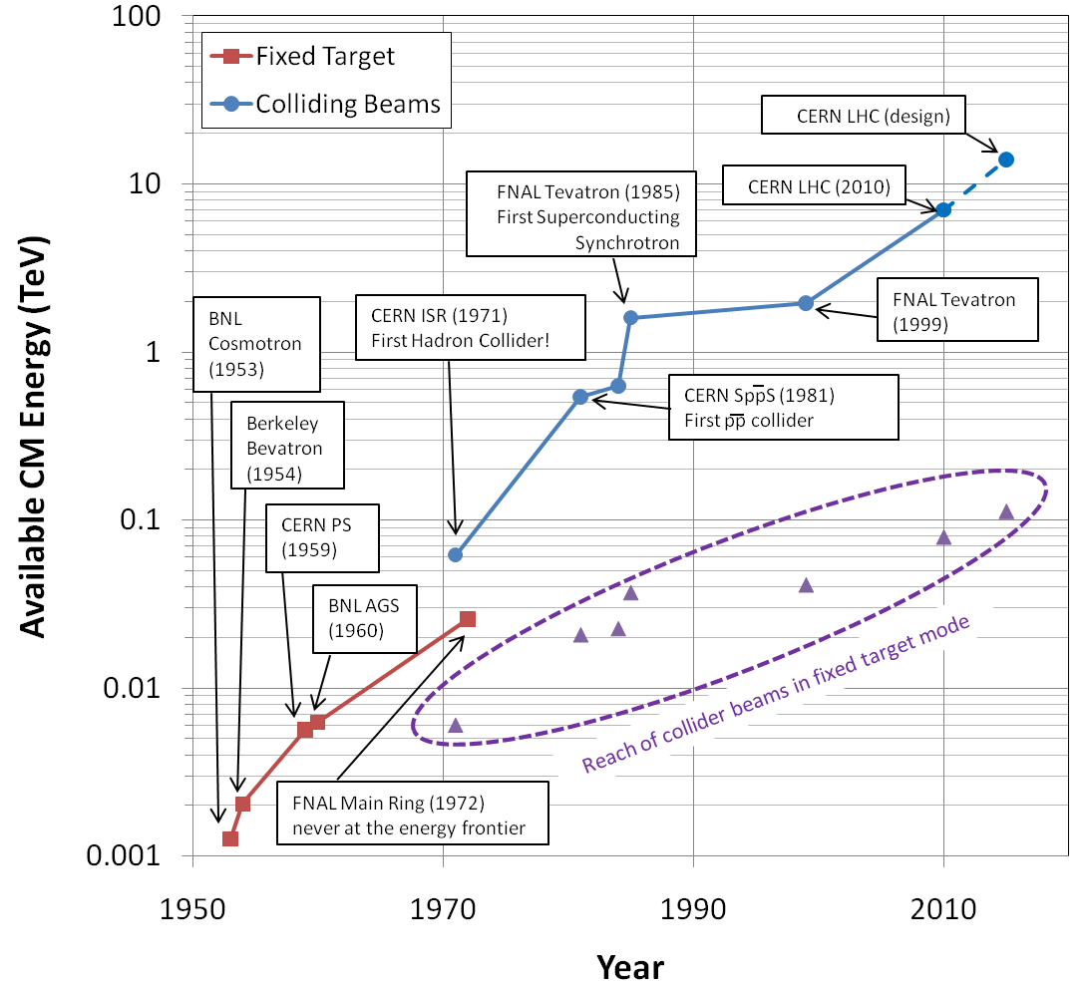
Summary: Evolution of the energy frontier
~a factor of 10 every 15 years
proton mass

Slide 49
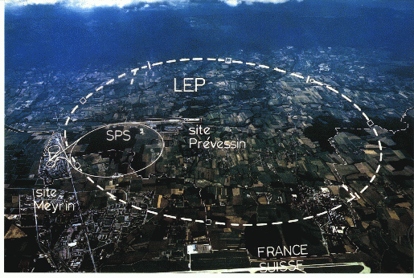
State of the art: Large Hadron Collider (LHC)
My House (1990-1992)
/LHC
Tunnel originally dug for LEP
  Built in 1980’s as an electron positron collider
  Max 100 GeV/beam, but 27 km in circumference!!

Slide 50
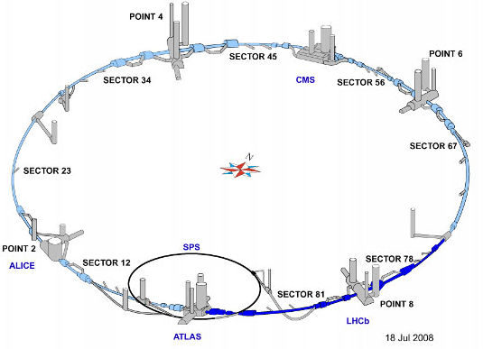
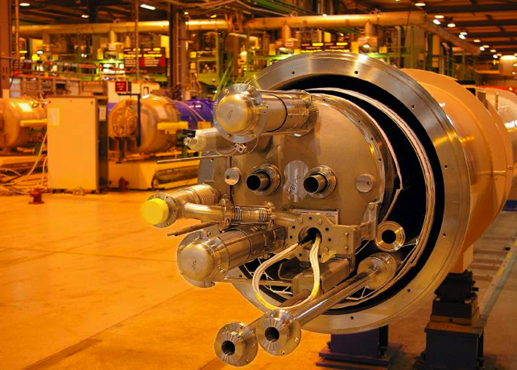
LHC layout and numbers
Design:
7 TeV+7 TeV proton beams
  Can’t make enough antiprotons for the LHC
  Magnets have two beam pipes, one going in each direction.
Stored beam energy 150 times more than Tevatron
  Each beam has only 5x10⁻¹⁰ grams of protons, but has the energy of a train going 100 mph!!
These beams are focused to a size smaller than a human hair to collide with each other!
27 km in circumference
2 major collision regions: CMS and ATLAS
2 “smaller” regions: ALICE and LHCb

Slide 51
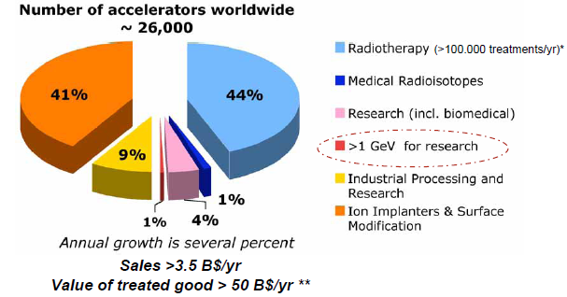
Research machines: just the tip of the iceberg

Slide 52
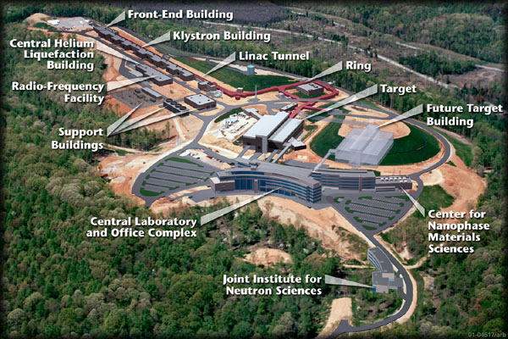
Example: Spallation Neutron Source
(Oak Ridge, TN)
A 1 GeV Linac loads 1.5E14 protons into a non-accelerating synchrotron ring.
These are fast extracted onto a Mercury target
This happens at 60 Hz -> 1.4 MW
Neutrons are used for biophysics, materials science, industry, etc…

Slide 53


Light sources: too many to count
Put circulating electron beam through an “undulator” to create synchrotron radiation (typically X-ray)
Many applications in biophysics,
materials science, industry.
New proposed machines will use
very short bunches to create coherent
light.

Slide 54

Other uses of accelerators
Radioisotope production
Medical treatment
Electron welding
Food sterilization
Catalyzed polymerization
Even art…
In a “Lichtenberg figure”, a low energy electron linac is used to implant a layer of charge in a sheet of lucite. This charge can remain for weeks until it is discharged by a mechanical disruption.

Slide 55
Thank you for your attention!

Slide 56
Backup

Slide 57
Early stages
The front end of any modern hadron accelerator looks something like this (Fermilab front end)
From here, particles go to a “Linac” (linear accelerator)…
200 MHz RFQ: 35➔750 keV
Solenoidal focusing for low energy beam
Redundant H⁻ sources: 0-35 keV

Slide 58
Example beam parameters
Compare Fermilab LINAC (K=400 MeV) to LHC (K=7000 GeV)
This would be the radius of curvature in a 1 T magnetic field or the field in Tesla needed to give a 1 m radius of curvature.

Slide 59

Review: basic trigonometry for small angles
The relationship between angle (in Radians) and the fundamental trigonometric functions is
For very small angles (θ<<1)
This is known as the “paraxial approximation”, and it will be very important for us
Arc length (s)
Hypotenuse (r)

Slide 60
Thin lens approximation and magnetic “kick”
If the path length through a
transverse magnetic field is short
compared to the bend radius
of the particle, then we can think of
the particle receiving a transverse “kick”
and it will be bent through small angle
In this “thin lens approximation”, a
dipole is the equivalent of a prism in
classical optics.
“paraxial approximation”

Slide 61
Strong focusing: quadrupole magnets as lenses
A positive particle coming out of the page off center in the horizontal plane will experience a restoring kick
proportional to the displacement
just like a “thin lens” with focal length
*or linear term in a gradient magnet

Slide 62



Some important early synchrotrons
Berkeley Bevatron,
1954 (weak focusing)
6.2 GeV protons
Discovered antiproton
CERN Proton Synchrotron (PS)
1959
628 m circumference
28 GeV protons
Still used in LHC injector chain!
CERN Proton Synchrotron (PS)
1960
808 m circumference
33 GeV protons
Discovered charm quark, CP violation, muon neutrino

Slide 63
Injection and Extraction
We typically would like to extract (or inject) beam by switching a magnetic field on between two bunches (order ~10-100 ns)
Unfortunately, getting the required field in such a short time would result in prohibitively high inductive voltages, so we usually do it in two steps:
fast, weak “kicker”
slower (or DC) extraction magnet with zero field on beam path.

Slide 64


Some other important accelerators (past):
LEP (at CERN):
  27 km in circumference
  - e+e-
  - Primarily at 2E=M_{Z} (90 GeV)
  - Pushed to E_{CM}=200GeV
  - L = 2E31
  - Highest energy circular e+e- collider that will ever be built.
  - Tunnel now houses LHC
SLC (at SLAC):
  2 km long LINAC accelerated electrons AND positrons on opposite phases.
  - 2E=M_{Z} (90 GeV)
  - polarized
  - L = 3E30
  - Proof of principle for linear collider

Slide 65


B-Factories
- B-Factories collide e+e- at E_{CM} = M(ϒ(4S)).
-Asymmetric beam energy (moving center of mass) allows for time-dependent measurement of B-decays to study CP violation.
KEKB (Belle Experiment):
- Located at KEK (Japan)
- 8GeV e- x 3.5 GeV e+
- Peak luminosity >1e34
PEP-II (BaBar Experiment)
- Located at SLAC (USA)
- 9GeV e- x 3.1 GeV e+
- Peak luminosity >1e34

Slide 66

Relativistic Heavy Ion Collider (RHIC)
- Located at Brookhaven:
Can collide protons (at 28.1 GeV) and many types of ions up to Gold (at 11 GeV/amu).
Luminosity: 2E26 for Gold
Goal: heavy ion physics, quark-gluon plasma, ??

Slide 67

Continuous Electron Beam Accelerator Facility (CEBAF)
Locate at Jefferson Laboratory, Newport News, VA
6GeV e- at 200 uA continuous current
Nuclear physics, precision spectroscopy, etc

Slide 68
Colliding Beam Luminosity
Circulating beams typically “bunched”
(number of interactions)
Cross-sectional area of beam
Total Luminosity:
Circumference of machine
Number of bunches
crossing rate

Slide 69

Explaining the LHC*…
*Kate McAlpine (http://www.youtube.com/user/alpinekat)

Slide 70

“Compact” (ha ha) Linear Collider (CLIC)?
Use low energy, high current electron beams to drive high energy accelerating structures
Up to 1.5 x 1.5 TeV, but VERY, VERY hard

Slide 71

What next?
The energy of Hadron colliders is limited by feasible size and magnet technology. Options:
  Get very large (~100 km circumference)
  More powerful magnets (requires new technology)
All accelerator magnets based on this
Future magnets could be based on this

Slide 72

Future Circular Collider (FCC)
Currently being discussed for ~2030s
80-100 km in circumference
Niobium-3-Tin (Nb₃Sn) magnets.
~100 TeV center of mass energy (~7 x LHC)

Slide 73
Other paths to the energy frontier
Leptons vs. Hadrons revisited
  Because 100% of the beam energy is available
  to the reaction, a lepton collider is
  competitive with a hadron collider of ~5-10
  times the beam energy (depending on the
  physics).
  A lepton collider of >1 TeV/beam could compete with the discovery potential of the LHC
    A lower energy lepton collider could be very useful for precision tests, but I’m talking about direct energy frontier discoveries.
  Unfortunately, building such a collider is VERY, VERY hard
    Eventually, circular e⁺e⁻ colliders will radiate away all of their energy each turn
      LEP reached 100 GeV/beam with a 27 km circuference synchrotron!
    ➔ Next discovery e⁺e⁻ collider will be linear

Slide 74
International Linear Collider (ILC)
LEP was the limit of circular e⁺e⁻ colliders
  Next step must be linear collider
  Proposed ILC 30 km long, 250 x 250 GeV e⁺e⁻ (NOT energy frontier)
We don’t yet know whether that’s high enough energy to be interesting
  Need to wait for LHC results
  What if we need more?

Slide 75

Muon colliders?
Muons are pointlike, like electrons, but because they’re heavier, synchrotron radiation is much less of a problem.
Unfortunately, muons are unstable, so you have to produce them, cool them, and collide them, before they decay.

Slide 76

Wakefield accelerators?
Many advances have been made in exploiting the huge fields that are produced in plasma oscillations.
Potential for accelerating gradients many orders of magnitude beyond RF cavities.
Still a long way to go for a practical accelerator.

Slide 77
Kinetic energy
A body in motion will have a
total energy given by
The difference between this
and mc² is called the “kinetic
energy”
Here are some examples of
kinetic energy
For v<<c (speed of light),
Kinetic energy ~ ½mv²
Kinetic Energy
Rest Energy
Example | Velocity | Velocity/ Speed of light | Kinetic Energy/(mc²)
Race car | 150 mph | .0000002 | .000000000000025
Apollo 12 (fastest people) | 24,791 mph | .000037 | .00000000068
Fermilab LINAC (K=400 MeV) | 214,000,000 m/s | .71 | .43
Proton in the LHC (full energy) | Light minus 2.7 m/s | .999999991 | 7500
Electron in LEP | Light minus 3.6 mm/s | .999999999988 | 203,000

Slide 78
Rough (and not particularly accurate) outline
Understanding energy scales
Motivation for particle accelerators
Getting to higher energy
  Cyclotrons
  Strong magnetic focusing
  Acceleration
  Colliding beams
Superconducting magnets
State of the art
Other uses for accelerators

Slide 79


Background: electric charges and electric fields*
You’ve all learned (I hope) that
like charges repel and opposite
charges attract
This can be interpreted as one charge creating an “electric field” which accelerates the other charge.
Charge [Coulombs]
“Electric Field” [Newtons/Coulomb]
or [Volts/Meter]
Δ means “change”
Acceleration [m/s²]
Mass [kg]
Force [Newtons]
*we’ll get to magnetic fields shortly

Slide 80


Work done by electric fields ➔ Voltage
“Work” is force over a distance.
For an electric field, this becomes
In practice, our sources of electric fields generally involve chemical or mechanical work, so we usually turn this relationship around. For example, consider a plate capacitor:
Electric field over distance = “voltage change”
The voltage of the source produces charge distributions on the two plates, resulting in a uniform field
The force felt by a charged particle between the plates will be
And the total energy gained by a particle crossing the gap will be
Which leads us to…

Slide 81
Glossary: standard symbols
I will use a lot of standard symbols, some of which make sense:
  E: electric field or total energy
  K: kinetic energy
  m: mass
  v: velocity
  V: voltage
  P: power
  e: fundamental electric charge
some of which don’t
  p: momentum
  c: speed of light
  q: charge
  I: current
  B: magnetic field
and some of which are Greek
  ρ (“rho”): curvature radius
  θ (“theta”): angle
  γ (“Lorentz gamma”): “time dilation factor”

Slide 82


Steering and Focusing: Magnetic Forces
You might think you understand how
magnets work, but the usual magnetic
forces you’re familiar with are actually
really complicated, involving the
motion of electrons inside matter.
At their most basic, magnetic
forces are exerted by moving
charges (currents) on other
moving charges
As we did with electric force, we’ll look at this as one current creating a “magnetic field” and the other experiencing it.
Parallel currents attract
Opposite currents repel

Slide 83
Understanding the force between two currents
One current produces the field
The other one experiences it

Slide 84


Weak focusing
Cyclotrons rely on the fact that
magnetic fields between two pole
faces are never perfectly uniform.
This prevents the particles from
spiraling out of the pole gap.
In early synchrotrons, radial field
profiles were optimized to take advantage of this effect, but in
any weak focused beams, the beam size grows with energy.
The most famous weak
focusing accelerator was the
Berkeley Bevatron, which had
a kinetic energy of 6.2 GeV
  High enough to make antiprotons
  (and win a Nobel Prize)
  It had an aperture 12”x48”!

Slide 85

First proton collider: CERN Intersecting Storage Rings (ISR)
1971
31 GeV + 31 GeV colliding proton beams.
  Highest CM Energy for 10 years
Set a luminosity record that was not broken for 28 years!

Slide 86


SppS: First proton-antiproton collider
Protons from the SPS were used to produce antiprotons, which were collected
These were injected in the opposite direction (same beam pipe) and accelerated
First collisions in 1981
Discovery of W and Z in 1983
  Nobel Prize for Rubbia and Van der Meer
Energy initially 270+270 GeV
Raised to 315+315 GeV
  Limited by power loss in
  magnets!
design

Slide 87


Superconductivity: enabling technology
The maximum SppS energy was limited by the maximum power loss that the conventional magnets could support.
  LHC made out of such magnets would be roughly the size of Rhode Island!
Highest energy colliders only possible using superconducting magnets
Must take the bad with the good
  Conventional magnets are Superconducting magnets are
  simple and naturally dissipate complex and represent a great
  energy as they operate deal of stored energy which must
  be handled if something goes wrong

Slide 88

When is a superconductor not a superconductor?
Superconductor can change phase back to normal conductor by crossing the “critical surface”
When this happens, the conductor heats quickly, causing the surrounding conductor to go normal and dumping lots of heat into the liquid Helium➔“quench”
  all of the energy stored in the magnet must be dissipated in some way
Dealing with quenches is the single biggest issue for any superconducting synchrotron!
Can push the B field (current) too high
Can increase the temp, through heat leaks, deposited energy or mechanical deformation
T_{c}

Slide 89

Quench example: MRI magnet*
*pulled off the web. We recover our Helium.

Slide 90


Tevatron: first superconducting synchrotron
The Fermilab Main Ring was completed in 1972 with normal magnets
By the late 70s, serious plans began for a superconducting collider in the same tunnel, followed by construction
  Dubbed “Saver Doubler”
  (later “Tevatron”)
  Helen Edwards led the construction effort.
1985 – First proton-antiproton collisions in Tevatron
  Most powerful accelerator in the world for the next quarter century
1995 – Top quark discovery
2011 – Tevatron shut down after successful LHC startup
Main Ring
Tevatron

Slide 91

Review: Special Relativity*
The two axioms of Special Relativity
  The laws of physics are the same in any “inertial” (non-accelerating) frame of reference
  The measured speed of light in a vacuum is the same in every inertial frame reference
Example
Observer 1 is inside a spaceship. He shines a light to a mirror on the other side and measures the time (T₁) it takes to return.
T₁:
Observer 2 is watching the spaceship go by. In his “frame”, the light travels a longer distance – at the same velocity ➔ the time he measures (T₂) is longer!
T₂:
*See SMP lecture by Mehreen Sultana, March 11, 2017

Slide 92
Time Dilation
If the speed of light is the same in both frames, then the measured time must be different!
Substitute L and square both sides
Lorentz “time dilation” factor (“gamma”)
We’re going to see a lot of this factor. We’ll discuss the behavior shortly

Slide 93




In case you didn’t believe me…
“Buck’s River Road Exxon”
Me
The guy who hired me: Prof. Kwan Lai
Fermilab E-706 Rochester Group
~1987
Then
Now

Slide 94

Summary: Units
We will use (mostly) SI units:
  Length: m (mm, μm, etc)
  Mass: kg
  Time: s (μs, ns, etc)
  Electrical units: Volts, Amps, etc
The exceptions be energy, mass, and momentum
  For energy, we will use electron-Volts [eV]
  For mass, we will use “equivalent energy” [eV/c²]
    Example: proton
  We will also use equivalent energy for momentum [eV/c]
  This looks weird, but it works very well with the relationship

Slide 95


Examples
e⁺e⁻ collision at the LEP collider
proton-proton collision at the LHC collider
So why don’t we stick to electrons??

Slide 96



Initial acceleration
Old: Static
New: RF Quadrupole (RFQ)
Static acceleration from Cockcroft-Walton.
FNAL = 750 keV
max ~1 MeV
RF structure combines an electric focusing quadrupole with a longitudinal accelerating gradient.

Slide 97


Linear Acceleration
Because the velocity is changing quickly, the first linac is generally a Drift Tube Linac (DTL), also known as an “Alvarez Linac”, which can match the drift tube separation to the changing velocity.
As energy gets higher, switch to
“pi-cavities”, which are more
efficient
After that, beam goes to a series of progressively larger synchrotron rings

