Slide 1

Enlightened: Some things we’ve Learned by Studying Light
Eric Prebys
Fermilab

Slide 2
An Ancient Quest
Since earliest human history, science has advanced primarily through our quest to understand two things:
  The motion of the sun, stars, planets, and other heavenly bodies.
  The nature of light.
The first is arguably how “science” began (leading to the creation of what we now call “physics”), while the second has led us to profound and surprising discoveries about the nature of reality itself.
  Big things happen when the two are combined
I’ll focus on this

Slide 3
Outline
The basics (easy stuff)
  Reflection
  Refraction
  Ray tracing and images
  Interference
Big surprises (hard stuff)
  Speed of light
  Electricity and Magnetism
  Theory of Relativity
  Quantum Mechanics and Quantum Electrodynamics
What this teaches us about how science is done
How this relates to what we do here

Slide 4
A (very!) Brief History of Light
5th century BC: the Greek philosopher Empedocles postulated that light traveled in “rays” from the eyes, allowing us to see
  Why can’t we see in the dark?
4th century BC: Aristotle argues that light rays originate from the object,
  His theory isn’t very quantitative, and doesn’t really catch on.
3rd century BC: Euclid worked out ray-based theories of reflection, still assuming light rays came from the eye
  although he did toy with the idea they might go in the other direction.
2nd century AD: Ptolomy extended Euclid’s work to include refraction (bending of light).
~1000 AD: The Arab scientist Alhazen created the first fairly accurate model of vision (including the direction of light rays)
~1600 AD: German scientist Johannes Kepler invents modern optics and image formation, explaining how lenses, mirrors, telescopes, microscopes, etc. work.

Slide 5
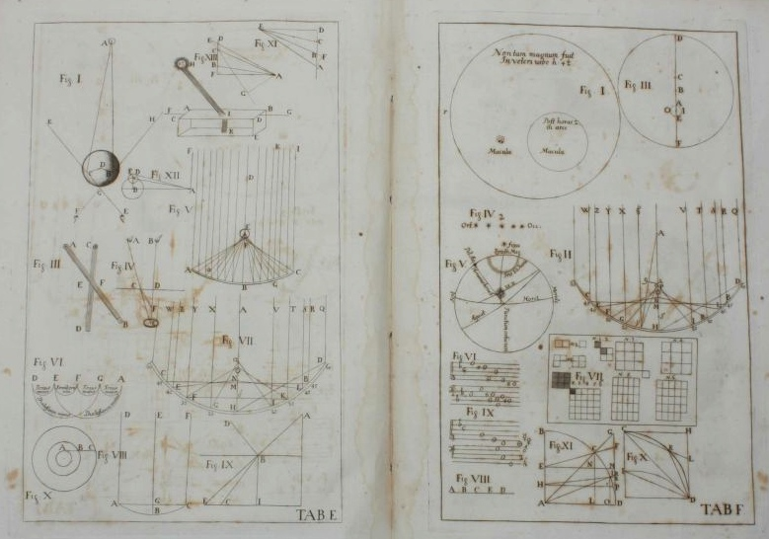
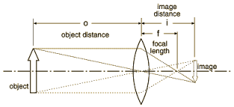
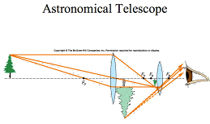
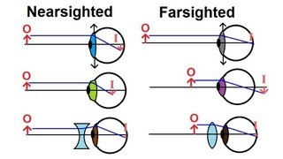
Keplerian Image Formation
In “Astronomiae Pars Optica” (1604), Kepler explained image formation in terms
refraction, reflection, and
“ray tracing”.
Led to significantly improved
telescopes!
To this day, Kepler’s “geometric
optics” is the basis of our
understanding of:
  mirrors
  telescopes
  microscopes
  cameras
  eyeglasses
  etc…

Slide 6
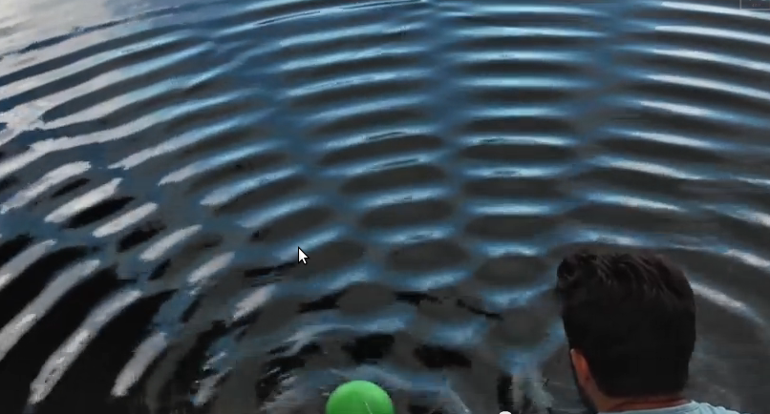
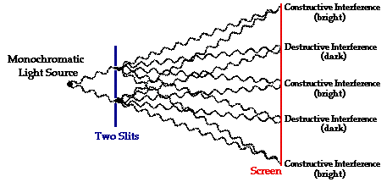
Nature of Light: Waves or Particles?
People were divided over whether light “rays” consisted of particles (“corpuscular theory”) or waves.
If waves, then they should “interfere” (add or cancel out)
Example: Interference of waves on water

Slide 7
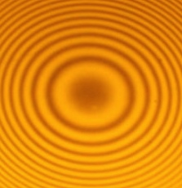
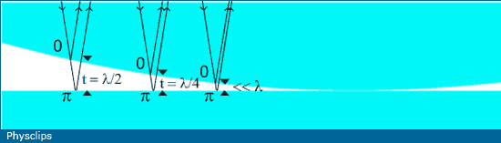
Newton’s Rings
Since we don’t see obvious signs of interference, light waves, if they exist, must be very small, and we would need small scale geometries to see them.
Newton (who firmly believed light was a particle!) observed interference by placing a curved surface against a flat surface
These “Newton’s Rings” were
strong evidence that light is a wave!
Can also calculate the wavelength.
Top View

Slide 8
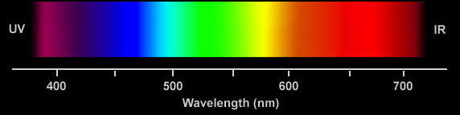
Color and Wavelength
Newton also observed that a prism split light into different colors
  Hypothesized that different colors were different “corpuscles”
In 1802, using interference techniques, Thomas Young determined that each color had unique wavelength
The picture is starting to come together: reflection, refraction, image formation, color. What’s left?
1 nanometer = 1 billionth of a meter

Slide 9

How fast does light move?
In the 5th century BC, the Greek philosopher Empedicles suggested that light might move with finite velocity
  Remember, he thought light went from our eyes to objects
Aristotle believe that light traveled instantly, and his view held for almost 2,000 years.
In the 17th century, at least two attempts were made to measure the speed of light.
  In 1629, Isaac Beeckman carried out an
  experiment in which looked for the time
  it took a cannon flash to reflect from a
  mirror a mile away.
  Around 1638, Galileo (possibly) tried to
  measure the speed of light using two men
  with lanterns on distant hilltops
Both men concluded that light was too fast to be measured in these simple ways.

Slide 10
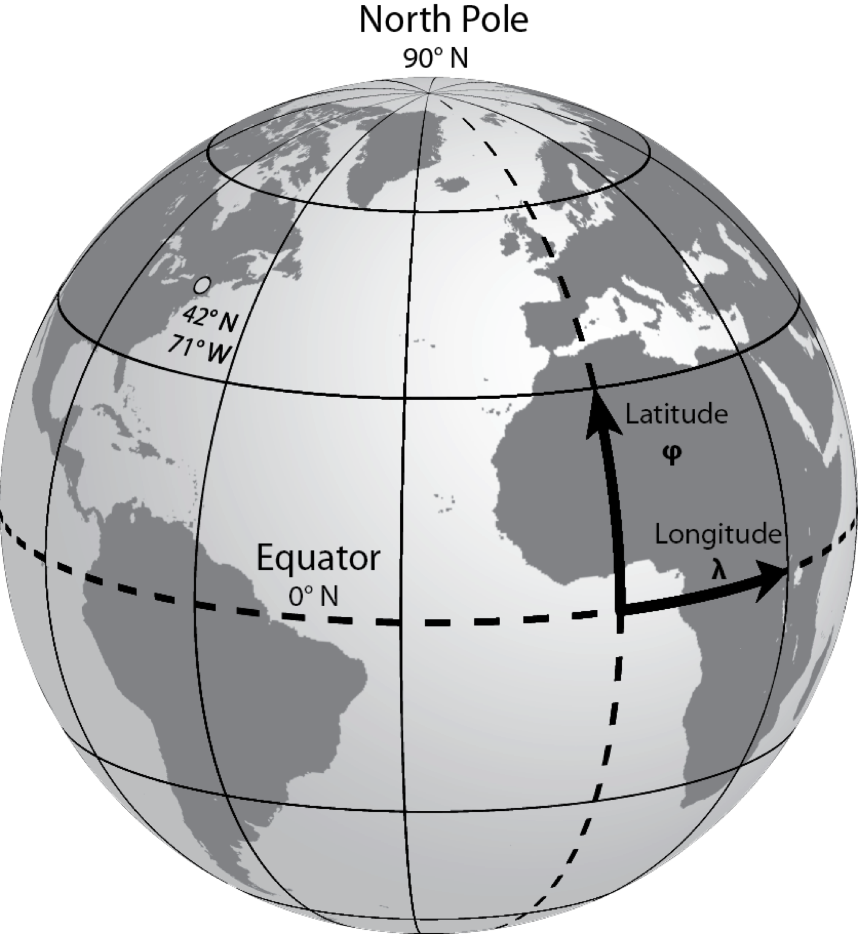
Digression: Latitude and Longitude
Our method of specifying a location on the Earth dates back at least to Eratosthenes, in the 3rd Century BC.
  First person to measure the circumference of the
  Earth
The North Pole always points in the same
direction, so latitude maybe measured anywhere
on Earth using the apparent angle of the sun
or stars, however
Because the Earth is spinning, I need both angles
and absolute time to measure longitude
  If I know it’s high noon in London, the angle
  of the sun with the horizon tells me my local longitude
  At the equator, a 1 minute error in time is a 16 mile error in position!
For centuries, longitude was determined by dead reckoning and (eventually) the time between a solar eclipse and local sunset.
What the heck does this have to do with the speed of light?
  Bear with me…

Slide 11
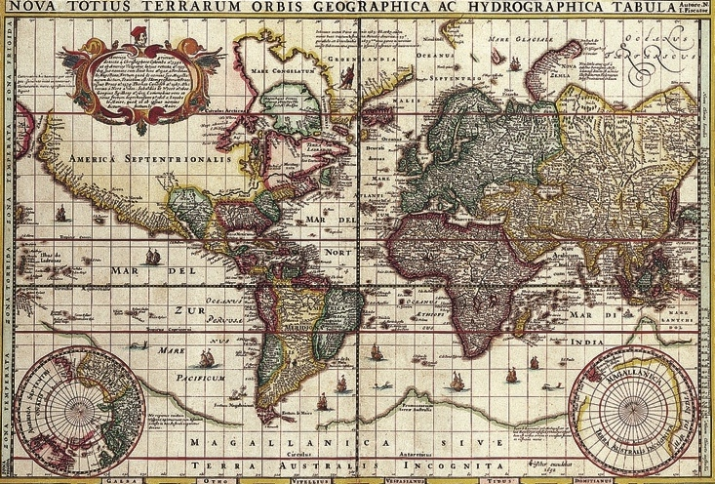
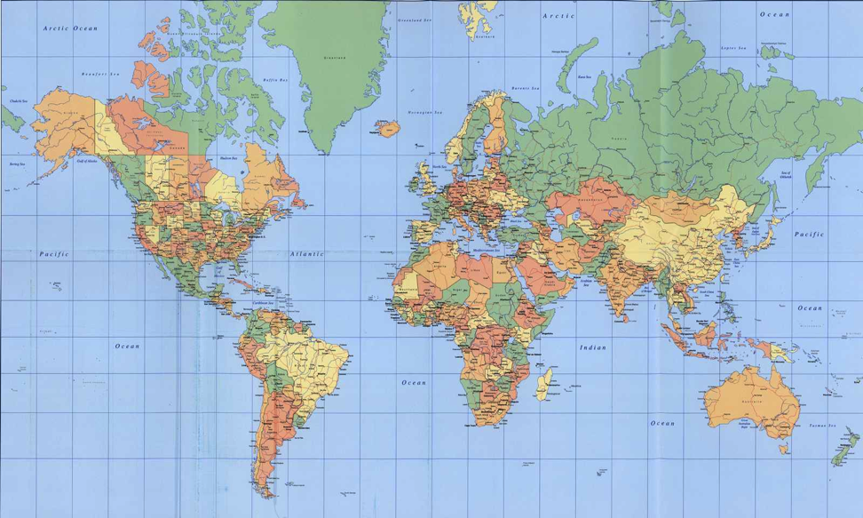
Maps and the New World
By the 16th and 17th centuries, Old World maps were pretty accurate
In the New World, latitude could be very precise, but longitude could be wildly off
Now it mattered!
  Ships had to navigate over large distances with no landmarks
Willem Janszoon Blaeu, ~1630
Modern

Slide 12
The Quest for Longitude
By the 17th century, longitude was THE big problem for navigation.
Numerous governments offered large prizes to the first person who could reliably determine longitude (ie, measure absolute time) over large distances.
Many believed that such accuracy could never be achieved with a mechanical clock, and would have to rely on some celestial reference.
This drove a period of intense advancement in observational astronomy
  spoiler alert: John Harrison eventually solved the problem with a clock*
*see “Longitude” by Dava Sobel

Slide 13
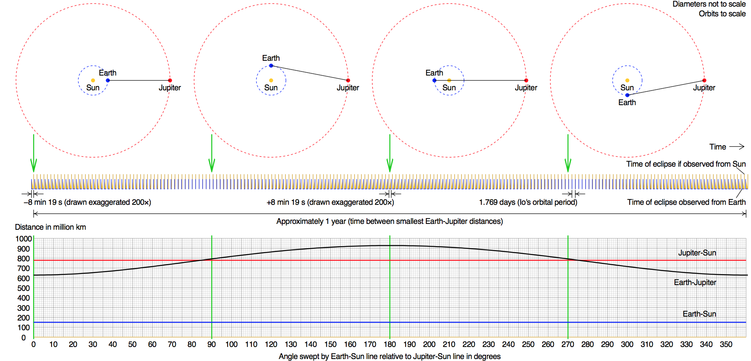
Rømer’s Accidental Discovery
The Danish astronomer Ole Rømer was trying to win the “Longitude Prize”, offered by King Phillip III of Spain.
Using a technique suggested by Galileo, he tried to use the period of Jupiter’s moon Io as a clock, starting observations in about 1668
He found that the period was shorter or longer depending on whether the Earth was approaching or receding from Jupiter, leading to a difference of around 20 minutes as the Earth went from one side of the sun to the other
  Remember, 1 minute = 16 mile error in position at the Equator!
He realized that he could explain this if light took 22 minutes to cross the diameter of the Earth’s orbit around the sun, and he and Christian Huygens calculated the speed of light to be about 135,000 miles per second
  Correct answer: 186,000 miles per second

Slide 14
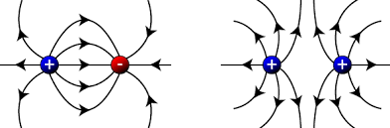
Moving on: Another Happy Accident
The 19th Century was the golden age of experimental physics, at least as far as electricity and magnetism were concerned.
By the second half of the century, scientists had learned
  Electric fields are created by electric charges

Slide 15
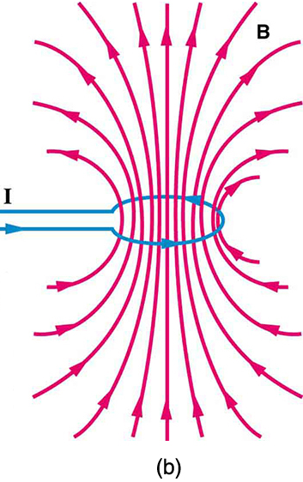
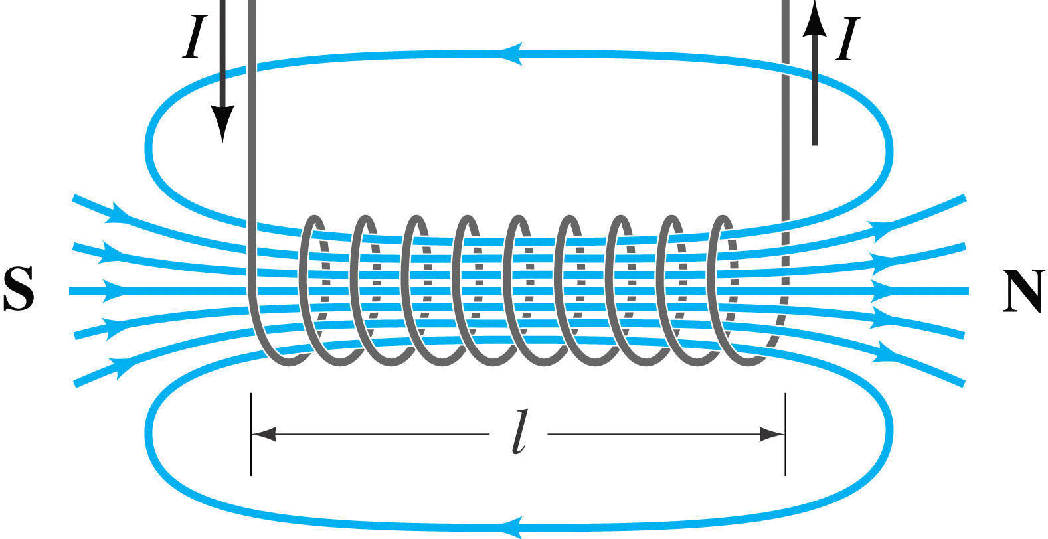
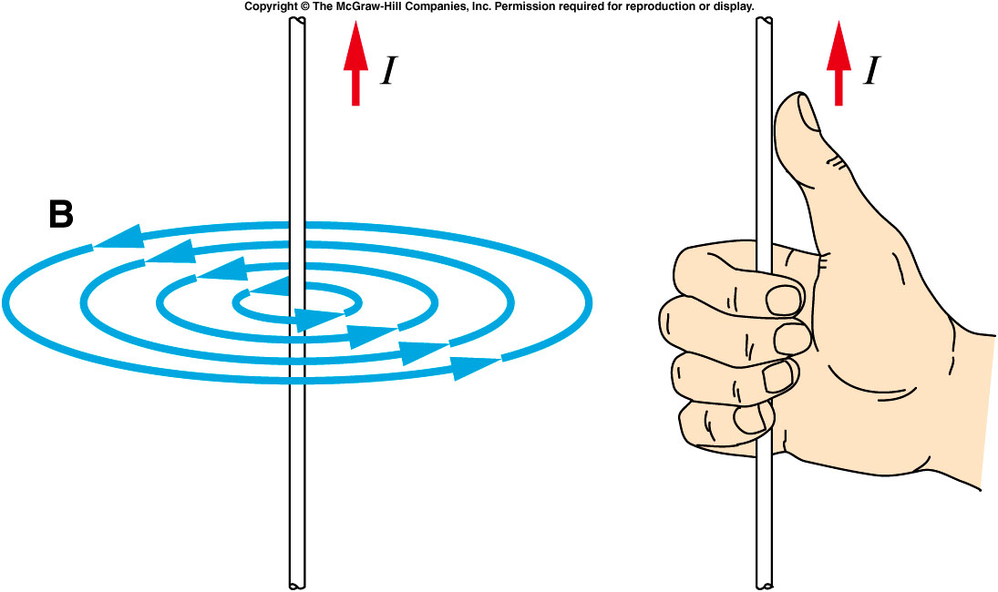
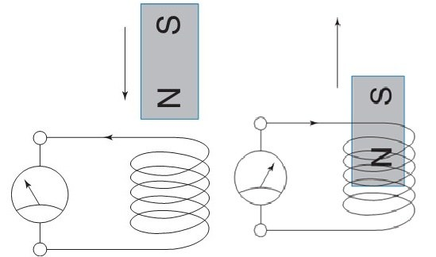
A Happy Accident (cont’d)
They also knew
  Magnetic fields are created by moving electric charges (electric current)
  Electric fields can also
  be induced by changing
  magnetic fields
    This is how a generator
    works

Slide 16
Maxwell’s Equations
In 1861, James Clerk Maxell attempted to collect everything that was known about Electricity and Magnetism into a single set of equations.
He was almost able to express all of the existing experimental observations as a self-consistent set of mathematical equations
  There was one (seemingly) small problem having to do with magnetic fields.
For purely mathematical reasons, he added an extra term
  In addition to electric currents, magnetic fields could be generated by changing electric fields.
This turned out to have rather profound implications…

Slide 17
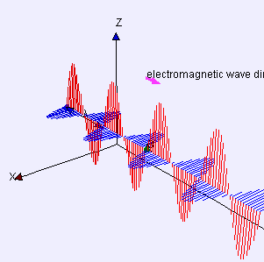
Electromagnetic Waves
Before, it was believed that you needed electric charges to make an electric or magnetic field, but Maxwell’s Equations showed you could have
  (changing electric field)➔(changing magnetic field)➔
  (changing electric field)➔
“Electromagnetic Wave”
What’s more, Maxwell could calculate
the velocity at which such a wave would
travel
  It exactly matched the speed of light!!!
He wrote (with trembling hands, maybe?):
  "we can scarcely avoid the inference that light consists in the transverse undulations of the same medium which is the cause of electric and magnetic phenomena"

Slide 18
It’s all the same thing…
In one fell swoop, Maxwell not only unified electricity and magnetism, but his results would eventually show that light, heat, radio waves, x-rays, gamma rays, etc., are all really the same thing – differing only in wavelength!
The entire
visible
spectrum.

Slide 19
What’s “undulating”?
As often happens science, one answer raised a lot more questions.
All (other) known waves require a “medium” (air, water, earth, “the wave”) to travel through.
Light at least appears to travel through a vacuum.
In science, always try the simplest answer first:
  Maybe vacuum isn’t really empty?
Scientists hypothesized the existence of “luminiferous aether”, and started to look for it…

Slide 20
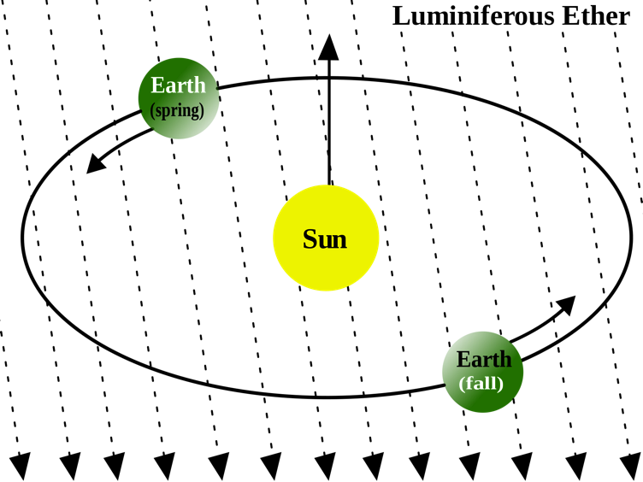
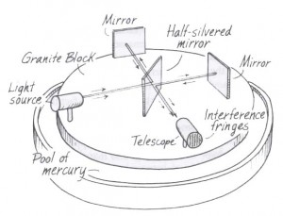
Michelson-Morley Experiment
If aether exists, then it must
fill space and the earth must be
passing through it.
Light traveling along the direction
of the Earth’s motion should have
a slightly different wavelength
than light traveling transverse to it.
In 1887, Albert Michelson and Edward
Morley performed a sensitive
experiment to measure this difference.
Their result:
  No difference ➔ no aether!
Biggest mystery in science for almost
20 years.

Slide 21
Einstein to the Rescue
In 1905, Albert Einstein postulated that perhaps the equations meant exactly what they appeared to mean:
  The speed of light was the same in any frame in which is was measured.
He showed that this could “work”, but only if you gave up the notion of fixed time.
  ➔ “Special Theory of Relativity”
Profound implications…

Slide 22
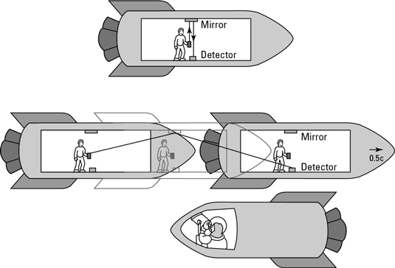
Example: Time Dilation
Einstein said, “The speed of light must be the same in any reference frame”. For example, the time it takes light to bounce off a mirror in a spaceship must be the same whether it’s measured by someone in the spaceship, or someone outside of the spaceship.
This seems weird, but it applies to everything we do at the lab
  Example: the faster pions and muons move, the longer they live.
These two people have to measure the same speed for light, even though light is traveling a different distance for the two of them.
The only solution? More time passes for the stationary observer than the guy in the spaceship!
  “Twin Paradox”

Slide 23
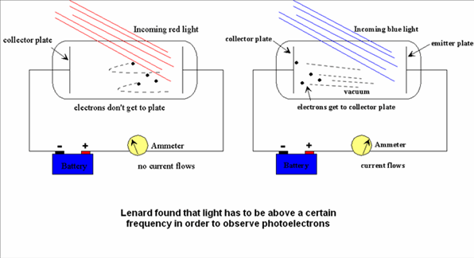
Now we’re done, right?
Well….
Around the turn of the last century, Philipp Lenard observed the “photoelectric effect”:
  light could knock electrons out of material and create an electric current, but their energy depended only on the color, not the intensity.
This really had people scratching their heads!

Slide 24
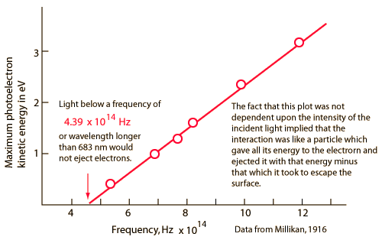
Einstein to the rescue (again)
The same year he proposed the Theory of Relativity, Einstein suggested a new theory for light
  Really, at this point, he was just showing off
He hypothesized that light consisted of “packets”, each with an energy that depended on its wavelength:
Shorter wavelengths have
higher energy, and can therefore
kick out electrons with higher
energy.
Planck’s Constant
Speed of light
Energy
Wavelength

Slide 25
Wait! What the what?
I thought we had that whole particle/wave thing worked out after the discovery of interference, right?
Now Einstein was saying light was a particle again.
How could light be both a particle and a wave?
This question obsessed the best minds in the world for decades (and still does, really)
Over time, a working theory emerged, known as “quantum mechanics”
…and it’s really kind of weird!

Slide 26
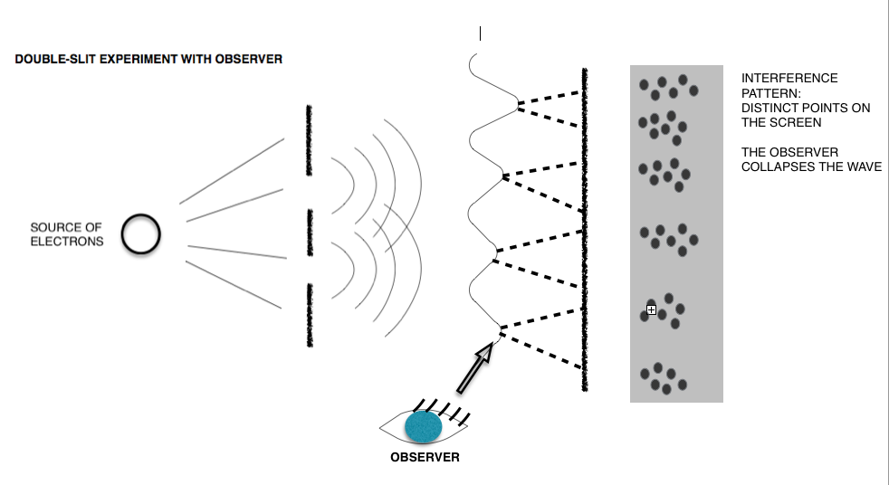
Quantum Mechanics
Light (and everything else) has a wavelength, which depends on its momentum
Particles propagate (and interfere!) as waves, but they are observed (interact) discretely, with a probability that depends on their amplitude.
At the smallest scales, everything is governed by random chance, and this introduces a fundamental uncertainty into our ability to measure things.
Momentum

Slide 27
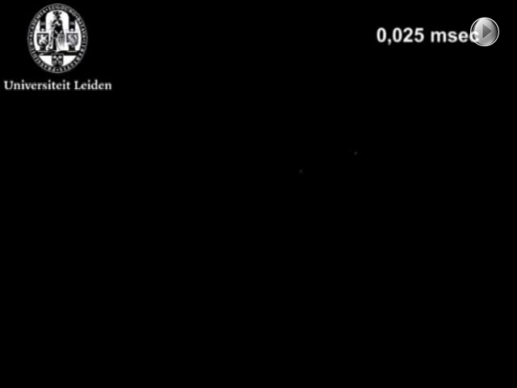
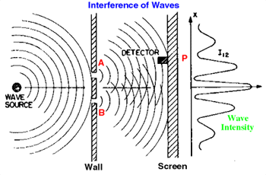
Example: Quantum Two-Slit Interference
Phosphor screen detects single photons from low intensity light source
When they add up, we see the interference pattern.

Slide 28
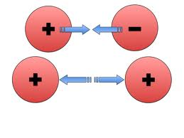
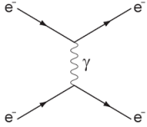
Quantum Electrodynamics (QED)
Based on the work of Richard Feynman and others, we now view the electric field as the discrete exchange of photons.
If the probability is high enough, you exchange a lot of photons and quantum ➔ classical again.
Classical picture: charged particles produce “fields”, which exert forces on other particles
Quantum picture: charged particles have a probability of exchanging “virtual photons”
“Feynman Diagram”

Slide 29
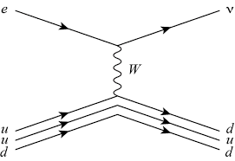
The Rest is History…
QED became the basis for our models of the other forces.
  In quantum mechanics, a “force” is something that changes the “state” of a particle, which can sometimes mean changing it into another particle.
And that’s just the beginning…
QED
Weak Interaction
Neutrino
“W” (like a photon but about 100 times as heavy as the proton!)
Proton

Slide 30
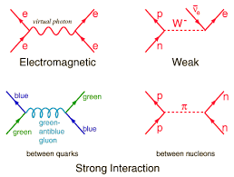
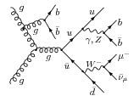
The Standard Model
We can generalize these Feynman Diagrams and change their orientation to explain every type of particle interaction there is
They’re literally the basis of everything we do here.

Slide 31
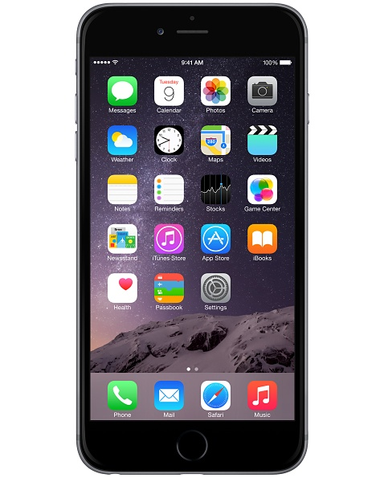
Summary: Consider the Smart Phone…
Processor/circuits
  Fabrication
    Classical optics (lithography)
    Photoelectric effect
  Operation
    Quantum mechanics
  Heat dissipation
    Radiant heat theory
LCD Screen
  Quantum mechanics
Camera
  Lens
    Classical optics
  CCD
    Photoelectric effect
Phone and wireless signals
  Electrodynamics
GPS
  Atomic clocks
    quantum mechanics
  Signals
    electrodynamics
  Corrections
    Special and General relativity

Slide 32
Acknowledgements
Fermilab, for encouraging outreach
Wikipedia and Google (of course)
You, for sitting inside instead of shopping!

Slide 33
Backup slides

Slide 34
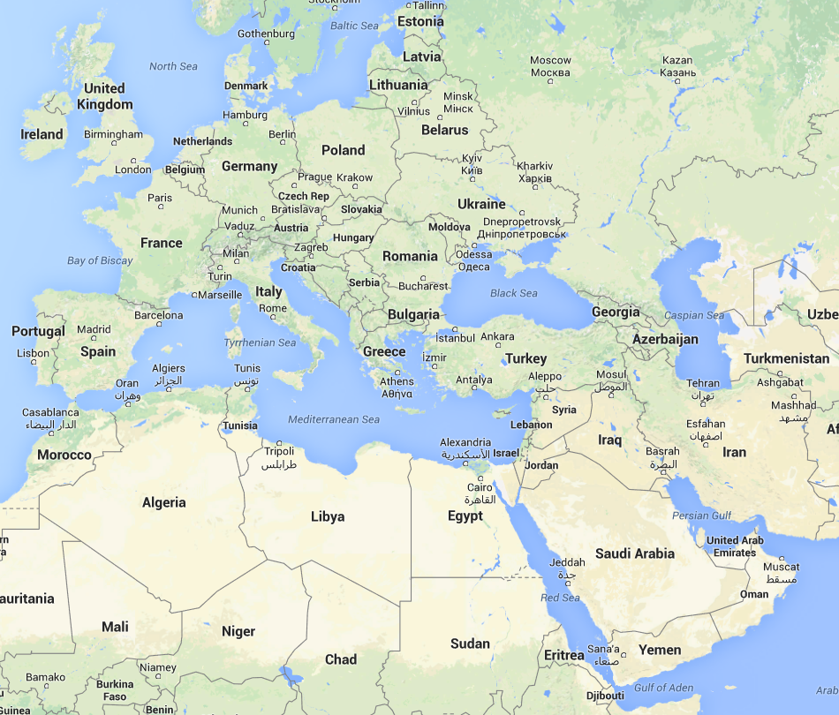
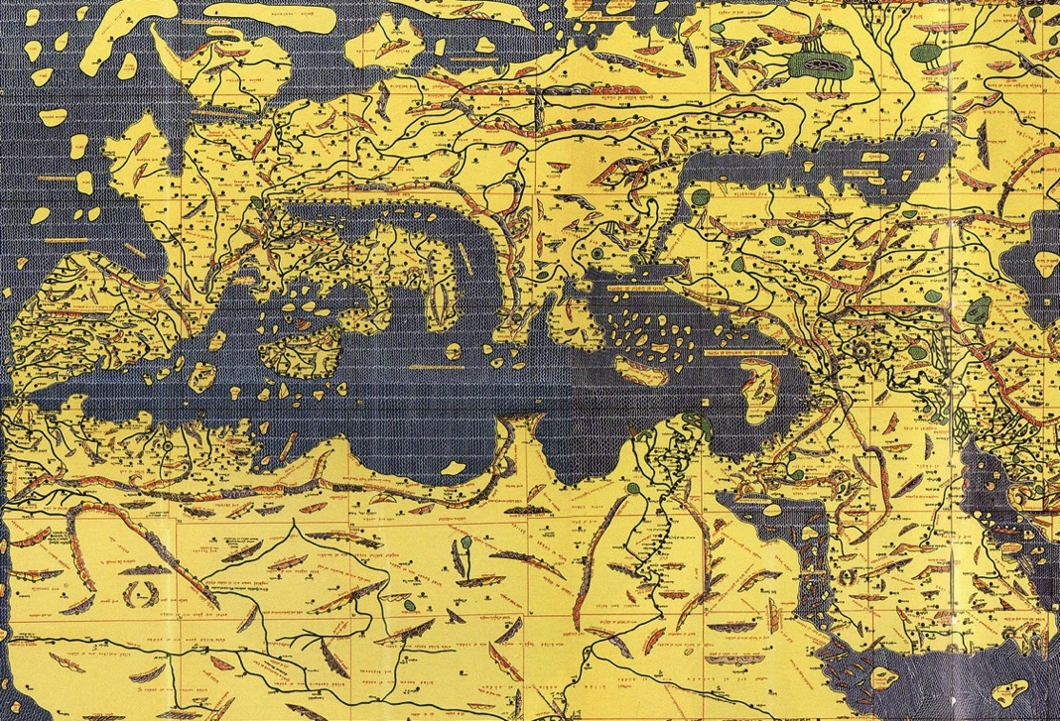
Maps
Latitude was determined by stars
  Pretty Accurate
Longitude was determined by dead reckoning
  Often way off
“Tabula Rogeriana” Muhammed al-Idrisi, 1154
(North was originally down)

Slide 35
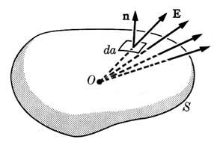
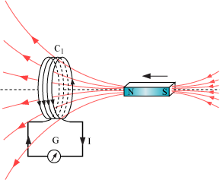
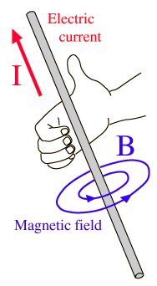
Maxwell’s Equation’s
In 1861, James Clerk Maxell attempted to collect everything that was known about Electricity and Magnetism into a single set of equations.
Coulomb’s Law:
  The electric field passing through a surface
  depends on the charge contained by that surface
Faraday’s Law:
  The electric field around a closed path
  depends on the rate of change of a magnetic
  field passing through the path.
Ampere’s Law:
  The magnetic field around a closed path depends on the
  electric current (flowing charge) passing through the path

Slide 36
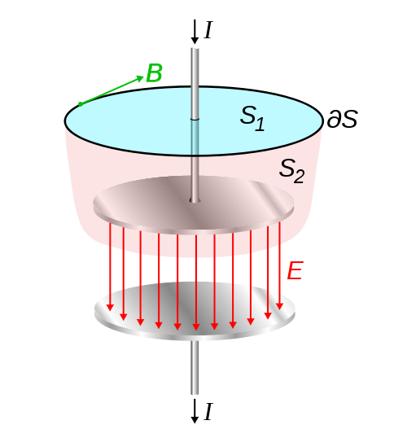
Displacement Current
There was a problem with Ampere’s Law
  Because electrical current can be blocked, there is no unique definition of the current passing through a loop.
Maxwell had a “fix”
  Any interruption in electric
  current causes a changing
  electric field.
For purely mathematical reasons,
Maxell hypothesized that a
magnetic field could be created
by an electric current or a
changing electric field.
This didn’t affect a single measurement that had been made until that point, but it had profound implications.
Current flowing here
Field changing here

Slide 37
Implications of Quantum Mechanics
At the smallest scales, things occur randomly. We can talk about probabilities, but not certainties.
The act of “observing” is never passive.
  Example: we see because a photon hits the retina of our eye, causing a quantum transition.
The fact that observation requires interaction introduces a fundamental uncertainty into our ability to measure things.

