Slide 1
Accelerators and High Energy Physics
Eric Prebys, FNAL
Case Western Reserve University Student Visit

Slide 2
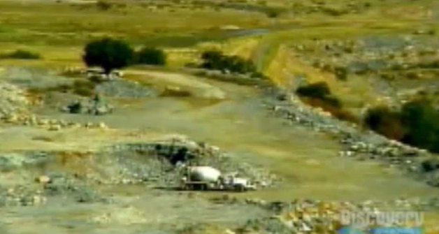
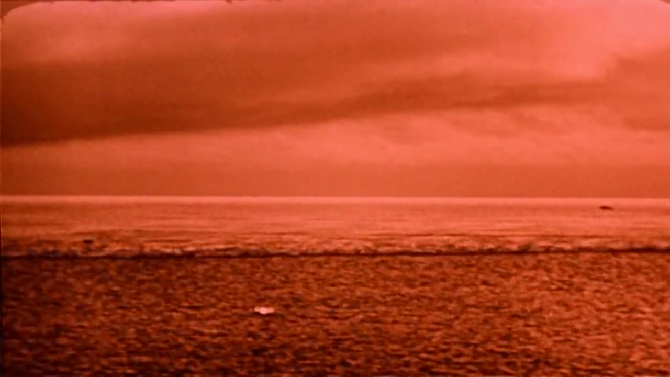

Understanding Energy
High Energy Physics is based on Einstein’s equivalence of Mass and Energy
All reactions involve some mass changing either to or from energy
If we could convert a kilogram of mass
entirely to energy, it would supply all
the electricity in the United States for
almost a day.
Chemical Explosion
Hydrogen Bomb
.00000005% of mass converted to energy.
~.1% (of just the Hydrogen!) converted.

Slide 3
Kinetic Energy
A body in motion will have a
total energy given by
The difference between this
and mc² is called the “kinetic
energy”
Here are some examples of
kinetic energy
For v<<c (speed of light),
Kinetic energy ~ ½mv²
Kinetic Energy
Rest Energy
Example | Velocity | Velocity/ Speed of light | Kinetic Energy/(mc²)
Race car | 150 mph | .0000002 | .000000000000025
Apollo 12 (fastest men) | 24,791 mph | .000037 | .00000000068
Proton in the LHC (full energy) | Light minus 2.7 m/s | .999999991 | 7500
Electron in LEP | Light minus 3.6 mm/s | .999999999988 | 203,000

Slide 4
Units of Energy
Energy is (force)x(distance)
For example, when you drop something, gravity “work” through the change in height to convert “potential energy” to “kinetic energy”.
In the same way, when we accelerate something in an electric field, electrical potential (“voltage”) is converted to kinetic energy.
For this reason, a convenient unit of energy is the
“electron-volt (eV)”
which is the energy you get when you accelerate a charge of one electron (or proton) over a 1 Volt potential.

Slide 5
Understanding electron-volts
The eV is a really small unit of energy.
  1.6x10⁻¹⁹ (=.00000000000000000016) Joules - our usual
  unit of energy.
  A 1 kg weight dropped 1m would have 6x10¹⁸ eV of energy!
On the other hand, it’s a very useful unit when talking about individual particles
  If we accelerate a proton using an electrical potential, we know exactly what the energy is.
  It’s also useful when thinking about mass/energy equivalence

Slide 6
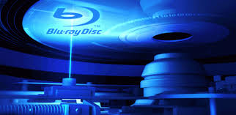
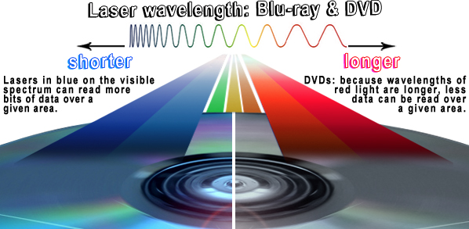
Another way to look at energy…
Question: Why are “blue ray” players blue?
Answer: because blue light is more energetic and has a shorter wavelengths, so the “bits” can be smaller
“Planck Constant”
wavelength
Energy

Slide 7
Wavelengths of other particles
It turns out that all particles have a wavelength
So going to higher energy allows us to probe smaller and smaller scales
If we put the high equivalent mass and the small scales together, we have…
“Planck Constant”
momentum

Slide 8
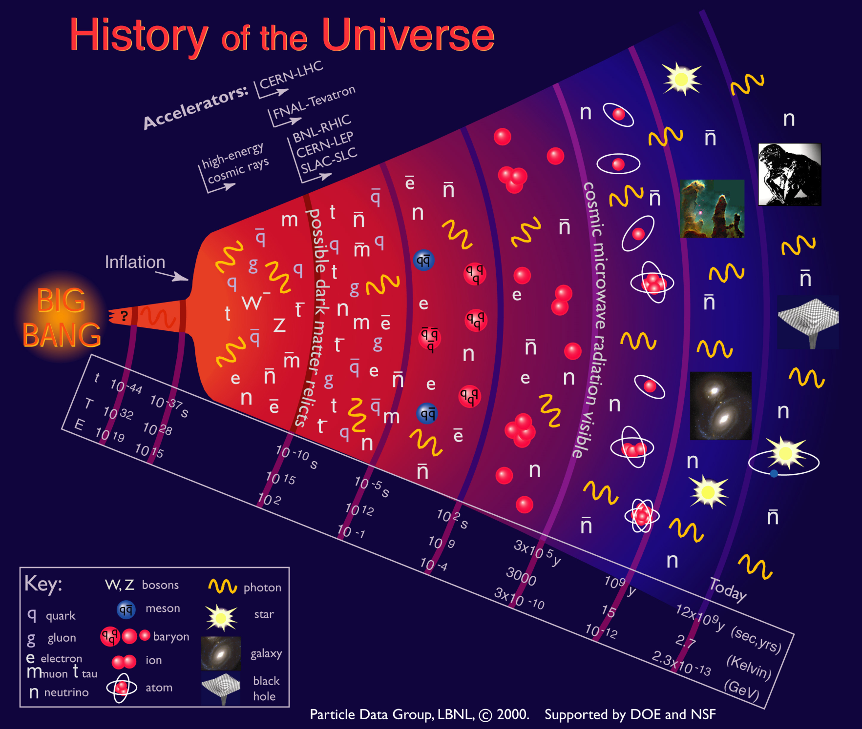
Going to higher energies = going back in time

Slide 9
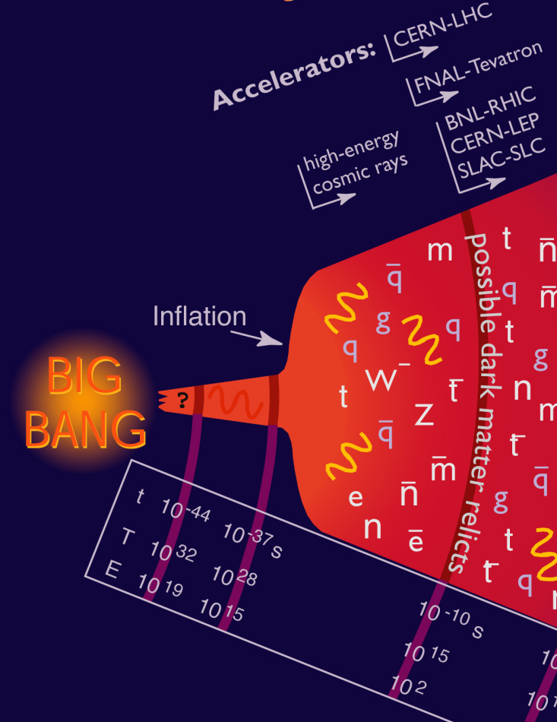
Where we are…
Accelerators allow us to go back 13.8 billion years and recreate conditions that existed a few trillionths of a second after the Big Bang
  the place where our current understanding of physics breaks down.
In addition to high energy, we need high
“luminosity”
that is, lots of particles interacting, to see rare processes.

Slide 10
State of the art: Large Hadron Collider (LHC)
Built at CERN, straddling the French/Swiss border
27 km in circumference
Has collided two proton beams at 4000 GeV each
In 2015, will reach design energy of 7000 GeV/beam.
That’s where we are. Now let’s see how we got here…

Slide 11
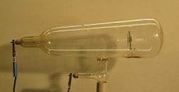
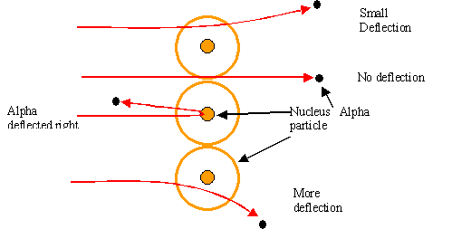
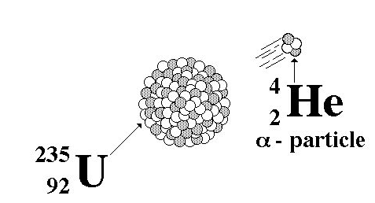
Rewind: Some pre-history
The first artificial acceleration of particles
was done using “Crookes tubes”, in the
latter half of the 19th century
  These were used to produce the first X-rays (1875)
  At the time no one understood what was going on
The first “particle physics experiment” told Ernest Rutherford the structure of the atom (1911)
In this case, the “accelerator” was a
naturally decaying ²³⁵U nucleus
Study the way radioactive particles “scatter” off of atoms

Slide 12
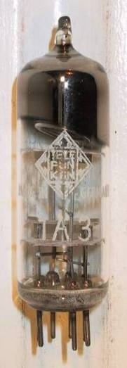
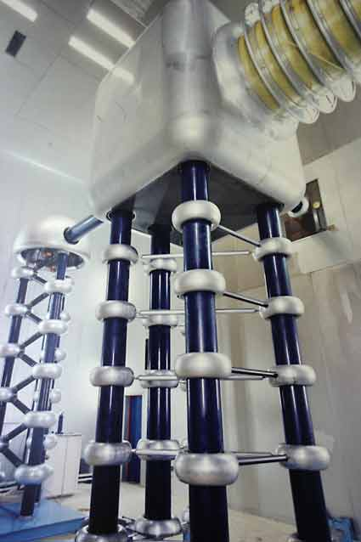
Man-made particle acceleration
The simplest accelerators accelerate charged particles through a static electric field. Example: vacuum tubes (or CRT TV’s)
Cathode
Anode
Limited by magnitude of electric field:
  - TV Picture tube ~keV
  - X-ray tube ~10’s of keV
  - Van de Graaf ~MeV’s
Solutions:
  Alternate fields to keep particles in
  accelerating fields -> Radio Frequency (RF) acceleration
  Bend particles so they see the same accelerating field over and over -> cyclotrons, synchrotrons
FNAL Cockroft-Walton = 750 kV

Slide 13
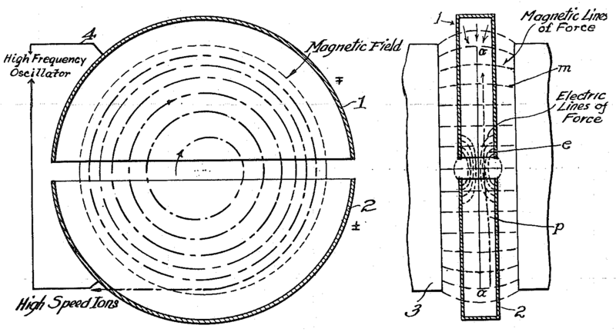
The Cyclotron (1930s)
side view
top view
A charged particle in a magnetic field will follow a circular path
Can accelerate particles by alternating the voltage on two accelerating “DEES”
Can get to high energies by adding just a little bit of energy each time around.
Accelerating “DEES”

Slide 14
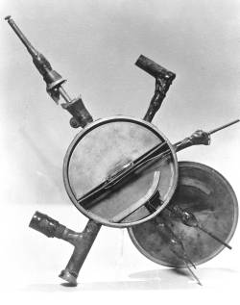
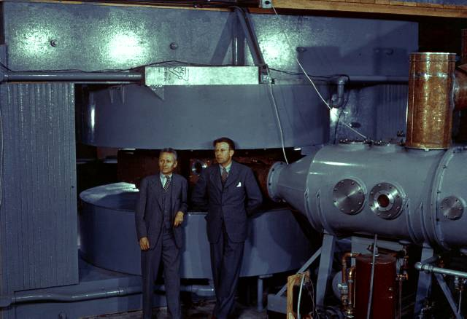
Round we go: the first cyclotrons
~1930 (Berkeley)
  Lawrence and Livingston
  K=80keV
1935 - 60” Cyclotron
  Lawrence, et al. (LBL)
  ~19 MeV (D2)
  Prototype for many

Slide 15
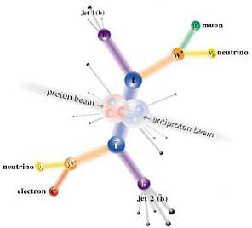
Interlude: Electrons vs. Protons
Electrons are point-like
  Well-defined initial state
  Full energy available to interaction
Protons are made of quarks and gluons
  Interaction take place between these consituents.
  Only a small fraction of energy available, not well-defined.
  Rest of particle fragments -> big mess!

Slide 16
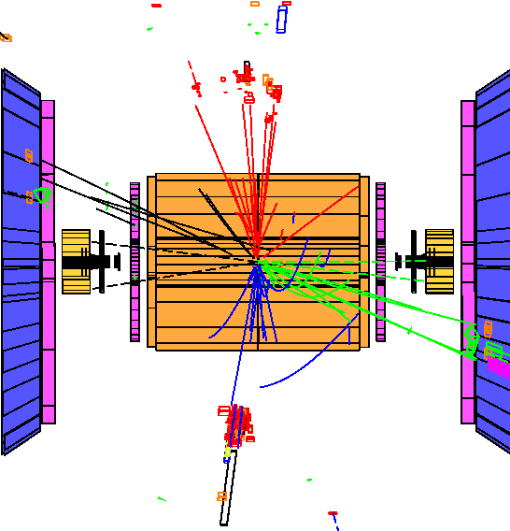
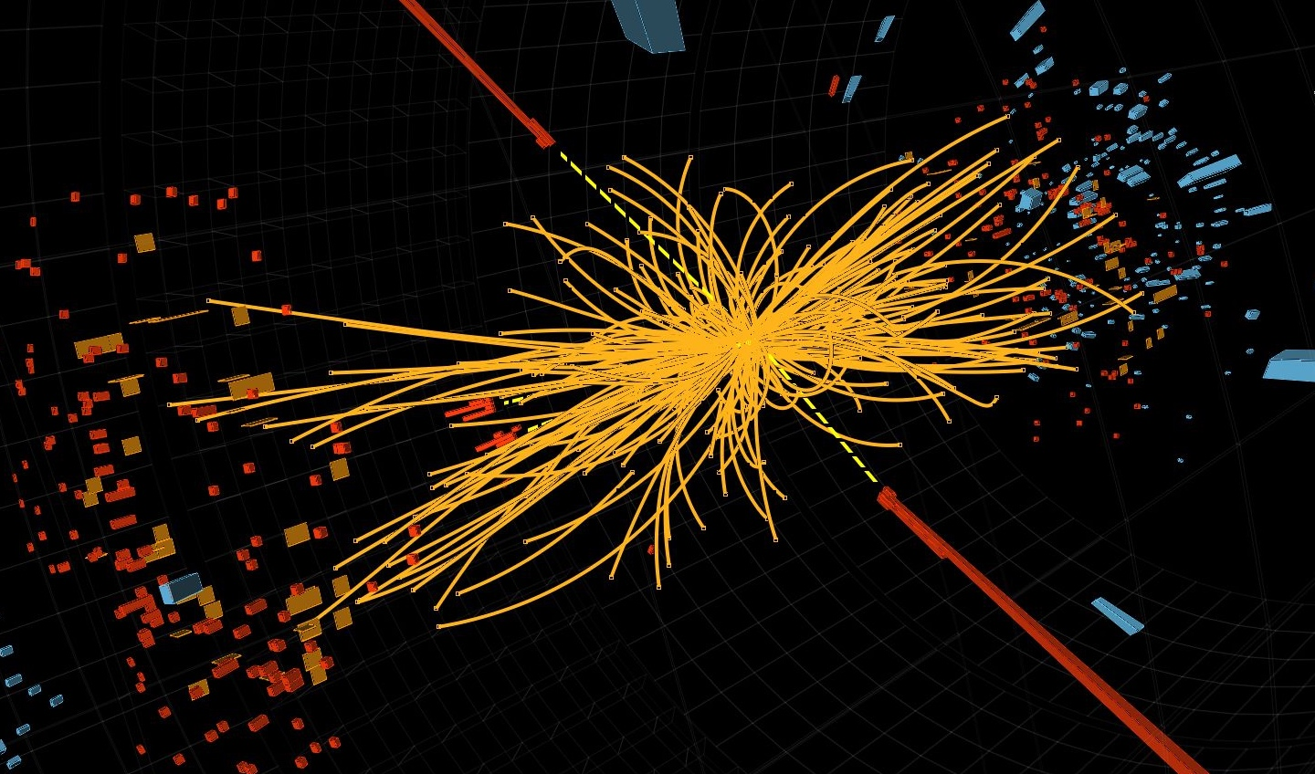
Examples
e⁺e⁻ collision at the LEP collider
proton-proton collision at the LHC collider
So why don’t we stick to electrons??

Slide 17
Synchrotron Radiation
As the trajectory of a charged particle is deflected, it emits “synchrotron radiation”
An electron will radiate about 10¹³ times more power than a proton of the same energy!!!!
Radius of curvature
Protons: Synchrotron radiation does not affect kinematics very much
  Energy limited by strength of magnetic fields and size of ring
Electrons: Synchrotron radiation dominates kinematics
  To to go higher energy, we have to lower the magnetic field and go to huge rings
  Eventually, we lose the benefit of a circular accelerator, because we lose all the energy each time around.
Since the beginning, the energy frontier has belonged to proton (and/or antiproton) machines

Slide 18
Onward and Upward!
Two major advances allowed accelerators to go beyond the energies possible at cyclotrons
  “Synchrotron” – in which the magnetic field is increased as the energy increases, such that particles continue to follow the same path.
    Edward McMillan, 1945
  “Strong focusing” – a technique in which magnetic gradients (non-uniform fields) are used to focus particles and keep them in a smaller beam pipe than was possible with cyclotrons.
    Courant, Livingston and Snyder, 1952*
*actually invented in 1949 by a Greek-American electrical engineer name Nicholas Christofilos, but it was completely ignored at the time!

Slide 19
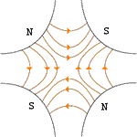
Strong focusing: quadrupole magnets as lenses
All fields cancel at the center
A positive particle coming out of the page off center in the horizontal plane will experience a restoring “kick”, proportional to the displacement
Just like a “thin lens” in classical optics

Slide 20
What about the other plane?
Defocusing!
Luckily, if we place equal and opposite pairs of lenses, there will be a net focusing regardless of the order.
➔pairs give net focusing in both planes -> “FODO cell”
The fundamental building block of synchrotrons and beam lines!

Slide 21
Longitudinal motion (acceleration)
We will generally accelerate particles using structures that generate time-varying electric fields (RF cavities), either in a linear arrangement (“linac”)
or located within a circulating ring
In both cases, we want to “phase" the RF so a nominal
arriving particle will see the same accelerating voltage
and therefore get the same boost in energy
cavity 0
cavity 1
cavity N
Nominal Energy

Slide 22
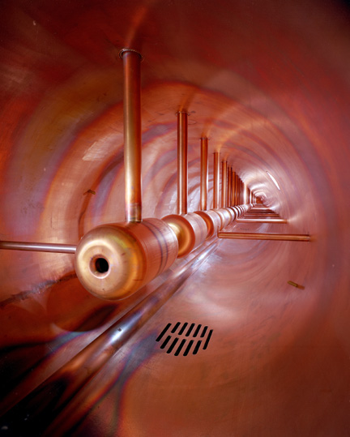
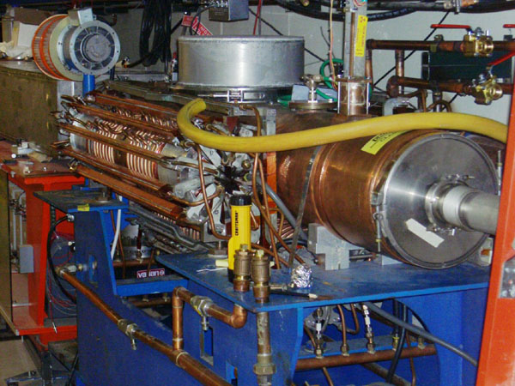
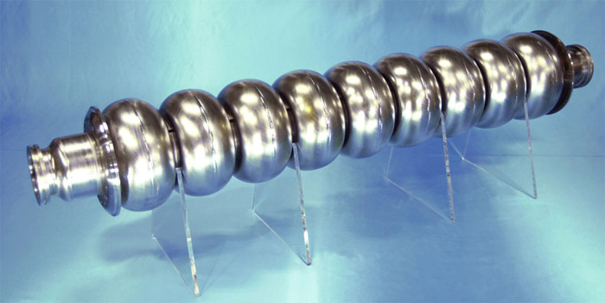
Examples of accelerating RF structures
Use resonant structures to make efficient use of power
37->53MHz Fermilab Booster cavity
Biased ferrite frequency tuner
Fermilab Drift Tube Linac (200MHz): oscillating field uniform along length
ILC prototype elipical cell “π-cavity” (1.3 GHz): field alternates with each cell

Slide 23
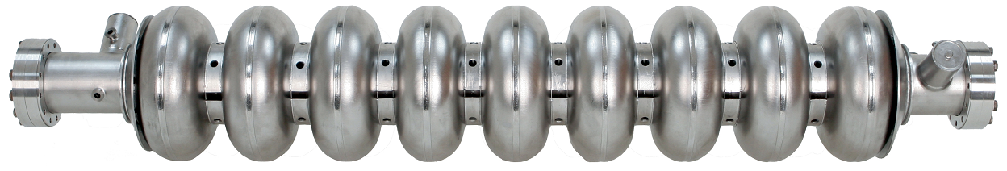
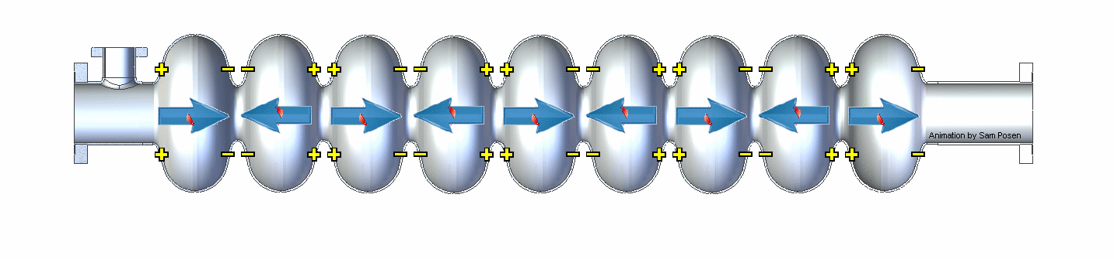
How RF Cavities Accelerate*
Input RF power at 1.3 GHz
Slowed down by factor of approximately 4x10⁹
~1 m
*Animation from Sam Posen

Slide 24
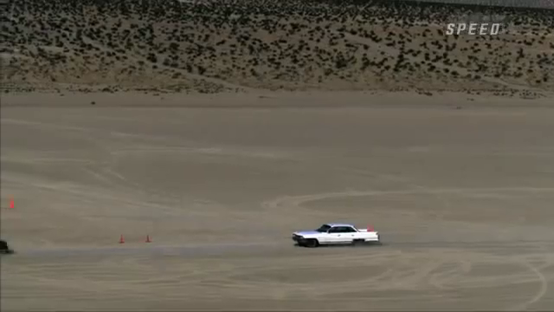

Colliding Beams
Two cars hitting each other head-on
at 60 mph…
…is about the same
as one car going 120 mph
hitting a parked car.
But things get very different as we approach the speed of light…

Slide 25
The Case for Colliding Beams
Beam hitting a stationary proton, the “center of mass” energy is
On the other hand, for colliding beams (of equal mass and energy) it’s
To get the 14 TeV CM design energy of the LHC with a single beam on a fixed target would require that beam to have an energy of 100,000 TeV!
  Would require a ring 10 times the diameter of the Earth!!

Slide 26
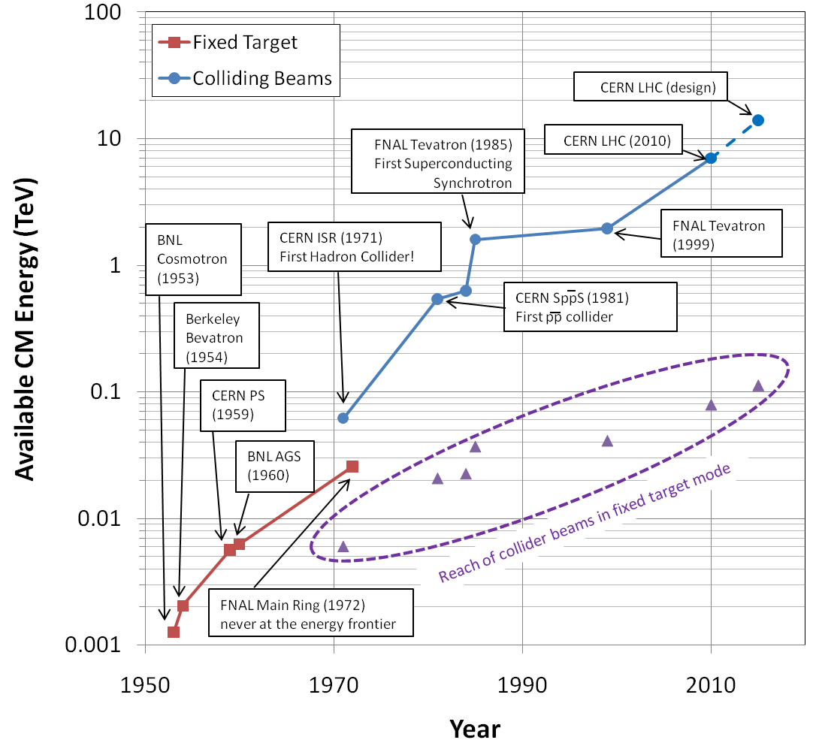
Evolution of the Energy Frontier
~a factor of 10 every 15 years
proton mass

Slide 27
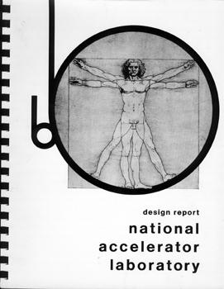
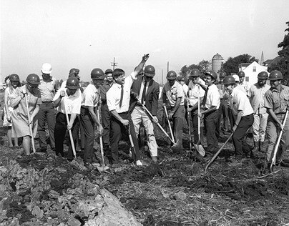
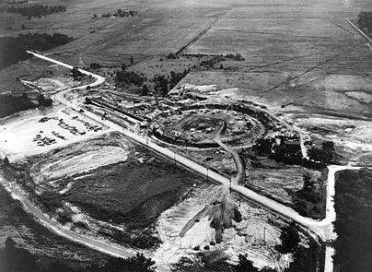
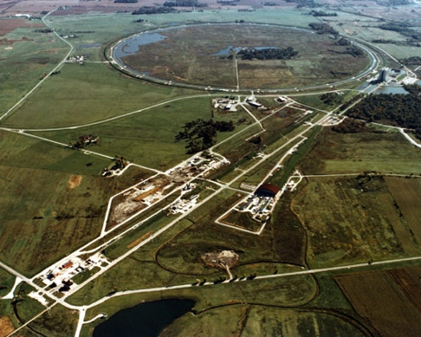
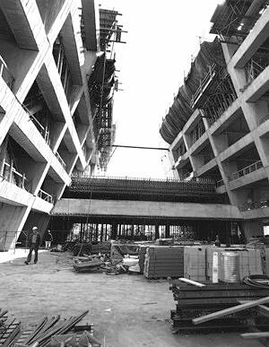
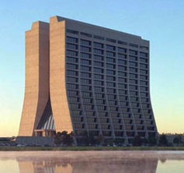
Fermilab: Early History
1963 – Committee chaired by Norman Ramsey recommends the construction of a 200 BeV synchrontron
  to be located at Berkeley (of course)
1965 - Joint Committee on Atomic Energy (JCAE) and the National Academy of Sciences (NAS) endorse the Ramsey Report
  but as a “National Accelerator Lab”, with a nation-wide site selection.
1966 – Weston, IL chosen as the site
1967 – Cornell physicist Robert Wilson named first director
1968 – Construction of NAL begins
1972 – First 200 GeV beam in the Main Ring (400 GeV later that year)
  Extracted to three fixed target, experimental beam lines: Meson, Neutrino, and Proton
1974 – Iconic “High Rise” completed. Lab dedicated to Enrico Fermi, and renamed “Fermi National Accelerator Laboratory”
  Fermi’s widow, Laura, attended the ceremony

Slide 28
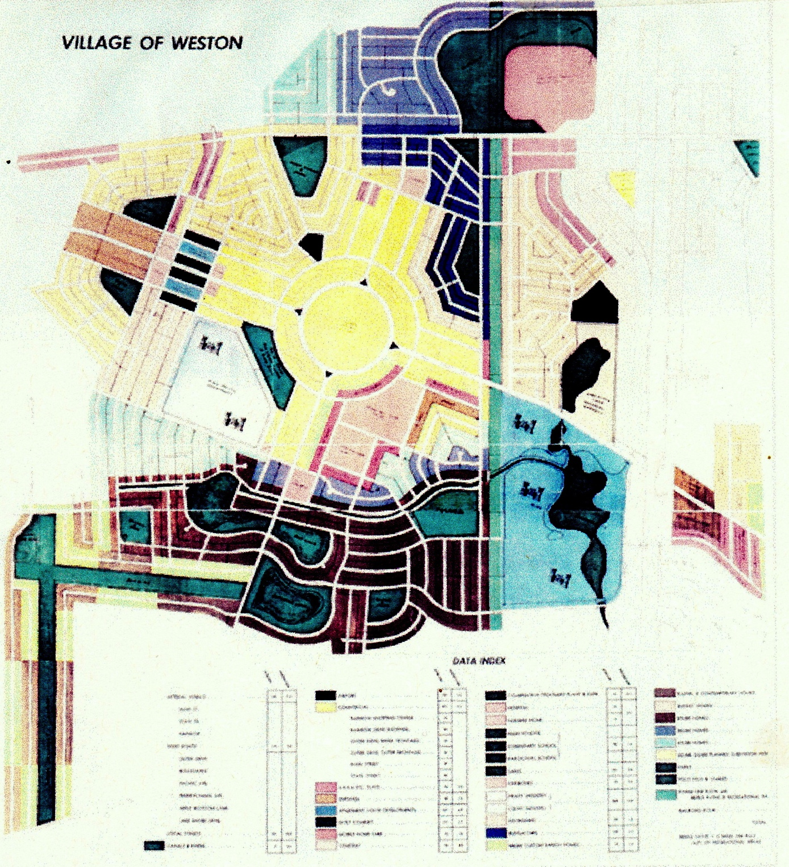
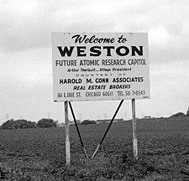
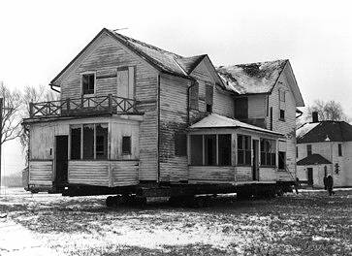
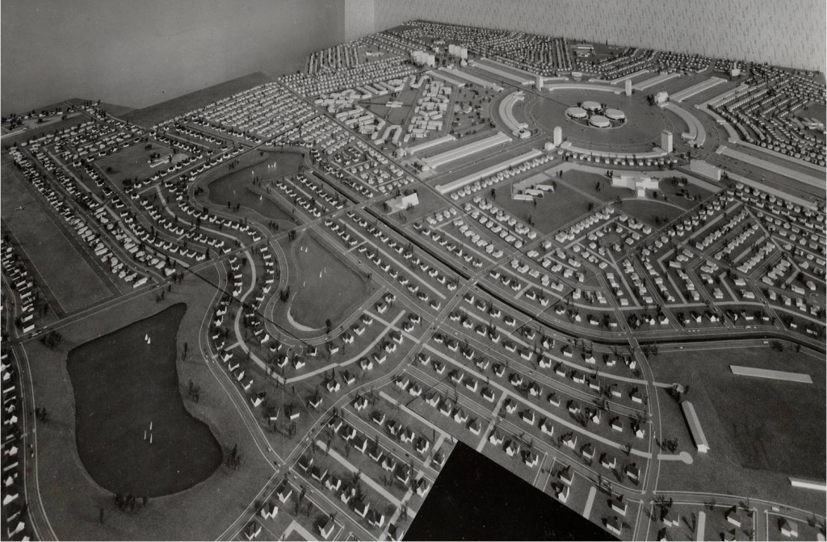
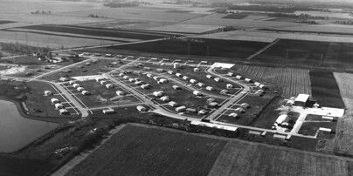
What Was Weston?
In 1964, developer William Riley began construction of Weston, IL, a planned community with houses, apartments, parks, churches, and shopping centers.
The development went bankrupt less than a year later, after the completion of only a small portion.
Local politicians convinced the state to propose the site for to the AEC for the new National Accelerator Lab
  Residents did not realize they would have to move!
In 1996, Weston site was chosen out of 126 proposals with over 200 sites.
The small completed part became the Fermilab Village.
Since it was the 60s, the mob had of course been involved. Faced with bankruptcy and threats, Riley testified against them and subsequently disappeared into witness protection.
Note round thing in middle

Slide 29
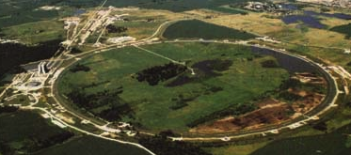

Main Ring: First Separated Function Synchrotron
Strong focusing was originally implemented by building magnets with non-parallel pole faces to introduce a linear magnetic gradient
=
+
dipole
quadrupole
CERN PS (1959, 29 GeV)
Later synchrotrons were built with physically separate dipole and quadrupole magnets.
The first “separated function” synchrotron was the Fermilab Main Ring (1972, 400 GeV)
+
=
dipole
quadrupole
Fermilab

Slide 30
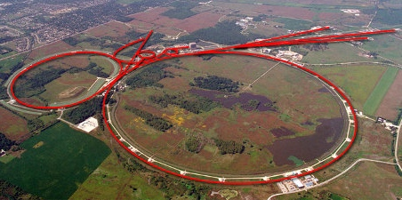
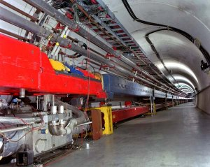
Tevatron: First Superconducting Synchrotron
1968 – Fermilab Construction Begins
1972 – Beam in Main Ring
  (normal magnets)
Plans soon began for a superconducting collider to share the ring.
  Dubbed “Saver Doubler”
  (later “Tevatron”)
1985 – First proton-antiproton collisions in Tevatron
  Most powerful accelerator in the world for the next quarter century
1995 – Top quark discovery
2011 – Tevatron shut down after successful LHC startup
Main Ring
Tevatron

Slide 31
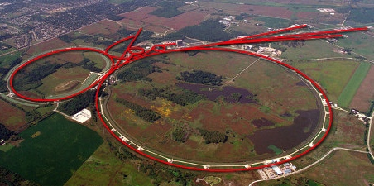
Tevatron: First Superconducting Synchrotron
From the beginning, Wilson was making plans for a superconducting ring to share the tunnel with the Main Ring
  Dubbed “Saver Doubler” (later “Tevatron”)
1982 – Magnet installation complete
1985 – First proton-antiproton collisions observed at CDF (1.6 TeV CoM). Most powerful accelerator in the world for the next quarter century
  Alternated collider and fixed target program.
1995 – Top quark discovery
Late 1990’s – major upgrades to increase luminosity, including separate ring
(Main Injector) to replace Main Ring
  Also removed extraction hardware to eliminate Tevatron fixed target program.
1999 – Tevatron Energy reaches 1.96TeV CoM energy
2011 – Tevatron shut down after successful LHC startup
Main Ring
Tevatron

Slide 32
Fermilab Firsts and Records
Firsts:
  First separated function synchrotron:
    Main Ring, 1972
  First superconducting synchrotron/collider
    Tevatron, 1983 (first collisions in 1986)
  First permanent magnet storage ring
    Recycler, 2000
Records:
  Highest energy proton beam
    Main Ring, 1972 (breaks AGS record)➔1983 (broken by Tevatron)
    Tevatron, 1983-2008 (broken by LHC)
  Highest energy hadron collider
    Tevatron, 1986 (breaks SppS record)➔2009 (broken by LHC)
  Highest hadronic luminosity
    Tevatron, 2005 (broke ISR *p-p* record!) ➔ 2011 (broken by LHC)
  Highest energy p-pbar collider
    Tevatron, 1986 (breaks SppS record)➔ present
  Highest p-pbar luminosity
    Tevatron, 1992 (broke SppS record)➔ present

Slide 33
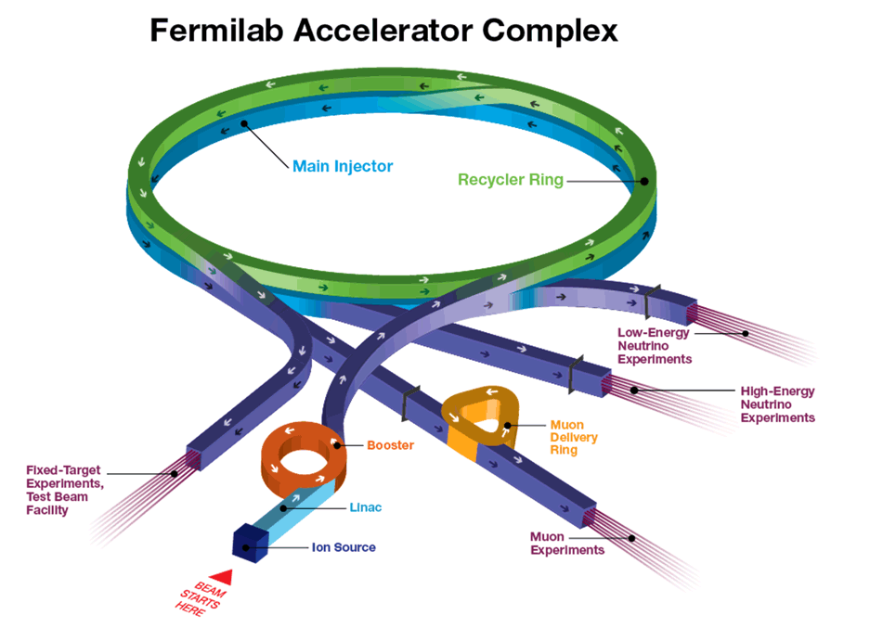
Example: Fermilab complex today
120 GeV
Fixed 8 GeV ring. Manipulates Booster beam
8 GeV
120 GeV
8 GeV
Formerly for antiprotons
120 GeV + secondary beams
400 MeV
750 keV
8 GeV

Slide 34
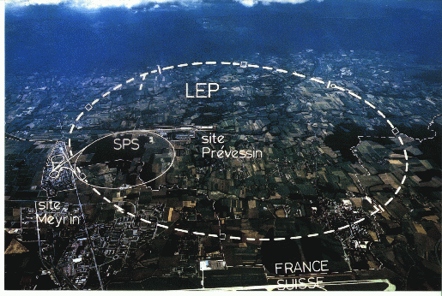
LHC: Location, Location, Location…
My House (1990-1992)
/LHC
Tunnel originally dug for LEP
  Built in 1980’s as an electron positron collider
  Max 100 GeV/beam, but 27 km in circumference!!

Slide 35
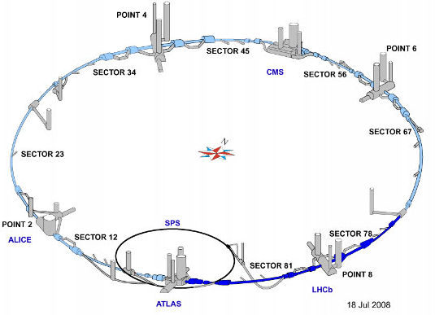
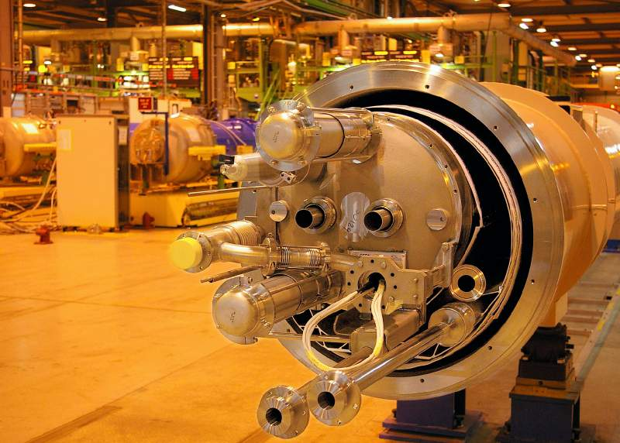
LHC Layout and Numbers
Design:
7 TeV+7 TeV proton beams
  Can’t make enough antiprotons for the LHC
  Magnets have two beam pipes, one going in each direction.
Stored beam energy 150 times more than Tevatron
  Each beam has only 5x10⁻¹⁰ grams of protons, but has the energy of a train going 100 mph!!
These beams are focused to a size smaller than a human hair to collide with each other!
27 km in circumference
2 major collision regions: CMS and ATLAS
2 “smaller” regions: ALICE and LHCb

Slide 36
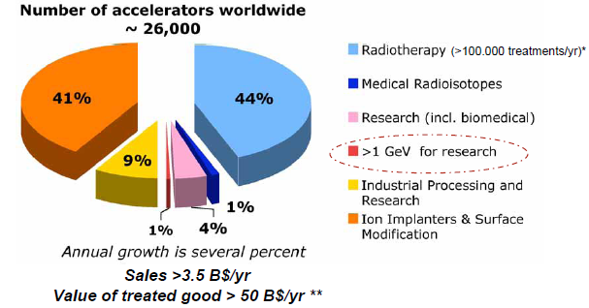
Just the Tip of the Iceberg
Energy frontier machines have always driven the technology, which has then been applied to many other things…

Slide 37
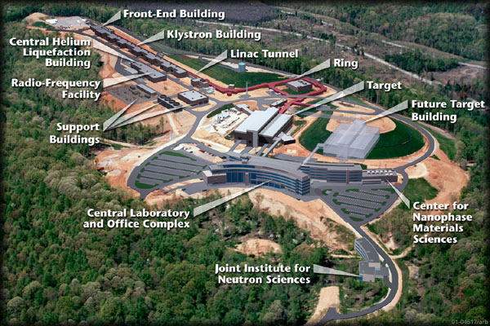
Example: Spallation Neutron Source
(Oak Ridge, TN)
A 1 GeV Linac loads 1.5E14 protons into a non-accelerating synchrotron ring.
These are fast extracted onto a Mercury target
This happens at 60 Hz -> 1.4 MW
Neutrons are used for biophysics, materials science, industry, etc…

Slide 38
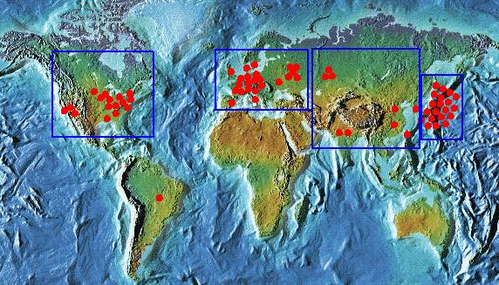
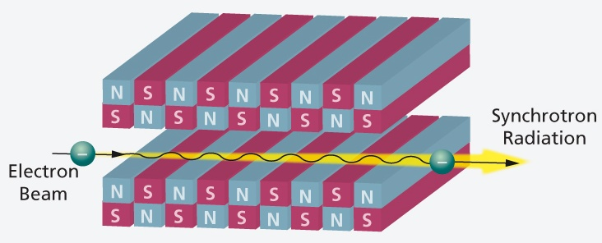
Light sources: too many to count
Put circulating electron beam through an “undulator” to create synchrotron radiation (typically X-ray)
Many applications in biophysics,
materials science, industry.
New proposed machines will use
very short bunches to create coherent
light.

Slide 39
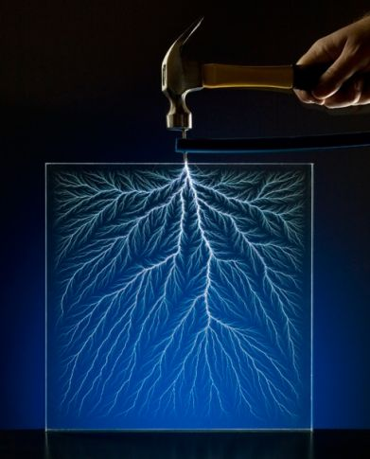
Other uses of accelerators
Radioisotope production
Medical treatment
Electron welding
Food sterilization
Catalyzed polymerization
Even art…
In a “Lichtenberg figure”, a low energy electron linac is used to implant a layer of charge in a sheet of lucite. This charge can remain for weeks until it is discharged by a mechanical disruption.

Slide 40
Backups

Slide 41
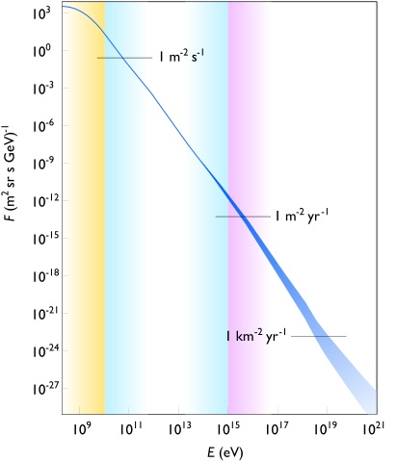
Natural particle acceleration
Max LHC energy
Radioactive sources produce maximum energies of a few million electron volts (MeV)
Cosmic rays reach energies of ~1,000,000,000 x LHC but the rates are too low to be useful as a study tool
  Remember what I said about “luminosity”.

Slide 42


Weak focusing
Cyclotrons relied on the fact that
magnetic fields between two pole
faces are never perfectly uniform.
This prevents the particles from
spiraling out of the pole gap.
In early synchrotrons, radial field
profiles were optimized to take advantage of this effect, but in
any weak focused beams, the beam size grows with energy.
The most famous weak
focusing accelerator was the
Berkeley Bevatron, which had
a kinetic energy of 6.2 GeV
  High enough to make antiprotons
  (and win a Nobel Prize)
  It had an aperture 12”x48”!

Slide 43

First Proton Collider: CERN Intersecting Storage Rings (ISR)
1971
31 GeV + 31 GeV colliding proton beams.
  Highest CM Energy for 10 years
Set a luminosity record that was not broken for 28 years!

Slide 44


SppS: First proton-antiproton Collider
Protons from the SPS were used to produce antiprotons, which were collected
These were injected in the opposite direction (same beam pipe) and accelerated
First collisions in 1981
Discovery of W and Z in 1983
  Nobel Prize for Rubbia and Van der Meer
Energy initially 270+270 GeV
Raised to 315+315 GeV
  Limited by power loss in
  magnets!
design

Slide 45


Superconductivity: Enabling Technology
The maximum SppS energy was limited by the maximum power loss that the conventional magnets could support.
  LHC made out of such magnets would be roughly the size of Rhode Island!
Highest energy colliders only possible using superconducting magnets
Must take the bad with the good
  Conventional magnets are Superconducting magnets are
  simple and naturally dissipate complex and represent a great
  energy as they operate deal of stored energy which must
  be handled if something goes wrong

Slide 46

When is a superconductor not a superconductor?
Superconductor can change phase back to normal conductor by crossing the “critical surface”
When this happens, the conductor heats quickly, causing the surrounding conductor to go normal and dumping lots of heat into the liquid Helium➔“quench”
  all of the energy stored in the magnet must be dissipated in some way
Dealing with quenches is the single biggest issue for any superconducting synchrotron!
Can push the B field (current) too high
Can increase the temp, through heat leaks, deposited energy or mechanical deformation
T_{c}

Slide 47

Quench Example: MRI Magnet*
*pulled off the web. We recover our Helium.

Slide 48


A Dead-end on the Road to Higher Energy
1980’s - US begins planning in earnest for a 20 TeV+20 TeV “Superconducting Super Collider” or (SSC).
  87 km in circumference!
  Considered superior to the
  “Large Hadron Collider” (LHC)
  then being proposed by CERN.
1987 – site chosen near
Dallas, TX
1989 – construction begins
1993 – amidst cost overruns
and the end of the Cold War,
the SSC is cancelled after
17 shafts and 22.5 km of
tunnel had been dug.

Slide 49



Some important early synchrotrons
Berkeley Bevatron,
1954 (weak focusing)
6.2 GeV protons
Discovered antiproton
CERN Proton Synchrotron (PS)
1959
628 m circumference
28 GeV protons
Still used in LHC injector chain!
CERN Proton Synchrotron (PS)
1960
808 m circumference
33 GeV protons
Discovered charm quark, CP violation, muon neutrino

Slide 50

Explaining the LHC*…
*Kate McAlpine (http://www.youtube.com/user/alpinekat)

Slide 51
Partial LHC Timeline
1994:
  The CERN Council formally approves the LHC
2000:
  LEP completes its final run
  First dipole magnet delivered
2007
  Last magnet delivered
  First sector cold
  All interconnections completed
2008
  Accelerator complete
  Last public access
  Ring cold and under vacuum
  September 10th: First circulating beam
  September 19th: BAD accident brings beam down for almost 2 years

Slide 52



It begins…
9:35 – First beam injected
9:58 – beam past CMS to point 6 dump
10:15 – beam to point 1 (ATLAS)
10:26 – First turn!
…and there was much rejoicing
Commissioning proceeded smoothly and rapidly until September 19th, when something very bad happened

Slide 53



It Ends: “The Incident”
A quench developed into an arc
This caused Helium to boil
The resulting pressure did a great deal of damage, and kept the machine off for more than a year.
Debris in beam vacuum pipe
Clean
Insulation
Soot
Secondary arcs

Slide 54




After the Incident
The LHC was off for almost two years to repair the damage and partially address the cause.
2010: Came up at a reduced energy: 3.5 TeV + 3.5 TeV
2012: Increased energy to 4 TeV + 4 TeV
Announced the discovery of Higgs particle July 4, 2012
  Responsible to giving particles mass
  Last piece of the “Standard Model”
2013 Nobel prize to Higgs and Englert

Slide 55
Plans for LHC
The LHC will be the centerpiece of the world’s energy frontier physics program for at least the next 15-20fd years.
The machine is currently of to fix the issue which cause “the incident”
Accelerator will come back up in 2015 at something close to the design energy
  At least 6.5 TeV/beam
Planning major upgrades to increase luminosity in ~2023

Slide 56

What next?
The energy of Hadron colliders is limited by feasible size and magnet technology. Options:
  Get very large (~100 km circumference)
  More powerful magnets (requires new technology)
All accelerator magnets based on this
Future magnets could be based on this

Slide 57

Future Circular Collider (FCC)
Currently being discussed for ~2030s
80-100 km in circumference
Niobium-3-Tin (Nb₃Sn) magnets.
~100 TeV center of mass energy

Slide 58

Rethinking Electrons
Next e+e- collider would have to be linear
Possibly use low energy, high current electron beams to drive high energy accelerating structures
Up to 1.5 x 1.5 TeV, but VERY, VERY hard
“Compact” (ha ha) Linear Collider (CLIC) proposed by CERN.

Slide 59

Muon colliders?
Muons are pointlike, like electrons, but because they’re heavier, synchrotron radiation is much less of a problem.
Unfortunately, muons are unstable, so you have to produce them, cool them, and collide them, before they decay.

Slide 60

Wakefield accelerators?
Many advances have been made in exploiting the huge fields that are produced in plasma oscillations.
Potential for accelerating gradients many orders of magnitude beyond RF cavities.
Still a long way to go for a practical accelerator.

