Slide 1
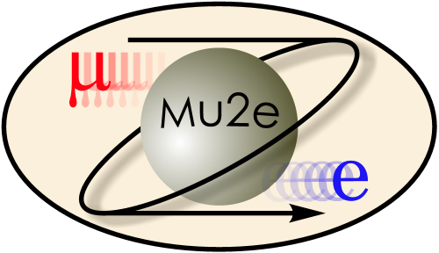
Mu2e: Search for Muon to Electron Conversion at Fermilab
Eric Prebys
Fermilab
(Mu2e Collaboration)

Slide 2
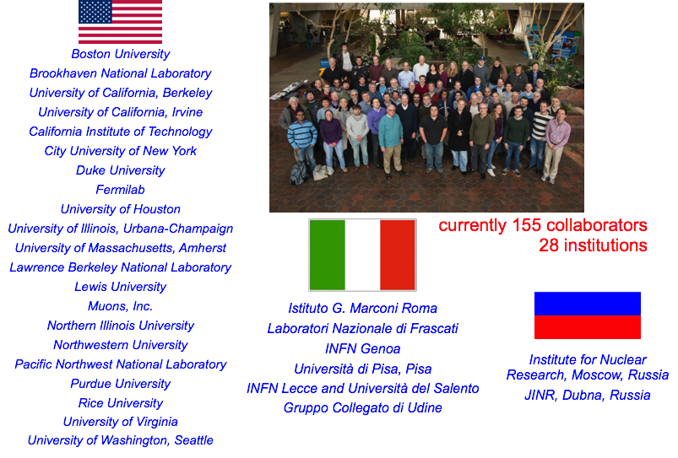
Mu2e Collaboration

Slide 3
Outline
History and Theoretical Motivation
Experimental Technique
Sensitivities
Mu2e in the context of other experiments
Conclusion

Slide 4
Provocative Comments
Once upon a time, high energy physics moved forward by going to higher energies and “seeing what came out”.
  The last time this happened was the discovery of the tau lepton and b quark in the 70s!
For the last 40 years, all other discoveries have been preceded by strong indirect evidence
  K➔μ⁺μ⁻ suppression ➔ charm quark
  CP Violation ➔ third generation
  Weak decays ➔ W and Z particles and their masses
  Precision tests at LEP and elsewhere ➔ top and Higgs masses
With the discovery of the Higgs, we now find ourselves without guidance for the first time in half a century
  The LHC was “guaranteed” to discover the Higgs (or it would have been even more interesting)
  No one knows the next “sure bet” energy!
If the past is any indicator, such guidance will likely come from indirect evidence.

Slide 5

Direct vs. Indirect Observation
Direct
Indirect

Slide 6
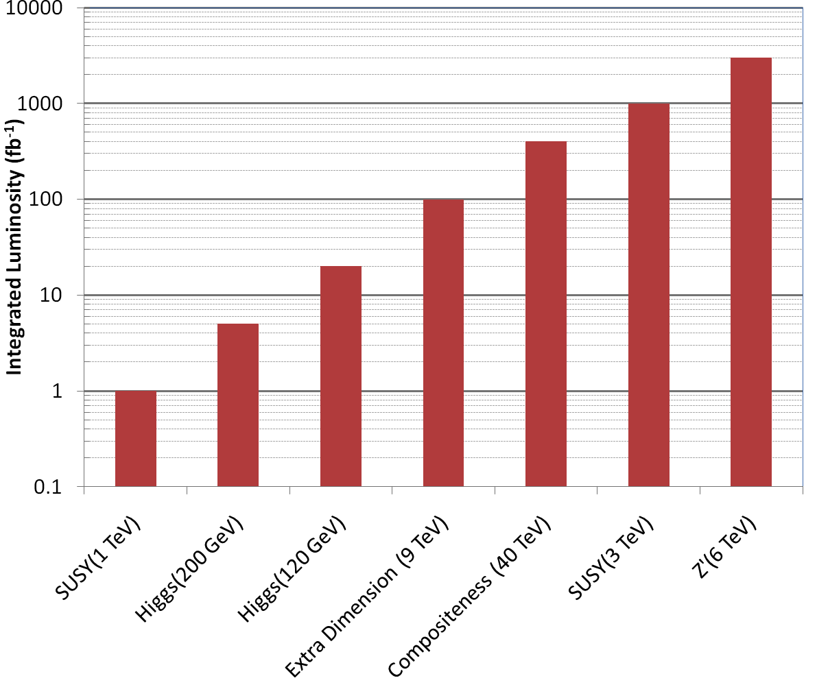
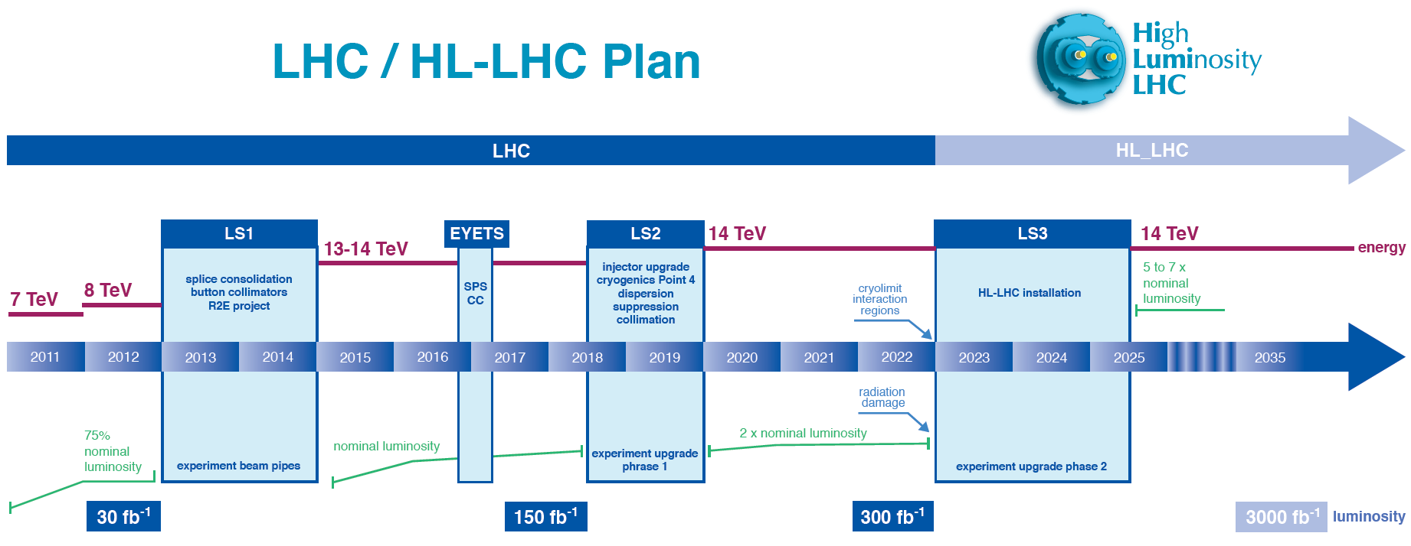
Case in Point…
The LHC has an upgrade plan and experimental program outlined that extend into the 2030s
  3000 fb⁻¹ of data at 13-14
  TeV CoM Energy
  HOWEVER:
    There’s no guaranty that it will find anything but the Higgs
    It’s not a major problem if it doesn’t (from the physics standpoint)

Slide 7
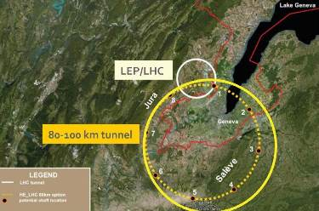
What then?
People are already discussing the “Future Circular Collider” (FCC)
  100 km circumference
  50+50 TeV proton beams
  Similar luminosity to LHC
Is not finding something at a 14 TeV collider enough justification to build a 100 TeV collider?
  In the absence of guidance, we have no choice but to think logarithmically
    (LHC to FCC) ~ (Tevatron to LHC) → “meh”
    Pretty weak scientific argument
    Non-starter politically

Slide 8
So to summarize…
Clearly:
  The LHC has the most promise for discovering new physics in the near future.
  Because of the complexity of any next generation colliders, we need to start thinking about them now.
However, it’s vital that we pursue a robust and diverse program of indirect studies, to maximize our chances of discovering new physics, and to inform the direction of major research initiatives in the future. These include
  Rare particle decays
  Precision studies
  Tests of fundamental symmetries
Of all indirect measurements, rare muon processes provide a very attractive mix of experimentally striking signatures and broad discovery potential.
So without further ado…

Slide 9
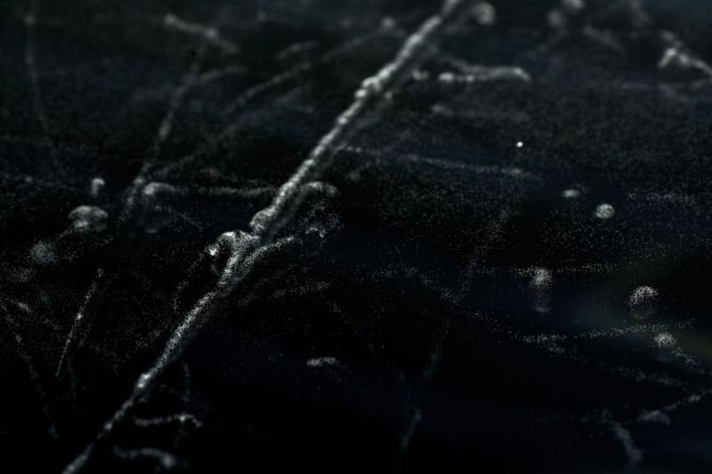
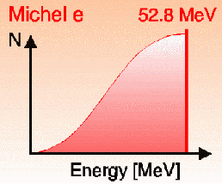
History of the Muon
The muon was originally discovered in 1936 by Anderson and Neddermeyer while studying cosmic ray data
By studying its penetration properties, they determined that it had a mass roughly 200 times that of the electron.
The muon was observed to decay to electron+”something invisible” with a spectrum consistent with a three body decay

Slide 10
Mediator of the Strong Force?
In 1934, Hideki Yukawa proposed that a massive particle mediated the strong force, resulting in a potential of the form
However, in 1946, Conversi, et al* showed that muon decays were not consistent with strong interactions
Yukawa’s particle turned out to be the pion, discovered in 1947.
The muon was an obvious candidate!
Studied decay rates as a function of target for both positive and negative “mu-mesons”. Not consistent with prediction for strongly interacting particles.
*PhysRev.71.209 (1947)

Slide 11
Excited Electron?
The other working theory was that the muon might be an excited state of an electron.
In 1947, Hincks and Pontecorvo* looked for gammas associated with stopped muon decay.
They detected no gammas, leading to the first limit on “Charged Lepton Flavor Violation” (CLFV)
Conclusion: the muon was a heavier version (flavor) of electron, that interacted only electromagnetically and weakly.
Fast forwarding (and skipping a whole bunch of stuff)…
*PhysRev.73.257 (1948)

Slide 12
Today’s Muon
Mass: 105.66 MeV/c² (~200m_{e} ~0.1m_{p})
Charge: ±e
Spin: ½ħ (fermion)
Lifetime: 2.2 μsec (cτ=660m)
Interactions: Electromagnetic and Weak, but NOT strong
Because muons are so much heavier than electrons, they are very penetrating

Slide 13
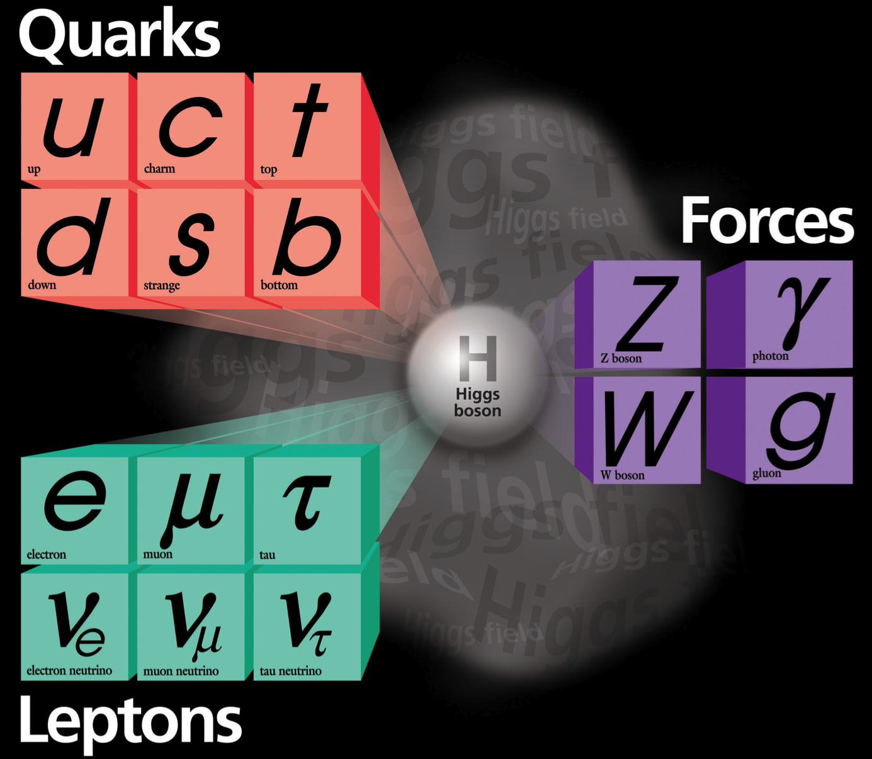
The Standard Model
Spin ½ “Fermions”
Spin 1 “Bosons”
Combine to form hadrons
Quarks can transition across generations
Mediate interactions
Leptons transition within generations…
Weak charged current (W±) interactions “flip” fundamental fermions in weak isospin space
Free
…except for neutrino mixing

Slide 14
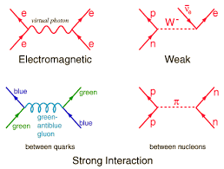
Interactions in the Standard Model
The bosons mediate interactions between the fundamental fermions
W particle causes a weak isospin transition within one weak quark or lepton generation

Slide 15
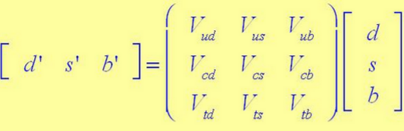
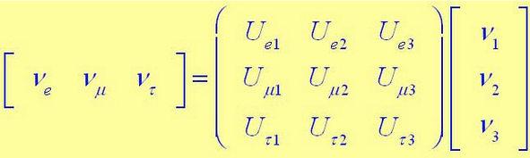
Generation (Flavor) Transitions
In both the quark and lepton sector, the weak eigenstates are related to the mass eigenstates by a unitary matrix
However, because the neutrino masses and their differences are so small, the phenomenology is very different
“almost” diagonal
~maximum mixing
Quarks: generational transitions observed
Leptons: weak transitions and mixing proceed separately
Pure weak state. Propagates as a superposition of mass eigenstates➔”neutrino mixing”
NOT observed!

Slide 16
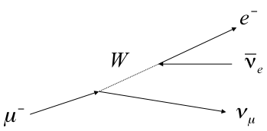
Lepton Number and Lepton Flavor Number
As a consequence, both lepton number and lepton “flavor” (generation) number are individually conserved*
muon decay
ν_{μ}+n➔μ⁻+p
*except in neutrino mixing

Slide 17
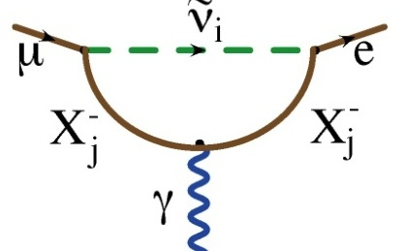
Charged Lepton Flavor Violation (CLFV)
The Z⁰ mediates neutral current scattering
Note: Observation of neutrino mixing shows CLFV can occur
However, the Standard Model
branching ratio is ~O(10⁻⁵²)
(35 orders of magnitude below our goal)
Virtual ν mixing
OK
However, “Flavor Changing Neutral Currents” (FCNC):
are forbidden in Standard Model
I’m going to shut up about neutrino mixing now!

Slide 18
Beyond the Standard Model
Because extensions to the Standard Model couple the lepton and quark sectors, Charged Lepton Flavor Violation (CLFV) is a nearly universal feature of such models.
The fact that it has not yet been observed already places strong constraints on these models.
CLFV is a powerful probe of multi-TeV scale dynamics
  complementary to direct collider searches
Among various possible CLFV modes, rare muon processes offer the best combination of broad physics reach and experimental sensitivity

Slide 19
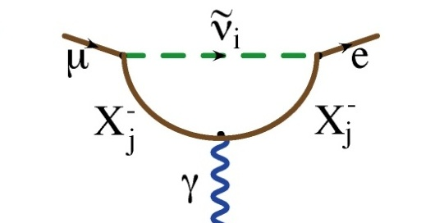
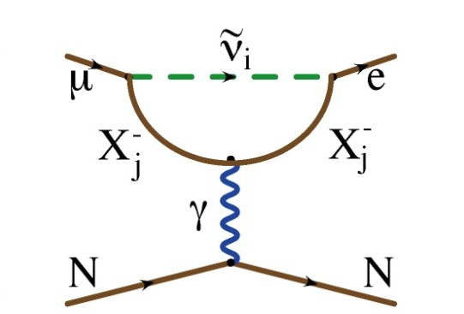
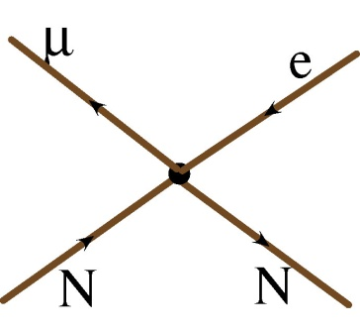
Generic Beyond Standard Model CLFV
There are two broad classes of CLFV reactions…
Flavor Changing Neutral Current
Dipole (penguin)
Can involve a real photon
Or a virtual photon
?
?
?
Mediated by virtual massive neutral Boson, e.g.
  Leptoquark
  Z’
  Composite
Approximated by “four fermi interaction”
?
?
?

Slide 20

Decay vs. Conversion
Only the “dipole”-like reactions can lead to a decay
However, if we capture a μ⁻ on a nucleus, it could could “convert” to an e⁻ via exchange of a virtual particle in both scenarios
photon
heavy neutral boson

Slide 21
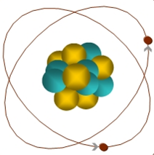
Experimental Signature of μ+N → e+N
When captured by a nucleus, a muon will have an enhanced probability of exchanging a virtual particle with the nucleus.
This reaction recoils against the entire nucleus, producing a mono-energetic electron carrying most of the muon rest energy
Very clean experimental signature!
μ
~105 MeV e⁻

Slide 22
What We (Plan to) Measure
We will measure the rate of
μ to e conversion…
…relative to ordinary μ capture
This is defined as

Slide 23
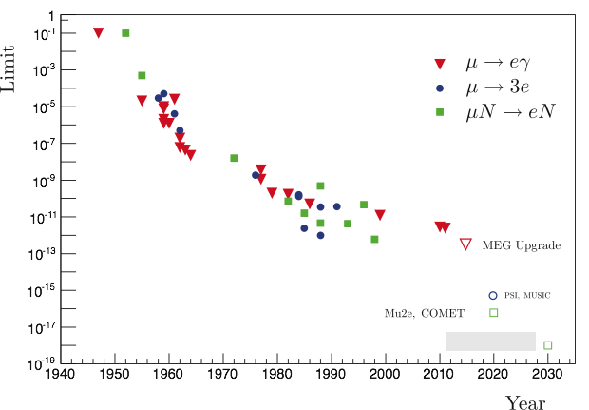
History of Lepton Flavor Violation Searches
90% C.L.
Best Limits (all from PSI)
  Br(μ➔eγ) < 4x10⁻¹³ (MEG 2016)
  Br(μ➔3e) < 1x10⁻¹² (Sindrum-I 1988)
  R_{μe}<7x10⁻¹³ (Sindrum-II 2006)
Not quite
apples-to-apples,
but…
Four orders of magnitude improvement!
R. Berstein
Mu2e will measure:
Goal: single event sensitivity of R_{μe}=3x10⁻¹⁷

Slide 24
Just to be clear…
We are not planning to make a measurement and compare it to a calculation.
We are looking for something that (effectively) doesn’t exist in the Standard Model.
Our goal is to build a experiment with negligible backgrounds, such that any observed signal will be unambiguous evidence of new physics.
We are planning for a improvement of roughly four orders of magnitude in sensitivity over the best previous measurement.
Hard to imagine a single measurement with this much potential.

Slide 25
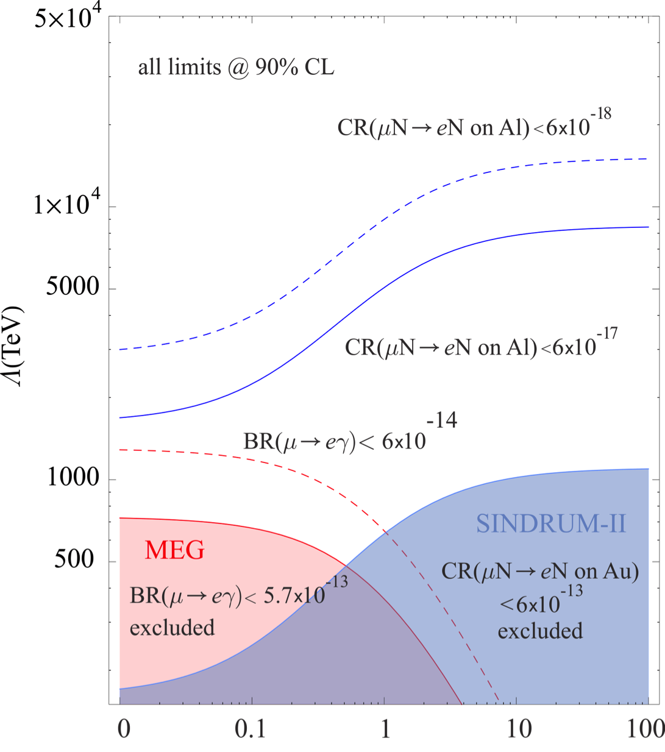
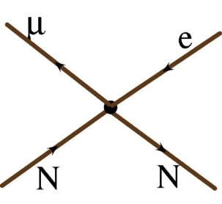
Dipole vs. Contact Reaction
A. de Gouvea
Our goal:
10⁴ in rate
10 in mass
(different for different models)

Slide 26
Example Sensitivities*
Supersymmetry
Second Higgs doublet
Predictions at 10⁻¹⁵
Heavy Neutrinos
Compositeness
Heavy Z’, Anomalous Z coupling
Leptoquarks
*After W. Marciano
No μ➔eγ signal

Slide 27
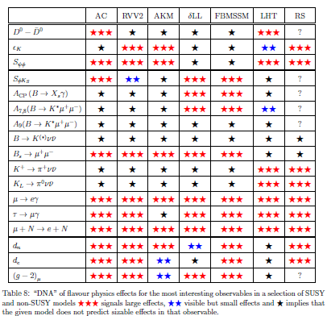
Example: μ→e in Supersymmetry*
SUSY Models
All SUSY models predict both μ➔eγ and μN➔eN
*from Altmannshofer, Buras, et al, Nucl.Phys.B830:17-94, 2010

Slide 28
How do we make muons?
This produces mostly pions
These quickly decay to muons
Hit a target with protons
Muons go much further

Slide 29
Biggest Issue: Decay in Orbit (DIO)
Free μ Decay:
Coherent DIO:
N
Very high rate
“Michel Spectrum”
  Peak energy ~53 MeV
Must design detector to be very insensitive to these.
Nucleus coherently balances momentum and smears out Michel Spectrum.
Rate approaches conversion (endpoint) energy as
~(E_{conversion}-E)⁵
Drives resolution requirement.

Slide 30
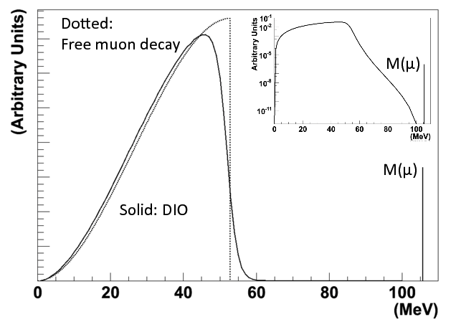
Decay in Orbit Spectrum
We want to be blind to this (acceptance)
We must resolve this

Slide 31
Prompt Backgrounds
There are significant backgrounds which are “prompt” with respect to the production and capture of muons:
  Radiative π- capture
  π⁻N →N*γ, γZ → e⁺e⁻
  Muon decay in flight
  μ⁻ → e⁻νν
  Pion decay in flight
  π⁻ → e⁻ν_{e}
  Prompt electrons
General approach
  Produce muons
  Transport muons to target where some are captured.
  Wait(!) for prompt backgrounds to go away
  Open detection window to look for conversion of captured muons.
Biggest worry

Slide 32
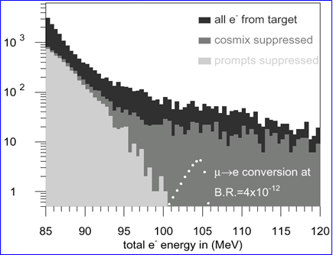
Experimental Challenge of “Waiting”
μ−>e Conversion: Sindrum II
Cosmic Background
Most backgrounds are ~prompt with respect to the proton beam
  Mostly radiative pion capture
Previous experiments suppressed these backgrounds by vetoing all observed electrons for a period of time after the arrival of each charged particle on the capture target.
  This leads to a fundamental to a rate limitation.
DIO tail

Slide 33
Pulsed Beams (first proposed for MELC*)
Replace individual protons with short proton pulses, separated by a time on the order of a muon life time.
Veto the time after the pulse to eliminate prompt backgrounds.
Design a transport channel to optimize the transport of right-sign, low momentum muons from the production target to the muon capture target.
Design a detector which is very insensitive to electrons from ordinary muon decays, and has excellent tracking resolution.
“Nothing” between bunches ➔ ”Extinction”
~200 ns
~1.5 μs
Prompt backgrounds
live window
*1992, Moscow Meson Factory

Slide 34
Summary: Experimental Needs
Proton beam:
  Bunches, separated by ~muon lifetime with “nothing” in between them.
Muon transport:
  Optimize for low momentum, negative muons
Detector:
  Completely blind to any particle with p≲60 MeV/c
  Excellent energy resolution for 105 MeV e⁻
    →Very low mass for both target and tracker!
Solenoids!

Slide 35
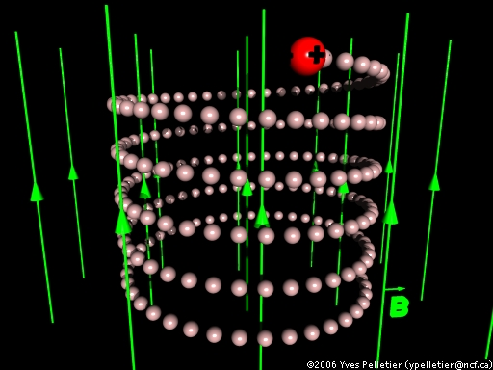
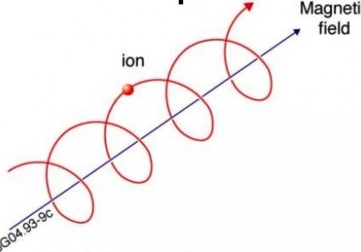
Refresher: Fun with Solenoids
Particles in a solenoidal field will
generally move in a helical path
Low momentum particles are
effectively “trapped” along
the field lines
  We use this to transport muons
A particle trapped along a curved
solenoidal field will drift out of the
plane of curvature
  This is how we will resolve muon charge
  and momentum in the transport line
For higher momentum particles, the curvature can be used to measure momentum
  This is how we will measure the momentum of electrons from the capture target
  10 MeV/c particle will have a radius of 3 cm in a 1 T field

Slide 36
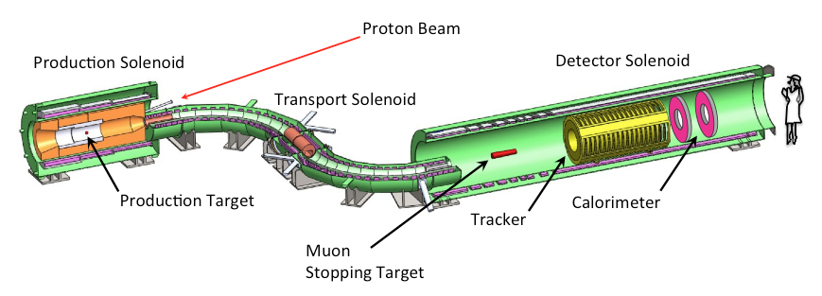
Mu2e: The Big Picture
Production Target
  Proton beam strikes target, producing mostly pions
Production Solenoid
  Contains backwards pions/muons and reflects slow forward pions/muons
Transport Solenoid
  Selects low momentum, negative muons
Capture Target, Detector, and Detector Solenoid
  Capture muons on target and wait for them to decay
  Detector blind to ordinary (Michel) decays, with E ≤ ½m_{μ}c²
  Optimized for E ~ m_{μ}c²

Slide 37
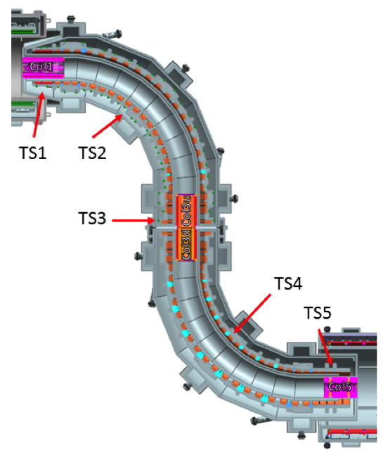
Transport Solenoid
Transports muons from production target to capture target
Curved solenoid eliminates line-of-sight backgrounds
Collimator in center selects low momentum negative muons
  RxB drift causes sign/momentum dependent vertical displacement
μ⁻
μ⁺

Slide 38
Detector and Detector Solenoid
Graded field around stopping target to increase acceptance
  Magnetic reflection again
Uniform field in tracking volume
Electromagnetic calorimeter to tag electrons.
μ Stopping Target(s)
Muon Absorber
Proton Absorber
Tracker
EM Calorimeter

Slide 39
Beam Needs
We’ve talked about the experiment. Now where do we put it?
Remember, we need a beam that looks kind of like this
This is where Fermilab comes in…

Slide 40
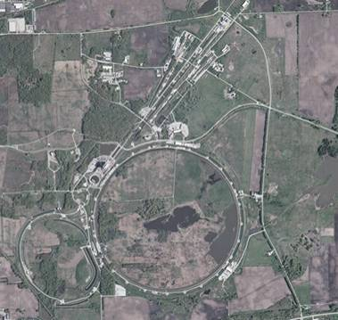
A Brief History of Fermilab
  1968: construction begins
  1972: first beams from Main Ring
    200➔400 GeV proton beams to fixed targets
    Highest energy lab for next 36 years!
  ~1985:
    “Tevatron”: first superconducting synchrotron shares tunnel with Main Ring
    900GeV x 900 GeV p-pBar collisions
    Highest energy collider for 23 years.
  1997: Major upgrade
    Main Injector replaces Main Ring
    -> more intensity
    980 GeV x 980 GeV p-pBar collisions
    Intense neutrino program
  2011: Tevatron permanently turned off after the LHC came full online.
  So what is the lab doing now?
Fixed Target Areas
Main Injector/
Recycler
Main Ring
Tevatron
Trivia: original Main Ring was the first “separated function” synchrotron

Slide 41
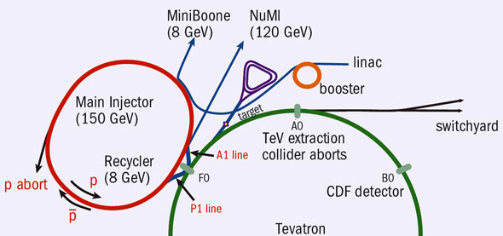
Fermilab Accelerator Complex Today
Now that LHC has taken over the Energy Frontier, Fermilab is focusing on intensity-based physics
Neutrinos
Accumulator/Debuncher: Formerly for pBar accumulation, soon muon and proton manipulation (Delivery Ring for Mu2e)
Recycler*: Formerly for pBar storage, now for proton manipulation
Future LBNF/DUNE
(120 GeV)
/Noνa
~45 years old!
/400 MeV
/8 GeV
120 GeV+secondaries
*first permanent magnet storage ring

Slide 42
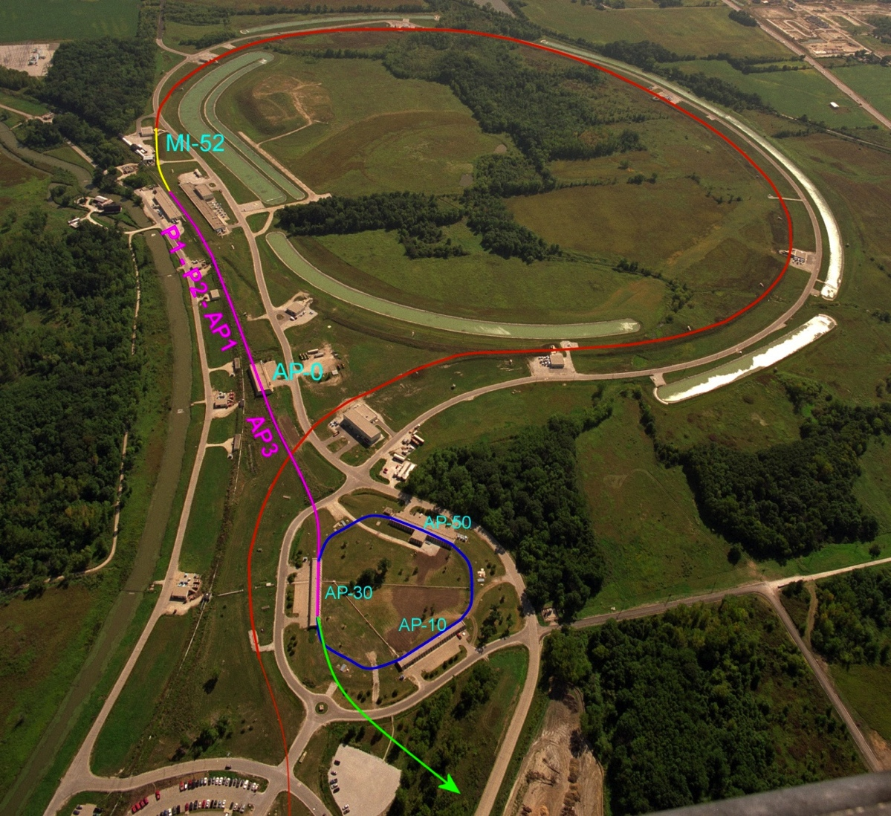
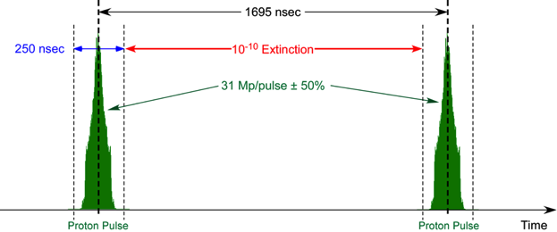
Mu2e Proton Delivery
Two Booster “batches” are injected into the Recycler (8 GeV storage ring). Each is:
  4x10¹² protons
  1.7 μsec long
These are divided into 8 bunches of 10¹² each
The bunches are extracted one at a time to the Delivery Ring
  Period = 1.7 μsec
As the bunch circulates, it is resonantly extracted to produce the desired beam structure.
  Bunches of ~3x10⁷ protons each
  Separated by 1.7 μsec
Main Injector/Recycler
Delivery Ring
(formerly pBar Debuncher)
Mu2e
Booster
Exactly what we need

Slide 43
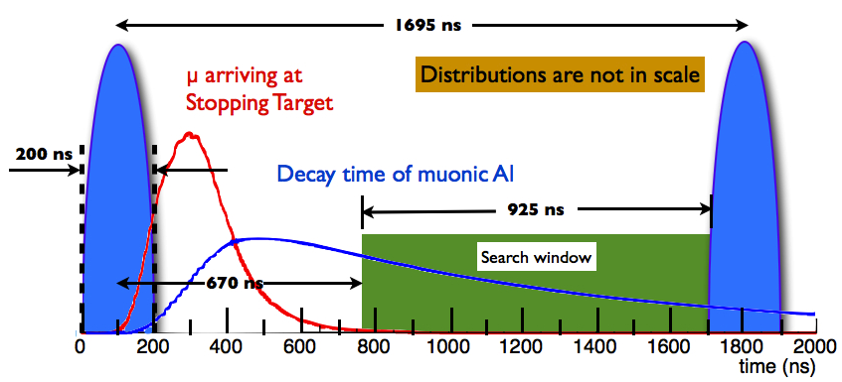
End Product
Target data set: ~3.6x10²⁰ protons in ~3 years

Slide 44
Sensitivity
Full Simulation (GEANT4)
3.6x10²⁰ protons on target
  3 years nominal running
Cuts chosen to maximize sensitivity
  Single Event Sensitivity: R_{μe}=2.9x10⁻¹⁷

Slide 45
Significance
Backgrounds
Bottom line:
  Single event sensitivity: R_{μe}=3x10⁻¹⁷
  90% C.L. (if no signal) : R_{μe}<7x10⁻¹⁷
  Typical SUSY Signal: ~40 events or more
8 GeV is a stupid energy!
4 order of magnitude improvement!

Slide 46
A long time coming
1992 | Proposed as “MELC” at Moscow Meson Factory
1997 | Proposed as “MECO” at Brookhaven (at this time, experiment incompatible with Fermilab operation)
1998-2005 | Intensive work on MECO technical design
July 2005 | Entire rare-decay program canceled at Brookhaven
2006 | MECO subgroup + Fermilab physicists work out means to mount experiment at Fermilab
Fall 2008 | Mu2e Proposal submitted to Fermilab
November 2008 | Stage 1 approval. Formal Project Planning begins
November 2009 | DOE Grants CD-0
July 2012 | CD-1
March 2015 | CD-2/3b
June 2016 | CD-3c
In DOE project-speak, this is the first “Critical Decision”: Statement of mission need = official existence
Approval of baseline and money for long lead elements
Full speed ahead!
Finally, things are really happening!

Slide 47
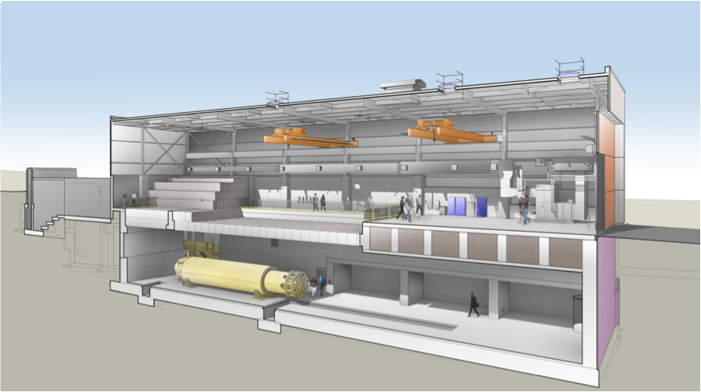
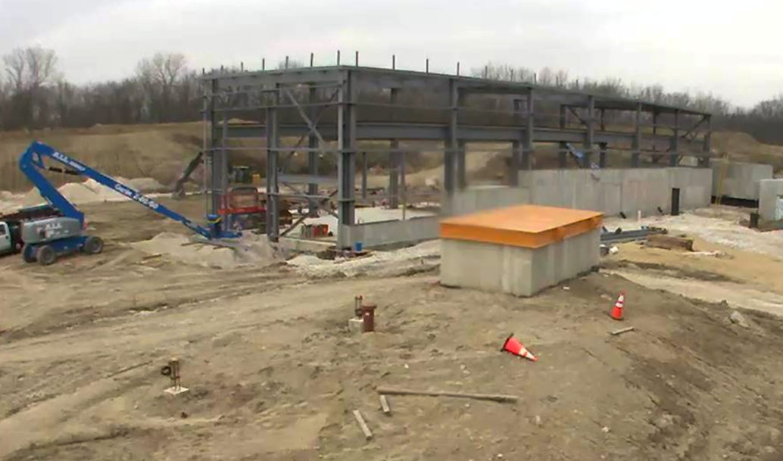
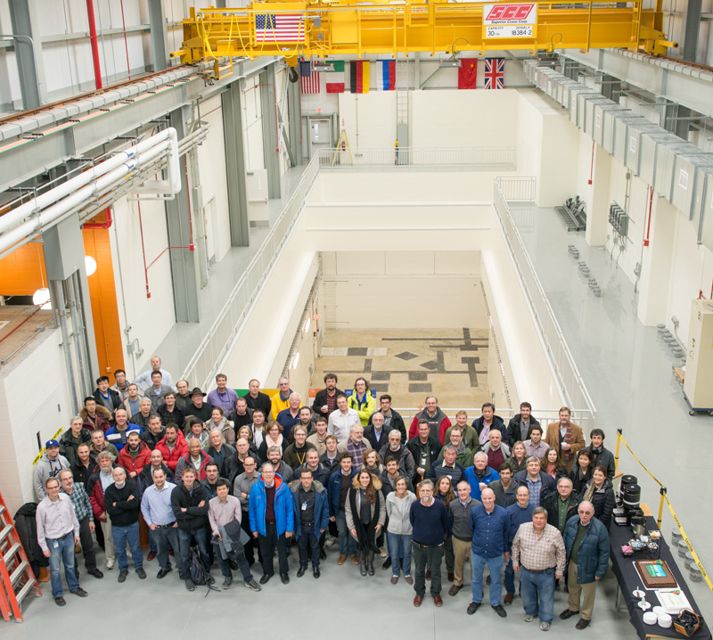
We have a home!
March, 2016
February 10, 2017

Slide 48
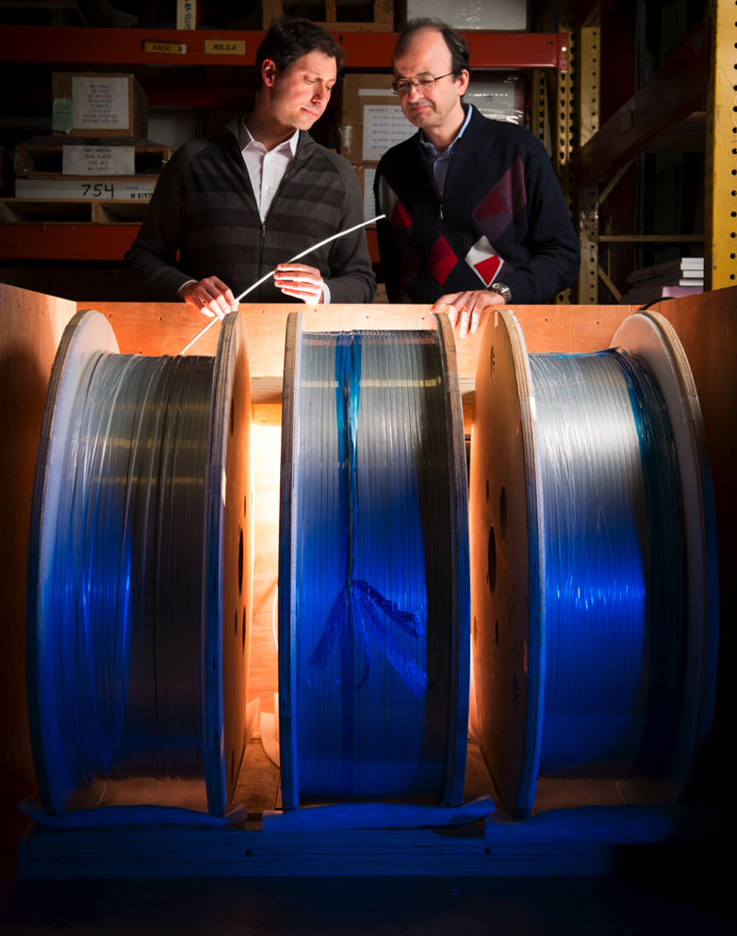
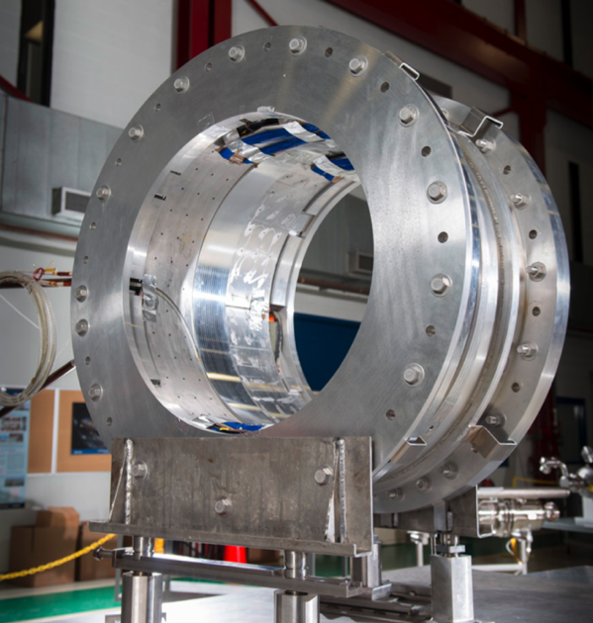
Magnet Procurement and Testing
Successful test of Transport Solenoid segment
Cable acceptance
Prototype of Helium transfer line

Slide 49
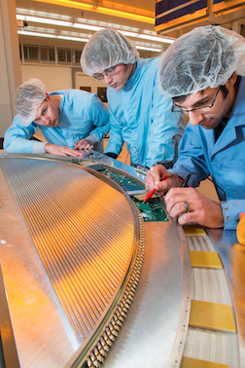
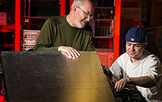
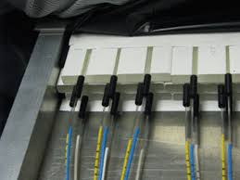
Detectors
Calorimeter Crystal Test
Straw Tube Tracker
Cosmic Ray Veto

Slide 50
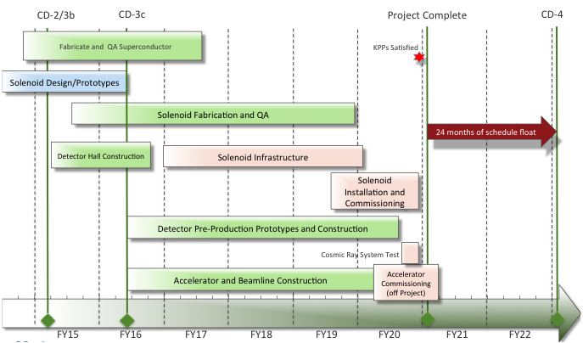
Schedule

Slide 51
Some things to think about
Mu2e has a nominal plan to run for three years to collect 3.6x10²⁰ protons on target.
This will enable us to measure R_{με} with a sensitivity 10,000 times greater than the previous best measurement.
This means that we will potentially be able to improve on that measurement with a few hours of running at nominal intensity.
We need to develop a plan to roll out results with improved sensitivity of, say 1,10,100,100,10000
This has implications for how well we will need to understand the detector at each step, our blinding procedures, etc.
Not a lot of thought has gone into this (yet).

Slide 52
The competition: COMET at J-PARC (Japan)
The COMET experiment is based on the same principle as Mu2e, and will use 8 GeV beam from the J-PARC Main Ring
It is currently being planned in two phases*
Well under way
Beam scheduled for 2019
Goal: SES = 3x10⁻¹⁵
  100 times less sensitive than Mu2e
~mid 2020s
Goal: SES = 3x10⁻¹⁷
  Same as Mu2e
*Phil Litchfield, PASCOS 2016

Slide 53

What if we see something?
R. Bernstein
Next questions:
  What do other experiments see?
  What’s the target dependence?

Slide 54
First question: what does μ→eγ see?
If the process is
purely of this form
(dipole), both the size
of the μ→eγ signal and
the target dependence are
tightly constrained (and easily calculated)
On the other hand, if the
process is of this form (4-Fermi)
then μ→eγ will never see any
signal
If both experiments see signals, but the relative sizes or target dependence aren’t what is predicted, it must be some combination of the two classes.

Slide 55

MEG Experiment (PSI, Switzerland)
The MEG experiment looks for μ⁺→e⁺γ in stopped muons, produced by the high intensity proton cyclotron at the Paul Scherrer Institute
Goal: BR(μ⁺→e⁺γ)<5x10⁻¹⁴
  Competitive with Mu2e for dipole reaction
Latest Results*
7.5x10¹⁴ stopped μ⁺
BR(μ⁺→e⁺γ)<4.2x10⁻¹³ (90% C.L.)
* Eur. Phys. J. C (2016) 76: 434

Slide 56
Other non-Standard Model Searches
Other ongoing or proposed experiments are investigating physics beyond the Standard Model, including
  neutron EDM
  electron EDM
  mixing
  mixing
  Anomalous rare decays, including
  Anomalous magnetic moment of the muon (g-2)
    Major initiative at Fermilab…

Slide 57
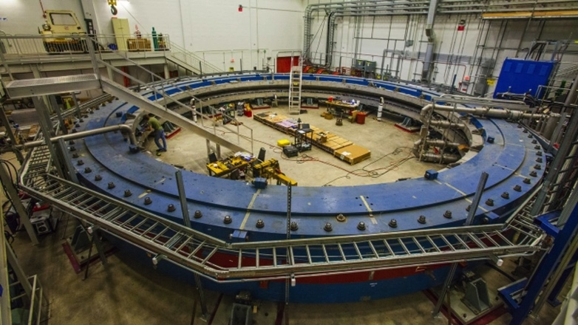
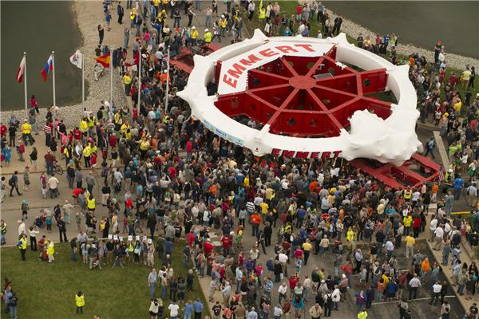
g-2 at Fermilab
Along with Mu2e, the g-2 experiment is an important part of the near term plan at Fermilab
  The muon magnetic moment is given by
  Without higher order corrections, g would be exactly 2
  The difference (“g-2”) is sensitive to both Standard Model effects and (potentially) new physics
  In 2001, an experiment at Brookhaven found a ~3σ discrepancy with the Standard Model
  That device was moved to Fermilab in 2013, and will soon begin taking data, aiming for 4 times the statistics (3σ→7.5σ)
Measure the anomalous precession of muons in a uniform magnetic field
Arrival: 7/26/2013

Slide 58
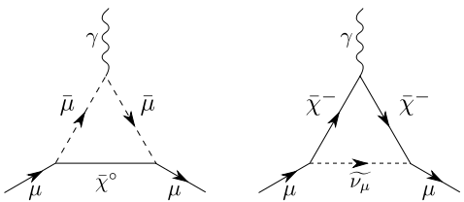
The Challenge of g-2
g-2 is sensitive to new physics,
such as SUSY
However, you must first properly account for the Standard Model contributions, including diagrams like*
where the interior lines can be leptons or quarks, and both theoretical calculations and experimental input are required.
*Aoyama, et al ProgTheorExpPhys. 2012, 01A107

Slide 59
Synergy of Mu2e with LHC
The Mu2e Experiment is well timed with the luminosity upgrade of the LHC
A limit (null result) from Mu2e would rule out many signals
  Most flavor violating searches would be ruled out for masses much higher than even the FCC
  Most of SUSY parameter space would be ruled out except for models specifically concocted to minimize flavor violation (e.g. “CKM models”)
A positive result would give lots of guidance for searches, and could also set the energy scale of the next machine.

Slide 60
Conclusions
We have proposed a realistic experiment to measure
    Single event sensitivity of R_{μe}=3x10⁻¹⁷
    This represents an improvement of four orders of magnitude compared to the existing limit, or over a factor of ten in effective mass reach. For comparison
      TeV -> LHC = factor of 7 (difference in luminosity makes in comparable)
      LEP 200 -> ILC = factor of 2.5
ANY signal would be unambiguous proof of physics beyond the Standard Model
  And would set the scale for future searches
The absence of a signal would be a very important constraint on proposed new models.
  And limit the space for new discoveries, even at the highest energies

Slide 61
Backup Slides

Slide 62
Just How Rare is that?
Sindrum limit
Single event sensitivity of Mu2e

Slide 63
Experimental Challenges for Increased Flux
At our level of sensitivity, we hit fundamental limits with this technique
  Simply increasing the proton flux will not improve the limit dramatically
Improve momentum resolution for the ~100 MeV electrons to reject high energy tails from ordinary DIO electrons.
  Limited by multiple scattering in target and detector plane
  ➔ go to bunched, mono-energetic muon beam, allowing for thinner target
Allow longer decay time for pions to decay
Both of these lead to a decay/compressor ring
Other issues with increased flux
  Upgrade target and capture solenoid to handle higher proton rate
    Target heating
    Quenching or radiation damage to production solenoid
  High rate detector
All of these efforts will benefit immensely from the knowledge and experience gained during the initial phase of the experiment.
If we see a signal a lower flux, can use increased flux to study in detail
  Precise measurement of R_{μe}
  Target dependence
  Comparison with μ→eγ rate

Slide 64
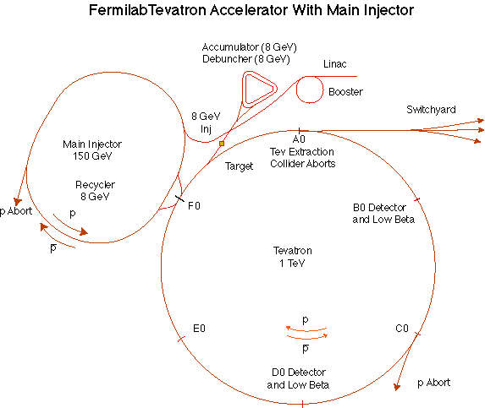
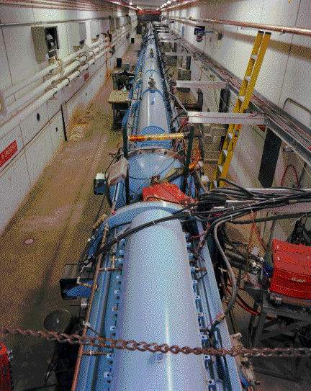
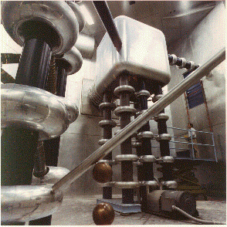
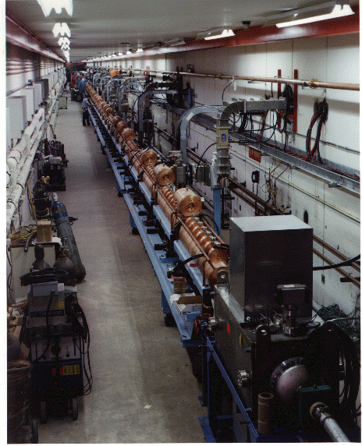
Preac(cellerator) and Linac
“New linac” (HEL)- Accelerate H- ions from 116 MeV to 400 MeV
“Preac” - Static Cockroft-Walton generator accelerates H- ions from 0 to 750 KeV.
“Old linac”(LEL)- accelerate H- ions from 750 keV to 116 MeV

Slide 65
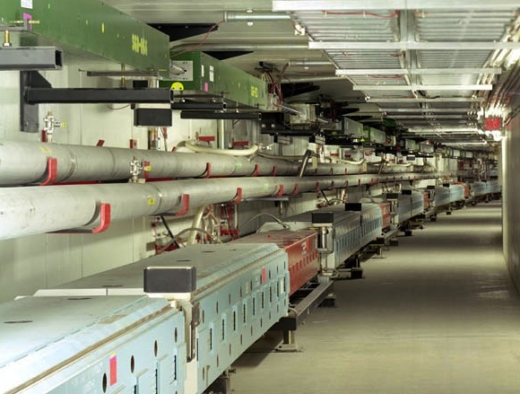
Main Injector/Recycler
The Main Injector can accept 8 GeV protons OR antiprotons from
  Booster
  The anti-proton accumulator
  The 8 GeV Recycler (which shares the same tunnel and stores antiprotons)
It can accelerate protons to 120 GeV (in a minimum of 1.4 s) and deliver them to
  The antiproton production target.
  The fixed target area.
  The NUMI beamline.
It can accelerate protons OR antiprotons to 150 GeV and inject them into the Tevatron.

Slide 66
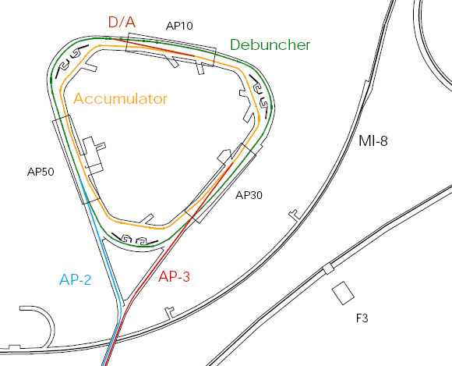

Present Operation of Debuncher/Accumulator
Protons are accelerated to 120 GeV in Main Injector and extracted to pBar target
pBars are collected and phase rotated in the “Debuncher”
Transferred to the “Accumulator”, where they are cooled and stacked
pBars not used after collider.

Slide 67
Mu2e in the NOvA era
Beam Delivered in 15 Hz “batches” from the Fermilab Booster

Slide 68


Extinction Performance
Beam motion in Collimator
Bunch
Transmission Window
Additional 10⁻⁵ extinction from beam delivery system

Slide 69
Review: Particle Motion in a Solenoidal Field
Generally, particles move in a
helical trajectory
For high momentum particles,
the curvature is used to measure
the momentum
Low momentum particles are
effectively “trapped” along
the field lines
A particle trapped along a curved
solenoidal field will drift out of the
plane of curvature with a velocity
  10 MeV/c particle will have a radius of 3 cm in a 1 T field
Can be used to resolve charge and momentum!

Slide 70
Resonant Extraction
Extracting all the beam at once is easy, but we want to extract it slowly over ~60 ms (~35,000 revolutions)
Use nonlinear (sextupole) magnets to drive a harmonic instability
Extract unstable beam as it propagates outward
  Standard technique in accelerator physics
Unstable beam motion in N(order) turns
Extraction Field
Extracted beam
Lost beam
Septum

Slide 71

Mu2e Spill Structure
1.33 sec Main Injector cycle
Detail:
  3x10⁷ p/bunch
  1.7 μsec bunch spacing
  ~30% duty factor
  ~1.2x10²⁰ protons year

Slide 72

Particle Tracking Technology
To achieve the required resolution, must keep mass as low as possible to minimize scattering
We’ve chosen transverse planes of “straw chambers” (~23,000 straws)
Advantages
  Established technology
  Modular: support, gas, and electronic
  connections at the ends, outside of
  tracking volume
  Broken wires isolated
Challenges
  Our specified wall thickness (15 μm)
  has never been done
  Operating in a vacuum may be problematic
Track ionizes gas in tube
Charge drifts to sense wire at center
Drift time gives precision position

Slide 73
Calorimeter
The Calorimeter will be used to tag electrons
  Electrons will deposit all of their energy
  Muons will deposit a small amount of ionization energy
Two layers of 200 mm long BaF₂ crystals
  1860 total
Very useful for timing
Tracker Hits
Before timing cut After timing cut

Slide 74
Extinction Monitor
Achieving 10⁻¹⁰ extinction is hard, but it’s not useful unless we can verify it.
Must measure extinction to 10⁻¹⁰ precision
  Roughly 1 proton every 300 bunches!
Monitor sensitive to single particles not feasible
  Would have to be blind to the 3x10⁷ particles in the bunch.
Focus on statistical technique
  Design a monitor to detect a small fraction of scattered particles from target
    10-50 per in-time bunch
  Good timing resolution
  Statistically build up precision profile for in time and out of time beam.
Goal
  Measure extinction to 10⁻¹⁰ precision in a few hours

Slide 75

Extinction Monitor Design
Selection channel built into target dump channel
Spectrometer based on 8 planes of ATLAS pixels
Optimized for few GeV/c particles

Slide 76
Target Dependence
Different models predict different target dependence and different relative rates for μN➔eN and μ➔eγ
Now we know this!

Slide 77


Cosmic Ray Veto (CRV)
Multiple layers of scintillator panels surround detector to veto cosmic rays
Efficiency specification: >99.99%

Slide 78
Choosing the Capture Target
The probability of of exchanging a virtual particle with the nucleus goes up with Z, however
Lifetime is shorter for high-Z
  Decreases useful live window
Also, need to avoid background from radiative muon capture limits choices
⇒Want M(Z)-M(Z-1)
< signal energy
⇒Aluminum is initial choice for Mu2e
Nucleus
R_{μe}(Z) / R_{μe}(Al)
Bound lifetime
Atomic Bind. Energy(1s)
Conversion Electron Energy
Prob decay >700 ns
Al(13,27)
1.0
.88 μs
0.47 MeV
104.97 MeV
0.45
Ti(22,~48)
1.7
.328 μs
1.36 MeV
104.18 MeV
0.16
Au(79,~197)
~0.8-1.5
.0726 μs
10.08 MeV
95.56 MeV
negligible

Slide 79
Stopping (capture) Target
Multiple thin layers to allow decay or conversion electrons to exit with minimal scattering
  17 Aluminum foils
  200 μm thick
Stops 49% of arriving muons
Foils
Conversion electron spectrum:
Targets
minimize
Support wires

Slide 80
Particle Detector
Helical trajectory
Charged tracking
Electromagnetic Calorimeter to tag electrons and provide timing →1860 BaF₂ crystals
Conversions hit multiple planes.
Most decays (p_{T}<53 MeV/c) go down the middle (vacuum)
~23,000 straws with 15 μm walls

Slide 81
Guidance: The P5 Report
The Particle Physics Project Prioritization Panel (P5) advises the DOE Office of High Energy Physics.
In 2013, the P5 was charged to determine priorities in US particle physics (primarily priorities for Fermilab) under various funding scenarios
In 2014, the panel report recommended proceeding with Mu2e under all funding scenarios.
So… full speed ahead!
bleak
flat
fantasy

Slide 82


Target and Heat Shield
Remember, this is inside a superconducting magnet
Produces pions which decay into muons
Tungsten Target
  8 kW beam
  700 W in target
  Radiatively cooled
Heat Shield
  Bronze insert
  3.3 kW average heat load
Target rod (~size of a straw)
Support

Slide 83

Fermilab Booster
Most “original” part of the complex
Accelerates protons from
400 MeV to 8 GeV
Operates in a 15 Hz resonant
circuit
  No time for beam manipulation
  Can’t make required beam structure
Sets a fundamental clock for the
complex
  15 Hz “tick”
Sets a fundamental unit of protons
  1 “batch” = up to ~4x10¹² protons
Since the can’t make the beam we need, how do we do it?
  By using almost everything else (impossible in Tevatron era)!

Slide 84


Major Backgrounds Revisited
1. Muon decay in orbit (DIO)
Defeated by good energy resolution

Slide 85
Major Backgrounds (cont’d)
2. Beam Related Backgrounds
Suppressed with 10⁻¹⁰ extinction (just talked about this)
3. Asynchronous Backgrounds: Cosmic Rays
Suppressed by active and passive shielding
Cosmic Ray Veto (CRV)
Four layers of scintillator surround experiment
Efficiency goal: >99.99%

Slide 86

Magnetic Field Gradient
Decreasing field prevents particle trapping and excessive straggling
Production Solenoid
Transport Solenoid
Detector Solenoid

Slide 87
Upgrade scenarios
Mu2e Signal?
No
Yes
Both prompt and DIO backgrounds must be lowered to measure
Must upgrade all aspects of production, transport and detection.
Must compare different targets.
Optimize muon transport and detector for short bound muon lifetimes.
Backgrounds might not be as important.
Rμe ~ 10⁻¹⁸

Slide 88

Eliminating out of Time Beam (Extinction)
The bunches from the Delivery Ring will have ~10⁻⁵ extinction
  We need 10⁻¹⁰ to make prompt backgrounds small compared to other backgrounds
A set of resonant dipoles in the beam line will deflect the beam such that only in-time beam is transmitted through a downstream collimator:
Think miniature golf
Angular deflection
Spatial offset

Slide 89
Production Solenoid
Axially graded (~5T➔2.5T) solenoid captures low energy backward and reflected pions, directing to the Transport Solenoid
Magnetic Gradient
Magnetic reflection
(pinch confinement)

