Slide 1
US LHC Accelerator Research Program (LARP)*
Eric Prebys, Fermilab
Director, LARP
*plus a bit of LAFS

Slide 2
LARP
The US LHC Accelerator Research Program (LARP) coordinates US R&D related to the LHC accelerator and injector chain at Fermilab, Brookhaven, SLAC, and Berkeley (with a little at J-Lab and UT Austin)
LARP has contributed to the initial operation of the LHC, but much of the program is focused on future upgrades.
The program is currently funded at a level of about $12-13M/year, divided among:
Accelerator research
Magnet research (~half of program)
Programmatic activities, including support for personnel at CERN
The confusion with this “LARP” (Live-Action Role Play) has led to some interesting emails

Slide 3
LHC Accelerator-Fermilab Software (LAFS)
It was decided early that LARP itself would not support software projects
For this reason, the LAFS groups was created.
Major LAFS Projects:
Role-based access control (RBAC): sophisticated access control for accelerator related applications
Suggested by LAFS, and now implemented extensively
Wire scanner app.
Read out and display flying wire information
Beam Synchrotron Radiation Monitor (BSRT) app And daemon:
Monitor beam synchrotron radiation to measure bunch shape and verify abort gap
Schottky application:
Set schottky DAQ parameters, read and display data
Lumi monitor application:
GUI to control and display data from the lumi monitor
Overlap with LARP

Slide 4
LARP Contributions to Initial LHC Operation
Schottky detector
Used for non-perturbative tune measurements (+chromaticities, momentum spread and transverse emmitances) – Operational, being handed off
Tune tracking
Implement a PLL with pick-ups and quads to lock LHC tune – Fully integrated
Investigating generalization to chromaticity tracking
AC dipole
US AC dipole to drive beam
Measure both linear and non-linear beam optics – Primary tool for high energy optics
Luminosity monitor
High radiation ionization detector integrated with the LHC neutral beam absorber (TAN) at IP 1 and 5. – Functional, becoming primary fast system.
Synchrotron Light Monitor
Used to passively measure transverse beam size and monitor abort gap
Not a LARP project, but significantly improved by LARP – Fully integrated
Low level RF tools
Leverage SLAC expertise for in situ characterization of RF cavities – Fully integrated
Personnel Programs…

Slide 5
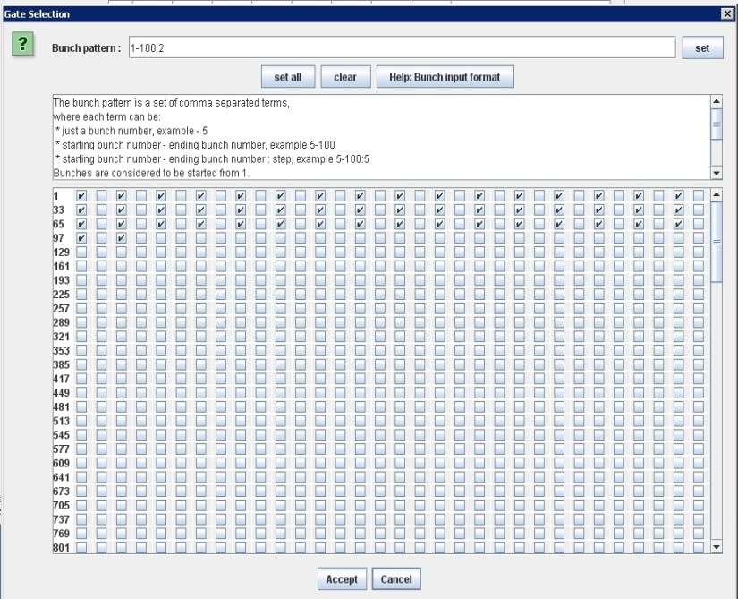
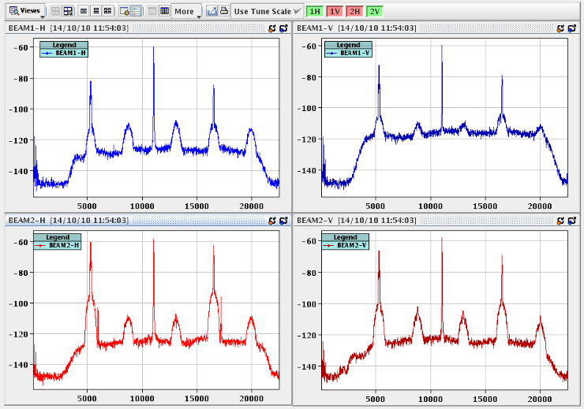
Schottky detector
Proposed by LARP, based on experience in RHIC
Installed in collaboration with CERN
Application written by LAFS (J. Cai)
In the process of handing off to CERN
Allows tune to be monitored on selected buckets
Data from 3.5 TeV Beam

Slide 6
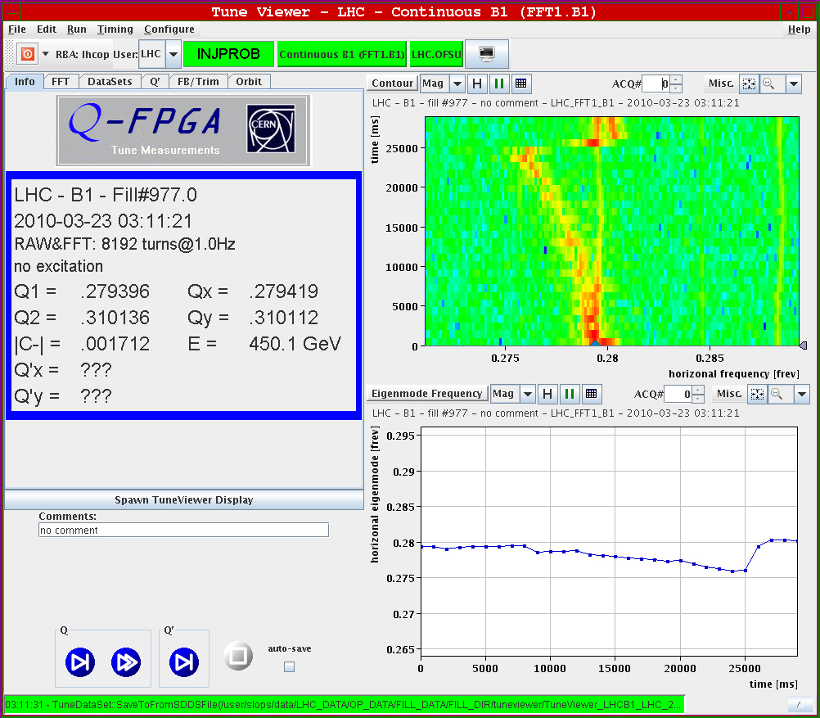
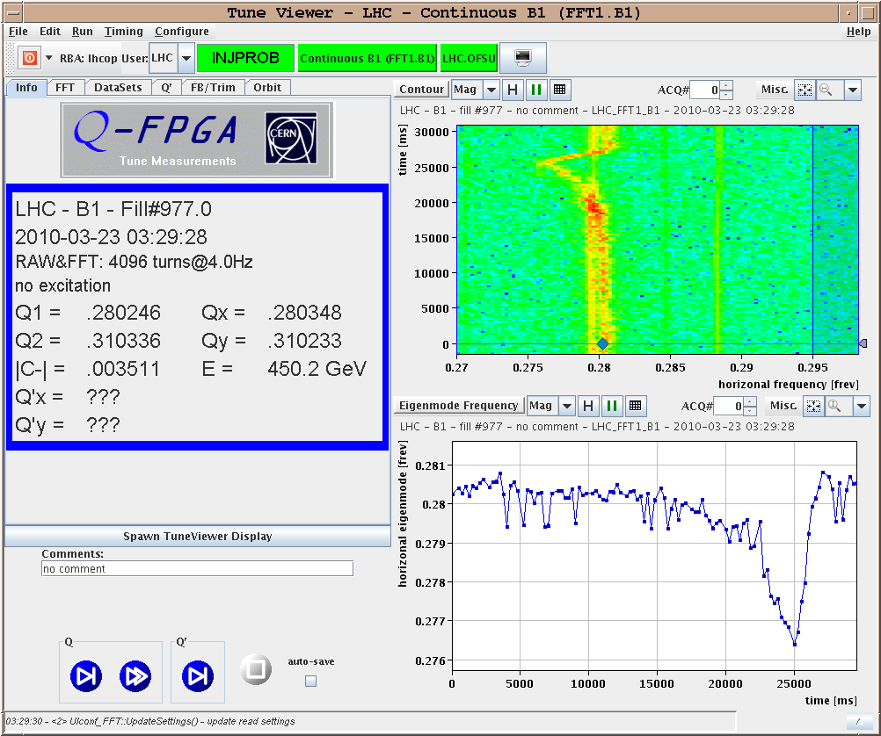
Tune Feedback
LARP contributed to the development of the tune feedback system.
Incorporated into LHC design very early (many have forgotten LARP had anything to do with it)
Part of standard operation.

Slide 7
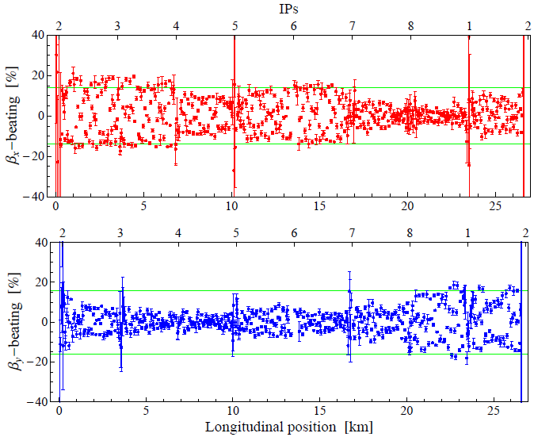
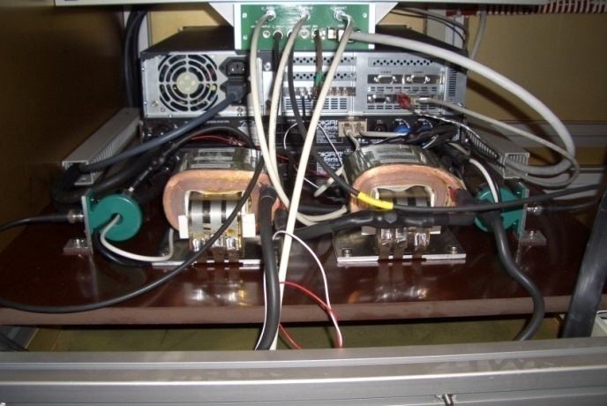
AC Dipole
By driving the beam near the (aliased) tune, one can probe linear and non-linear optics
4 AC dipoles installed at CERN based on tests in the Tevatron (R. Miyamoto)
Primary tool for 3.5 TeV β measurement.
Audio amplifiers
β measurement at 3.5 TeV

Slide 8
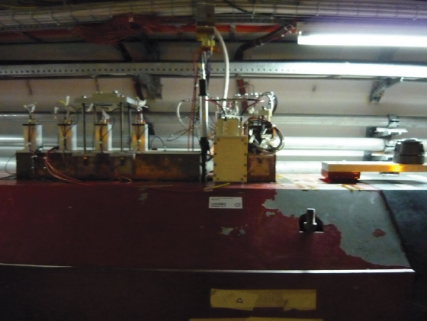
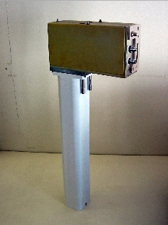
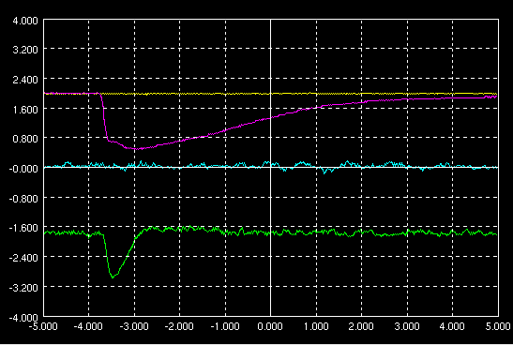
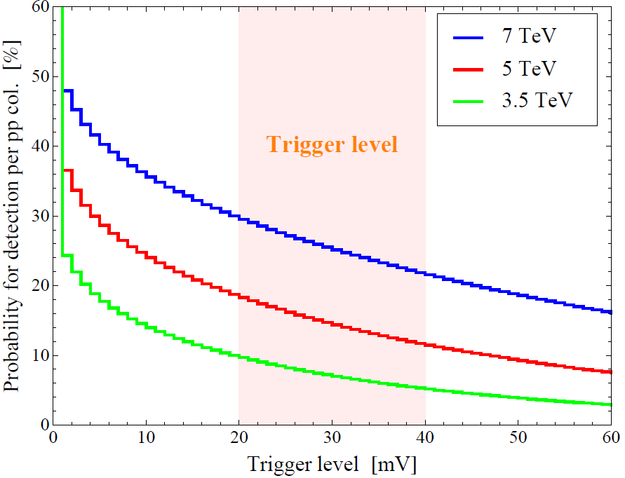
Lumi Detector
Installation at IP5
First 3.5+3.5 TeV Signals
Noise
PMT signal
Noise (scale x 50)
LUMI signal

Slide 9
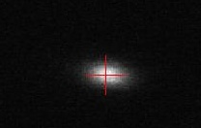
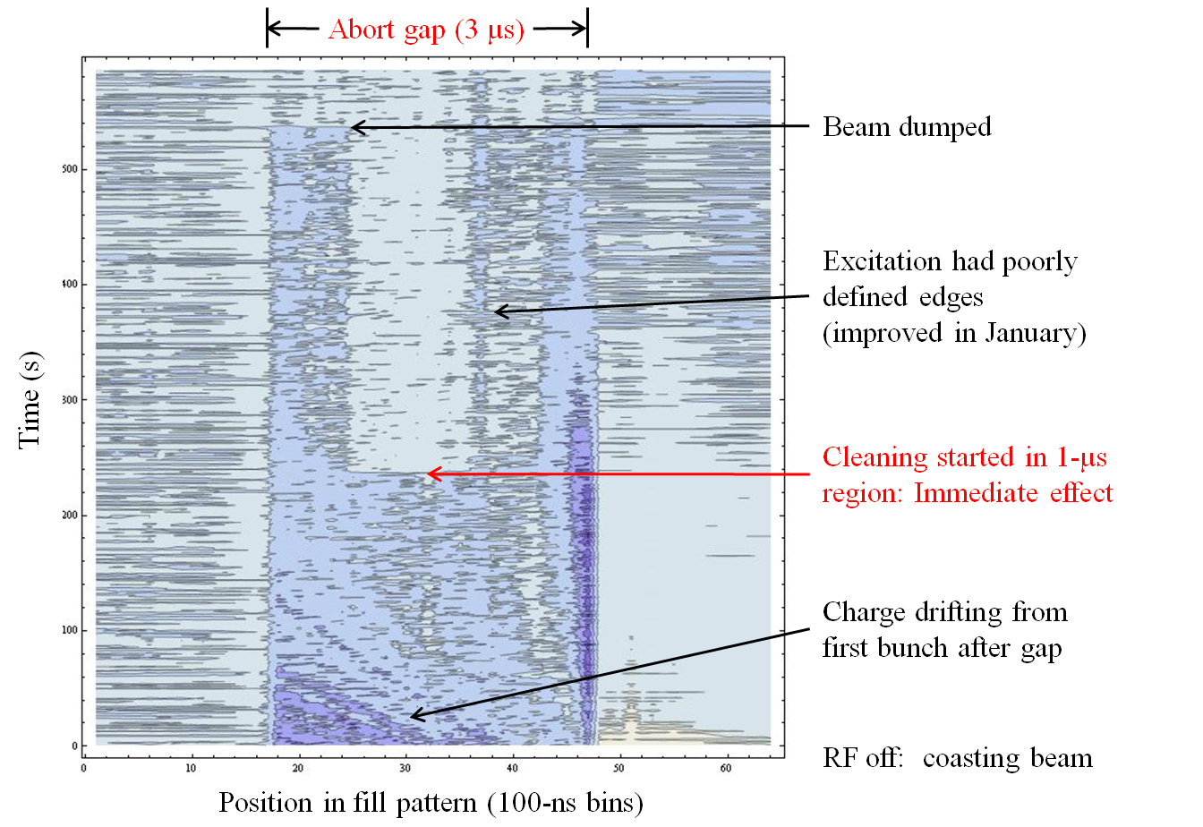
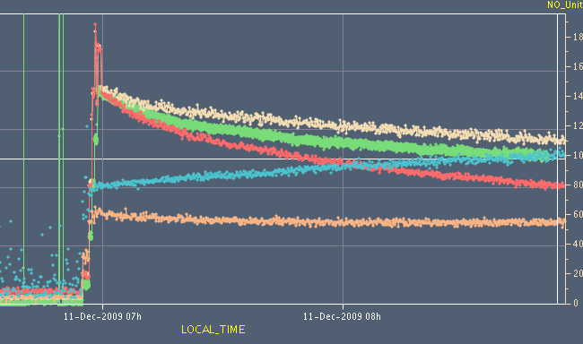
Sync. Light Monitor (Improved by LARP and LAFS)
Used to measure beam profile and monitor abort gap
Not originally a LARP activity.
Alan Fisher (LARP visitor from SLAC) proposed and implemented dramatically improved optics to accommodate shifting source location
Passive profile measurement
Early emittance measurement

Slide 10
LLRF Tools
Leverage RF tools and techniques developed at PEP-II
Effort led by John Fox
Configuration tools used extensively during LHC RF commissioning

Slide 11
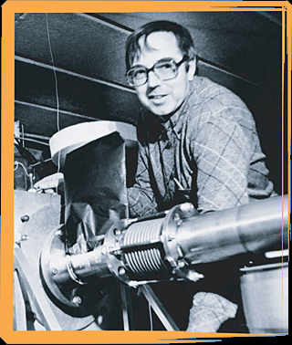
Toohig Fellowship
Named for Tim Toohig, one of the founders of Fermilab
Open to recent PhD’s in accelerator science or HEP.
Successful candidates divide their time between CERN and one of the four host labs.
Past
Helene Felice, LBNL, now post-doc
Rama Calaga, BNL, now staff and LTV
Ricardo DiMaria, BNL, now CERN Fellow
Present
Ryoichi Miyamoto, BNL
Dariusz Bocian, FNAL
Future
two offers out
If interested, contact John Fox at SLAC

Slide 12
Long Term Visitors Program
LARP Pays transportations and living expenses for US scientists working at CERN for extended periods (at least 4 months)
Extremely successful at integrating people into CERN operations
Past:
Jim Strait, FNAL – Machine protection/splice consilidation
Steve Peggs , BNL – UA9
Alan Fisher, SLAC – Synchrotron Light Monitor
Present:
Rama Calaga, BNL – crab cavities and commissioning
Eliana Gianfelice, FNAL – abort gap cleaning
Chandra Bhat, FNAL – flat bunches for Large Pewinski Angle solution
Uli Wienands, SLAC – UA9, PS2, PSB
Interested parties coordinate with a CERN sponsor and apply to the program (Uli Wienands, SLAC)

Slide 13
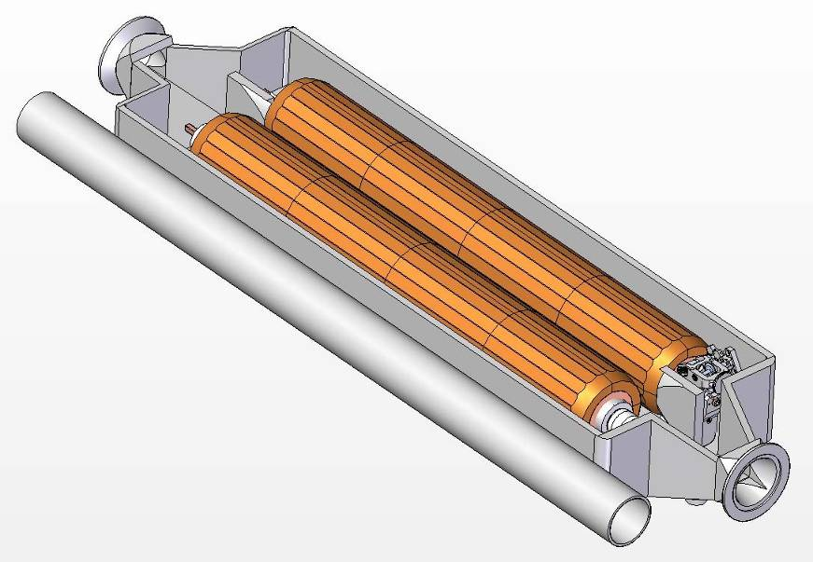
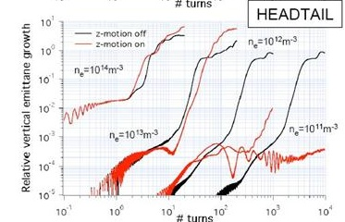
LARP Accelerator R&D for Future LHC
Rotatable collimators
Can rotate different facets into place after catastrophic beam incidents
Beam-beam studies
General simulation
Electron lens
Electron cloud studies
Study effects of electron cloud in LHC and injector chain
Used to drive mitigation effort
Crystal Collimation
T980 (FNAL) and UA9 (CERN)
Crab Cavities
More later

Slide 14
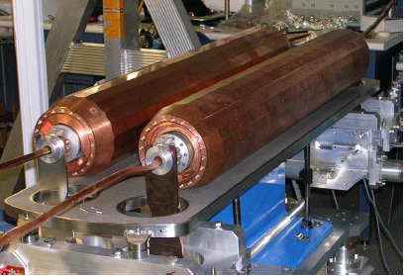
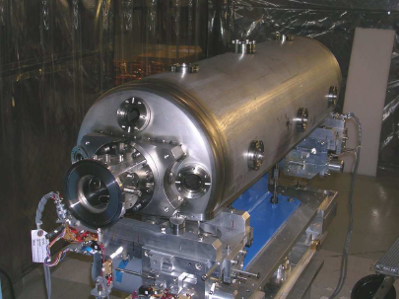
Collimator Status
First prototype nearly complete at SLAC
Will be shipped to CERN for impedance and functionality testing in the SPS
Second test will occur next year in the new CERN HiRadMat facility
Test behavior under catastrophic beam event
If they pass these tests, they will be part of the collimation upgrade in 2016.

Slide 15
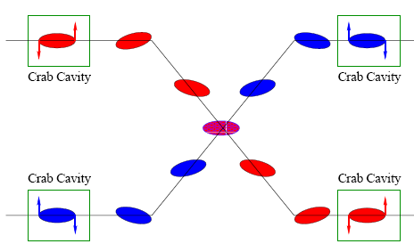
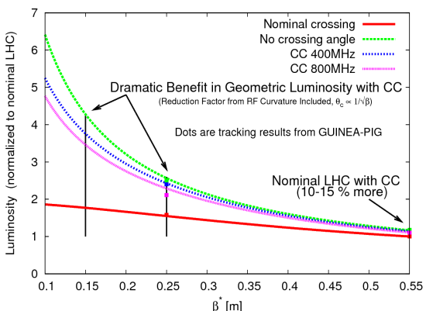
Crab Cavities
Lateral deflecting cavities allow bunches to hit head on even though beams cross
Successfully used a KEK
Additional advantage:
The crab angle is an easy knob to level the luminosity, stretching out the store and preventing excessive pile up at the beginning.
Endorsed by CERN in 2009
Now part of base line planning for HL-LHC

Slide 16
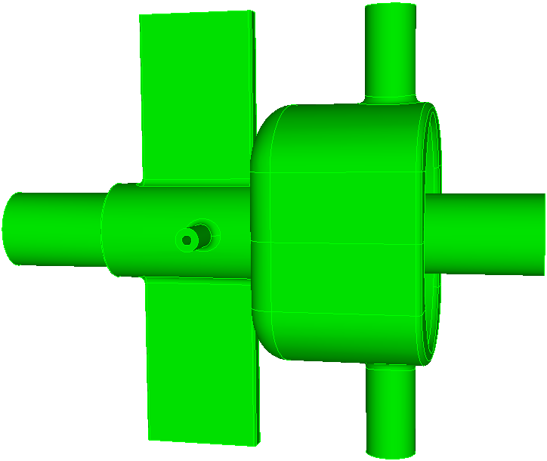
LARP Crab Cavity Work
WG HOM coupler
Coax LOM/SOM coupler
LARP has been the primary advocate of crab cavities for the LHC upgrade
In fall, 2009 CERN formally endorsed crab cavities for HL-LHC
Contingent on a plan to operate system safely!!
Technical challenges
Designing “compact” cavities that can fit in the available space
Machine protection
“local” vs “global” scheme
Actual production is beyond the scope of LARP
LARP R&D ⇒ separate, international(?) project
Power coupler
SLAC half wave
Fermilab “mushroom”
JLAB “toaster”

Slide 17
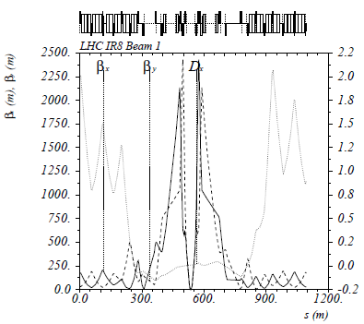
Magnet Systems: The Case for New Quadupoles
HL-LHC Proposal: β*=55 cm ⇒ β*=10 cm
Just like classical optics
Small, intense focus ⇒ big, powerful lens
Small β*⇒huge β at focusing quad
Need bigger quads to go to smaller β*
Existing quads
70 mm aperture
200 T/m gradient
Proposed for upgrade
At least 120 mm aperture
200 T/m gradient
Field 70% higher at pole face
⇒ Beyond the limit of NbTi

Slide 18
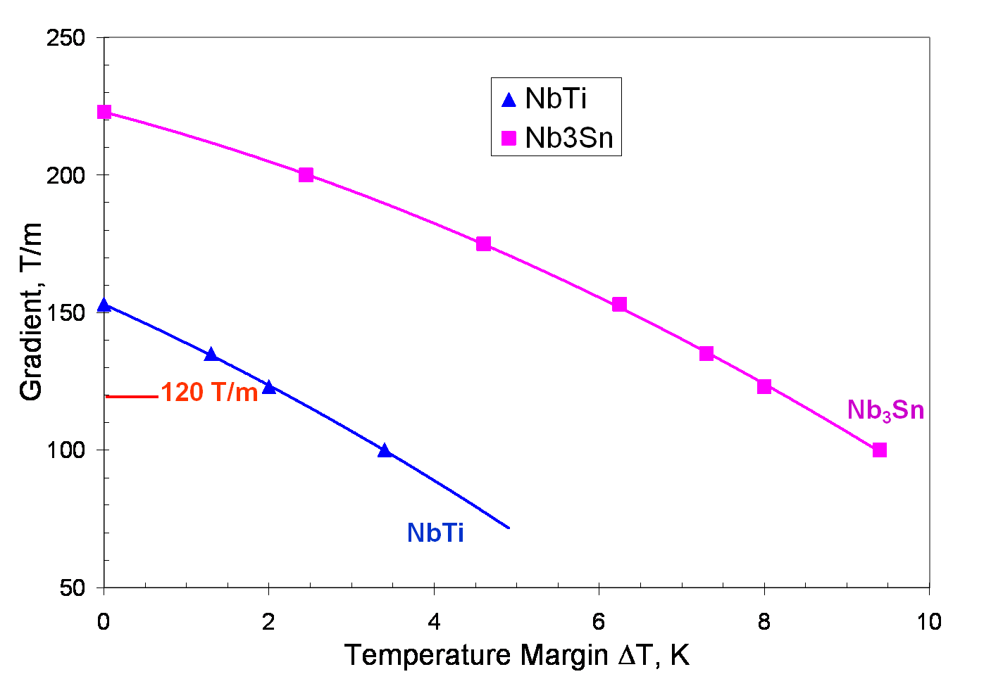
Motivation for Nb₃Sn
Nb₃Sn can be used to increase aperture/gradient and/or increase heat load margin, relative to NbTi
Limit of NbTi magnets
Very attractive, but no one has ever built accelerator quality magnets out of Nb₃Sn
Whereas NbTi remains pliable in its superconducting state, Nb₃Sn must be reacted at high temperature, causing it to become brittle
Must wind coil on a mandrel
React in an oven
Carefully transfer and assemble
120 mm aperture

Slide 19
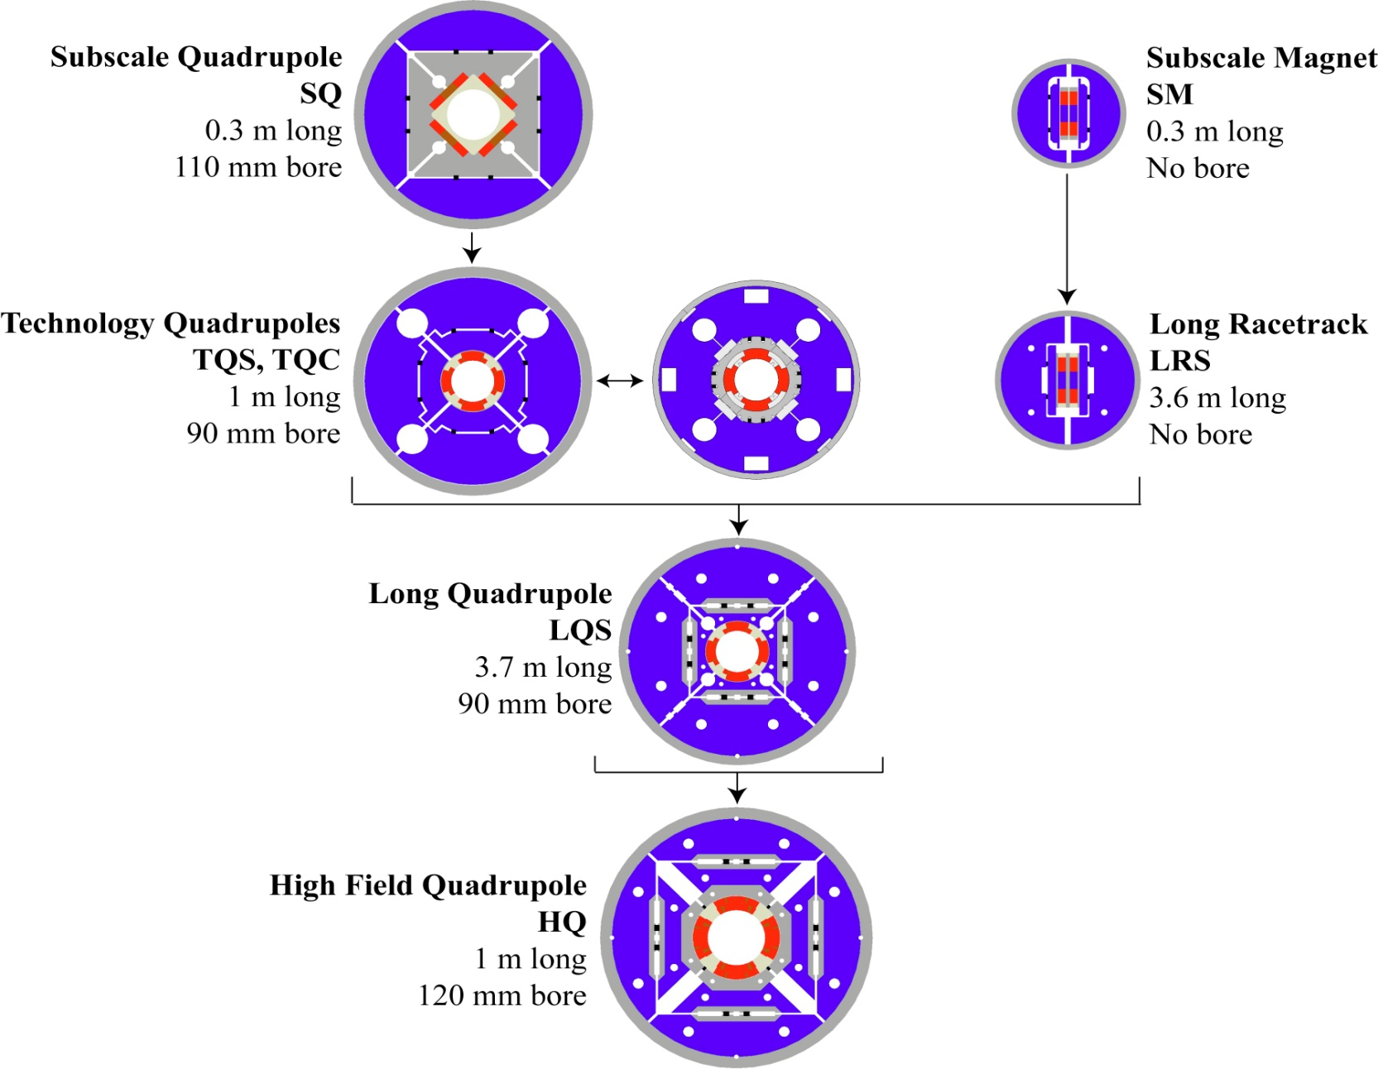
LARP Magnet Development Tree
Completed
Achieved
220 T/m
Length scale-up
High field
Accelerator features
Being tested

Slide 20
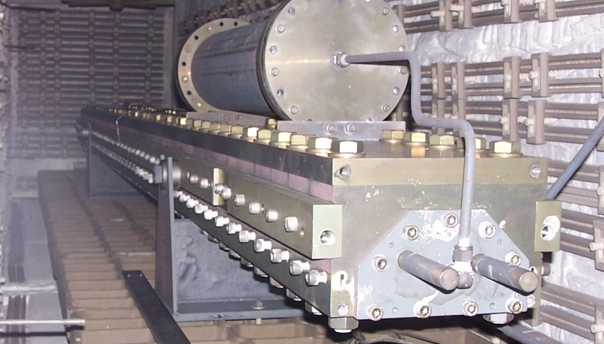
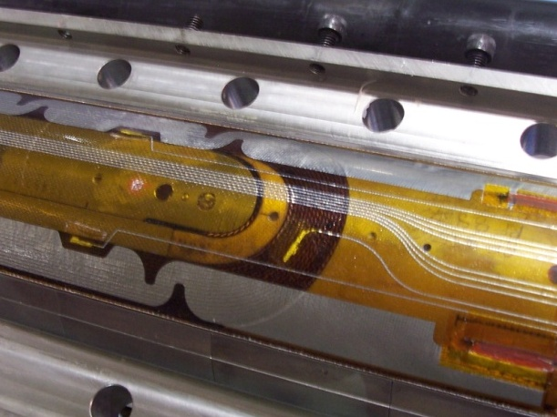
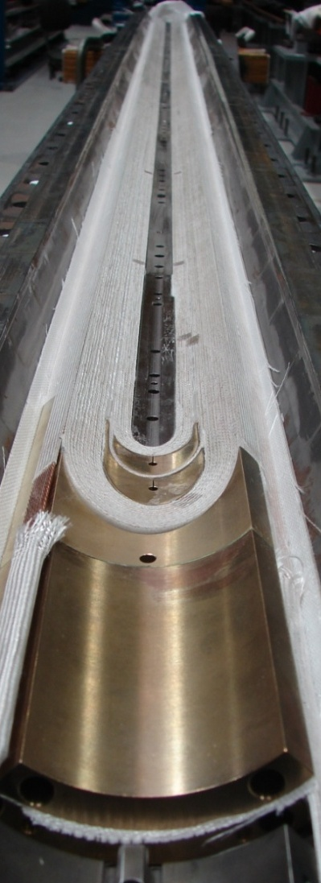
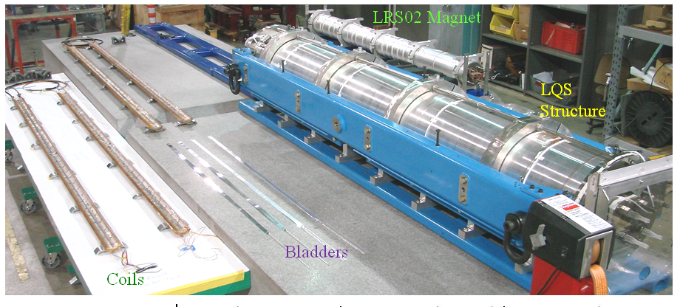
LQ (4m x 90mm) Assembly and Test
Reaction/Potting
(BNL and FNAL)
Instrumentation and
heater traces (LBNL)
Winding/curing (FNAL)

Slide 21
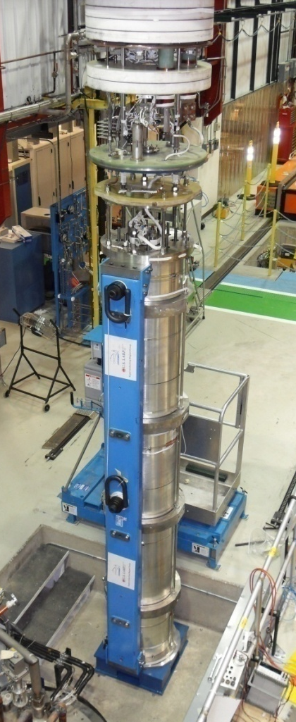
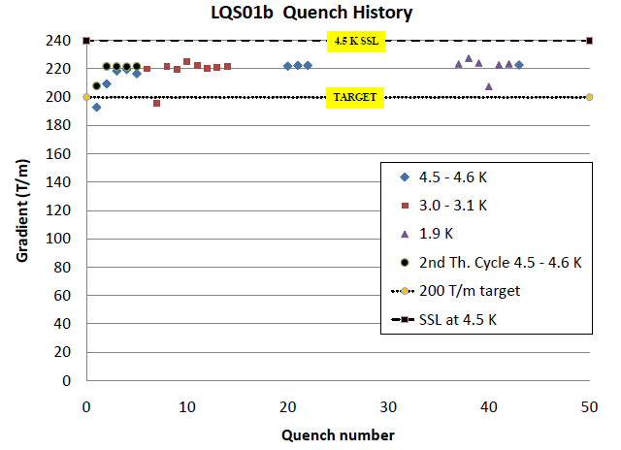
LQ Test
Tested in vertical test facility at Fermilab
200 T/m in this magnet was the original goal of LARP (2003)!

Slide 22
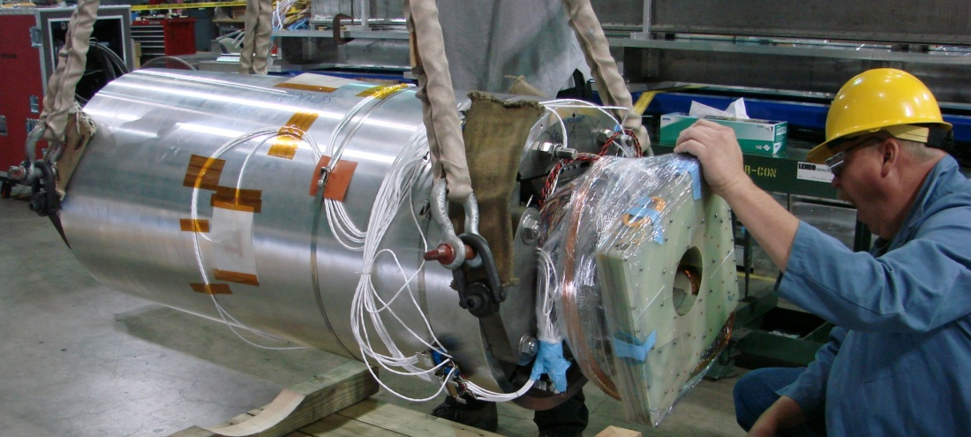
HQ Test
Prototype tested at LBNL
Achieved 157 T/m
Less than goal, but more than NbTi
Electrical fault in voltage tap
Investigating
Will repair and test at CERN

Slide 23
Beyond HQ
The aperture for the focus quadrupoles in the HL-LHC has not yet been determined
Could be as high as 150 mm
In the mean time, LARP will build several “longer” (~2m) 120 mm magnets to investigate
Field quality
Alignment
Thermal behavior
Full length prototype, at final aperture will be part of construction project R&D (~2015).

Slide 24
Enough about science…Let’s talk management!
Upgrade planning will be organized through EuCARD*,
Centrally managed from CERN (Lucio Rossi)
Non-CERN funds provided by EU
Non-EU partners (KEK, LARP, etc) will be coordinated by EuCARD, but receive no money.
Work Packages:
WP1: Management
WP2: Beam Physics and Layout
WP3: Magnet Design
WP4: Crab Cavity Design
WP5: Collimation and Beam Losses
WP6: Machine Protection
WP7: Machine/Experiment Interface
WP8: Environment & Safety
Significant LARP and other US Involvement
*European Coordination for Accelerator R&D

Slide 25
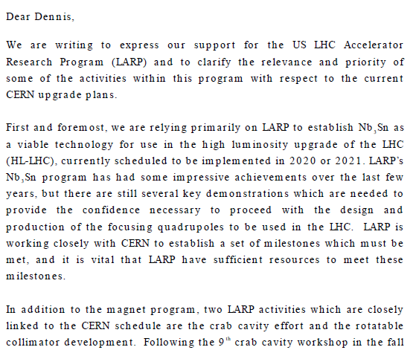
Relevance of LARP to CERN Upgrade
Letter to Dennis Kovar, Head Office of DOE Office of High Energy Physics, 17-August-2010
(…)

Slide 26
Marching Toward 2020
The EuCARD HL-LHC collaboration will submit a study proposal in November of this year
Conceptual Design Report: ~2013
Technical Design Report: ~2015
LARP is a ~$12M/year R&D organization
Major activities will need to “spin off” as independent projects
Nb₃Sn quardupole project should be in place by 2014-2015 to be ready for 2020
Crab cavities are a ~$50M international effort that will need to be centrally coordinated from CERN

Slide 27
Backup Material

Slide 28
Limits to LHC Luminosity*
Rearranging terms a bit…
Total beam current. Limited by:
Uncontrolled beam loss!
E-cloud and other instabilities
Brightness, limited by
Injector chain
Max. beam-beam
If bunches closer than ~400 ns, must turn on crossing angle…
Betatron function at IP, limited by
magnet technology
chromatic effects
…which reduces this
*see, eg, F. Zimmermann, “CERN Upgrade Plans”, EPS-HEP 09, Krakow

Slide 29
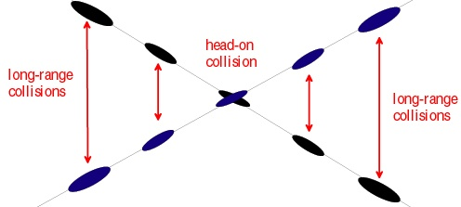
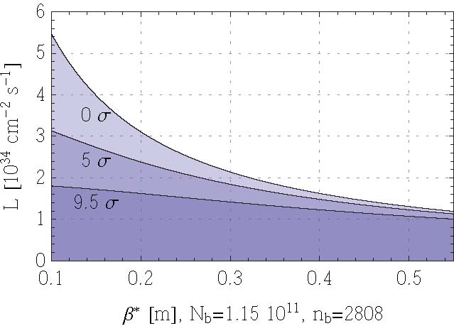
Effect of Crossing Angle
Reduces luminosity
“Piwinski Angle”
Separation of first parasitic interaction
No crossing angle
Effect increases for smaller beam
Nominal crossing angle (9.5σ)
Conclusion: without some sort of compensation, crossing angle effects will ~cancel any benefit of improved focus optics!
Limit of current optics
Potential upgrade plan

Slide 30
Summary of Options (Not Quite Up to date)
Classified ~by method of dealing with crossing angle
Requires magnets close to detectors
Requires (at least) PS2
Big pile-up
Parameter | Symbol | Initial | Full Luminosity Upgrade
 |  |  | Early Sep. | Full Crab | Low Emit. | Large Piw. Ang.
transverse emittance | ε [μm] | 3.75 | 3.75 | 3.75 | 1.0 | 3.75
protons per bunch | N_{b} [10¹¹] | 1.15 | 1.7 | 1.7 | 1.7 | 4.9
bunch spacing | Δt [ns] | 25 | 25 | 25 | 25 | 50
beam current | I [A] | 0.58 | 0.86 | 0.86 | 0.86 | 1.22
longitudinal profile |  | Gauss | Gauss | Gauss | Gauss | Flat
rms bunch length | σ_{z} [cm] | 7.55 | 7.55 | 7.55 | 7.55 | 11.8
beta* at IP1&5 | β∗ [m] | 0.55 | 0.08 | 0.08 | 0.1 | 0.25
full crossing angle | θ_{c} [μrad] | 285 | 0 | 0 | 311 | 381
Piwinski parameter | φ=θ_{c}σ_{z}/(2*σ_{x}*) | 0.64 | 0 | 0 | 3.2 | 2.0
peak luminosity | L [10³⁴ cm⁻²s⁻¹] | 1 | 14.0 | 14.0 | 16.3 | 11.9
peak events/crossing |  | 19 | 266 | 266 | 310 | 452
initial lumi lifetime | τ_{L} [h] | 22 | 2.2 | 2.2 | 2.0 | 4.0
Luminous region | σ_{l} [cm] | 4.5 | 5.3 | 5.3 | 1.6 | 4.2
excerpted from F. Zimmermann, “LHC Upgrades”, EPS-HEP 09, Krakow, July 2009

Slide 31
Plan for Next Decade
Run until end of 2011, or until 1 fb⁻¹ of integrated luminosity
About .5% of the way there, so far
Shut down for ~15 month to fully repair all ~10000 faulty joints
Resolder
Install clamps
Install pressure relief on all cryostats
Shut down in 2016
Tie in new LINAC
Increase Booster energy 1.4->2.0 GeV
Finalize collimation system (LHC collimation is a talk in itself)
Shut down in 2020
Full luminosity: >5x10³⁴ leveled
New inner triplets based on Nb₃Sn
Crab cavities
Large Pewinski Angle being pursued as backup

Slide 32
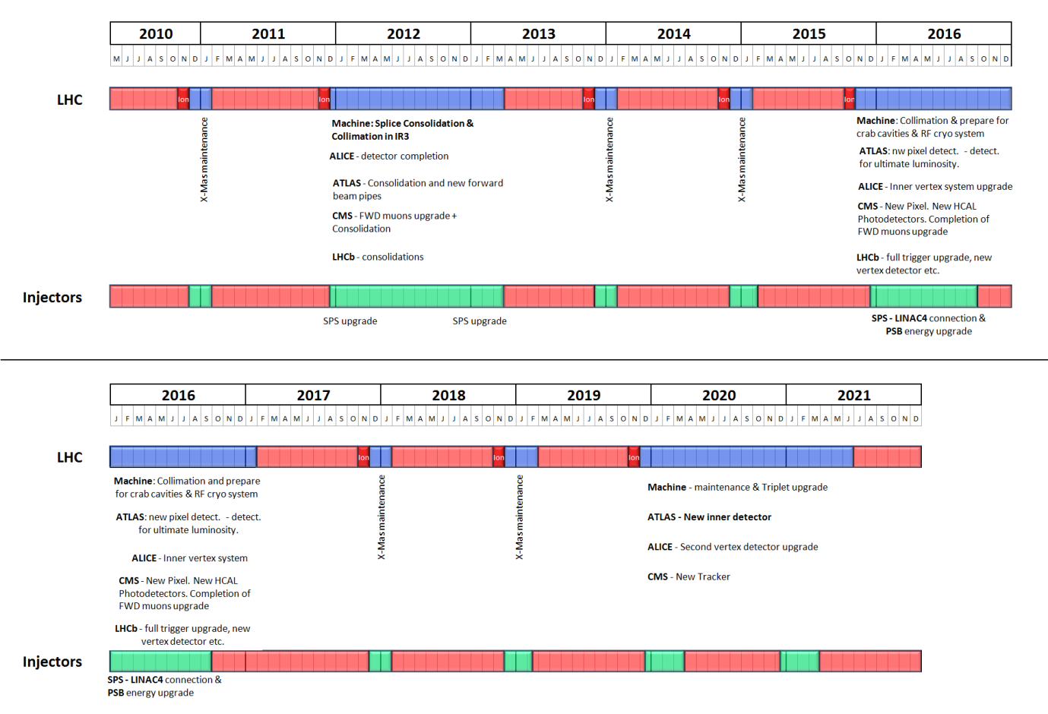
Tentative LHC Timeline
Energy: 3.5 TeV
Energy: 6-7 TeV
Collimation limit ~2x10³²
Collimation limit .5-1x10³⁴
Energy: ~7.0 TeV
Energy: ~7 TeV
Luminosity→1x10³⁴
Lum.→>5x10³⁴
Collimation limit >5x10³⁴

