Slide 1
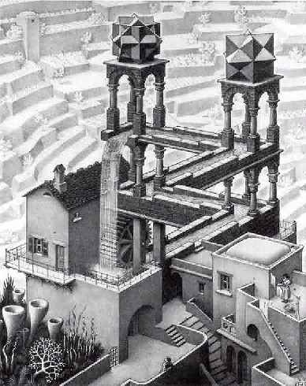
Energy: No Such Thing as a Free Lunch
Eric Prebys
Fermilab

Slide 2
Outline
Introduction and motivation
A brief history of perpetual motion
The science of energy conservation and the Laws of Thermodynamic
Some case studies
Getting it wrong:
  How honest people convince themselves and others of crazy things.
Good science gone bad
The point?
http://home.fnal.gov/~prebys/talks/ask_a_scientist_energy/

Slide 3
Why give this lecture?
Education
  The concepts of work and energy are central to our understanding of nature, and it’s good for everyone to have some knowledge of them.
  Some seemingly arcane (and boring) principles turn out to be very important.
  You can learn a lot about good science by studying bad science.
Public Service
  Maybe I can prevent someone from losing money in some energy based investment scam or wasting their lives on a quixotic search for something that doesn’t exist.
Reality Check
  Energy is likely “The Big Issue” of the 21st century
    Availability
    Impact
  As long as people believe there’s a magic technology just around the corner, they will avoid addressing these problems!

Slide 4
Why now?
The basic facts:
  The energy consumption of the human race is increasing.
  Soon, the developing world will pass the US and Western Europe in energy usage.
  Our reliance on fossil fuels is impacting our environment, perhaps catastrophically.
  Fossil fuels will run out – maybe in 10 years, maybe in 100, but they will run out.
The current emphasis on “going green” has raised the stakes for alternative energy sources:
  Scientifically, this is very exciting, but…
  It will also not be lost on the con men.

Slide 5

Is this lecture necessary?
Unfortunately, Homer’s conceptual understanding is well above average!

Slide 6
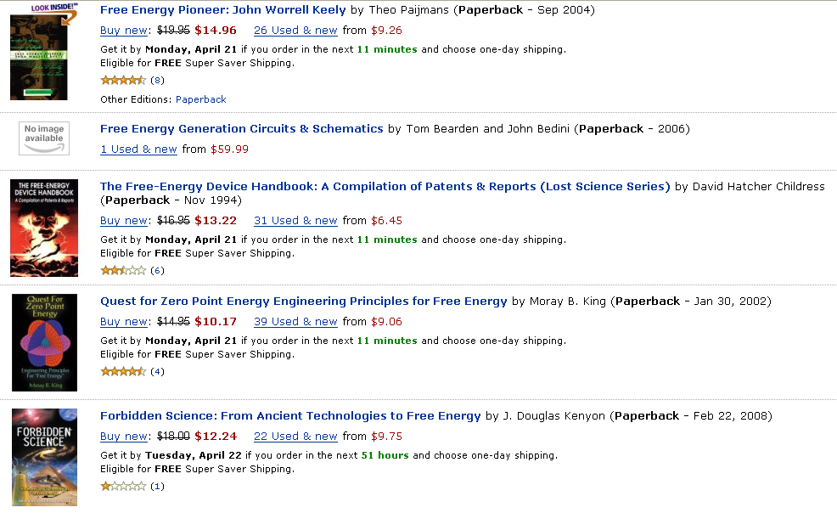
Evidence: Amazon search "free energy"
Top 5:

Slide 7
Working definition: How free is "free"?
For the purposes of this discussion, “free energy” refers to transformative technologies that:
  Can be implemented on an individual basis
    i.e. non-centralized
  Will enable dramatic reduction in domestic and/or transportation energy expenses
    say, a factor of four or more
  Do not require a lifestyle change
  Involve only modest capital costs
    Pay for themselves in less than a year or so
Some examples which do NOT qualify:
  Trading in your Hummer for a motorcycle
    Lifestyle change
  Converting your home to 100% solar
    Takes many years to recover the cost

Slide 8
Types of “free energy”
Perpetual Motion: A device which produces useable output energy with no input energy or fuel.
  To the extent science declares anything “impossible”, this is impossible.
Dramatically improved efficiency in utilizing an existing power source.
  A legitimate idea, but there limits
A new source of energy or radically different way of tapping and established source of energy
  Examples: cold fusion, zero point energy, hydrinos, etc.
In many cases, claims of the second two
types really imply the first

Slide 9
Science: Definition
The Good:
  Make observations and measurements
  Develop a model to explain these with the fewest possible variables and assumptions (must also be consistent with all other scientific data).
  Investigate the predictions and consequences of this model.
The Bad
  Like good science in principle, but lack of rigor and/or bias (intentional or unintentional) lead to erroneous conclusions.
The Ugly
  Propose theories or claim experimental results which cannot possibly be reconciled with significant body of real world data.
  Can be the product of profound ignorance or deliberate fraud.
  Aka “Crackpot Science”, “Voodoo Science”, etc
Most free energy resides solidly here

Slide 10
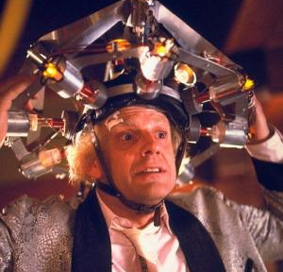

Science: Myth vs. Reality
Myth
  Independent
  Maverick
  Makes lots of important discoveries in career
  Results come quickly
Reality
  Systematic and meticulous
  Often work in large groups
  Results take time!!
  One significant discover y = Nobel Prize!
Society loves this…
… but benefits from this

Slide 11
But what about Jobs and Wozniac?
It’s important to make a distinction between “science” and “technology”
  Science concerns the fundamental rules of nature
  Technology is the application of these rules.
Science and technology are closely intertwined, but they are still distinct.
  New science enables new technology
  New technology is used to push the boundaries of science.
Although we live in a time of amazing technological advances, fundamental scientific advances are still few and far between.
  Last new source of energy was nuclear power (early 20th century)

Slide 12
"Voodoo Science"
Bob Park’s seven warning signs
  Discoverers make their claims directly to the popular media, rather than to fellow scientists.
  Discoverers claim that a conspiracy has tried to suppress the discovery.
  The claimed effect appears so weak that observers can hardly distinguish it from noise. No amount of further work increases the signal.
  Anecdotal evidence is used to back up the claim.
  True believers cite ancient traditions in support of the new claim.
  The discoverer or discoverers work in isolation from the mainstream scientific community.
  The discovery, if true, would require a change in the understanding of the fundamental laws of nature.

Slide 13
"Voodoo Science" (cont'd)
Eric’s extra three warning signs
  Relying on overly complex demonstrations and protocols.
  Claims are vague and contradictory.
  Claims have profound and obvious consequences which are not addressed.

Slide 14
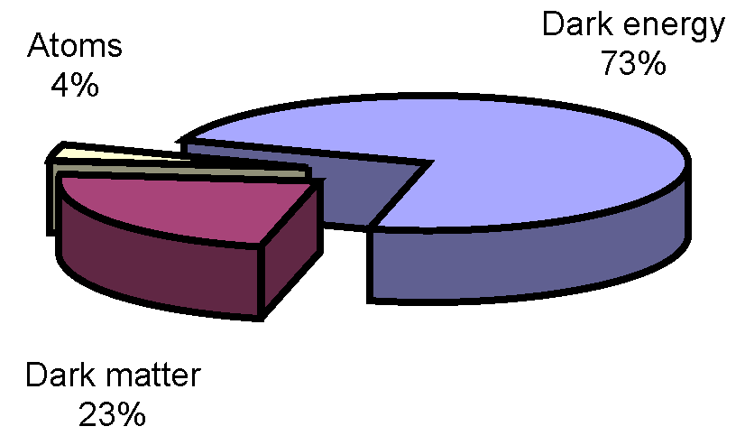
How can we be so sure or ourselves?
After all, we only know what 4% of the universe is made of.
Can’t there be some sort of energy source in the other 96%?
Maybe, but even if we don’t know what 96% is, we know a lot about what it isn’t.

Slide 15
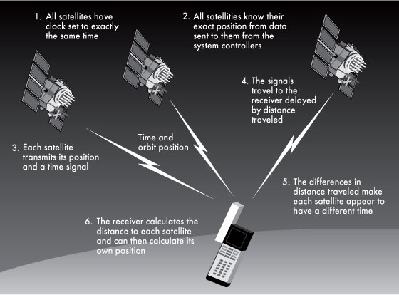
Consider the GPS
For a GPS to work, we have
to understand
  The chemistry of the fuel
  The dynamics of the launch
  and orbit
  The physics of the onboard
  atomic clocks
  The E&M involved in
  generating and transmitting the signal
  The Special and General Relativity corrections required
    38 μsec = 11.4 km/day error without them!
  And then there’s all the physics needed to put that much computing in your hand.
None of this would work if unknown particles and forces interacted significantly with ordinary matter.

Slide 16
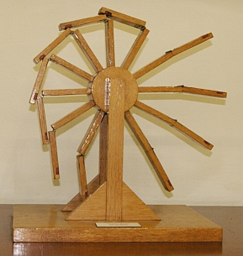
Perpetual motion: a brief history

Slide 17

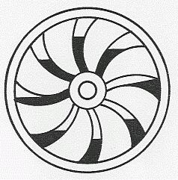
Early perpetual motion machines
Some of the oldest perpetual motion machines were documented by the Indian author Bhaskara (c. 1159), who made sketches of something called the “Persian Wheel”
This device used flowing water (or sand) to create a “perpetual imbalance”

Slide 18
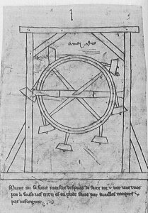
Perpetual motion in the West
The first sketch of a perpetual motion machine in the Western world was made by Villard de Honnecourt
(c. 1250).
The principle was similar to
the “Persian Wheel”, but it
relied on levers and weights
to achieve imbalance.
Over the next several
centuries, a number of
conceptual machines were
designed along these
lines.

Slide 19
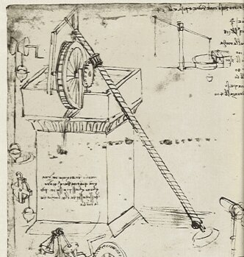
Leonardo da Vinci
Historians like to point out that Leonardo da Vinci spent a lot of time debunking things like Honnecourt’s wheel.
They usually leave out that
he personally believed that
the key to perpetual motion
was some combination of
a water wheel and an
Archimedes screw.
Of course, there was no reason
to believe this wouldn’t work –
then
  In fact, can you prove it now?

Slide 20
Perpetual motion and physics
We need to examine these early claims in the context of the time.
Because there was no theoretical framework to rule out these machines, these people were behaving as good scientists.
  The fact they didn’t work was an important piece of experimental evidence.
All of this changed with Newton
  F=ma and the “universal law of gravitation” held the mathematical key to ruling out all of these “imbalance” type perpetual motion machines in one fell swoop.

Slide 21
Physics and energy
In the 18th and 19th centuries, a great deal of physics was done to formalize the concepts of work, energy, and conservation laws.
  The non-observation of perpetual motion was taken as input to these theories.
The 19th century saw the development of thermodynamics
  Term originally coined by James Joule to describe the science of heat and power
  Generalized to cover all physical systems
  Lays out the specifics of the relationship between physical systems and usable energy
As new types of physics were discovered, the still fit into this paradigm
  Electricity and Magnetism
  Relativity
  Nuclear energy
  Quantum Mechanics

Slide 22
First Law of Thermodynamics
Every system is characterized by an energy (U)
This law is also known as “Conservation of Energy”
Change in energy
“Heat” put into system
Work done by system

Slide 23
Second Law of Thermodynamics
Not all energy is useable!!
Every system is characterized by an “entropy” (S)
  A measure of energy and degree of order
    Generally “Low entropy” = high energy and high order
The entropy of a “closed” system can never decrease.
Can only get work out of system in a transition to a higher entropy state. (S₂>S₁)

Slide 24

Second Law and Heat
Entropy increases as heat flows from high to low temperature
  We can extract work when heat flows from high temperature to low temperature
  We have to do work to move heat from low temperature to high temperature.

Slide 25
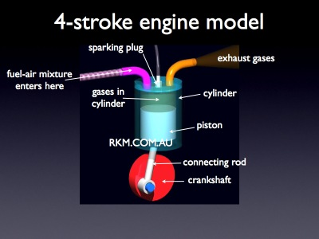
2nd law: getting energy out…
Internal Combustion Engine
  Hydrocarbons burn in a transition to a higher entropy chemical state (chemical thermodynamics)
  Mechanical work is extracted as hot, compressed gasses (low entropy) go to cool gasses at lower pressure (high entropy)

Slide 26
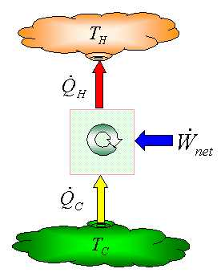
2nd Law: doing work to move heat
Air conditioning
This is why you can’t use your refrigerator to cool your house!
Work is done to move heat from inside the house to the radiator unit outside the house.
The heat radiated outside the house is equal to the heat removed from the house plus the work it took to move it.

Slide 27
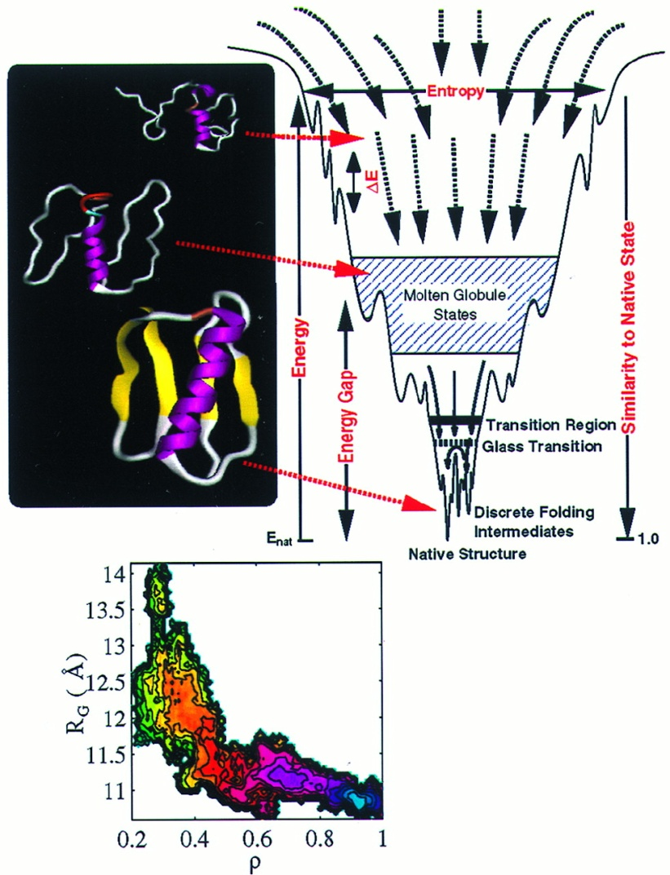
Generalization of Laws of Thermodynamics
Although the Laws of Thermodynamics were originally developed to described the
flow of heat, the concepts of
energy and entropy have been
generalized to apply to
every dynamic physical
system:
  Example: protein folding

Slide 28
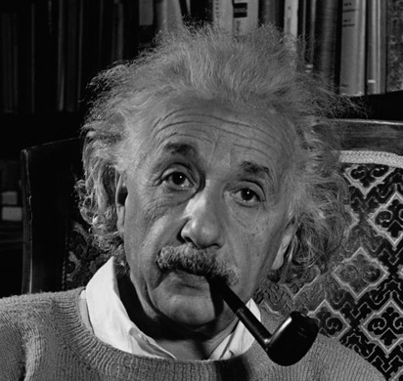
My World: Energy Conservation in Particle Decay
Einstein said
  Particle at rest: E=Mc²
  Particle in motion: E²=(Mc²)²+(pc)²
When a neutron decays (at rest)
momentum
Total
energy
conserved

Slide 29
The Bottom Line
To date, no violation of the Laws of Thermodynamics has ever been observed
  Period.
  Exclamation point!
  Red box around it

Slide 30
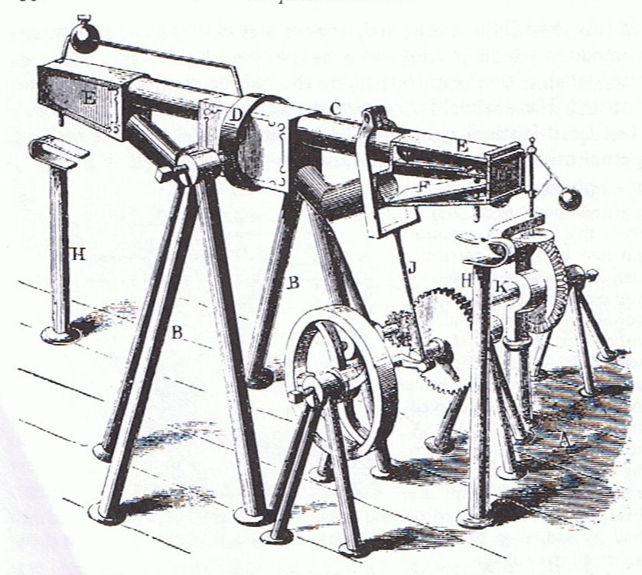
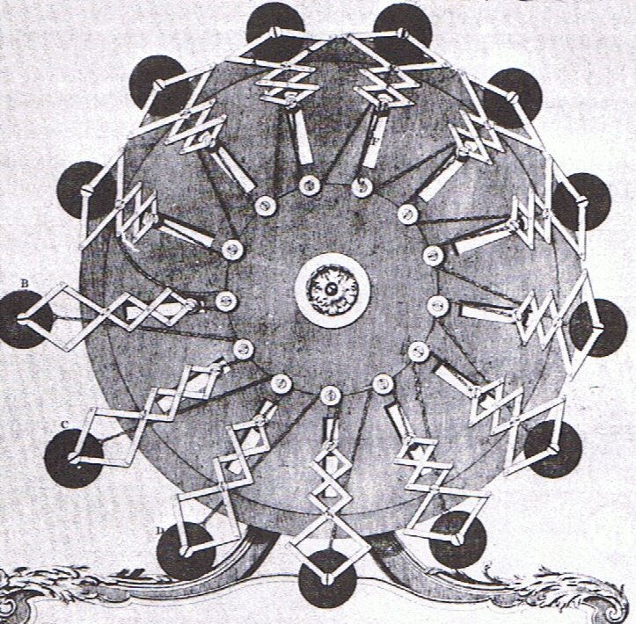
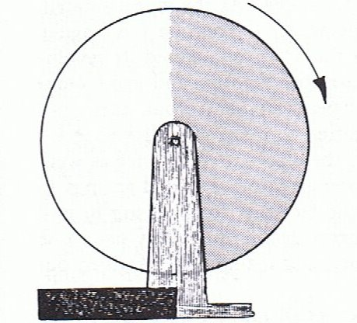
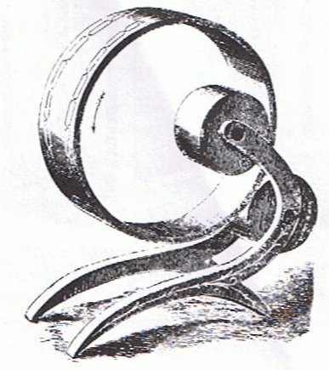
Interest continued, undaunted by facts*
Gravitational imbalance…
*Illustrations taken from A.W.J.G Ord-Hume, “Perpetual Motion: The History of an Obsession”
Gravitational shield!

Slide 31
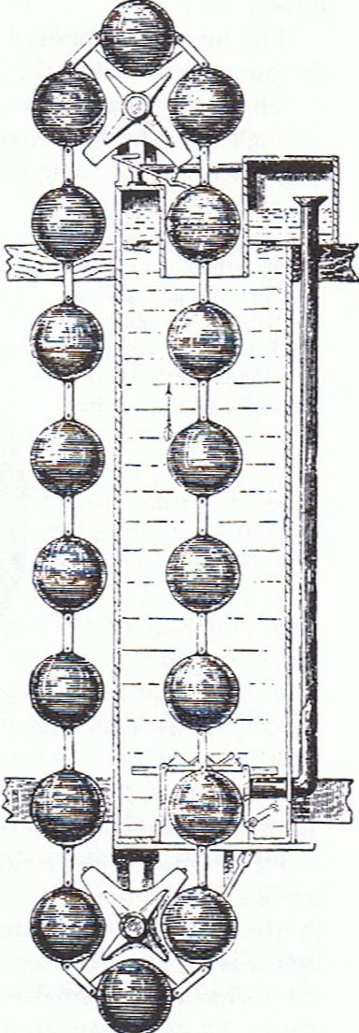
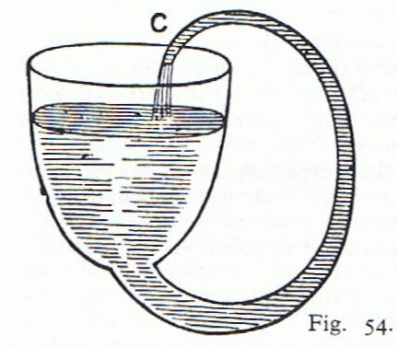
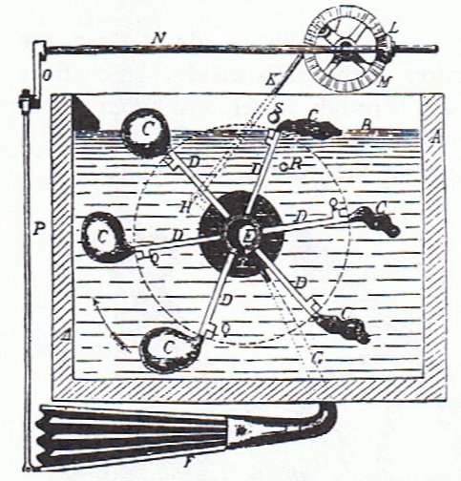
More ideas
Capillary action and buoyancy…

Slide 32
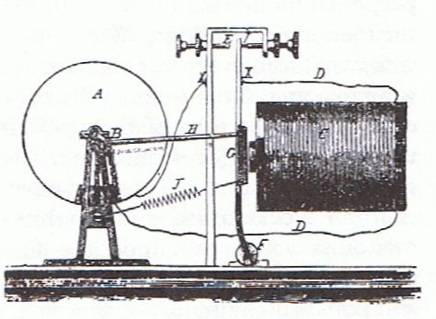
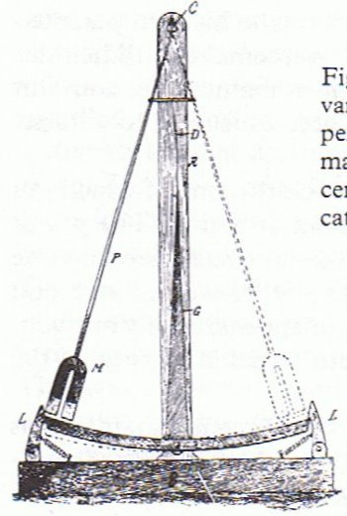
Hope springs eternal
Electricity/magnetism based…
As we’ll see, this is the class with the most staying power today

Slide 33
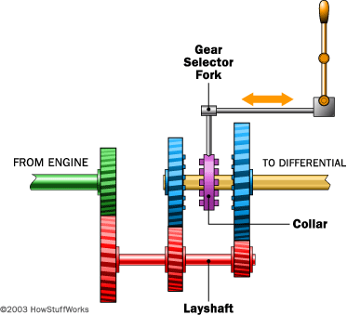
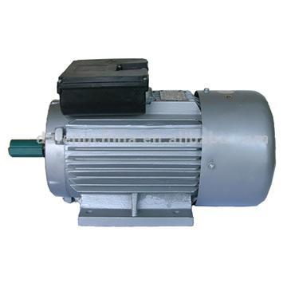
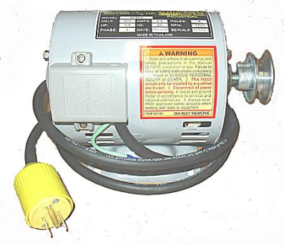
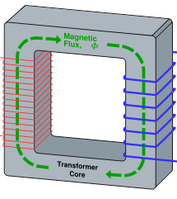

Perpetual Motion 101 (electricity example)
Start with a motor…
which turns a generator…
which powers the motor…
with perhaps some left over!
Doesn’t work??
Try adding some gears…
or maybe a transformer
etc, etc, etc…

Slide 34
Redefining the problem
Instead of talking about “perpetual motion”, talk about “over-unity”; that is, gearboxes, transformers, etc, in which the power out is greater than the power in
Physically, P_{out}≤P_{in} - ALWAYS
“Over-unity” = “perpetual motion” - PERIOD
torque
current
angular frequency
voltage

Slide 35
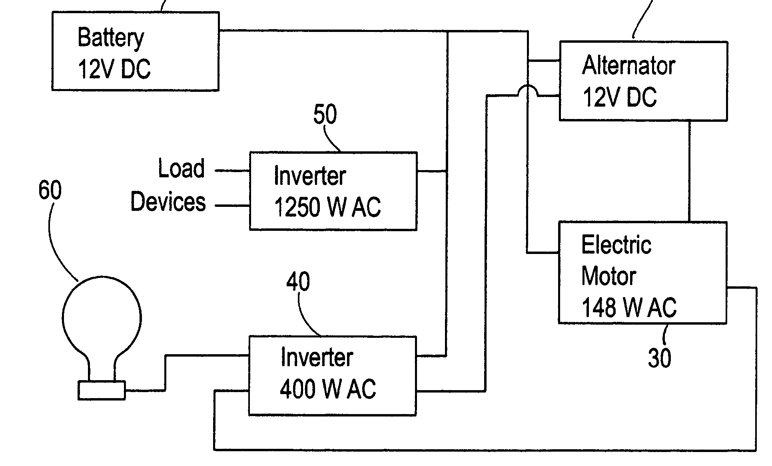
In case you thought my example was silly
US Patent #7,095,126: ”Internal Energy Generating Power Source” (2006)
ABSTRACT
An external power source such as a battery is used to initially supply power to start an alternator and generator. Once the system has started it is not necessary for the battery to supply power to the system. The battery can then be disconnected. The alternator and electric motor work in combination to generator (sic) electrical power.

Slide 36
Speaking of patents
A partial list of US patents purported to support perpetual motion:
  2,006,676: “Electrolytic Carburetor” (Garrett Carburetor)
    Launched a whole kook industry
  4,074,153: “Magnetic propulsion device”
  4,151,431: “Permanent magnet motor”
  4,215,330: “Permanent magnet propulsion system”
  6,246,561: “Methods for controlling the path of magnet flux…”
  6,362,718: “Motionless electromagnetic generator”
    More about this one later
  6,523,646: “Spring driven apparatus”
  6,526,925: “Piston driven rotary engine”
  6,962,052: “Energy generation mechanism, device and system”
  7,095,126: “Internal energy generating power source”
    The one we just talked about

Slide 37
Patents and perpetual motion
The Patent Office has had so much trouble with perpetual motion machine patents that it’s developed special rules.:
  “With the exception of cases involving perpetual motion, a model is not ordinarily required by the Office to demonstrate the operability of a device. If operability of a device is questioned, the applicant must establish it to the satisfaction of the examiner”
  - 35 U.S.C 101 (Examiners’ Handbook)
  Translation: “If the Patent Office didn’t ask for a working model, they didn’t believe it was a perpetual motion machine”.

Slide 38
More about patents
Also from the Examiners’ Manual
  “A rejection under 35 U.S.C. 101 for lack of utility should not be based on grounds that the invention is frivolous, fraudulent or against public policy.”
In a judicial case involving this statute, the judge ruled
  “...we find no basis in section 101 to hold that inventions can be ruled unpatentable for lack of utility simply because they have the capacity to fool some members of the public.“
  Translation: “The Patent Office will patent things even if it’s clear they will be used to defraud people”

Slide 39
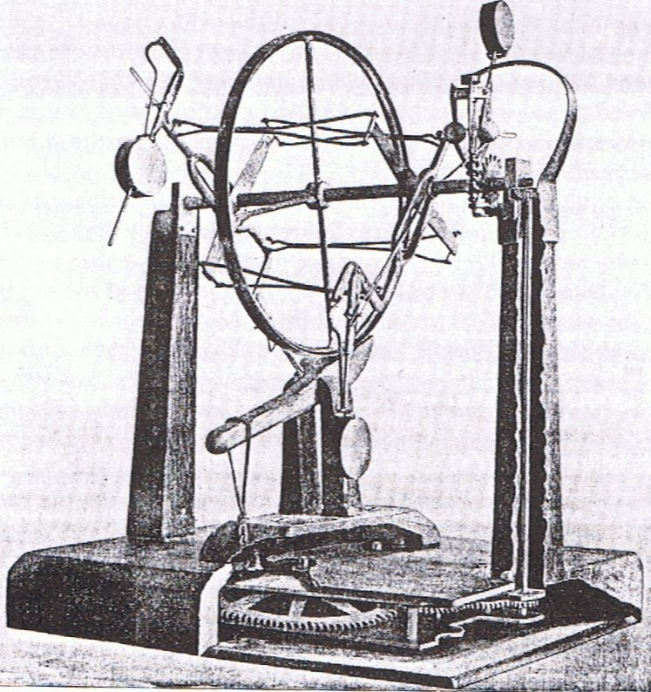
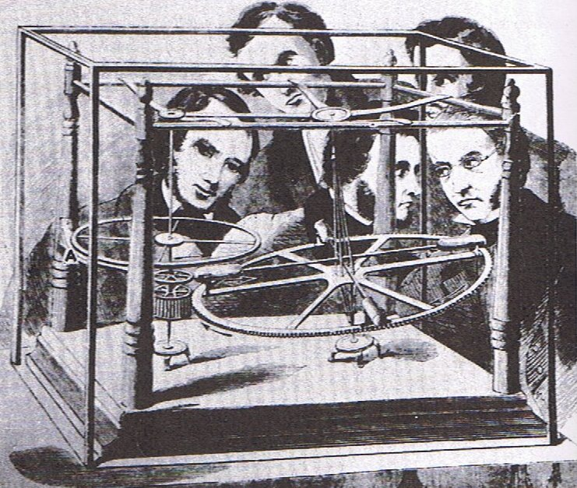
Early frauds
Perpetual motion was mostly an intellectual curiosity, until the Industrial Revolution convinced people of its “value”
J.M. Aldrich’s machine ran on hidden springs (1899)
E.P. Willis’ “overbalanced wheel” ran on hidden compressed air. (1850’s)

Slide 40
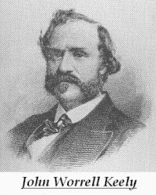
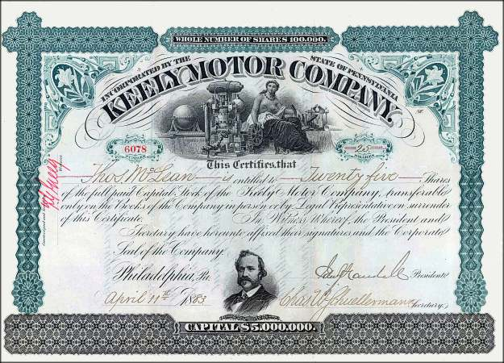
John Keely: the father of the free energy scam
There were numerous perpetual motion frauds in the 19th century, but most were pretty small scale
In 1872, John E. Worrel Keely claimed
to have discovered a new type of
motor, which used some sort of
musical resonance to extract energy
from the “luminiferous ether”.
He formed the “Keely Motor Company”, began giving public demonstrations and selling stock.

Slide 41
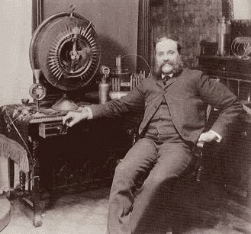
Keely and his times
In the context of the times, Keely’s claims were not all that unbelievable:
  This was before Special Relativity, and
  “Luminiferous Ether” was the
  hypothetical fluid through which
  electromagnetic waves, including light,
  propagated.
  This was the golden age of empirical
  physics, and finding a way to extract
  energy from this medium was not yet
  experimentally ruled out.
Keely’s behavior, on other hand, should have raised some alarm bells
  He never published any data regarding the mode of operation of his machine in scientific journals.
  He never allowed any independent test or even inspection of his machine.

Slide 42
The end(?) of Keely
After many years of delays, investors were becoming frustrated with Keely’s failure to produce a commercial device, and his refusal to allow independent testing.
  They began withdrawing their investments and advising others to do the same.
Clara Bloomfield-Moore, a wealthy Philadelphia widow, came to the rescue with a large sum of cash and a monthly stipend.
  However, she insisted on a review by the engineer E.A. Scott.
  She dramatically reduced her support when it came back negative.
In 1890, Keely announced a new product, “The Liberator”, which would allow a motor to run on water.
  Few people believed him.
Keely died a few years later

Slide 43
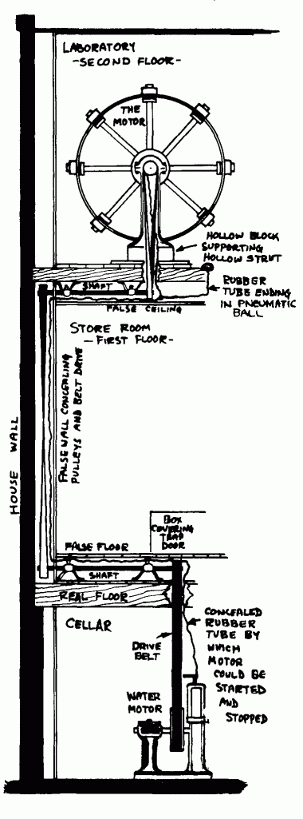
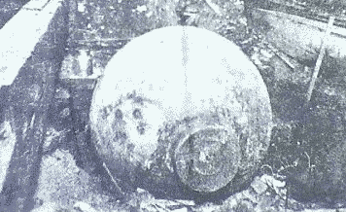
Keely: postmortem
“Scientific American” had always been skeptical of Keely. Following his death, they inspected his home.
They discovered an elaborate system of pipes and hoses, connected to his machines through hollowed out legs on the furniture!
The entire system was powered by a compressed air tank in the basement.

Slide 44
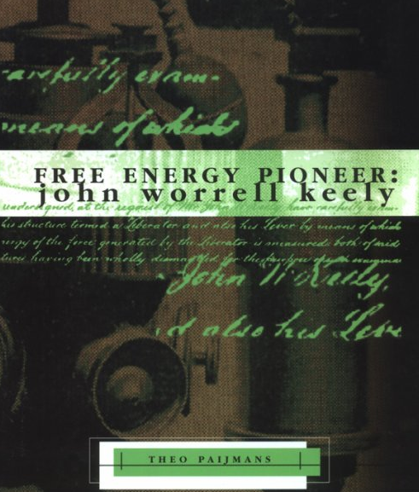
Keely today
Keely’s claims were thoroughly
and completely debunked over a
century ago.
Nevertheless, thousands of
people still believe Keely held the
key to limitless power and much
more.
Example
  “Over 100 years ago, John Ernst Worrell Keely (1827-1898), developed an advanced synthesis of science and philosophy. Keely was harnessing Sound, Light, Heart, Mind and Will to operate revolutionary new machinery and to improve Life and health. This is a science based on Natural Law governing Life, hope and Love and not Death, despair and destruction.”
              - from the Sympathetic Vibration Physics website

Slide 45
Major classes of modern free energy devices
Motors that run on permanent magnets
  Usually find excuses to connect them to batteries
“Over-unity” transformers that put out more electrical power than they take in.
  Rather than admit they are selling a perpetual motion machine, they will usually claim to be tapping the “Zero Point Energy” (ZPE)
Engines that run on water
  Generally deny being “perpetual motion machines”
  Instead claim to split water into H and O with “very high efficiency”
Fancy jars of goo
  Cold fusion
  Self-charging batteries
  Yet more ZPE devices

Slide 46
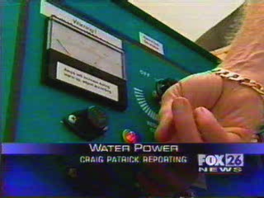
Energy from water*
*this is the clip that got me started on this crusade

Slide 47
Science and the media
With a few exceptions, when it comes to science, news media are awful.
When it comes to pseudo-science, the media are godawful.
When it comes to free energy con games, news media should arguably be charged as accomplices.
If you remember nothing else from this lecture, remember this:
  No significant scientific result has ever been reported first by the evening news (or a YouTube video)!

Slide 48
What a good reporter might have noticed
If you could build a car that runs on water, why would you build a “gas-water hybrid”? Nostalgia?
They used “4 ounces of water”, but how much gas?
Do you have a lot of call to cut through charcoal?
  Could it be the Oxygen was combining directly with the Carbon and the charcoal was simply burning itself?
Nothing magic about making a flame with Hydrogen from electrolysis.
  Particularly with a unit the size of an arc-welder.
This sort of thing has been tried many times before
  Google “Brown’s gas” or “Klein’s gas”, for example

Slide 49
The "science" of Aquygen
Like many free energy scams, Aquygen claims their product is based on revolutionary new physics.
  In this case, a new molecular state of Hydrogen and Oxygen (HHO)
Their website includes a scientific paper by R. Santilli at the “Institute for Basic Research”
What is the IBR?
  Well, it has four locations, one for each of its four members:
    Florida
    Italy
    Kazakhstan (and this was before Borat!)
    Nigeria (OK, should have expected that)
Basically, they publish scientific sounding nonsense in support of free energy scams.

Slide 50
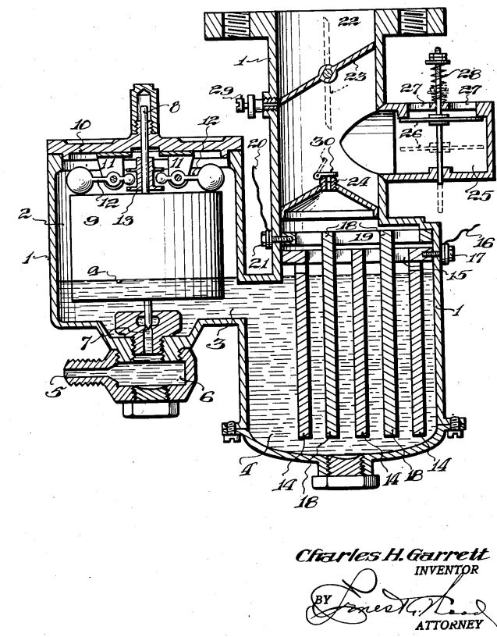
Motors that run on water
Tapping the energy of water is to
the “free energy community” what
the Philosopher’s Stone was to
alchemists.
Recall, Keely himself claimed to
have a motor which ran on water
in 1890.
A patent was issued in 1935 for the “Garrett Carburetor”, which set the standard for countless water schemes to follow. The principle is quite simple:
  Invent an “efficient” way to use electricity to separate water into Hydrogen and Oxygen.
  Burn the Hydrogen.
  Use a small amount of the energy to generate electricity to produce more Hydrogen.

Slide 51
The problem
Burning Hydrogen and Oxygen produces water.
Remember the First Law of Thermodynamics
  An engine that runs on water
    Starts with water
    Ends with water (i.e. in the same state)
    Extracts useable energy
Cars that run on water violate the laws of physics as we know them

Slide 52
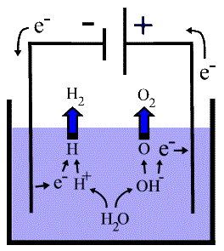
Electrolysis: in the real world
Electrolysis is the process by which
electricity is used to break water
into Hydrogen and Oxygen
Energy is released when the
Hydrogen and Oxygen are
recombined , which again
produces water
The energy release in recombining the Hydrogen and Oxygen is always less than the energy used in electrolysis.

Slide 53
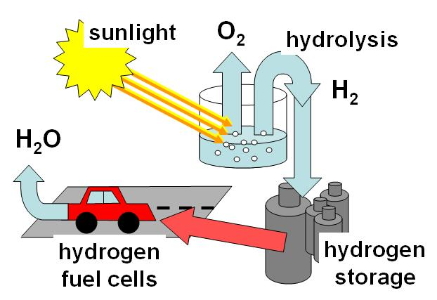
Application of Hydrogen cycle
Hydrogen can be used to store energy from inherently intermittent sources like wind and solar
Lots of practical problems to solve, but no problem with the laws of physics

Slide 54
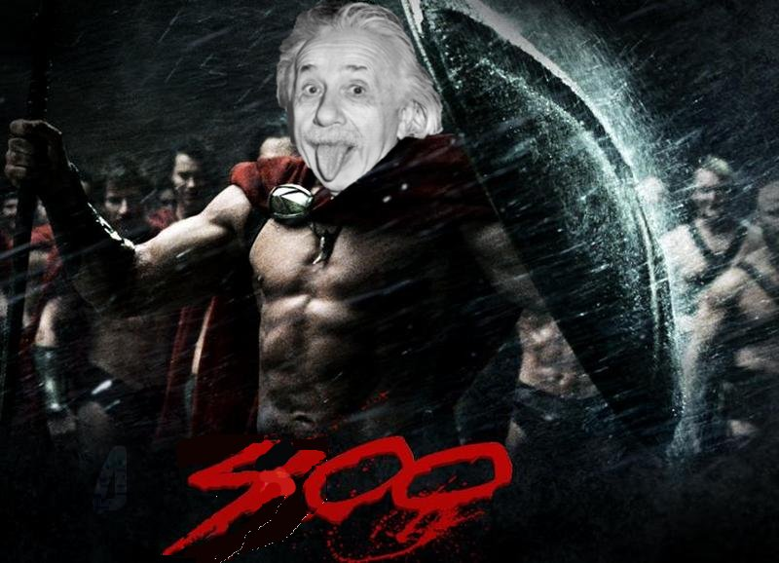
Case Study: Genesis World Energy
On December 5, 2002, Genesis World Energy issued a press release announcing
  “a scientific breakthrough that allows consumers to easily access the energy contained within the hydrogen and oxygen molecular structure of ordinary water”
This technology had
reportedly been
developed by “more
than 400 visionaries
from a wide range of
disciplines”.
Oddly, none were
named, but we were
assured they were
very impressive.

Slide 55
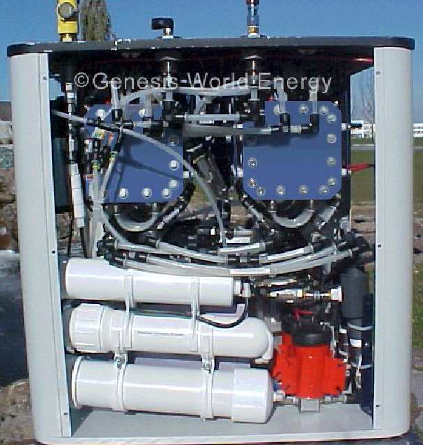
More oddities
In addition to the mysterious “400”, none of the company officers are named, nor does the company appear to have any facilities, or even an address.
Skeptics point out that the
press release specifies the
output of their “Edison
Device” in “kilowatts per
day” – a nonsensical unit.
  This error is never corrected
The company releases some
pictures, but allows no
independent inspections.

Slide 56


The plot thickens
On March 18, 2003, the company announces that it is poised to invest $20 billion in manufacturing facilities to begin producing commercial units in 2004, ramping up to 2 million units per day by the end of the year.
Even assuming they mean per business day, at the stated price of $3000 for the domestic unit, this translates to $1.5 trillion in gross annual sales
  ~ 4 x
  ~ 1 x

Slide 57
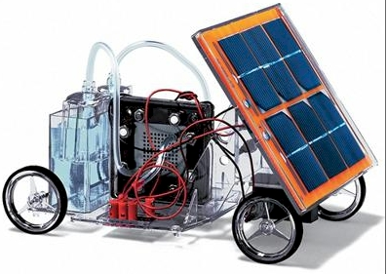
Beginning to unravel
On April 23, 2003, still having never produced a commercial product, GWE announces a new automotive technology.
Many recognize their
demonstration device as a child’s
toy which had been used in a
previous free energy scam.
2004 comes with no commercial
product. In response to nervous investors, GWE releases a report from an unnamed “independent lab”.
  Skeptics immediately jump on numerous errors – including the same unit confusion that was in the original press release.

Slide 58
The end of Genesis World Energy
On September 23, 2005, Patrick Kelly was arrested in Idaho on a New Jersey warrant. Although his name had never appeared in any news releases, Kelly was identified as the president of Genesis World Energy (which had changed its name at least twice by that time).
On September 31, 2006, Kelly pled guilty to securities fraud and was sentenced to five years in prison and a $400,000 fine. In sentencing, the judge stated, “the defendant is going to prison because he stole from investors”
  It’s estimated he took in about $2.5M in “investments”
In the end, the “400” turned out to be Kelly and one partner, whose involvement so limited that he wasn’t even convicted.

Slide 59
Prosecuting energy con men
Kelly was convicted for misappropriating corporate funds for personal expenditures (houses, credit cards for his daughter, etc)
  Only accused of mishandling about 10% of investment money.
  Ultimately irrelevant that the technology was bogus
Difficult to prosecute based on scientific claims. Must prove:
  Technology doesn’t work
  Technology can’t possibly work
  The people asking for your money know this
Most con men are smarter than Kelly
  Classify investments as “venture capital”
  Pay themselves a large salary
  Divert a little money to meaningless “R&D”
  Continue with impunity

Slide 60
Getting it wrong
Many of these people are quite sincere in their beliefs.
How can they get something as simple as conservation of energy so wrong?
A little knowledge is a dangerous thing.
One of the most common mistakes is to apply approximate physics formulae to situations where they aren’t relevant.

Slide 61
Defense of "fringe" science
It’s important to distinguish “crackpot science” from “fringe science”
“Fringe science” is science that involves measurements or theories which are extremely difficult to reconcile with the prevailing theoretical framework, but are nevertheless not yet ruled out experimentally.
  Fringe science is not only legitimate but vital.
Many accepted theories were once “fringe”
  Plate tectnonics
  Theory of relativity
  Quantum mechanics
  Expanding universe
Some examples of current fringe experiments include
  Search for tachyons
  Gravitational mass of antimatter
Unfortunately, unless care is taken, fringe science can easily become crackpot science…

Slide 62
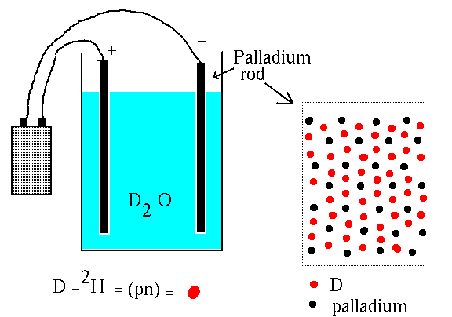
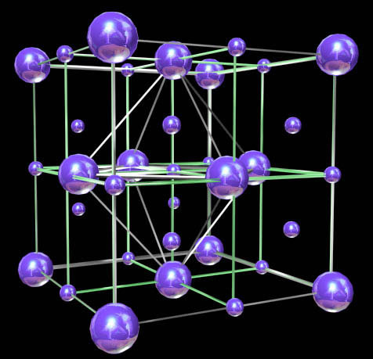
Cold fusion: the revolution that wasn't
In 1989, two teams announced
they had seen evidence for
nuclear fusion at room
temperature taking place in a
Palladium rod which had been
loaded with Deuterium from
heavy water.
One team, Pons and Fleischmann,
claimed energy release at a level which
promised practical application.
Although difficult to reconcile
with solid state physics, there’s
nothing a priori impossible about
the claim, and theorists struggle
to accommodate the result.

Slide 63
The road from fallacy to fraud
At the 1989 APS meeting, no one was able to confirm Pons and Fleischmann’s results
Nathan Lewis, a chemist at Cal Tech, offered an explanation for all of their results in terms of sloppy experimental techniques:
  Pons and Fleischmann did not attend, as they were busy soliciting funds.
In addition, obvious cross-checks were not done
  Control test with ordinary water
  Assay for Helium, the product of fusion
Cold fusion was dead – scientifically anyway.

Slide 64

And yet…
Cold fusion is alive and well in the minds of believers
There are magazines, websites, books, products, and conferences.
Still makes the news ~once/year
  Recent “60 Minutes” episode
Pons and Fleischmann continued to carry out “research” in France, funded by private investors.

Slide 65
Some final comments
This is just the tip of the iceberg
  Just go to YouTube and search for
    Tom Bearden
    Joe Newman
    Stan Meyer
    Bedini Motor
    Or just “free energy”
  Watch the videos and read the comments
Perpetual motion is just one facet of our society’s obsession with pseudo-science
  Compare the Atsrology section of B&N with the Science section.
We will never solve the daunting (and exciting) energy challenges facing us unless we first face reality.

Slide 66
Backup slides

Slide 67
First: some acknowledgements
Donna Askins
  This originally started as a proposed guest lecture for a class she was going to give at a local community college
Prof. Janet Conrad
  For letting me try this lecture the first time at Columbia University.
Prof. Bob Park
  For writing “Voodoo Science”
  and a lifetime spent at the thankless task of trying to educate the public about science
Eric Krieg
  Catalogs free energy claims and scams as a public service
Fermilab
  For encouraging public outreach
Google, Wikipedia, and YouTube!!!

Slide 68

Don't be fooled by technobabble
Sounds impressive…or at least incomprehensible

Slide 69
The claims in the video
“Standard electrodynamics assumes flat spacetime”
  WRONG – electrodynamics works fine in curved spacetime, which leads to the bending of light
  This was predicted by Einstein and experimental verified almost a century ago!
Reference to Lee and Yang
  He seems to be confusing the 1957 Nobel Prize (Lee and Yang) for discovering “handedness” in weak interactions with the 1979 Nobel Prize (Glashow, Weinberg, Salam) for unifying electromagnetic and weak interaction by (among other things) interacting with the vacuum.
  Of course, neither of these have anything to do with what he’s talking about.
The point is, there’s no content in this video or any of the dozens of others Bearden has produced.
  It’s just scientific-sounding nonsense!

Slide 70
So how can you tell the difference…
…between real science, and scientific sounding jargon?
Science is very complex and specialized. Some things can really only be understood by experts.
For example, consider the two journal articles
Even scientists sometimes have to avoid the “Emperor's New Clothes” syndrome.
Chang and Georgi,
“Quantum modified mooses”
Nuclear Physics B672 (2003)
Ganfornina and Valdes,
“Studies on the Tsagas-Sourlas-Santilli Isotopology”
Algebras, Groups, and Geometries (2003)
Real paper by real physicists in a respected journal (Nucl. Phys. B)
Nonsense, self-published by kooks

Slide 71
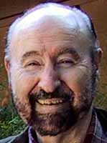
Who is Tom Bearden?
In short, he’s the cult figure in the
free energy community:
  Next to Tesla, of course
He has a B.S. in Math from
Northeastern Louisiana University,
and a Master’s in Nuclear Engineering
from the Georgia Institute Technology.
He retired from the Army at the rank of Colonel
  This appears to have been his only real job .
For a while he identified himself as “Thomas Bearden, PhD”
  His PhD turned out to be purchased from “Trinity College and University” – a notorious degree mill.
  He’s back to just “Thomas Bearden” - usually

Slide 72





Bearden's claims
For decades, Bearden has been making numerous claims involving “over-unity” physics (he avoids the term “perpetual motion”)
  Claims that these technologies are being suppressed by governments and special interests
He has written at least 10 books on free energy, conspiracy theories, AIDS
For example, he believes both the Challenger accident and Chernobyl were triggered by secret “scalar wave” weapons.
… and one on Aikido

Slide 73
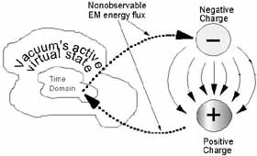
The "science" of Tom Bearden
Bearden supports his claims
with a random stream of
physics jargon and famous
names:
  “Zero Point energy”, “Scalar
  waves”, “Nikola Tesla”,
  “broken symmetry”,
  “Aharonov-Bohm Effect”, etc, etc, etc.
One analysis of his theories (by real physicists) described them as:
  "full of misconceptions and misunderstandings concerning the theory of the electromagnetic field”
        - Carvalho and Rodrigues, “The non sequitur mathematics and physics of the New Electrodynamics proposed by the AIAS group"

Slide 74
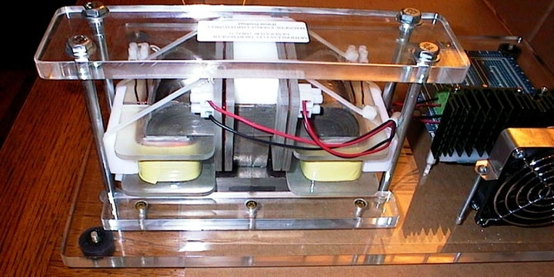
The motionless electric generator (MEG)
Patented in 2002 by a group
led by Bearden.
Purports to be a device for
extracting energy from the
vacuum (or from “scalar waves”,
the explanation is not clear).
In 2002, Bearden promised a
commercial model in “a year or so”
As of 2005, he claimed he still needed “$10-$12 million dollars” to develop the MEG into a commercial product.
  It’s not clear what the money is for, since he claims it has already produced “100 times more energy than was input”.
To date, there is still no commercial product.
Independent analyst essentially describe it as “a fancy transformer”.
Cited by many as “absolute proof” of “over-unity” physics.

Slide 75
Other claims by Bearden*
Numerous “over-unity” technologies exist, but are actively suppressed by government or special interests, using means up to and including murder.
Believes that something called “scalar waves” are being secretly developed as a weapon, and in fact are responible for:
  Cernobyl
  The disintegration of the space shuttle Challenger
  The 2001 Indonesian tsumani
  Hurricane Katrina, which was engineered by a combination of the KGB, the Japanese Yakuza, and remaining members of the Aum Shinrikyo cult
What conclusion would you draw about the guy?
*from his website http://www.cheniere.org/

Slide 76
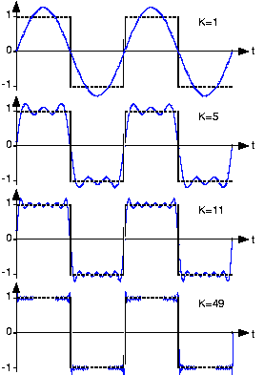
Example: complex waveforms
For a sine wave
but for a square wave
No simple formula works all the time.

Slide 77
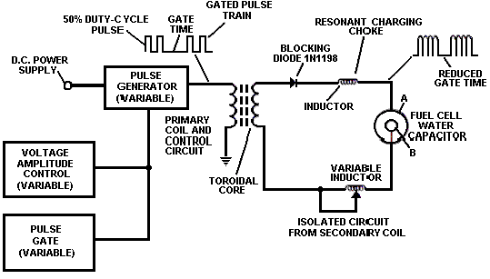
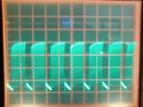
Can it be that simple?
Power circuit from Stan Meyer’s “Water Fuel Cell”
  Electrolysis driving waveform
All “over-unity” claims regarding Meyer’s cell result from erroneous evaluation of the power in this complex waveform.
Complicated waveforms are a very common feature of “over-unity” circuits.

