Slide 1
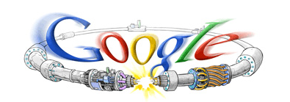
Upgrade Path for the LHC and the Role of US Collaboration
Eric Prebys, Fermilab
Director, US LHC Accelerator Research Program (LARP)
Google welcome screen from September 10, 2008

Slide 2

A Word about LARP
The US LHC Accelerator Research Program (LARP) coordinates US R&D related to the LHC accelerator and injector chain at Fermilab, Brookhaven, SLAC, and Berkeley (with a little at J-Lab and UT Austin)
LARP has contributed to the initial
operation of the LHC, but much of
the program is focused on future
upgrades.
The program is currently funded at
a level of about $12-13M/year, divided
among:
  Accelerator research
  Magnet research
  Programmatic activities, including support
  for personnel at CERN
NOT to be confused with this “LARP” (Live-Action Role Play), which has led to some interesting emails
(more about LARP later)

Slide 3
Outline
Overview of the LHC
2008 Startup
“The Incident” and Response
Current Commissioning Status and Plans
Upgrade Issues
Plan through 2020
LARP/US Role

Slide 4
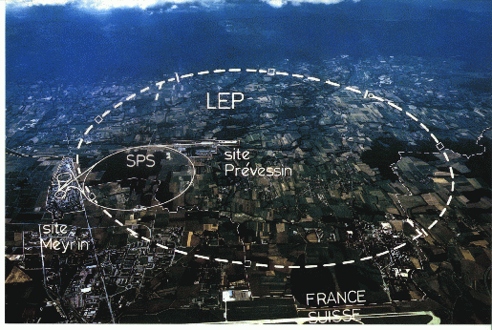
LHC: Location, Location, Location…
/LHC
Tunnel originally dug for LEP
  Built in 1980’s as an electron positron collider
  Max 100 GeV/beam, but 27 km in circumference!

Slide 5
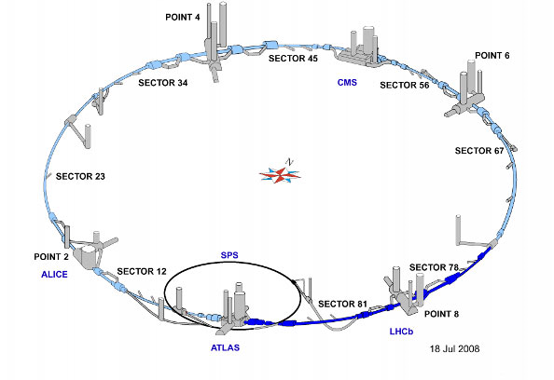
LHC Layout
8 crossing interaction points (IP’s)
Accelerator sectors labeled by which points they go between
  ie, sector 3-4 goes from point 3 to point 4

Slide 6
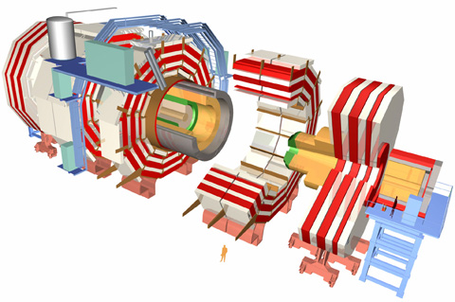
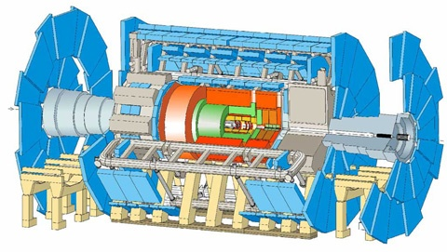

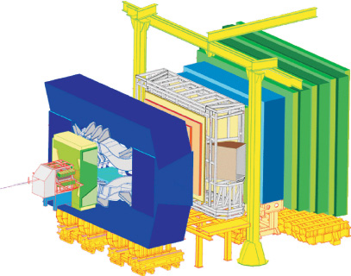
CERN Experiments
Huge, general purpose experiments:
“Medium” special purpose experiments:
Compact Muon Solenoid (CMS)
A Toroidal LHC ApparatuS (ATLAS)
A Large Ion Collider Experiment (ALICE)
B physics at the LHC (LHCb)

Slide 7
Nominal LHC Parameters Compared to Tevatron
Parameter | Tevatron | “nominal” LHC
Circumference | 6.28 km (2*PI) | 27 km
Beam Energy | 980 GeV | 7 TeV
Number of bunches | 36 | 2808
Protons/bunch | 275x10⁹ | 115x10⁹
pBar/bunch | 80x10⁹ | -
Stored beam energy | 1.6 + .5 MJ | 366+366 MJ*
Peak luminosity | 3.3x10³² cm⁻²s⁻¹ | 1.0x10³⁴ cm⁻²s⁻¹
Main Dipoles | 780 | 1232
Bend Field | 4.2 T | 8.3 T
Main Quadrupoles | ~200 | ~600
Operating temperature | 4.2 K (liquid He) | 1.9K (superfluid He)
1.0x10³⁴ cm⁻²s⁻¹ ~ 50 fb⁻¹/yr
*2.1 MJ ≡ “stick of dynamite” ⇒ very scary numbers

Slide 8
Partial LHC Timeline
1994:
  The CERN Council formally approves the LHC
1995:
  LHC Technical Design Report
2000:
  LEP completes its final run
  First dipole delivered
2005
  Civil engineering complete (CMS cavern)
  First dipole lowered into tunnel
2007
  Last magnet delivered
  First sector cold
  All interconnections completed
2008
  Accelerator complete
  Last public access
  Ring cold and under vacuum

Slide 9
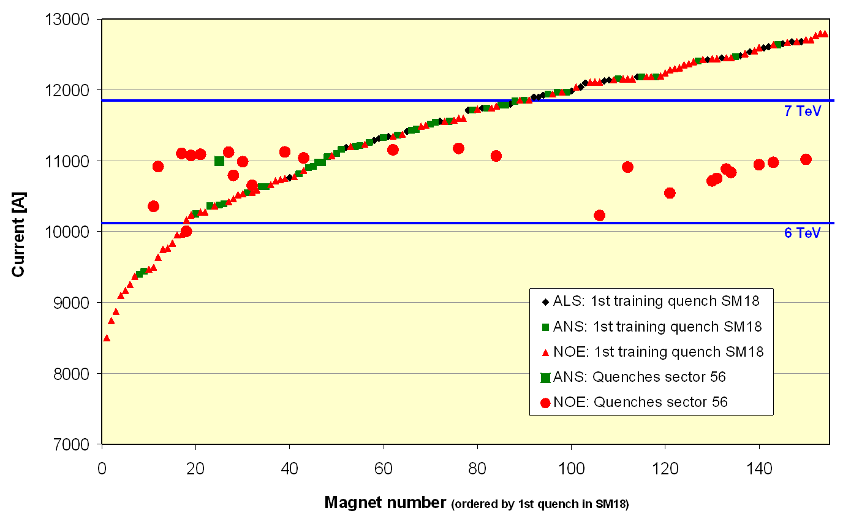
Problems out of the Gate
Magnet de-training
  ALL magnets were “trained” to
  achieve 7+ TeV.
  After being installed in the
  tunnel, it was discovered that
  the magnets supplied by one of
  the three vendors “forgot” their
  training.
Symmetric Quenches
  The original LHC quench protection system was insensitive to quenches
  that affected both apertures simultaneously.
  While this seldom happens in a primary quench, it turns out to be common when a quench propagates from one magnet to the next.
1st Training quench above ground
1st quench
in tunnel
For these reasons, the initial energy target was reduced to 5+5 TeV well before the start of the 2008 run.

Slide 10
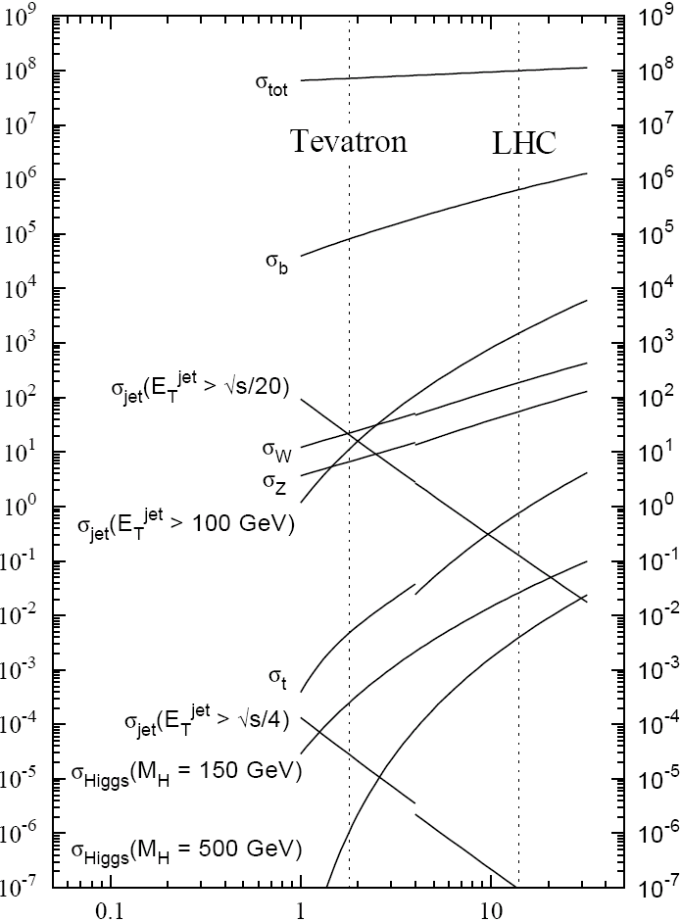

Experimental reach of LHC vs. Tevatron
200 pb⁻¹ at 5 TeV+5 TeV
~5 fb⁻¹ at 1 TeV+ 1 TeV
σ_{W} (M_{W}=80 GeV)
σ_{Z} (M_{Z}=91 GeV)

Slide 11
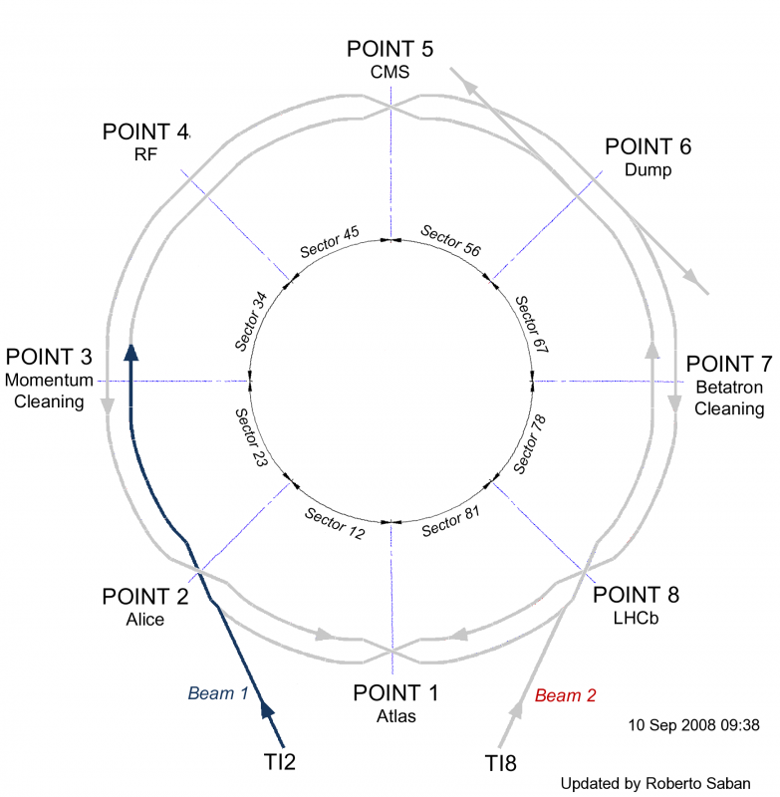
September 10, 2008: The Big Day
September 10, 2008: The (first) Big Day
Plotted the biggest media event in the history of science
This plot shows how
far beam had been
prior to Sept. 10.
Progress prior to event

Slide 12
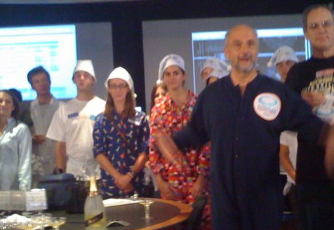
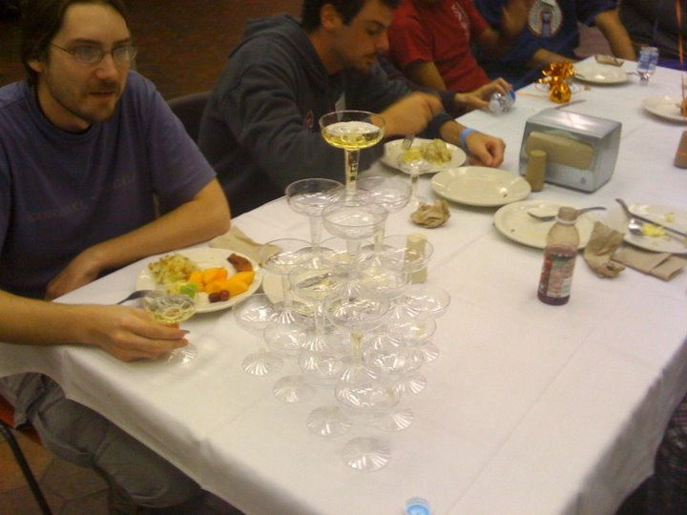
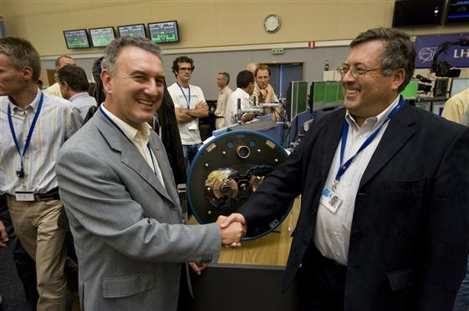
It begins…
9:35 – First beam injected
9:58 – beam past CMS to point 6 dump
10:15 – beam to point 1 (ATLAS)
10:26 – First turn!
…and there was much rejoicing
Commissioning proceeded smoothly and rapidly until September 19th, when something very bad happened

Slide 13

Nature abhors a (news) vacuum…
Italian newspapers were very poetic (at least as translated by “Babel Fish”):
"the black cloud of the bitterness still has not
been dissolved on the small forest in which
they are dipped the candid buildings of the CERN"
“Lyn Evans, head of the plan, support that it
was better to wait for before igniting the
machine and making the verifications of the parts.“*
Or you could Google “What really happened at CERN”:
**
* “Big Bang, il test bloccato fino all primavera 2009”, Corriere dela Sera, Sept. 24, 2008
**http://www.rense.com/general83/IncidentatCERN.pdf

Slide 14
What (really) really happened on September 19^{th*}
Sector 3-4 was being ramped to 9.3 kA, the equivalent of 5.5 TeV
  All other sectors had already been ramped to this level
  Sector 3-4 had previously only been ramped to 7 kA (4.1 TeV)
At 11:18AM, a quench developed in the splice between dipole C24 and quadrupole Q24
  Not initially detected by quench protection circuit
  Power supply tripped at .46 sec
  Discharge switches activated at .86 sec
Within the first second, an arc formed at the site of the quench
  The heat of the arc caused Helium to boil.
  The pressure rose beyond .13 MPa and ruptured into the insulation vacuum.
  Vacuum also degraded in the beam pipe
The pressure at the vacuum barrier reached ~10 bar (design value 1.5 bar). The force was transferred to the magnet stands, which broke.
*Official talk by Philippe LeBrun, Chamonix, Jan. 2009

Slide 15
Pressure forces on SSS vacuum barrier
Vacuum
Pressure
1 bar
1/3 load on cold mass (and support post)
~23 kN
1/3 load on barrier
~46 kN
Total load on 1 jack ~70 kN
V. Parma

Slide 16
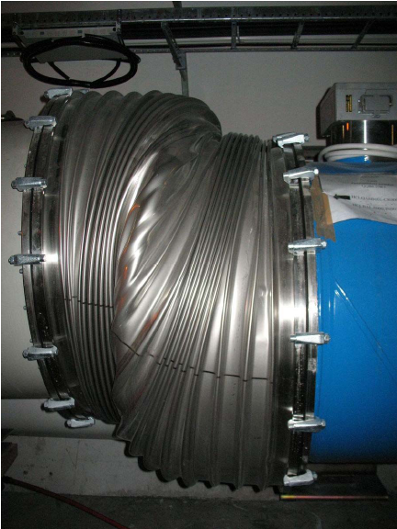

Collateral Damage: Magnet Displacements
QQBI.27R3

Slide 17
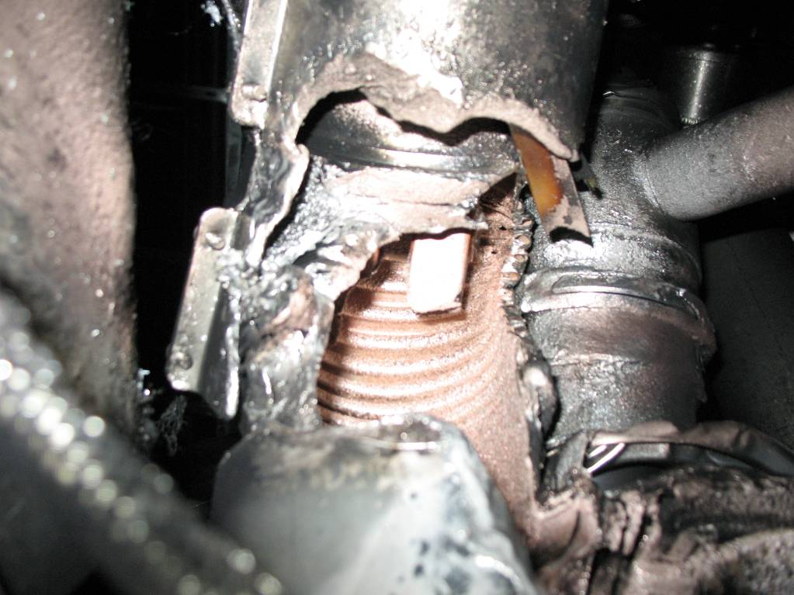
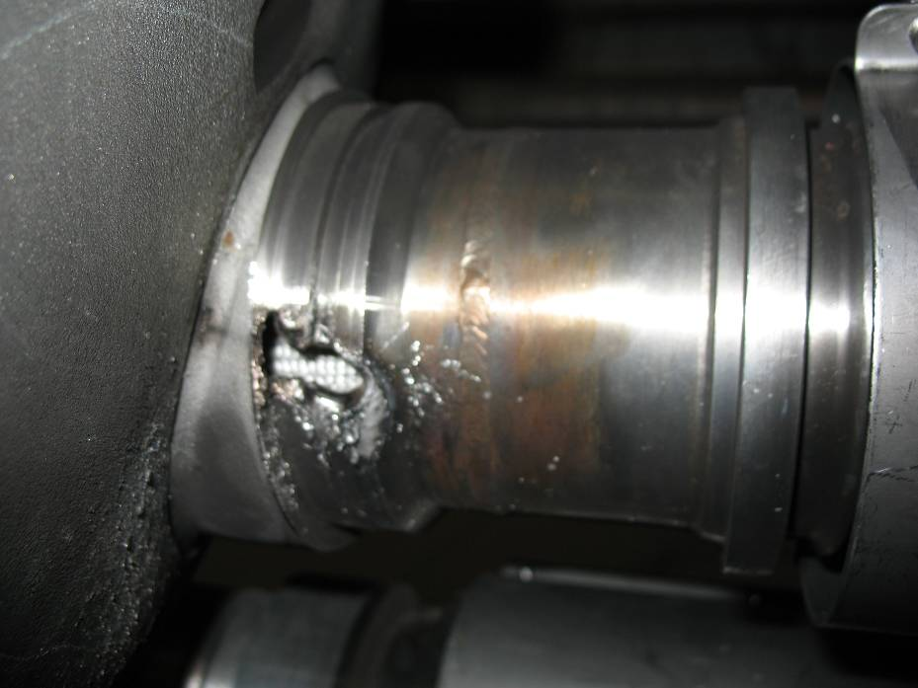
Collateral Damage: Secondary Arcs
QBBI.B31R3 M3 line
QQBI.27R3 M3 line

Slide 18
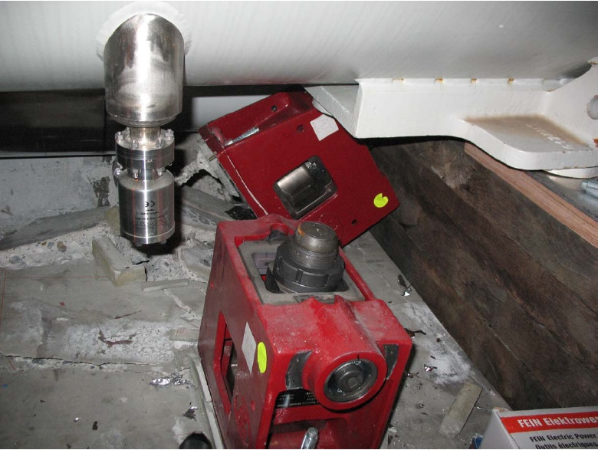
Collateral Damage: Ground Supports

Slide 19
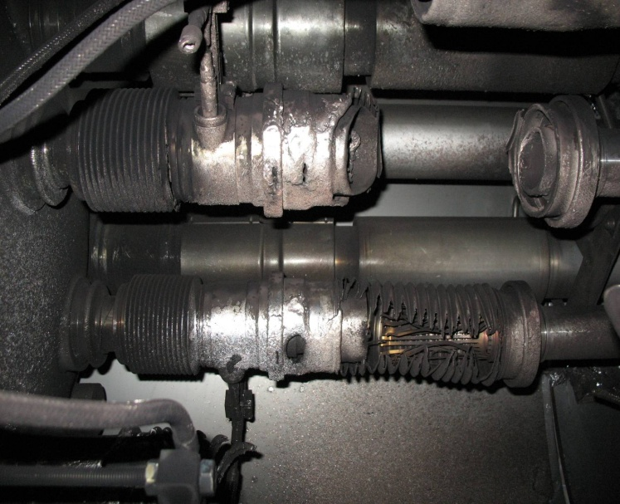
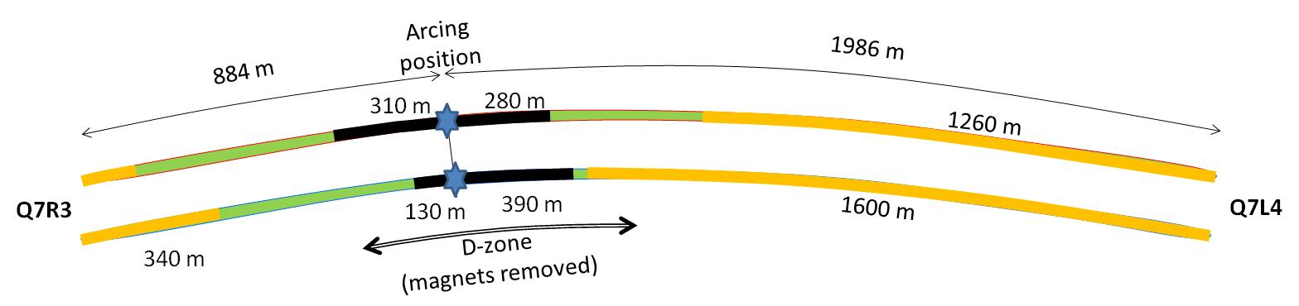

Collateral Damage: Beam Vacuum
Arc burned through beam vacuum pipe
clean
MLI
soot
The beam pipes were polluted with thousands of pieces of MLI and soot, from one extremity to the other of the sector
LSS3
LSS4
OK
Debris
MLI
Soot

Slide 20
Important Questions About “The Incident”
Why did the joint fail?
  Inherent problems with joint design
    No clamps
    Details of joint design
    Solder used
  Quality control problems
Why wasn’t it detected in time?
  There was indirect (calorimetric) evidence of an ohmic heat loss, but these data were not routinely monitored
  The bus quench protection circuit had a threshold of 1V, a factor of >1000 too high to detect the quench in time.
Why did it do so much damage?
  The pressure relief system was designed around an MCI Helium release of 2 kg/s, a factor of ten below what occurred.

Slide 21
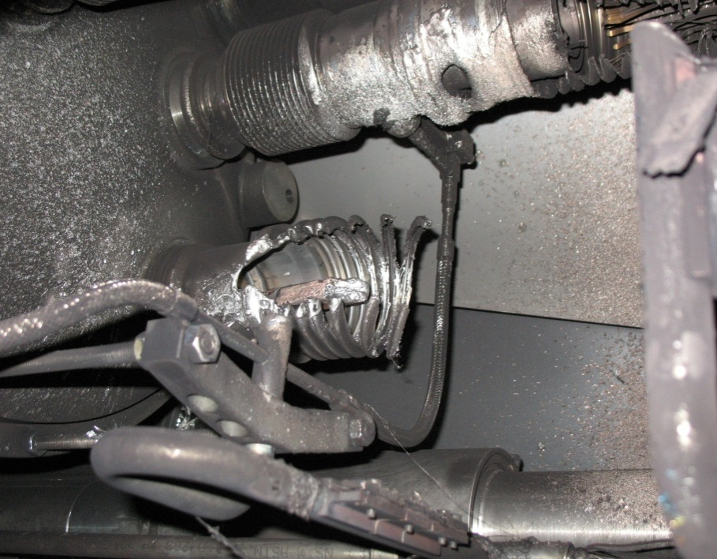
What happened?
Working theory: A resistive joint of about 220 nΩ with bad electrical and thermal contacts with the stabilizer
No electrical contact between wedge and U-profile with the bus on at least 1 side of the joint
No bonding at joint with the U-profile and the wedge
Loss of clamping pressure on the joint, and between joint and stabilizer
Degradation of transverse contact between superconducting cable and stabilizer
Interruption of longitudinal electrical continuity in stabilizer
Problem: this is where the evidence used to be
A. Verweij

Slide 22
Improvements
Bad joints
  Test for high resistance and look for signatures of heat loss in joints
  Warm up to repair any with signs of problems (additional three sectors)
Quench protection
  Old system sensitive to 1V
  New system sensitive to .3 mV (factor >3000)
Pressure relief
  Warm sectors (4 out of 8)
    Install 200mm relief flanges
    Enough capacity to handle even the maximum credible incident (MCI)
  Cold sectors
    Reconfigure service flanges as relief flanges
    Reinforce floor mounts
    Enough capacity to handle the incident that occurred, but not quite the MCI

Slide 23
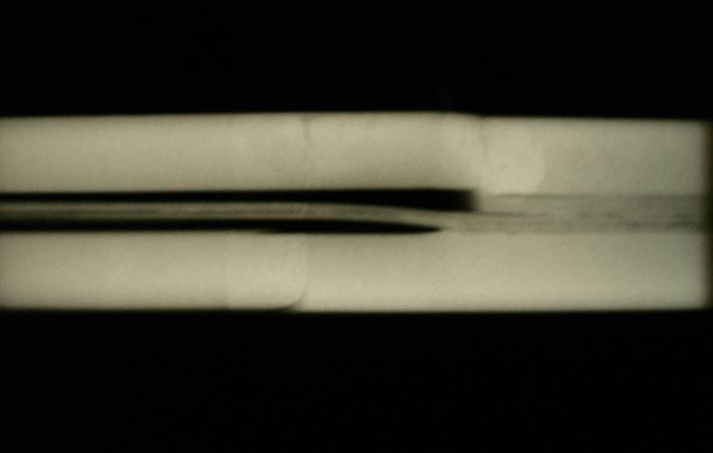
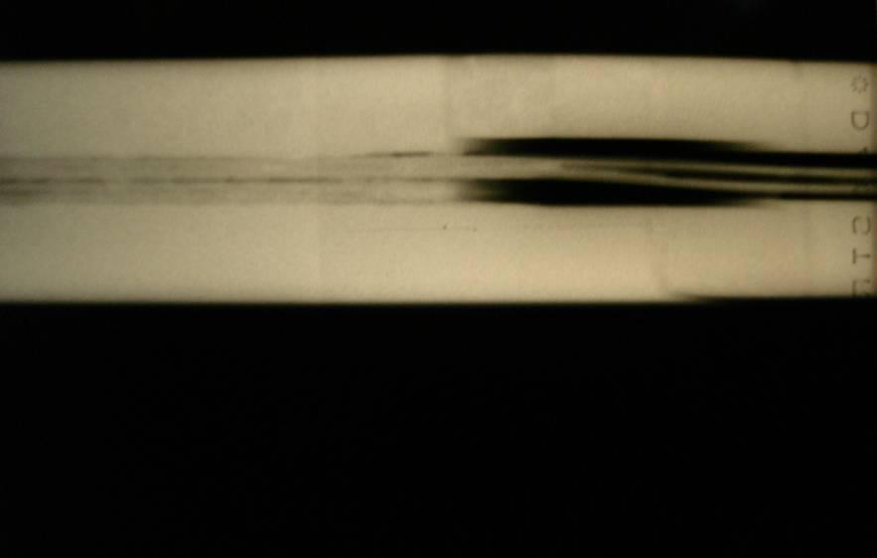
Bad surprise
With new quench protection, it was determined that joints would only fail if they had bad thermal and bad electrical contact, and how likely is that?
  Very, unfortunately ⇒ must verify copper joint
Have to warm up to at least 80K to measure Copper integrity.
Solder used to solder joint had the same melting temperature as solder used to pot cable in stablizer
⇒Solder wicked away from cable

Slide 24
Impact of Joint Problem
Tests at 80K identified an additional bad joint
  One additional sector was warmed up
  New release flanges were NOT installed
Based on thermal modeling of the joints, it was determined that they might NOT be reliable even at 5 TeV
  3.5 TeV considered the maximum safe operating energy for now
Decision:
  Run at 3.5+3.5 TeV until the end of 2011 or 1 fb⁻¹, whichever comes first.
  Shut down for ~15 months to repair all 10,000 (!!) joints.
    Dismantle
    Re-solder
    Clamp

Slide 25
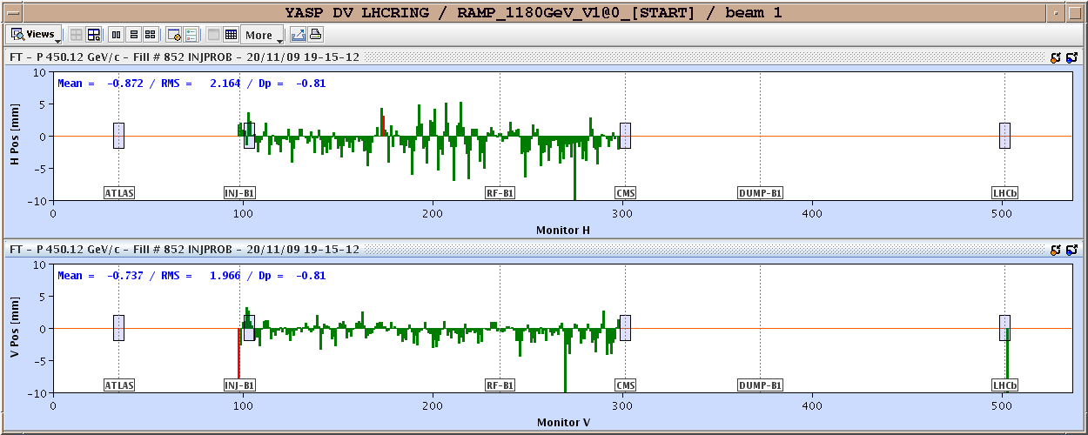
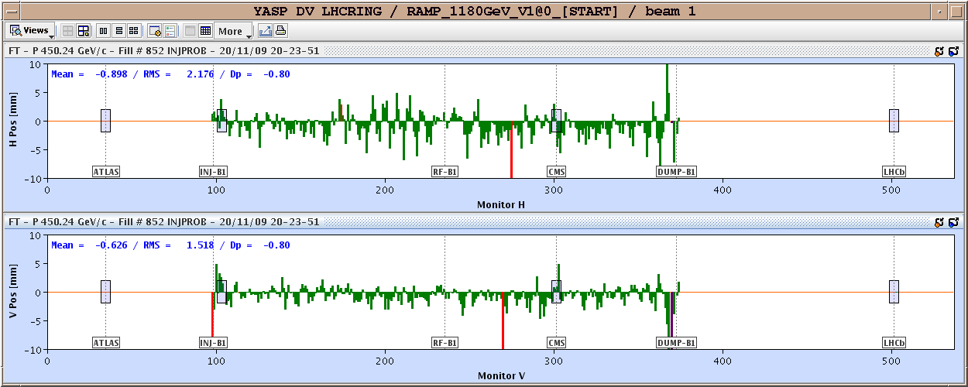
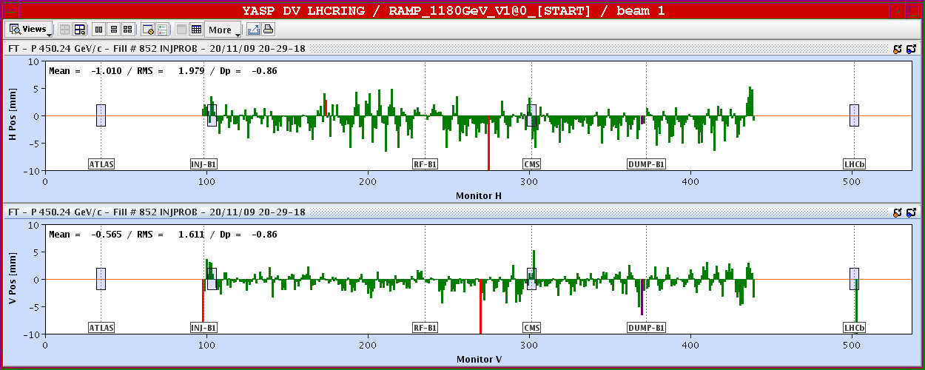
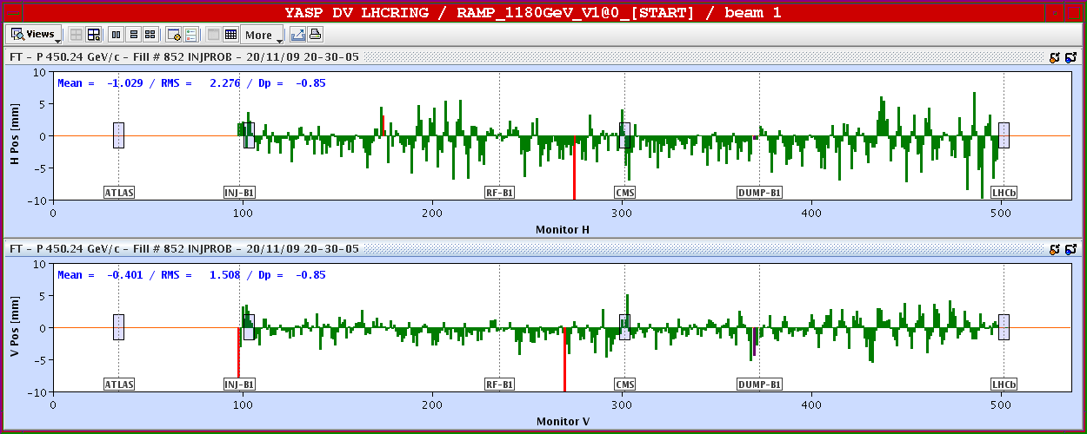
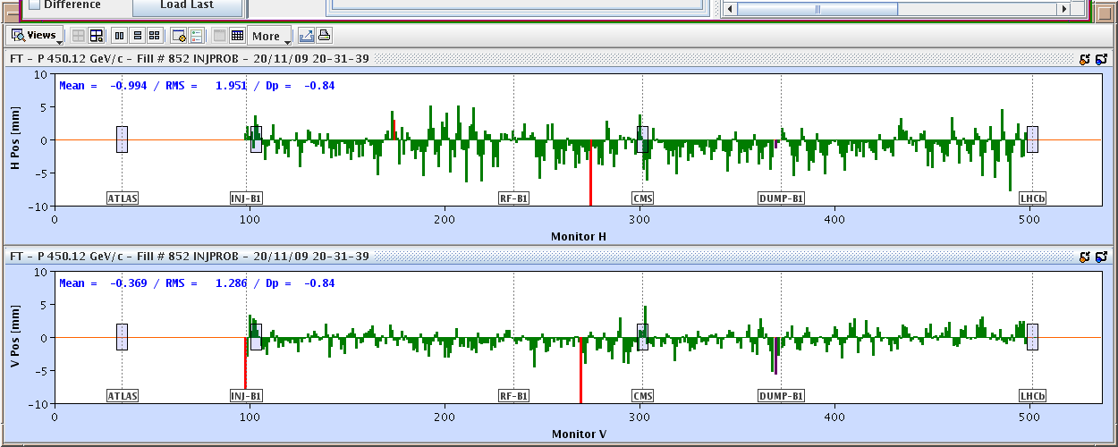
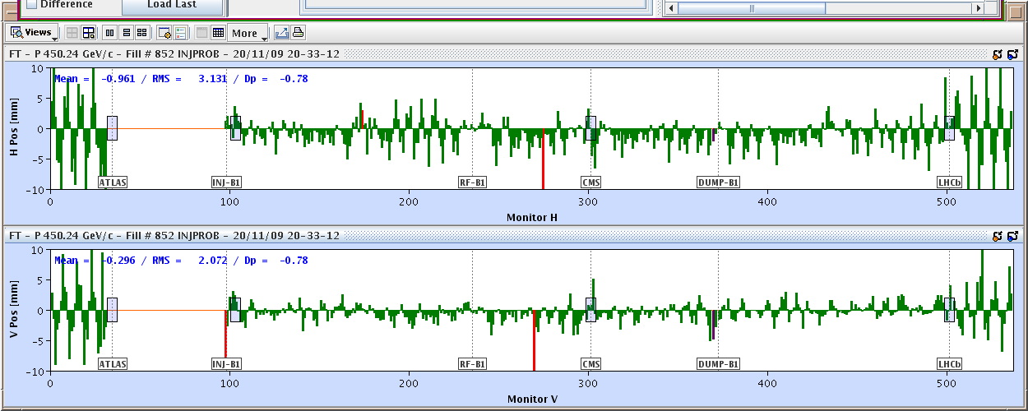
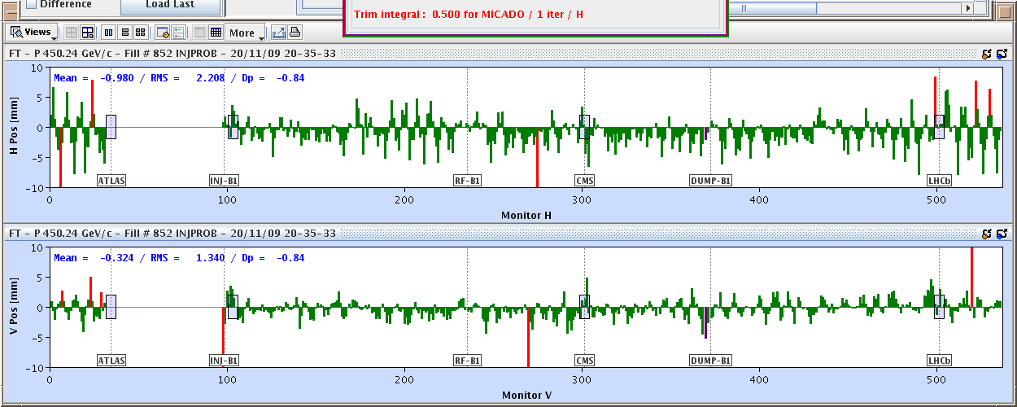
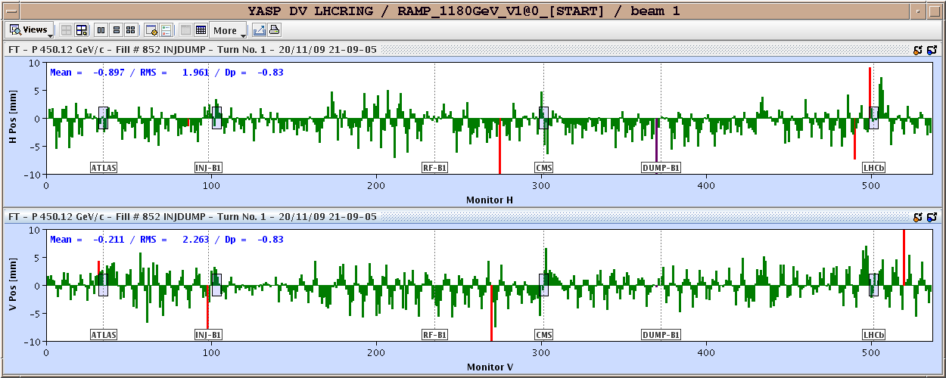
November 20, 2009: Going Around…Again
Total time: 1:43
Then things began to move with dizzying speed…

Slide 26
Progress Since Start-up
Sunday, November 29th, 2009:
  Both beams accelerated to 1.18 TeV simultaneously
  LHC Highest Energy Accelerator
Monday, December 14th
  Stable 2x2 at 1.18 TeV
  Collisions in all four experiments
  LHC Highest Energy Collider
Tuesday, March 30th, 2010
  Collisions at 3.5+3.5 TeV
  LHC Reaches target energy for 2010/2011
Then the hard part started…

Slide 27
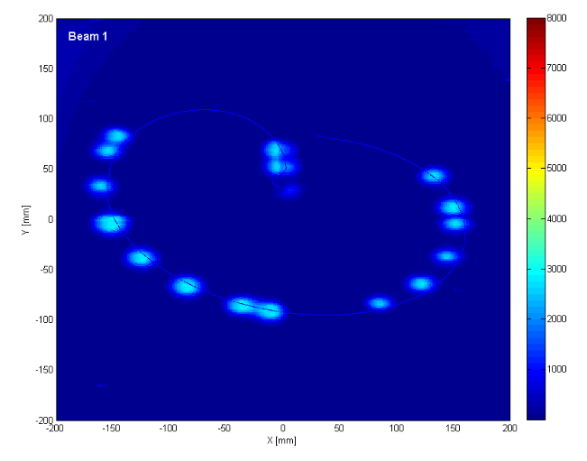
General Plan
Push bunch intensity
  Already reached nominal bunch intensity of 1.1x10¹¹ much faster than anticipated.
Increase number of bunches
  Go from single bunches to “bunch trains”, with gradually reduced spacing.
At all points, must carefully verify
  Beam collimation
  Beam protection
  Beam abort
Remember:
  TeV=1 week for cold repair
  LHC=3 months for cold repair
Example: beam sweeping over abort

Slide 28
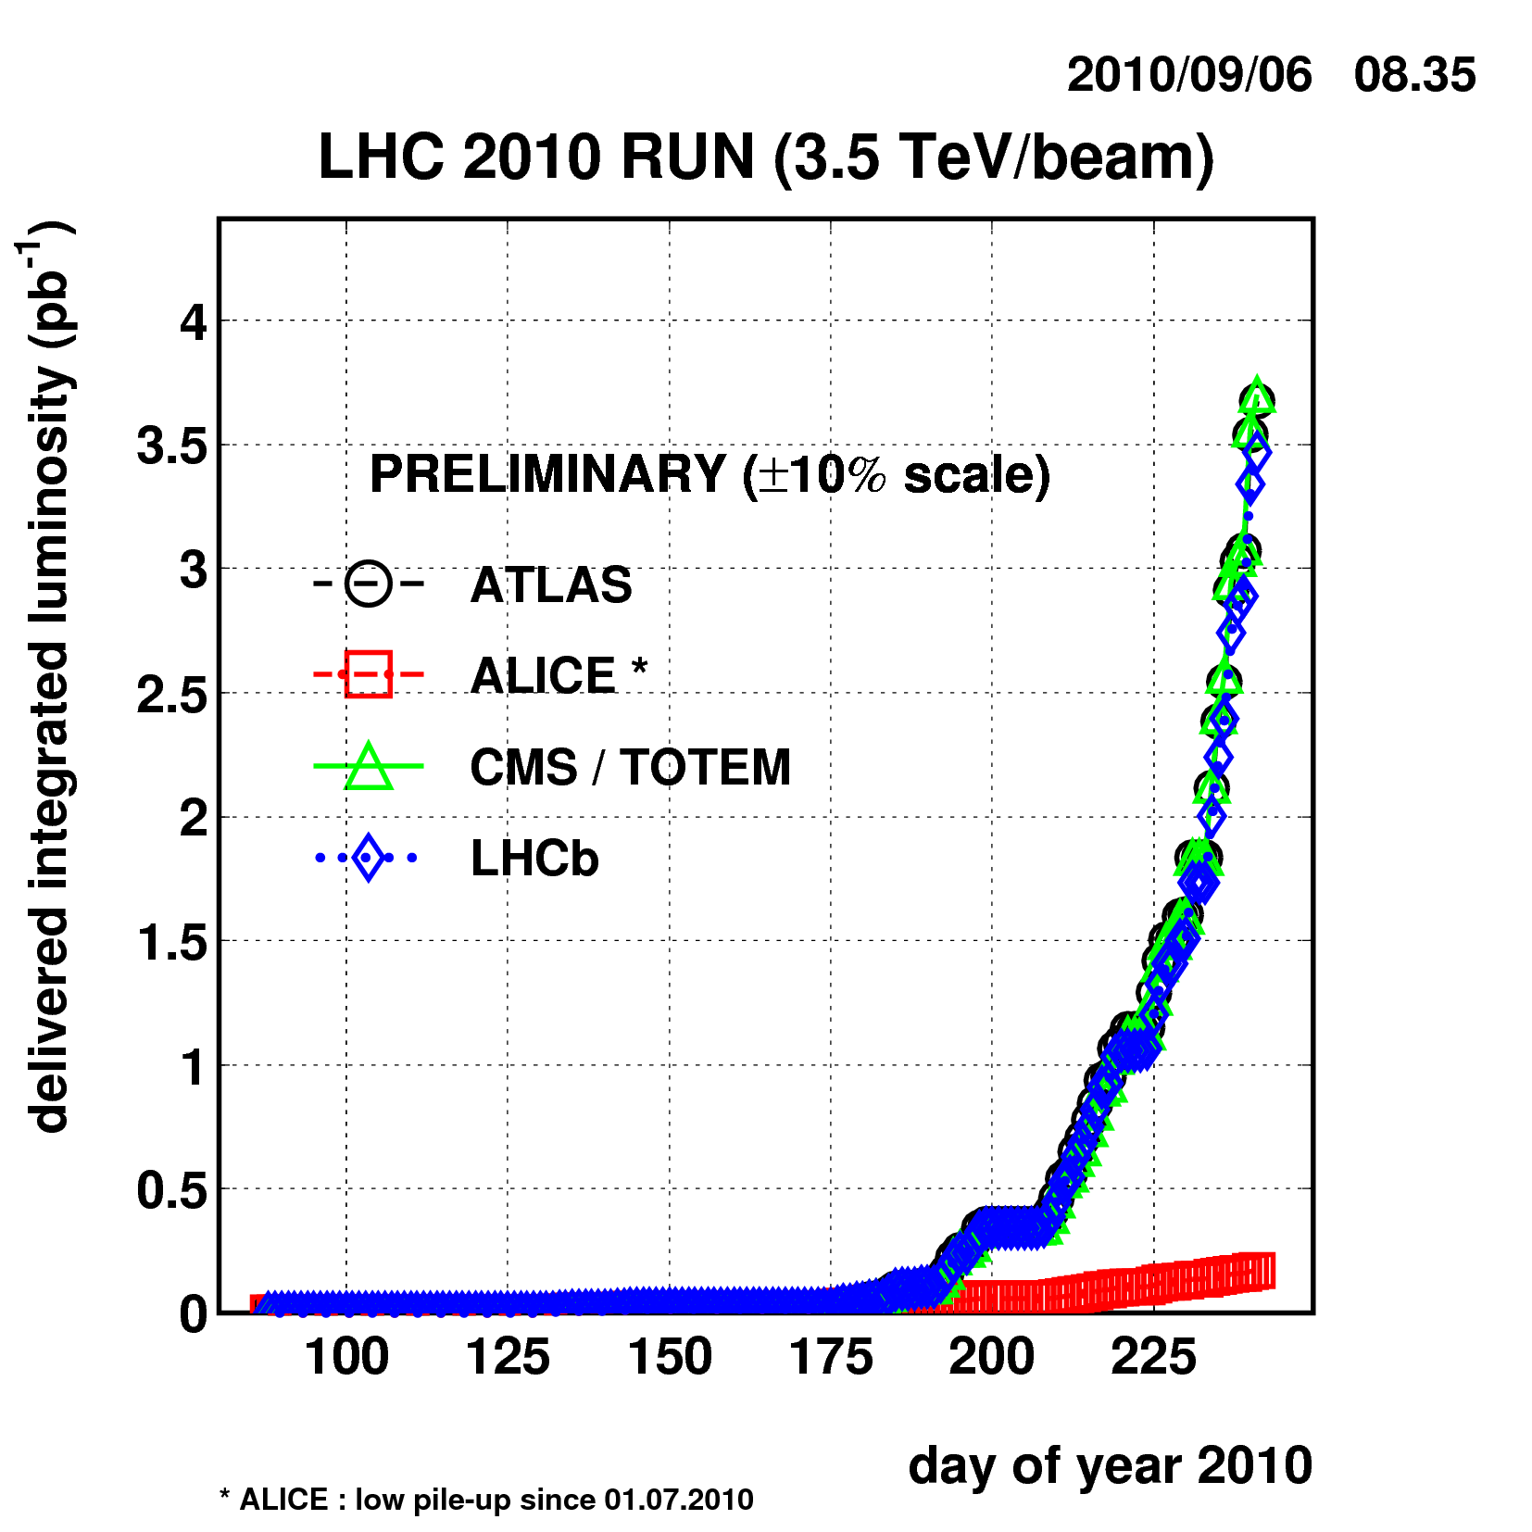
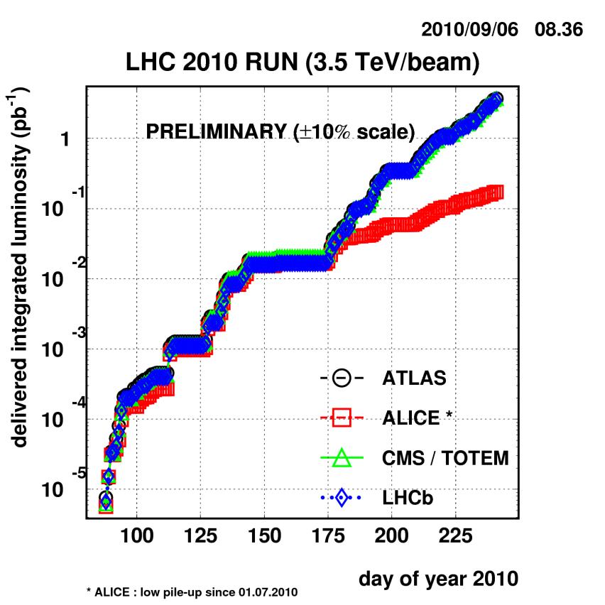
Current Status
Reached full bunch intensity
  1.1x10¹¹/bunch
  Can’t overstate how important this milestone is.
Peak luminosity: ~1x10³¹ cm⁻²s⁻¹

Slide 29
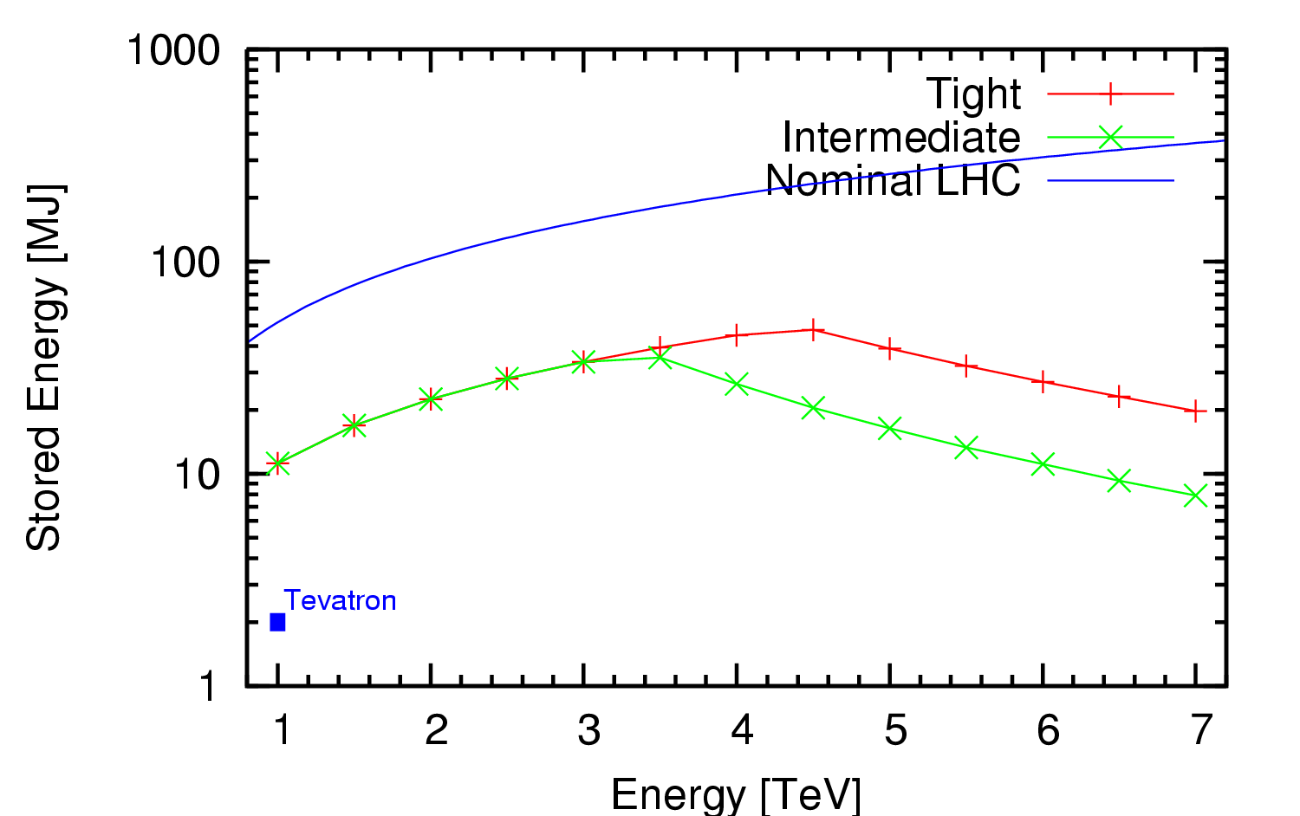
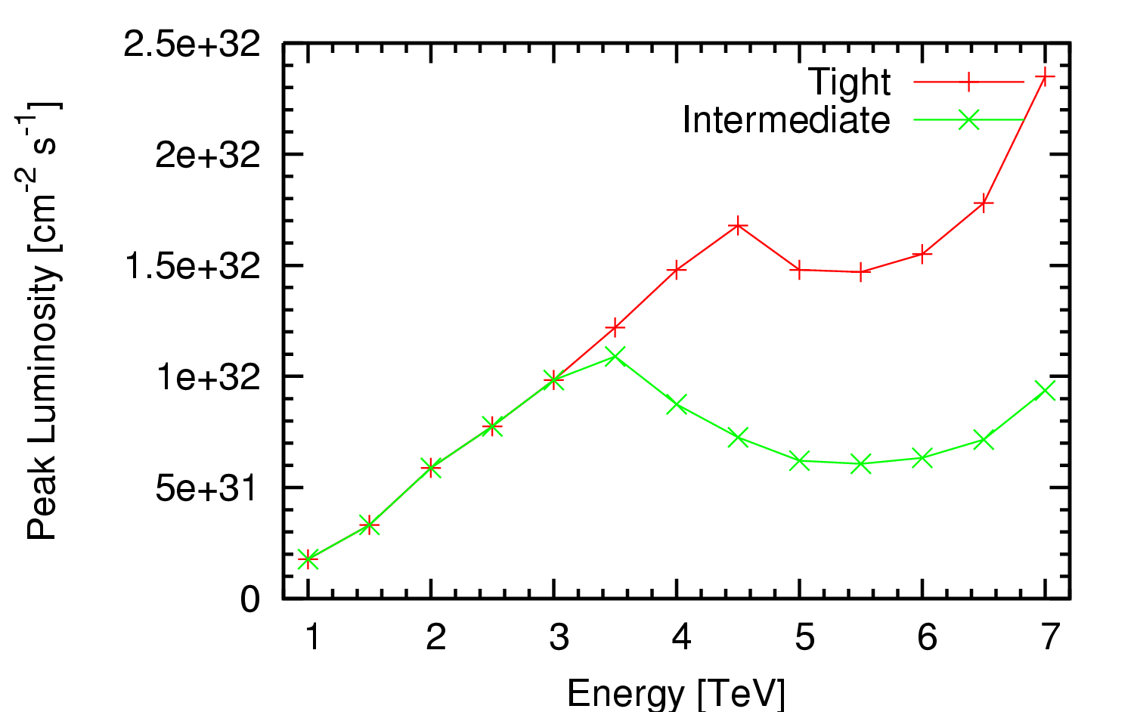
Limits of Present Collimation System*
Existing collimation system cannot reach nominal luminosity
*Ralph Assmann, “Cassandra Talk”

Slide 30
Nominal plan for 2010/2011
1-2% of nominal luminosity
~100 pb⁻¹/month
already exceeded this

Slide 31
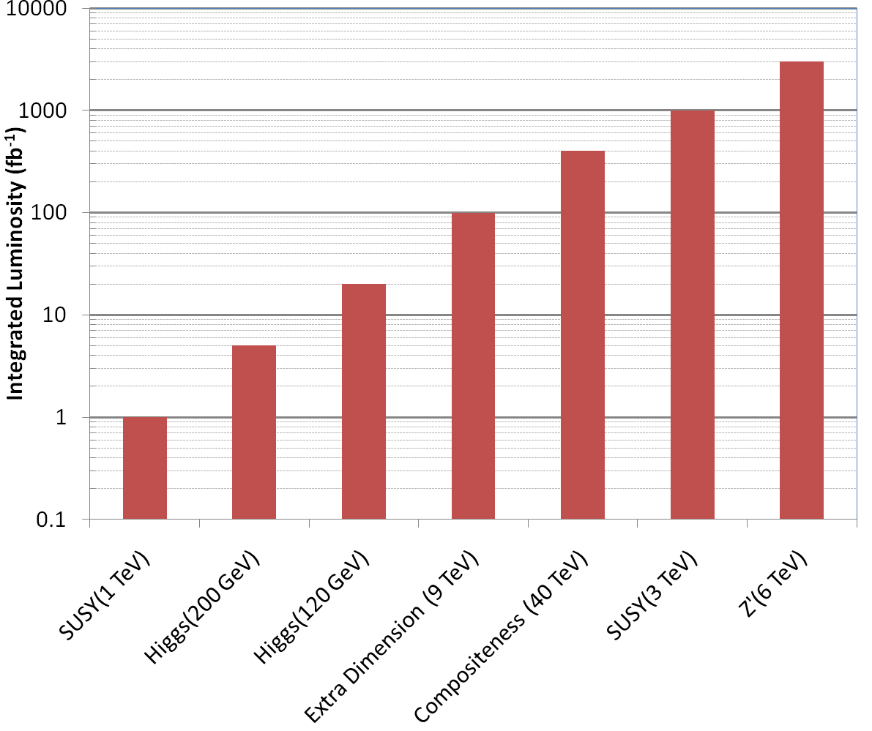
Nice work, but…
3000 fb⁻¹
~ 50 years at nominal luminosity!
The future begins now

Slide 32
Original 2 Phase LHC Upgrade Path
Initial operation (starting in 2008!)
  Ramp up to 1x10³⁴ cm⁻²s⁻¹
Phase I upgrade
  After ~500 fb⁻¹ (2014?), the inner triplet would be burned up.
  Replace with new, large aperture quads, but still NbTi
  Replace Linac to increase brightness
  Luminosity goal: 2-3x10³⁴ cm⁻²s⁻¹
Phase II upgrade
  ~2020
  Luminosity goal: 1x10³⁵
  Details not certain:
    New technology for larger aperture quads (Nb₃Sn)
    crab cavities to compensate for crossing angle
    Improved injector chain (PS2 + SPL)?
No major changes to optics or IR’s
Significant changes

Slide 33
Problems with the Original Plan
By 2014, the LHC will have optimistically accumulated ~10’s of fb⁻¹, and the luminosity will still be increasing.
  The lifetime of the existing triplet magnets is ~500 fb⁻¹
  Is it likely the experiments will want to stop for a year upgrade followed by a year of re-commissioning?
  ⇒Pursuing the two phase upgrade only makes sense of the overall timescale is increased dramatically.
Decision
  Eliminate the two phase approach, and focus on a single upgrade.
  Goal: leveled luminosity of >5x10³⁴ cm⁻²s⁻¹.
  Referred to as Phase II, S-LHC, HL-LHC
So how do we get to higher luminosity?
High Luminosity LHC

Slide 34
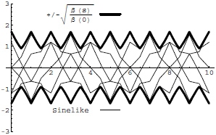
Digression: All the Beam Physics U Need 2 Know
Transverse beam size
is given by
Betatron function:
envelope determined by optics of machine
Trajectories over multiple turns
Note: emittance shrinks with increasing beam energy ⇒”normalized emittance”
Emittance: area of the ensemble of particle in phase space
Area = ε
Usual relativistic β & γ

Slide 35
Collider Luminosity
For identical, Gaussian colliding beams, luminosity is given by
Revolution frequency
Number of bunches
Bunch size
Betatron function at collision point
Transverse beam size
Normalized beam emittance
Geometric factor, related to crossing angle.

Slide 36
Limits to LHC Luminosity*
Rearranging terms a bit…
Total beam current. Limited by:
  Uncontrolled beam loss!
  E-cloud and other instabilities
Brightness, limited by
Injector chain
Max. beam-beam
If n_{b}>156, must turn on crossing angle…
β at IP, limited by
  magnet technology
  chromatic effects
…which reduces this
*see, eg, F. Zimmermann, “CERN Upgrade Plans”, EPS-HEP 09, Krakow

Slide 37
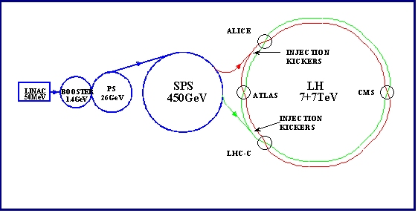
Current LHC Injector Chain
Particularly important
Electron cloud and other instabilities
Space Charge Limitations at Booster and PS injection
Transition crossing in PS and SPS
Schematic ONLY. Scale and orientation not correct

Slide 38
Attacking Luminosity on Many Fronts
Total beam current:
  Probably limited by electron cloud in SPS
    Beam pipe coating?
    Feedback system?
Beam size at interaction region
  Limited by magnet technology in final focusing quads
    Nb₃Sn?
  Chromatic effects⇔collimation
    Still being investigated
Beam brightness (N_{b}/ε)
  Limited by injector chain
    New LINAC
    Increased Booster Energy
    PS⇒PS2
Biggest uncertainty is how to deal with crossing angle…
unlikely

Slide 39
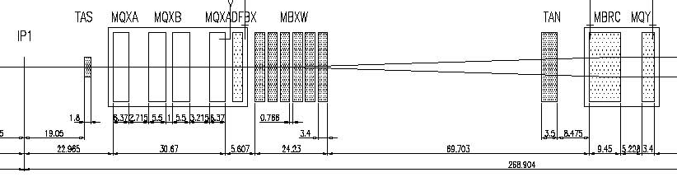
IR Layout and Crossing Angle
Present Separation Dipole
Final Triplet
IP
~59 m
Nominal Bunch spacing: 25 ns ⇒7.5 m
Collision spacing: 3.75 m
~2x15 parasitic collisions per IR
To eliminate crossing angle would require separation dipole ~3 m from IP, ie within detector!
  “Early Separation” scheme
Implement Crossing Angle for n_{b}>156

Slide 40
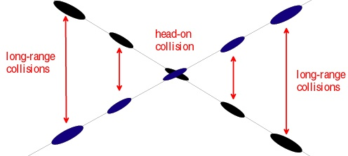
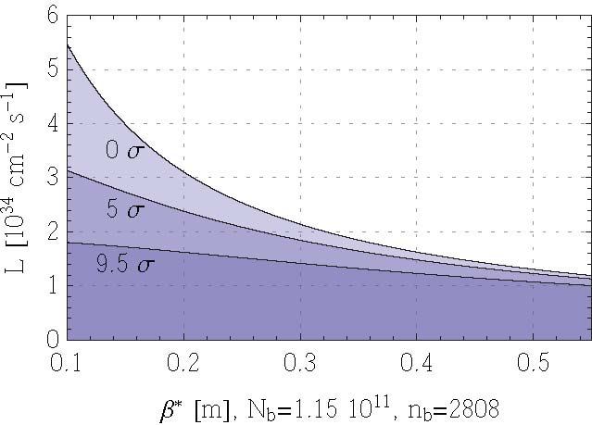
Effect of Crossing Angle
Reduces luminosity
“Piwinski Angle”
Separation of first parasitic interaction
No crossing angle
Effect increases for smaller beam
Nominal crossing
angle (9.5σ)
Conclusion: without some sort of compensation, crossing angle effects will ~cancel any benefit of improved focus optics!
Limit of current optics
Upgrade plan

Slide 41
Crossing Angle: Not All Bad
Crossing angle reduces luminosity, but also reduces beam-beam effects
In principle, effects should
cancel and we can increase the
bunch size; however, because of
limits on total beam current, go to big, flat, bunches at 50 ns
  ⇒ lots of event pile-up
same R factor
“Large Piwinksi Angle” (LPA) Solution

Slide 42
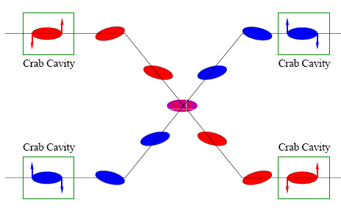
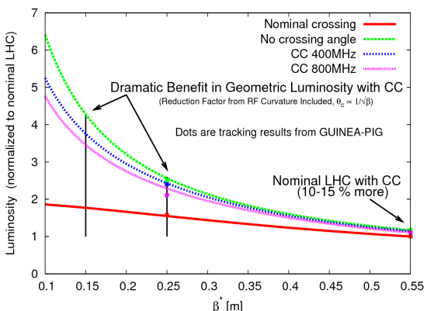
Other Option: Crab Cavities
Lateral deflecting cavities allow bunches to hit head on even though beams cross
Successfully used a KEK
Additional advantage:
  The crab angle is an easy knob to level the luminosity, stretching out the store and preventing excessive pile up at the beginning.

Slide 43
Summary of Options (Not Quite Up to date)
Requires magnets close to detectors
Requires (at least) PS2
Big pile-up
Parameter | Symbol | Initial | Full Luminosity Upgrade
 |  |  | Early Sep. | Full Crab | Low Emit. | Large Piw. Ang.
transverse emittance | ε [μm] | 3.75 | 3.75 | 3.75 | 1.0 | 3.75
protons per bunch | N_{b} [10¹¹] | 1.15 | 1.7 | 1.7 | 1.7 | 4.9
bunch spacing | Δt [ns] | 25 | 25 | 25 | 25 | 50
beam current | I [A] | 0.58 | 0.86 | 0.86 | 0.86 | 1.22
longitudinal profile |  | Gauss | Gauss | Gauss | Gauss | Flat
rms bunch length | σ_{z} [cm] | 7.55 | 7.55 | 7.55 | 7.55 | 11.8
beta* at IP1&5 | β∗ [m] | 0.55 | 0.08 | 0.08 | 0.1 | 0.25
full crossing angle | θ_{c} [μrad] | 285 | 0 | 0 | 311 | 381
Piwinski parameter | φ=θ_{c}σ_{z}/(2*σ_{x}*) | 0.64 | 0 | 0 | 3.2 | 2.0
peak luminosity | L [10³⁴ cm⁻²s⁻¹] | 1 | 14.0 | 14.0 | 16.3 | 11.9
peak events/crossing |  | 19 | 266 | 266 | 310 | 452
initial lumi lifetime | τ_{L} [h] | 22 | 2.2 | 2.2 | 2.0 | 4.0
Luminous region | σ_{l} [cm] | 4.5 | 5.3 | 5.3 | 1.6 | 4.2
excerpted from F. Zimmermann, “LHC Upgrades”, EPS-HEP 09, Krakow, July 2009

Slide 44
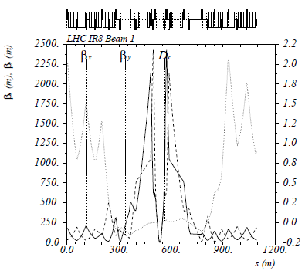
The Case for New Quadupoles
HL-LHC Proposal: β*=55 cm ⇒ β*=10 cm
Just like classical optics
  Small, intense focus ⇒ big, powerful lens
  Small β*⇒huge β at focusing quad
  Need bigger quads to go to smaller β*
Existing quads
70 mm aperture
200 T/m gradient
Proposed for upgrade
At least 120 mm aperture
200 T/m gradient
Field 70% higher at pole face
⇒ Beyond the limit of NbTi

Slide 45
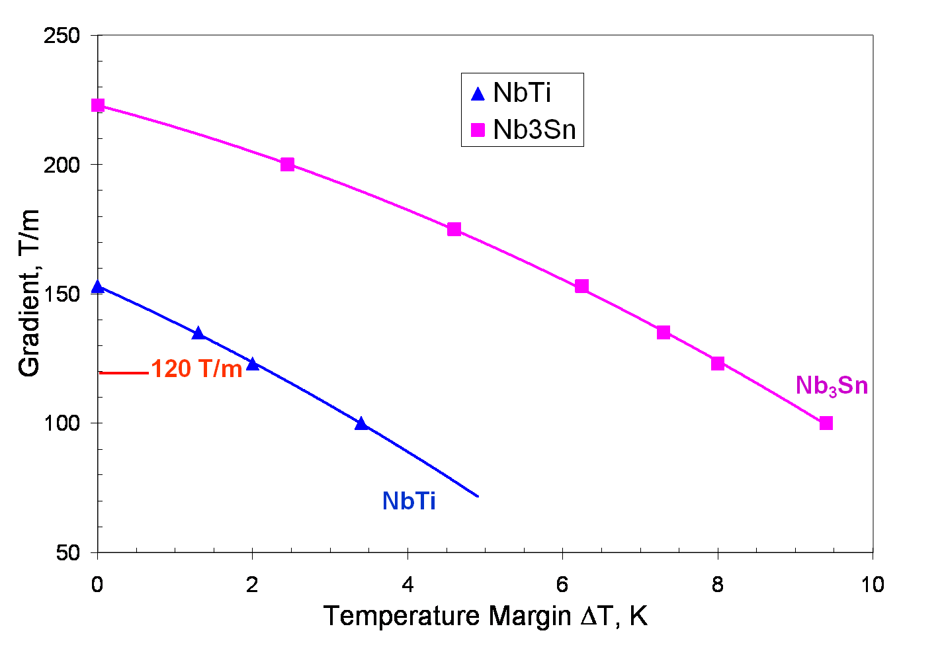
Motivation for Nb₃Sn
Nb₃Sn can be used to increase aperture/gradient and/or increase heat load margin, relative to NbTi
Limit of NbTi magnets
Very attractive, but no one has ever built accelerator quality magnets out of Nb₃Sn
Whereas NbTi remains pliable in its superconducting state, Nb3Sn must be reacted at high temperature, causing it to become brittle
  Must wind coil on a mandril
  React
  Carefully transfer to yolk
120 mm aperture

Slide 46
Plan for Next Decade
Run until end of 2011, or until 1 fb⁻¹ of integrated luminosity
  About .5% of the way there, so far
Shut down for ~15 month to fully repair all ~10000 faulty joints
  Resolder
  Install clamps
  Install pressure relief on all cryostats
Shut down in 2016
  Tie in new LINAC
  Increase Booster energy 1.4->2.0 GeV
  Finalize collimation system (LHC collimation is a talk in itself)
Shut down in 2020
  Full luminosity: >5x10³⁴ leveled
    New inner triplets based on Nb₃Sn
    Crab cavities
    Large Pewinski Angle being pursued as backup

Slide 47
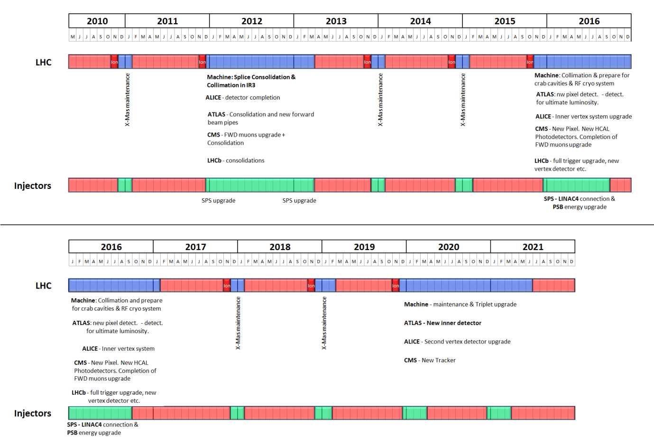
Tentative LHC Timeline
Energy: 3.5 TeV
Energy: 6-7 TeV
Collimation limit ~2x10³²
Collimation limit .5-1x10³⁴
Energy: ~7.0 TeV
Energy: ~7 TeV
Luminosity→1x10³⁴
Lum.→>5x10³⁴
Collimation limit >5x10³⁴

Slide 48
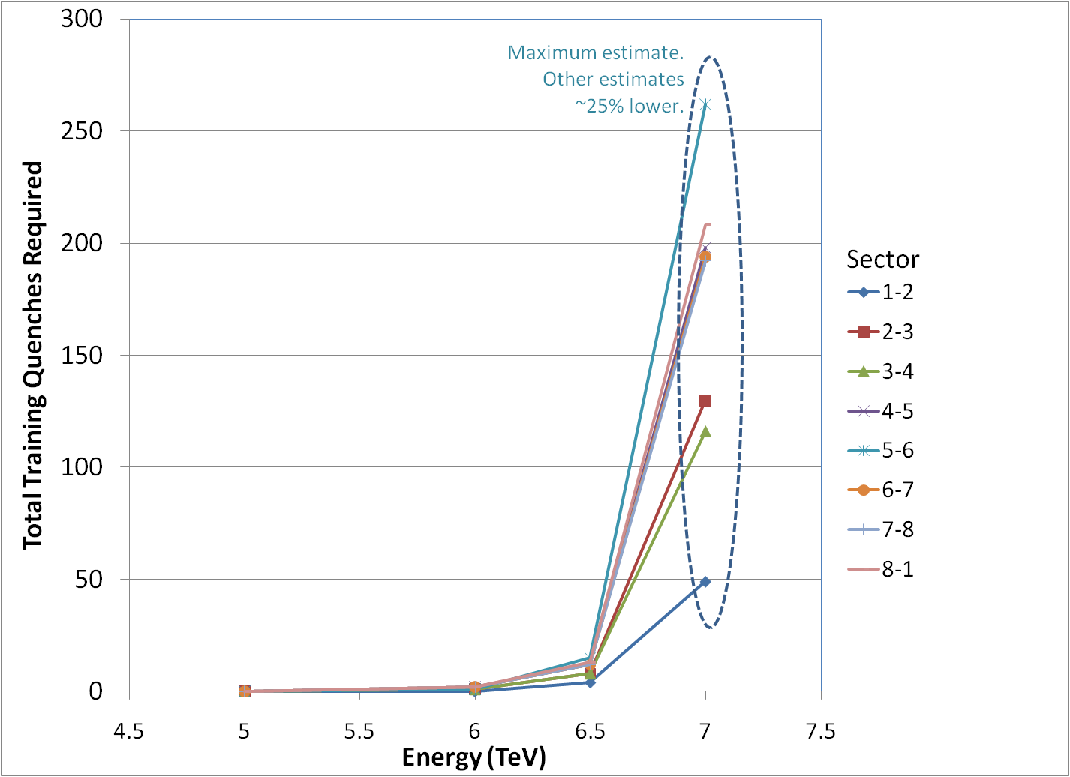
Getting to 7 TeV*
Note, at high field, max 2-3 quenches/day/sector
  Sectors can be done in parallel/day/sector (can be done in parallel)
No decision yet, but it will be a while
*my summary of data from A. Verveij, talk at Chamonix, Jan. 2009

Slide 49
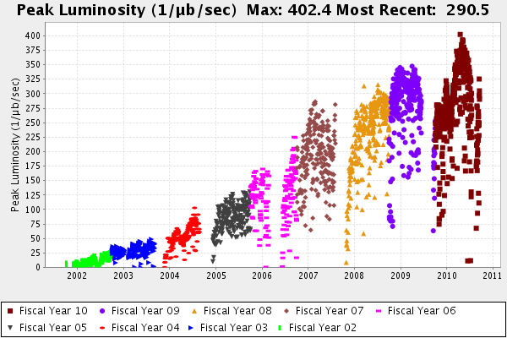
Comparison: Tevatron Run II
LHC Nominal
(10,000)
Ultimate Run II Goal
2011 Goal
Initial Run II Goal
Run I record
LHC Now

Slide 50
Enough about science…Let’s talk management!
Upgrade planning will be organized through EuCARD*,
  Centrally managed from CERN (Lucio Rossi)
  Non-CERN funds provided by EU
  Non-EU partners (KEK, LARP, etc) will be coordinated by EuCARD, but receive no money.
Work Packages:
  WP1: Management
  WP2: Beam Physics and Layout
  WP3: Magnet Design
  WP4: Crab Cavity Design
  WP5: Collimation and Beam Losses
  WP6: Machine Protection
  WP7: Machine/Experiment Interface
  WP8: Environment & Safety
Significant LARP and other US Involvement
*European Coordination for Accelerator R&D

Slide 51
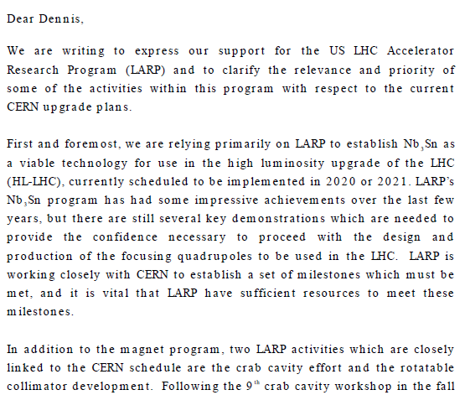

Relevance of LARP to CERN Upgrade
Letter to Dennis Kovar, Head Office of DOE
Office of High Energy Physics, 17-August-2010
(…)

Slide 52
LHC Accelerator Research Program (LARP)
Proposed in 2003 to coordinate efforts at US labs
related to the LHC accelerator (as opposed to CMS or ATLAS)
  Originally FNAL, BNL, and LBNL
  SLAC joined shortly thereafter
  Some work (AC Dipole) supported at UT Austin
LARP Goals
  Advance International Cooperation in High Energy Accelerators
  Advance High Energy Physics
    By helping the LHC integrate luminosity as quickly as possible
  Advance U.S. Accelerator Science and Technology
LARP includes projects related to initial operation, but a significant part of the program concerns the LHC upgrades

Slide 53
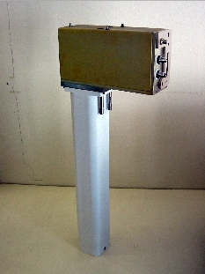
LARP Contributions to Initial LHC Operation
Schottky detector
  Used for non-perturbative tune measurements (+chromaticities, momentum spread and transverse emmitances)
Tune tracking
  Implement a PLL with pick-ups and quads to lock LHC tune
  Investigating generalization to chromaticity tracking
AC dipole
  US AC dipole to drive beam
  Measure both linear and non-linear
  beam optics
Luminosity monitor
  High radiation ionization detector
  integrated with the LHC neutral beam
  absorber (TAN) at IP 1 and 5.
Low level RF tools
  Leverage SLAC expertise for in situ characterization
  of RF cavities
Personnel Programs…

Slide 54
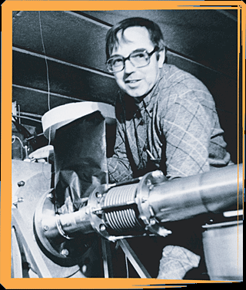
LARP Personnel Programs
Long Term Visitors program
  Pay transportations and living expenses for US scientists working at CERN for extended periods (at least 4 months)
  Extremely successful at integrating people into CERN operations
  Interested parties coordinate with a CERN sponsor and apply to the program (Uli Wienands, SLAC)
Toohig Fellowship
  Named for Tim Toohig.
  Open to recent PhD’s in accelerator
  science OR HEP.
  Successful candidates divide their
  time between CERN and one of
  the four host labs.
  Currently 2 Toohig Fellows in
  program (+2 offers).

Slide 55


LARP Accelerator R&D for Future LHC
Rotatable collimators
  Can rotate different facets into
  place after catastrophic beam
  incidents
  Delivering prototype for test
  this year
Crystal Collimation
Beam-beam studies
  General simulation
  Electron lens (See Shiltsev talk)
  Wire compensation
Electron cloud studies
  Study effects of electron cloud in
  LHC and injector chain

Slide 56


Collimator Status
First prototype nearly complete at SLAC
Will be shipped to CERN for impedance and functionality testing in the SPS
Second test will occur next year in the new CERN HiRadMat facility
  Test behavior under catastrophic beam event
If they pass these tests, they will be part of the collimation upgrade in 2016.

Slide 57



LARP Crab Cavity Work
WG HOM coupler
Coax LOM/SOM coupler
LARP has been the primary advocate
of crab cavities for the LHC upgrade
In fall, 2009 CERN formally
endorsed crab cavities for HL-LHC
  Contingent on a plan to operate system safely!!
Technical challenges
  Designing “compact” cavities that can
  fit in the available space
  Machine protection
  “local” vs “global” scheme
Actual production is beyond the scope
of LARP
  LARP R&D ⇒ separate, international(?) project
Power coupler
SLAC half wave
Fermilab “mushroom”
JLAB “toaster”

Slide 58

LARP Magnet Development Tree
Completed
Achieved
220 T/m
Length scale-up
High field
Accelerator features
Being
tested

Slide 59




LQ (4m x 90mm) Assembly and Test
Reaction/Potting
(BNL and FNAL)
Instrumentation and
heater traces (LBNL)
Winding/curing (FNAL)

Slide 60


LQ Test
Tested in vertical test facility at Fermilab

Slide 61


HQ (1m x 120 mm) design
Goal: 200 T/m gradient
Unique “shell” preloading structure

Slide 62



HQ Test
Prototype tested at LBNL
Achieved 157 T/m
  Less than goal, but more than NbTi
Electrical fault in voltage tap
  Investigating
  Will repair and test at CERN

Slide 63
Beyond HQ
The aperture for the focus quadrupoles in the HL-LHC has not yet been determined
  Could be as high as 150 mm
In the mean time, LARP will build several “longer” (~2m) 120 mm magnets to investigate
  Field quality
  Alignment
  Thermal behavior
Full length prototype, at final aperture will be part of construction project R&D (~2015).

Slide 64
Marching Toward 2020
The EuCARD HL-LHC collaboration will submit a study proposal in November of this year
  Conceptual Design Report: ~2013
  Technical Design Report: ~2015
LARP is a ~$12M/year R&D organization
  Major activities will need to “spin off” as independent projects
    Nb₃Sn quardupole project should be in place by 2014-2015 to be ready for 2020
    Crab cavities are a ~$50M international effort that will need to be centrally coordinated from CERN

Slide 65

The Long Road to Discovery
Even with the higher luminosity, still need a lot of time to reach the discovery potential of the LHC
Lots of new challenges between now and then!
Z’@6TeV
ADD X-dim@9TeV
SUSY@3TeV
Note: VERY outdated plot. Ignore horizontal scale.
Could conceivably get to 3000 fb⁻¹ by 2030.
3000
Compositeness@40TeV
H(120GeV)→γγ
300
Higgs@200GeV
SUSY@1TeV
30
200 fb⁻¹/yr
HL-LHC Upgrade
10-20
fb⁻¹/yr
50-100 fb⁻¹/yr
500 fb⁻¹/yr
50 x Tevatron luminosity
250 x Tevatron luminosity

Slide 66
Summary
The LHC is the most complex scientific apparatus ever built – by a good margin.
The start up has been remarkably smooth.
Things look very good, but there’s still a long road ahead.
Even thought the machine is just starting up, we’re already late for the future.

Slide 67
Acknowledgements and Further Reading
This talk represents the work of an almost countless number of people.
I have incorporated significant material from:
  The annual Chamonix meetings
    http://tinyurl.com/Chamonix2009 (“the incident”)
    http://tinyurl.com/Chamonix2010 (upgrade plans)
  Frank Zimmermann’s many luminosity talks, eg. EPS-HEP, Krakow 2009
    http://tinyurl.com/Zimmermann-Krakow
  Talks presented at LARP collaborations and DOE reviews
    See http://www.uslarp.org/
Apologies for the many interesting topics I didn’t cover!

Slide 68
Staying Informed
Twitter feed (big news):
  http://twitter.com/cern
LHC Coordination Page:
  http://lpc.web.cern.ch/lpc/
LARP Activities:
  http://www.uslarp.org/

