Slide 1
Insertions
(Complete Version)
Eric Prebys, FNAL

Slide 2
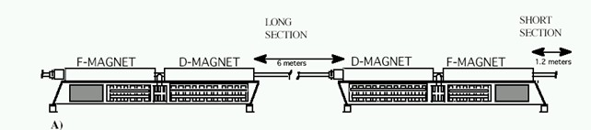
The Problem
So far, we have talked about a synchrotron made out of identical FODO cells, with the space between the quads taken up by bend dipoles.
The problem is that this is not particularly useful, because there’s no place to put beam in or take it out, and no way to collide beams.
One solutions is to design a “straight” into every cell. Example: the Fermilab Booster
However, this is very wasteful of real estate. It would not be practical for the LHC.
x24

Slide 3
Insertions
Since putting a empty straight section in every period is not practical, we need to explicitly accommodate the following in our design:
  Locations for injection of extraction.
  “Straight” sections for RF, instrumentation, etc
  Low beta points for collisions
Since we generally think of these as taking the place of things in our lattice, we call them “insertions”
FODO
FODO
FODO
Insertion
FODO
FODO
FODO
Match lattice functions

Slide 4
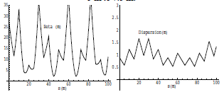
Mismatch and Beta Beating
Simply modifying a section of the lattice without matching will result in a distortion of the lattice functions around the ring (sometimes called “beta” beating)
Here’s an example of increasing the drift space in one FODO cell from 5 to 7.5 m

Slide 5
Collins Insertion
A Collins Insertion is a way of using two quads to put a straight section into a FODO lattice
Where s₂ is the usable straight region

Slide 6
Require that the lattice functions at both ends of the insertion match the regular lattice functions at those point
Where μ_{I} is a free parameter
After a bit of algebra
Maximize s₂ with μ_{I}=π/2, α max (which is why we locate it L/2 from quad)
Works in both planes if α_{x}=-α_{y} (true for simple FODO)

Slide 7
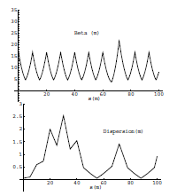
Dispersion Suppression
The problem with the Collins insertion is that it does not match dispersion, so just sticking it in the lattice will lead to distortions in the dispersion
This is typically dealt with by suppressing the dispersion entirely in the region of the insertion.
Collins Insertion

Slide 8
Dispersion Suppression (cont’d)
On common technique is called the “missing magnet” scheme, in which the FODO cells on either side of the straight section are operated with two different bending dipoles and a half-strength quad
Recall that the dispersion matrix for a FODO half cell is (lecture 4)
Straight section
Mirror image

Slide 9
So we solve for
Where D_{m} and D’_{m} are the dispersion functions at the end of a normal cell (for a simple lattice, D’_{m}=0)
We get the surprisingly simple result
Note that if θ=60°
So the cell next to the insertion is normal, and the next one has no magnets, hence the name “missing magnet”.
Since dispersion can only be generated by bend magnets, if I suppress it before a straight section, it will remain zero in the straight section

Slide 10
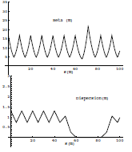
Combining Insertions
Because the Collins Insertion has no bend magnets, it cannot generate dispersion if there is none there to begin with, so if we put a Collins Insertion inside of a dispersion suppressor, we match both dispersion and the lattice functions.

Slide 11
Low β Insertions
In a collider, we will want to focus the beam in both planes as small as possible.
This can be done with a symmetric pair of focusing triplets, matched to the lattice functions (dispersion suppression is assumed)
Recall that in a drift, β evolves as
Where s is measured from the location of the waist
Symmetric
FODO
FODO
FODO
FODO
triplet
triplet
FODO
FODO
FODO
FODO
Dispersion suppression
Dispersion suppression

Slide 12
Phase Advance of a Low Beta Insertion
We can calculate the phase advance of the insertion as
For L>>β*, this is about π, which guarantees that all the lattice parameters will match except dispersion (and we’ve suppressed that).
This means that each low beta insertion will increase the tune by about 1/2

Slide 13
Limits to β*
β
β distortion of off-momentum particles
➔ 1/β*
(affects collimation)
s
➔ small β* means large β
(aperture) at focusing triplet

Slide 14
Putting the Pieces Together
So now we see that in general, a synchrotron will contain
  A series of identical FODO cells in most of the ring.
  Straight sections, with modified cells on either end.
  Dispersion suppression before and after these straight sections
If it’s a collider, it will also contain
  One or more low beta insertions with dispersion suppression on either side.
  The beta function will be very large on either side of the low beta point

Slide 15
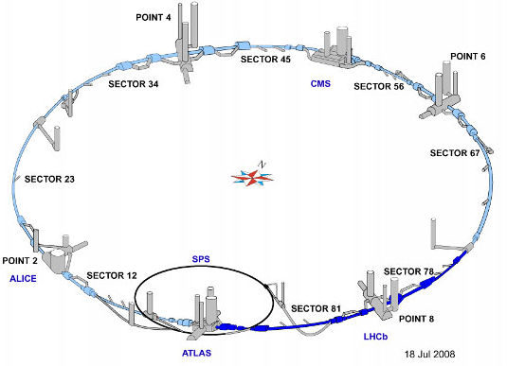
Example: LHC
Recall the LHC layout
  Superperiodicity of 8
  Need insertions for two low beta collision regions (ATLAS, CMS)
  Two higher beta collision regions (ALICE, LHCb), which double as injections points.
  Other straights for RF cavities, beam extraction, etc.

Slide 16
LHC Optics (out of date)
Low β collisions
Injection straights/higher β collisions
Dispersion Suppression

Slide 17
Beam Line Issues (not in original printout)
Beam lines are typically built in discrete sections:
  Matching (to a source, injection point, or extraction point)
  Transport:
    The FODO cells we’ve been talking about
  Bends
    Designed as “achromats” to suppress dispersion!
  Focus (or “waist”)
    Uses quad triplet to minimize beta in both planes
  Collimation sections
    90°apart in phase space to clean up 2D phase space

Slide 18
Final Focus Triplet
As we saw, our normal FODO cell has maxima in one plane where the minima are in the other.
For targets or collisions, we want small beta functions in both planes.
This optical problem can be solved with a triplet
  Middle quad ~twice the strength of outer quads (MAD problem for next week)

Slide 19
Dispersion Suppression
Any bend section will introduce dispersion. After the bend, it will propagate as
It will never go away unless we explicitly suppress it in the design

Slide 20

Achromats
There are generally two types of basic “achromats”
“Dogleg”, with 360°of phase advance between to opposite sign dipoles
“Double bend”, with 180°of phase advance between two same sign dipoles

Slide 21
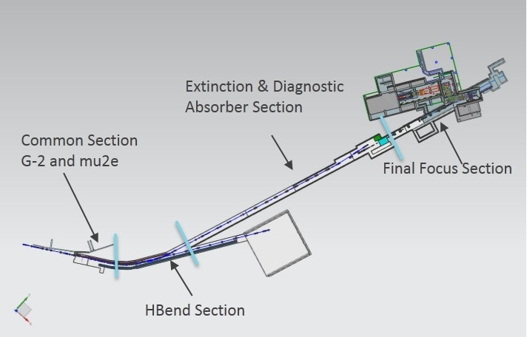
Mu2e Proton Beam
Muon production target
triplet
collimator
weird magnet requirement
”achromat”
matching

Slide 22
G4beamline version
Converted from MAD file with (homebrew) Python Script

